Slide 1

Hamdi Boukamcha
http://matlab-recognition-code.com
Hamdi Boukamcha

Slide 2

Quantify faces by parameters specifying their shape and texture.
To recognize faces across a wide range of illumination conditions.
Face recognition needs to be achieved across variations in pose.
Hamdi Boukamcha

Slide 3

Hamdi Boukamcha
Model Intrinsic and Extrinsic parameters separately.
Estimate 3D Shape of faces to store information of all poses.
Computer Graphics Simulation of Illumination and other Extrinsic parameters.

Slide 4

Hamdi Boukamcha
Estimate the Intrinsic Parameters
Estimate the Extrinsic Parameters
Use a Cost Function to find the nearest neighbor face in the Database.

Slide 5

Hamdi Boukamcha
A face is represented by 2 vectors:
    S₀ =(x₁, y₁ , z₁ , ……………..x_{n} , y_{n} , z_{n} )^{T}
    T₀ =(R₁, G₁ , B₁ , ……………..R_{n} , G_{n} , B_{n} )^{T}
    where:
    pixel at (x_{k}, y_{k} , z_{k}) have colors (R_{k}, G_{k} , B_{k}).
    S₀ is known as the shape vector.
    T₀ is known as the texture vector.
To make calculations easier, we will use cylindrical coordinates where (x_{k}, y_{k} , z_{k}) is equivalent to (h_{k}, φ_{k} , r(h_{k},φ_{k})).

Slide 6

Hamdi Boukamcha
A laser scanner of a new face is used to obtain the shape and texture vectors in cylindrical coordinates. The two vectors combined:
I(h,φ)=(r(h,φ),R(h,φ),G(h,φ),B(h,φ))^{T}
Any convex combination of shape and texture vectors gives rise to a new face. S = Σ_{i}a_{i}S_{i} , T = Σ_{i}b_{i}T_{i}

Slide 7

Hamdi Boukamcha
Since it is impossible to take laser scans of every person’s face in one identical pose, we need to correlate every point with the equivalent point on a reference face.
Also, you don’t want two faces’ convex combination giving rise to a face with two noses!!
A modified version of the Optic Flow algorithm is used to establish dense point-to-point correspondence.

Slide 8

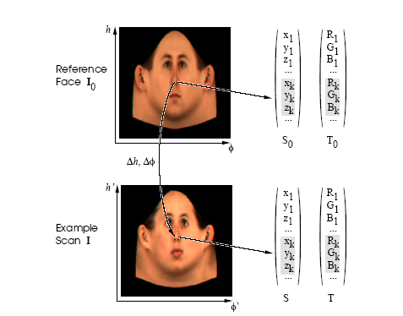
For scans parameterized with
(h,φ), the flow field that maps each point of the reference face to the points of the new face is used to form vectors S and T.
Hamdi Boukamcha

Slide 9

Hamdi Boukamcha
The algorithm compares points having similar intensities on the reference face and the new face.
E=Σ_{h,φ}||(v_{h}δI(h,φ)/δh+v_{φ}δI(h,φ)/δφ +ΔI||²
E is minimized for every point (h,φ).
We need to determine v(h,φ)=(Δh(h,φ),Δφ(h,φ))^{T} such that each point I₁(h,φ) is mapped to I₂(h+Δh,φ+Δφ)

Slide 10

Hamdi Boukamcha
We perform Principal Component Analysis on the set of shape and texture vectors S_{i} and T_{i} to reduce the dimensionality.
A larger variety of different faces can be generated if linear combinations of shape and texture vectors are formed separately for eyes, nose, mouth etc.

Slide 11

Hamdi Boukamcha
To recognize a face in the image we need to estimate the extrinsic and intrinsic parameters.
For initialization the user alternately clicks on a point in the image and the corresponding point in the reference face.
About 6 or 7 points are required like the corners of the eyes, tip of the nose etc.

Slide 12

Hamdi Boukamcha
The Algorithm optimizes
    Shape coefficients: (α₁, α₂, α₃,….)^{T}
    Texture coefficients: (β₁, β₂, β₃,….)^{T}
    22 rendering parameters:
      Pose angles: φ,λ and θ
      Translation t_{w} and focal length of the camera f
      Various illumination parameters like ambient light intensities, directed light intensities, angles etc.
The illumination parameters also include parameters for the Phong model which accounts for non-lambertian reflections and takes into account the position of the eye.

Slide 13

Hamdi Boukamcha
The Fitting Algorithm is a stochastic version of Newton’s Algorithm.
The face is divided into small triangles. The gradient calculation is done at the centers of these triangles.
At each iteration, 40 triangles are chosen randomly for the error function and gradient calculation.
This not only speeds up the optimization process but also avoids local minima.

Slide 14

Hamdi Boukamcha
The error function is derived using Bayesian Parameter Estimation.
The error function takes into account the errors due to the differences in color, coordinates, rendering parameters and prior probabilities of the parameters.
For each iteration, the algorithm computes the gradient of the error function at certain points and then changes the values of the parameters.

Slide 15

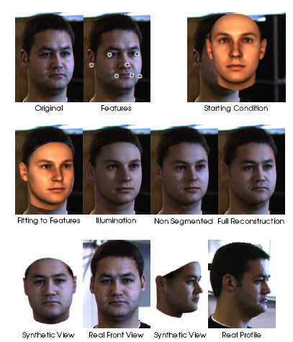
The process of face reconstruction is shown here, stepwise, from a single image and a set of feature points.
Hamdi Boukamcha

Slide 16

Hamdi Boukamcha
The function which is used to compare two faces c₁ and c₂ could be one of:
      Mahalanobis Distances
      Cosine of the angle between the two vectors
      A cost function motivated by Linear Discriminant analysis.
Of these, the last one gave the best results.

Slide 17

Hamdi Boukamcha
The paper discussed the following three issues:
  Learning class-specific information about human faces from a dataset of examples.
  Estimating 3D shape and texture along with all relevant 3D scene parameters.
  Representing and comparing faces for recognition tasks.

Slide 18

Hamdi Boukamcha
What they did not discuss in the paper:
  Can Optic Flow algorithm be applied in such a scenario?
  How do they initialize the system before applying Newton’s Method?
Why only 6 or 8 points for initialization, or 5 segments of the face?

Slide 19

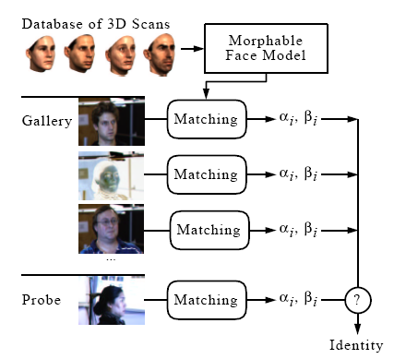
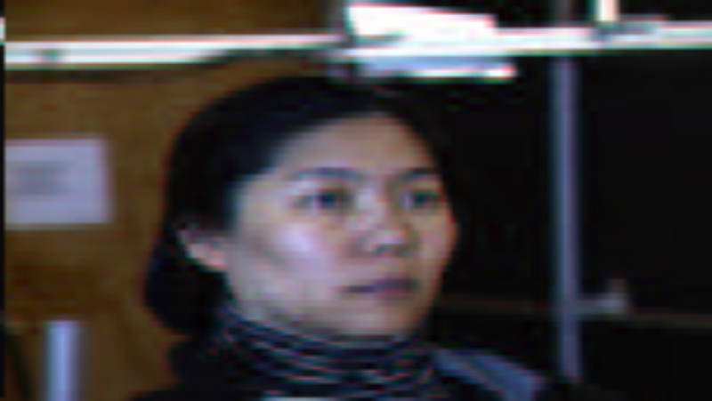
The 3D morphable face model is used to encode the faces. For recognition, the model coefficients of a new face are used to compare with the coeffs. of the faces in the database.
Hamdi Boukamcha

