Slide 1

WELCOME TO ZEEL CODE LABS
Presenting by :-
Akash Talikoti
Chinmay Vastrad
Yuvaraj Kadam
Naveenkumar Gundkalle
Guidance by :- Bhushan Dongare

Slide 2
Contents
Overview of the organization
Vision and mission of the organization.
Organization Structure.
Roles and Responsibility of personnel in the organization.
Products and market performance.

Slide 3
Overview of the organization
At Zeel Code Labs, we grow by finding new clients and creating the right solutions for them.
This has helped us become one of the top and most successful development companies. Our development experience helps us keep growing—we know how to find leads and turn them to revenue streams.

Slide 4
Vision and Mission
Vision:
Our goal is to grow as one of the most innovative IT solution and service providers. We focus on working efficiently using a strong and well-organized approach, gradually shifting from hard work to smart work — not just in our team, but also for our clients.
Mission:
To produce excellent services in the field of IT Services and Consultancy with maximum efforts driven towards customer satisfaction.

Slide 5
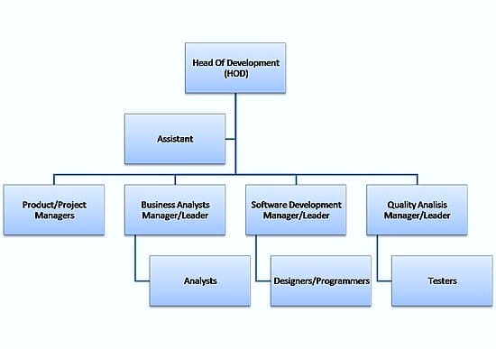
Organization Structure

Slide 6
Roles and Responsibilities
Problem solving by collaborating with team
Maintain documentation of assigned task
Provide Meaningful Work
Assign tasks that help interns learn and develop real-world skills
Ensure all work given follows ethical and legal standards

Slide 7
Products and market performance
Custom Software Development: Tailored software solutions to meet specific business needs.​
Mobile & Web Development: Design and development of responsive websites and mobile applications.​
Data Science: Analyzing structured and unstructured data to uncover patterns and insights.
Cloud Computing: Providing scalable cloud solutions to enhance business agility.
Cybersecurity: Implementing security measures to protect digital assets.
Overall Rating: 4.7 out of 5 stars based on employee reviews.​

Slide 8
Services
Software Solutions
Web Solutions
Networking Solutions
Quality Assurance & Testing
Application Maintenance & Support

Slide 9
ON JOB TRAINING (OJT-1)

Slide 10
Placement Management System
The Placement Management System is a web-based application designed to streamline the campus recruitment process. It provides a centralized platform for students, placement officers, and recruiters to manage and coordinate job placements efficiently.
The platform is built using modern web technologies like HTML, CSS, JavaScript, Bootstrap. It combines elegant design with user-friendly features to create a trustworthy and attractive online store for gold jewelry lovers.

Slide 11
Problem Statement
Manual Placement Process – Traditional placement processes involve a lot of paperwork and manual effort, leading to inefficiency and errors.
Data Management Issues – Maintaining student records, recruiter details, and job applications manually can result in data loss or inconsistency.
Lack of Application Tracking – Students face difficulty in tracking the status of their job applications and interview schedules.

Slide 12
Future Scope
AI-Powered Job Matching
Interview Scheduling Integration
Mobile Application
Internship Opportunities and Campus Events

Slide 13
USE CASE-1

Slide 14
Student Register (Sign Up)
Student (Sign Up)
Student enters personal details (Name, Email, Phone, Roll No.).
Sets up login credentials (Username, Password).
Verifies email/phone (confirmation link).
Completes profile setup (Educational details, Skills, Resume upload).
Registration is completed and stored in the database.
Student (Login)
Student enters Username & Password.
System verifies credentials from the database.
If correct, student dashboard is displayed.
If incorrect, an error message appears.

Slide 15
Login Pages
HOD (Login)
HOD enters login credentials.
System authenticates from the database.
If verified, access to student lists, placement stats, and reports.
Can approve/reject student applications for placements.
Placement Officer(Login)
Placement officer logs in with valid credentials.
Can manage job postings, recruiter details, and placement records.
Approves student applications and schedules interviews.
Tracks overall placement progress and generates reports.
Principal (Login)
Principal logs in using admin credentials.
Can view placement reports and overall statistics.
Approves major decisions related to placement policies.
Can send notifications or messages to students and staff.

Slide 16
ON JOB TRAINING (OJT-2)

Slide 17
School Management System
A School Management System (SMS) is a web-based application designed to streamline and automate various administrative and academic processes in educational institutions. It serves as a centralized platform for students, teachers, administrators to efficiently manage school operations, track student performance, and facilitate communication.
The platform is built using modern web technologies like React, Tailwind CSS, JavaScript, Node.js and Mongo DB. It combines elegant design with user-friendly features to create a trustworthy and attractive online store for gold jewelry lovers.

Slide 18
Problem Statement
Manual Record Management – Difficulty in maintaining and retrieving student and staff records efficiently.
Lack of Centralized Data – No unified system for student records, academic progress, and financial transactions.
Inefficient Communication – Teachers, students lack a structured platform for communication.

Slide 19
Future Scope
AI-Powered Student Performance Analysis
Mobile Application Development
Automated Fee Payment & Scholarship Management
Parent-Teacher Communication Portal

Slide 20
USE CASE-2

Slide 21
Student Registration
Actors: Admin, Student
Description: Allows the admin to register a new student by filling in details like name, class, guardian info, etc.
Preconditions: Admin is logged in.
Postconditions: Student profile is created and stored in the database.
Teacher Management
Actors: Admin
Description: Admin adds, edits, or removes teacher records.
Preconditions: Admin must be authenticated.
Postconditions: Updated list of teachers is saved.

Slide 22
Class Scheduling
Actors: Admin, Teachers
Description: Admin creates a timetable by assigning subjects and teachers to classes.
Preconditions: Class and teacher records exist.
Postconditions: Timetable becomes available to students and teachers.
Attendance Tracking
Actors: Teachers
Description: Teachers mark daily attendance for their assigned classes.
Preconditions: Class and student lists are available.
Postconditions: Attendance records are saved.
Exam Management
Actors: Admin, Teachers
Description: Schedule exams, enter marks, and generate result cards.
Preconditions: Student and subject data are available.
Postconditions: Results are stored and accessible to parents/students.

Slide 23
THE END

