Slide 1

WELCOME TO ZEEL CODE LABS
Presenting by :-
Siddarth Mali
Omkar Khot
Adarsh Bhojepatil
Shashank Kumbar
Guidance by :- Bhushan Dongare

Slide 2
Contents
Overview of the organization
Vision and mission of the organization.
Organization Structure.
Roles and Responsibility of personnel in the organization.
Products and market performance.

Slide 3
Overview of the organization
At Zeel Code Labs, we grow by finding new clients and creating the right solutions for them.
This has helped us become one of the top and most successful development companies. Our development experience helps us keep growing—we know how to find leads and turn them to revenue streams.

Slide 4
Vision and Mission
Vision:
Our goal is to grow as one of the most innovative IT solution and service providers. We focus on working efficiently using a strong and well-organized approach, gradually shifting from hard work to smart work — not just in our team, but also for our clients.
Mission:
To produce excellent services in the field of IT Services and Consultancy with maximum efforts driven towards customer satisfaction.

Slide 5
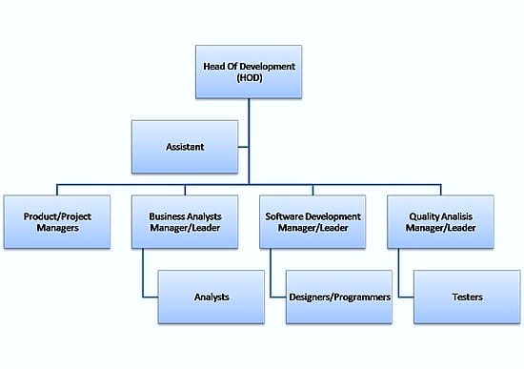
Organization Structure

Slide 6
Roles and Responsibilities
Problem solving by collaborating with team
Maintain documentation of assigned task
Provide Meaningful Work
Assign tasks that help interns learn and develop real-world skills
Ensure all work given follows ethical and legal standards

Slide 7
Products and market performance
Custom Software Development: Tailored software solutions to meet specific business needs.​
Mobile & Web Development: Design and development of responsive websites and mobile applications.​
Data Science: Analyzing structured and unstructured data to uncover patterns and insights.
Cloud Computing: Providing scalable cloud solutions to enhance business agility.
Cybersecurity: Implementing security measures to protect digital assets.
Overall Rating: 4.7 out of 5 stars based on employee reviews.​

Slide 8
Services
Software Solutions
Web Solutions
Networking Solutions
Quality Assurance & Testing
Application Maintenance & Support

Slide 9
ON JOB TRAINING (OJT-1)

Slide 10
Hospital Management System
The Hospital Management System (HMS) is a software solution that automates and streamlines hospital operations, including patient registration, appointment scheduling, medical record management. It enhances efficiency, reduces human errors, and ensures secure data management. By integrating various hospital departments, HMS improves communication and decision-making.

Slide 11
Problem Statement
Time-Consuming Processes – Patient registration, appointment scheduling, and billing take longer when done manually..
Difficulty in Managing Appointments – Manual scheduling often leads to overbooking, long patient wait times, and mismanagement..
Resource Management Challenges – Hospitals struggle to efficiently track bed availability, staff schedules, and equipment usage..

Slide 12
Future Scope
Integration of AI for predictive analysis in patient treatment.
Cloud-based access for remote patient monitoring.
Mobile application for easier patient-doctor communication.
Blockchain for secure medical data storage.

Slide 13
USE CASE-1

Slide 14
Patient Registration
Actors: Receptionist, Patient
Description: Register a new patient by entering personal and contact details.
Preconditions: Receptionist is logged in.
Postconditions: Patient profile is created and stored.
Doctor Management
Actors: Admin
Description: Add, update, or remove doctor profiles with specialization and availability.
Preconditions: Admin is authenticated.
Postconditions: Doctor list is updated.

Slide 15
Appointment Scheduling
Actors: Receptionist, Patient
Description: Book, view, or cancel appointments with available doctors.
Preconditions: Patient is registered, doctor is available.
Postconditions: Appointment is saved in the system.
Medical Record Management
Actors: Doctor, Nurse
Description: Maintain records of patient history, diagnosis, prescriptions, and reports.
Preconditions: Patient is admitted or has visited.
Postconditions: Records are stored and linked to the patient.
Staff Management
Actors: Admin
Description: Manage hospital staff (nurses, technicians, clerks).
Preconditions: Admin is authenticated.
Postconditions: Staff records are updated.

Slide 16
ON JOB TRAINING (OJT-2)

Slide 17
Expense Tracker
In today's fast-paced world, managing personal and business finances efficiently has become crucial.
An Expense Tracker is a digital or manual tool designed to help individuals and organizations monitor their income, expenses, and savings systematically. By tracking financial transactions, users can make informed decisions, reduce unnecessary expenditures, and achieve their financial goals effectively.

Slide 18
Problem Statement
Difficulty in tracking daily income and expenses.
Forgetting bill payments and due dates.
No proper categorization of expenses.
Challenges in saving money efficiently.

Slide 19
Future Scope
AI-Based Expense Analysis – Implementing artificial intelligence to provide smart spending suggestions and detect unnecessary expenses.
Automated Expense Tracking – Integrating with bank accounts and digital wallets to automatically track transactions.
Multi-User Collaboration – Allowing family members or teams to manage shared expenses together.
Voice Command Integration – Enabling users to record expenses through voice assistants like Google Assistant and Alexa.

Slide 20
USE CASE-2

Slide 21
User Registration and Login
Actors: User
Description: Users can sign up and log in securely to access their personal expense data.
Preconditions: User is not registered/logged in.
Postconditions: User account is created or session is started.
Add Expense
Actors: User
Description: Users can record an expense by entering details like category, amount, date, and description.
Preconditions: User is logged in.
Postconditions: Expense is stored in the database.

Slide 22
Edit or Delete Expense
Actors: User
Description: Users can modify or remove previously recorded expenses.
Preconditions: Expense exists and user is logged in.
Postconditions: Expense record is updated or deleted.
Generate Reports
Actors: User
Description: Users can view reports based on time, category, or overall spending.
Preconditions: Expense data is available.
Postconditions: Report is displayed or downloaded.
Visual Charts and Graphs
Actors: User
Description: Graphical representation of expenses for easier understanding.
Preconditions: Expenses are recorded.
Postconditions: Charts are generated and shown.

Slide 23
THE END

