Slide 1


Slide 2



TEAM 03 SECTION 01 (MEET THE TEAM)
Gowtham
Data Engineer
Akash Vemula
Data Scientist
Varun Yadhav
Data Analyst

Slide 3

Objective
Develop machine learning models to perform sentiment analysis on customer reviews, assessing the number of positive reviews and determining the product's overall quality.

Slide 4


Slide 5

Business Problem
Companies selling smart devices, like Amazon Alexa, receive thousands of customer reviews, making it challenging to manually analyze feedback and identify areas for product improvement. Without an automated system, businesses may struggle to extract meaningful insights, resulting in missed opportunities to enhance product quality, customer satisfaction, and market competitiveness.

Slide 6
Proposed Solution
This project implements machine learning-driven sentiment analysis to automatically analyze customer reviews and extract actionable insights. The approach includes algorithms like Naïve Bayes, Decision Tree, and Random Forest to analysis the data to reveal trends in positive and negative feedbacks.
This automated analysis helps businesses efficiently identify customer pain points and product strengths, enabling data-driven product improvements and ultimately enhancing customer satisfaction.

Slide 7
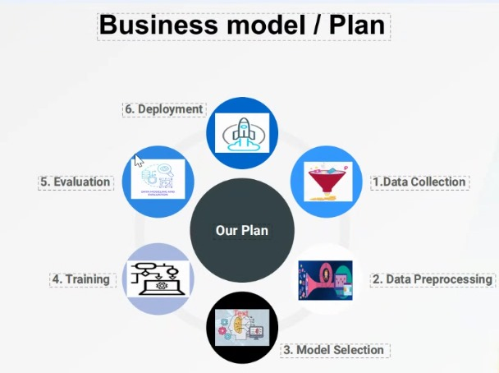

Slide 8
What We Learned
AI-Powered Sentiment Analysis: Used machine learning models to analyze large datasets of reviews.
Automated Insights & Trends: Identified key customer pain points and product strengths, enabling data-driven decision-making for product improvements.
Business Impact: Reduced manual effort in review analysis, enhanced customer satisfaction, and helped companies stay competitive in the smart device market.

Slide 9

Thank you!!!

