Slide 1
EIP-4337: Account Abstraction
DEEP DIVING

Slide 2
What is Account Abstraction
Account abstraction in the context of blockchains like Ethereum refers to the idea of making user accounts more flexible and programmable. In this model, the rules for how a transaction is processed (like signature verification) are defined in smart contract code, allowing for a wide range of customizations. This can include more complex access controls, recovery mechanisms, and integration with off-chain systems

Slide 3
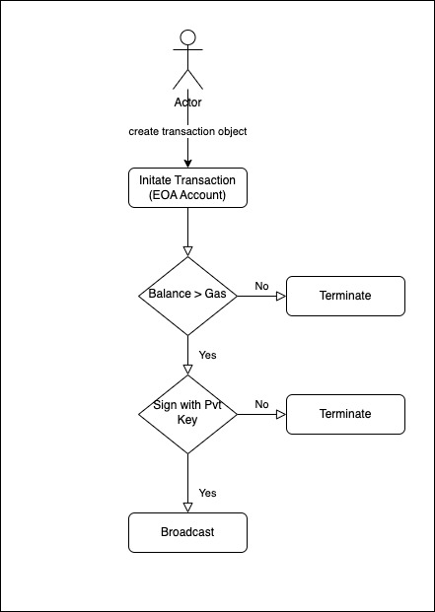
Traditional Ethereum Transaction flow

Slide 4
Components of Account Abstraction
Bundler
Entrypoint
Smart Account
Paymaster
Aggregator

Slide 5
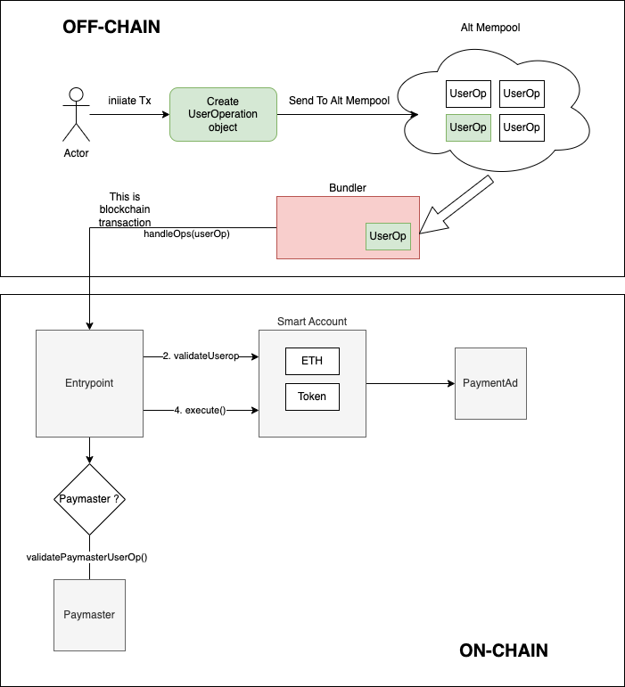
Transaction Flow

Slide 6
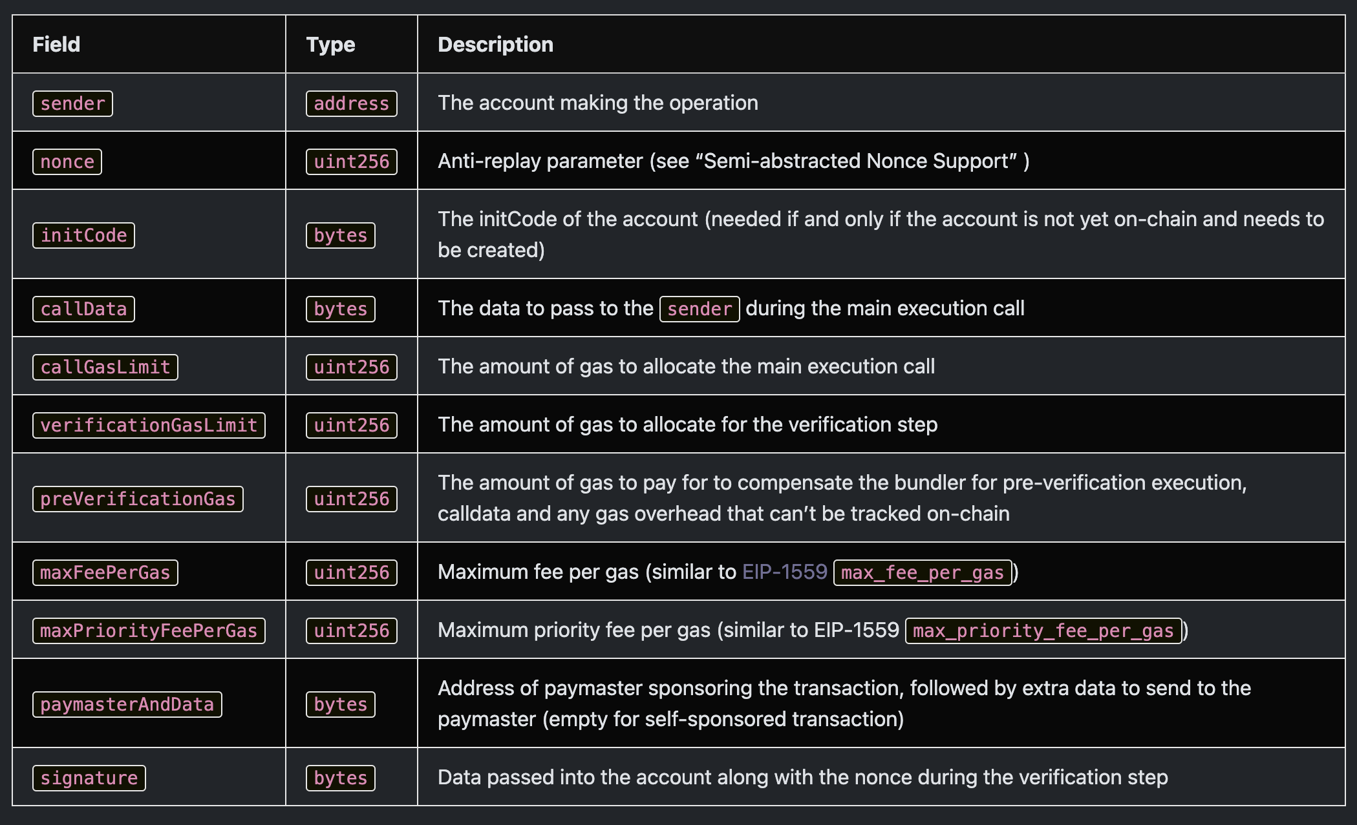
UserOperation Object (UserOp)

Slide 7
Bundler
a node (block builder) that can handle UserOperations, create a valid an EntryPoint.handleOps() transaction, and add it to the block while it is still valid
Users send UserOperation objects to a dedicated user operation mempool. Bundlers keep listening to these alt mempool, create a bundle transaction and trigger entrypoint.handleOps().

Slide 8
Entrypoint Contract
A singleton contract to execute bundles of UserOperations. Bundlers/Clients whitelist the supported entrypoint.
Functions Necessary for Entrypoint contract.
handleOps
handleOpsAggregator

Slide 9
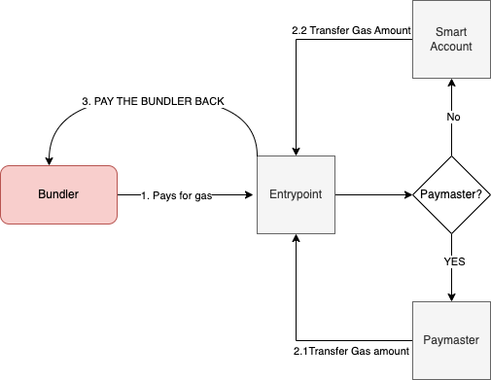
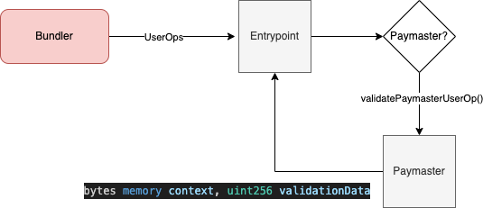
Paymaster

Slide 10
Smart Account / BaseAccount
The wallet creation itself is done by a “factory” contract, with wallet-specific data. The factory is expected to use CREATE2 (not CREATE) to create the wallet, so that the order of creation of wallets doesn’t interfere with the generated addresses.
The contract created by this factory method should accept a call to validateUserOp to validate the UserOp’s signature. For security reasons, it is important that the generated contract address will depend on the initial signature. This way, even if someone can create a wallet at that address, he can’t set different credentials to control it.

Slide 11
Financial Products and Services Innovation
Streamlined Financial Products: Banks can use account abstraction to create more efficient and integrated financial products, such as seamlessly linking digital asset wallets with traditional banking services.
Automated Compliance and Reporting: Smart contracts can be programmed to automatically comply with regulatory requirements, making compliance easier and more reliable.
Tokenization of Assets: Account abstraction facilitates the tokenization process, allowing for the seamless integration of digital assets like stocks, bonds, or real estate into blockchain ecosystems.

Slide 12
Integration of Account Abstraction and MPC
Enhanced Security Protocols: By integrating MPC with account abstraction, the security of blockchain accounts can be significantly enhanced. Account abstraction allows for the implementation of complex logic in smart contracts, and MPC ensures that the execution of this logic is secure and distributed among multiple parties.
Flexible Key Management: Account abstraction can be used to define custom rules for transaction validation, which can include requirements for multi-party approval using MPC. This allows for the creation of highly secure, yet flexible, access control mechanisms for blockchain accounts.
Decentralized Control and Recovery Options: The combination of these technologies allows for decentralized control over an account. For instance, a set of parties (like different departments in a bank or different executors in a trust) can be required to agree on a transaction. Moreover, account abstraction can allow for sophisticated recovery mechanisms in case key shares are lost.
Compliance and Regulation: MPC can ensure that no single party has complete control over a transaction, which is beneficial for meeting certain regulatory and compliance standards. Account abstraction can be used to encode these compliance rules directly into the blockchain account.
Institutional Adoption: For institutions like banks or financial services, the combination of account abstraction and MPC provides a balance between security, regulatory compliance, and operational efficiency. This makes blockchain technology more palatable for institutional use and can accelerate the adoption of blockchain-based services.

