Slide 1

Rental Price Tier Classification
By:- Akash Yadav, Aryan Varmora, Yunshuo Kyle Tian

Slide 2

Introduction
Data: Apartment rental pricing dataset (Source: UCI)
Background of the data:
This dataset contains around 100,000 observations with comprehensive details about US apartment rentals. It includes attributes like amenities, bedrooms, pricing, location, and more. Partially cleaned, it's a valuable resource for real estate research, enabling various data analysis tasks and insights into US apartment rental dynamics. Ideal for further analysis.

Slide 3
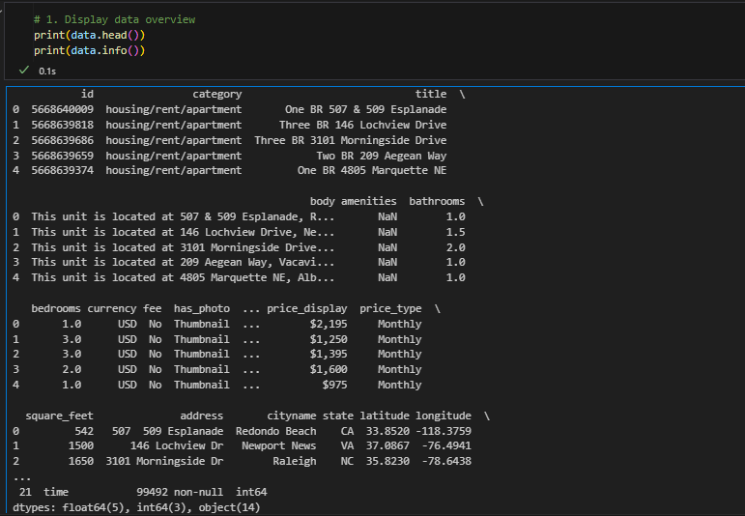

Overview Of the Dataset
Dataset Size: Total Records: 99105
Columns: Total: 23 features
Includes detailed information on pricing, amenities, location, number of bedrooms and bathrooms, square footage, pet policies, and more..
The dataset features a broad spectrum of apartment rentals across various regions in the US. It reflects diverse aspects such as rental prices, apartment features, and geographical locations, providing a holistic view of the apartment rental market.
Data Source : https://archive.ics.uci.edu/dataset/555/apartment+for+rent+classified

Slide 4

Problem Statement
Why We Need ML-Based Automation
ML provide objective pricing across large datasets
Capable of detecting hidden patterns in pricing based on area, size, etc.
Enables platforms like Zillow, Airbnb to offer smart pricing recommendations
Specific Goal of This Project
To classify rental listings into Low, Medium, or High tiers using ML models trained on features like:
Bedrooms, Bathrooms, Square Feet, Longitude and Latitude.
City and State (location)

Slide 5

Real-World Example
Two apartments in Brooklyn, NY and Charlotte, NC may have identical layouts (2 bed, 1 bath, 800 sq ft), but demand, cost of living, and location drastically impact their rent.
This project uses Data Mining Techniques to learn these patterns and assign accurate tiers based on the data — not guesswork.

Slide 6
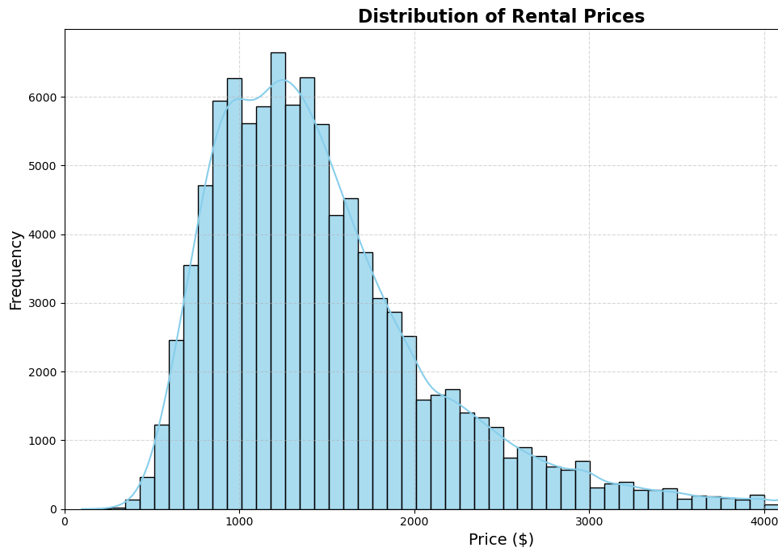
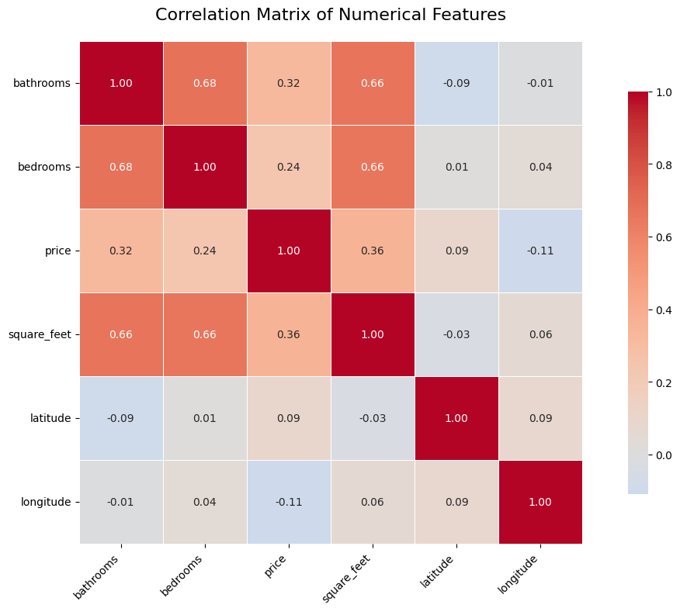
Exploratory Data Analysis (EDA)
The rental price distribution is right-skewed, with most listings concentrated between $800 and $1800.
A peak around $1200 suggests this is the most common rental range in the dataset.
There are high positive correlations (0.66-0.68) among bathrooms, bedrooms, and square_feet, indicating multicollinearity among the size features.
square_feet (0.36) and bathrooms (0.32) exhibit the highest, although moderate, positive correlations with price among the remaining features like bedrooms (0.24).

Slide 7

Data Cleaning & Preprocessing
Handling Missing Values
Missing entries found in bathrooms, bedrooms, square_feet, and location fields
Filling missing value with default text(Unknown)
Dropping rows with missing critical information
Addressed using imputation techniques:
Numerical features: Replaced with Median values
Categorical features: Filled with the most frequent value
Adding derived numerical features such as room_density, bed_bath_ratio.

Slide 8
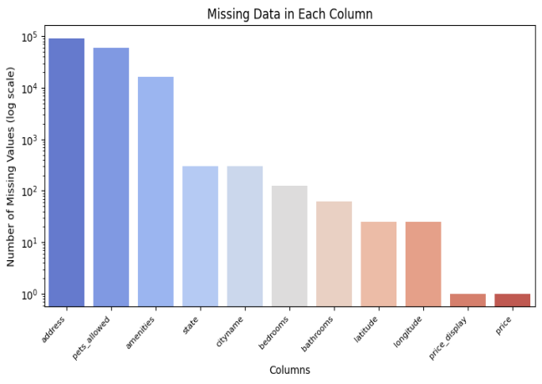
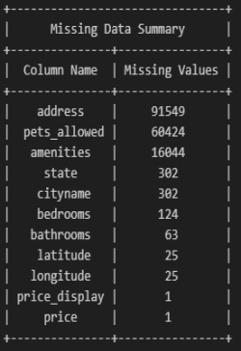
Missing Values

Slide 9
Outliers Detection
Dataset Columns | Number of Outliers | Outliers Range | Percentage of Outliers | IQR Bounds
bathrooms | 202 | 4.00 to 9.00 | 0.20% | [-0.50, 3.50]
bedrooms | 1832 | 4.00 to 9.00 | 1.80% | [-0.50, 3.50]
price | 4622 | 2970.00 to 52500.00 | 4.66% | [-162.50, 2969.50]
square feet | 2836 | 101.00 to 40000.00 | 2.86% | [150.00, 1694.00]
latitude | 89 | 19.57 to 64.83 | 0.09% | [24.43, 49.27]
longitude | 86 | -159.37 to -147.72 | 0.09% | [-145.68, -36.72]
Outliers in numerical features were identified using the Interquartile Range (IQR) method:
Lower Bound = Q1 − 1.5 · IQR, Upper Bound = Q3 + 1.5 · IQR.

Slide 10
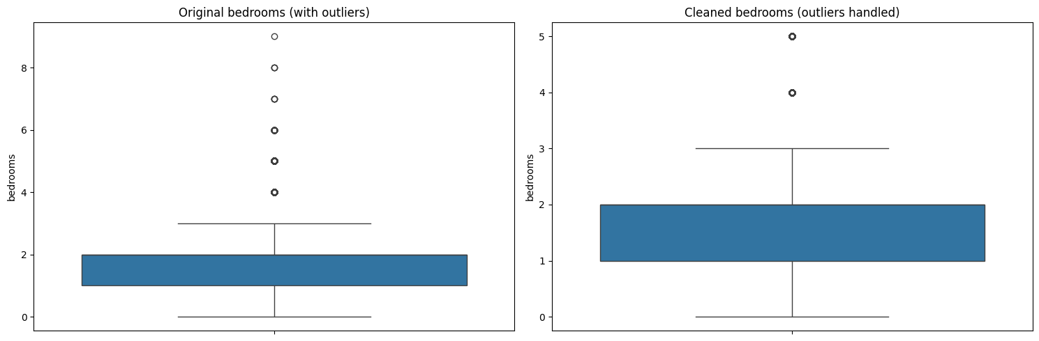
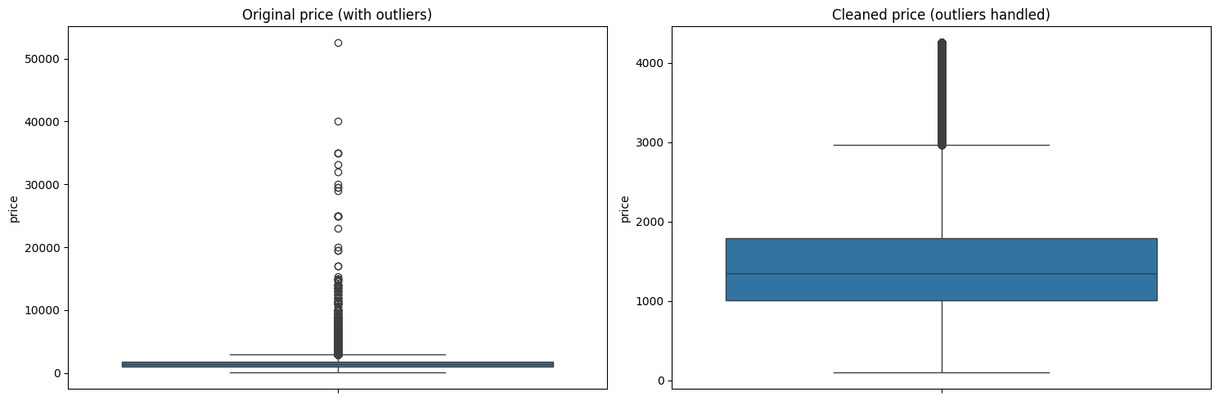
Outlier Handling
Outlier handling involved removing data points falling outside the calculated 1.5 * IQR range for selected features.
This removal targeted the 'bathrooms', 'bedrooms', 'price', 'square_feet', 'latitude', and 'longitude' columns specifically.
The process was applied sequentially: outliers were removed based on 'bathrooms', then the resulting data was filtered for 'bedrooms', and so on.

Slide 11
Feature Engineering
Feature Scaling: Numerical features were scaled using the StandardScaler to standardize their ranges.
One-Hot Encoding for Categorical Features
Feature Selection:
Numeric Features: bedrooms, bathrooms, square_feet, bed_bath_ratio, sqft_per_bedroom latitude, longitude
Categorical Features: cityname, state, pets_allowed, price_type
Price Tier Generation via Quantile Binning. Original price column was continuous and highly skewed. Transformed into three tiers using qcut():
Low: Bottom 33%
Medium: Middle 33%
High: Top 33%

Slide 12

Model Selection
Why These 6 Models?
KNN
Logistic Regression
Decision Tree
Random Forest
Naive Bayes
AdaBoost

Slide 13
Model Training & Hyperparameters
Data Splitting
Dataset was split using Train/Test Split:
80% Training
20% Testing
Ensured balanced class representation using stratify=y
Techniques Used
GridSearchCV: Exhaustive hyperparameter tuning
Applied for KNN, Logistic Regression, Random Forest, and AdaBoost
SMOTE Used in early stages for class balancing

Slide 14
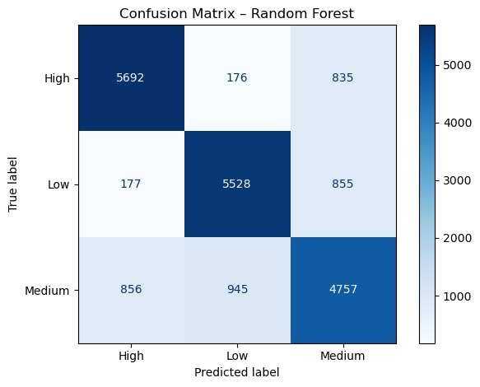
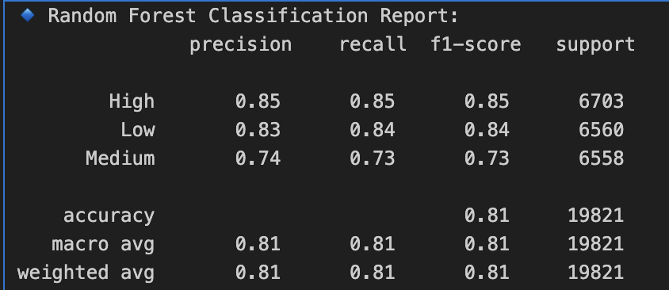
Best Models:- Random Forest
Random Forest clearly distinguishes 'High' tier from others
Minor confusion in Medium vs. Low, expected due to pricing similarities
Random Forest had the highest accuracy (81%) and strong scores across all metrics
KNN matched Random Forest in Precision, Recall, and F1, but slightly lower in accuracy
Logistic Regression offered balanced and interpretable results (F1 = 0.74)
Decision Tree, Naive Bayes, and AdaBoost showed comparatively lower performance

Slide 15
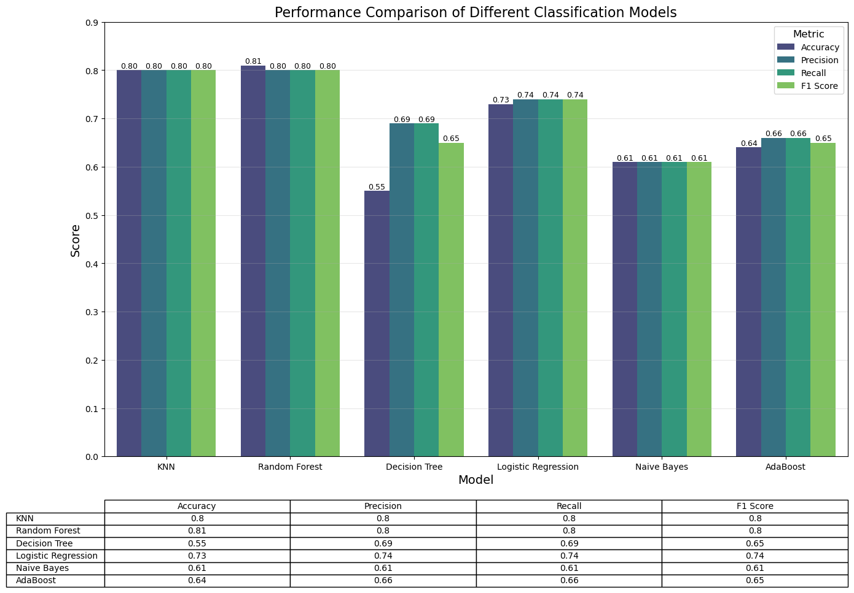
Model Results Comparison

Slide 16
Limitations
Regional Bias in Quantile Binning
Price tiers were generated using global quantile cuts
This doesn’t account for local market variations (e.g., NYC vs. rural areas)
May lead to unfair categorization in regionally skewed data
2. Lack of Rich Contextual Features
Dataset does not include:
Proximity to public transit or downtown
Renovation status, building age
Neighborhood-level factors (safety, amenities)
Limits the model’s ability to capture real-world price influencers
3. No Temporal Modeling
Dataset is treated as time-independent
No incorporation of:
Seasonal trends (e.g., summer rental spikes)
Price evolution over years
Reduces applicability for forecasting

Slide 17
Future Work
1. Localized Price Binning
Define price tiers using city- or state-specific quantiles
Accounts for regional cost-of-living differences
Reduces bias in rental classification
2. Feature Enrichment
Engineer new features such as:
amenities_count
Distance to transit, schools, or downtown
Improve model’s ability to understand context
3. Time-Aware Modeling
Incorporate variables like:
listing_date, year_built, or seasonal cycles
Enables forecasting and understanding market trends
Use SHAP values for:
Feature importance
Individual prediction explanations
Bias auditing and fairness diagnostics
5. Interactive Deployment
Build a web-based dashboard with:
Map visualizations
Real-time inputs for prediction
City-specific pricing guidance
4. Explainability with SHAP

Slide 18

Thank You

