Slide 1

TrekTale Share Your Journey, Inspire the World
A Cloud-Powered Platform for Travel Enthusiasts
By Akash Yadav

Slide 2
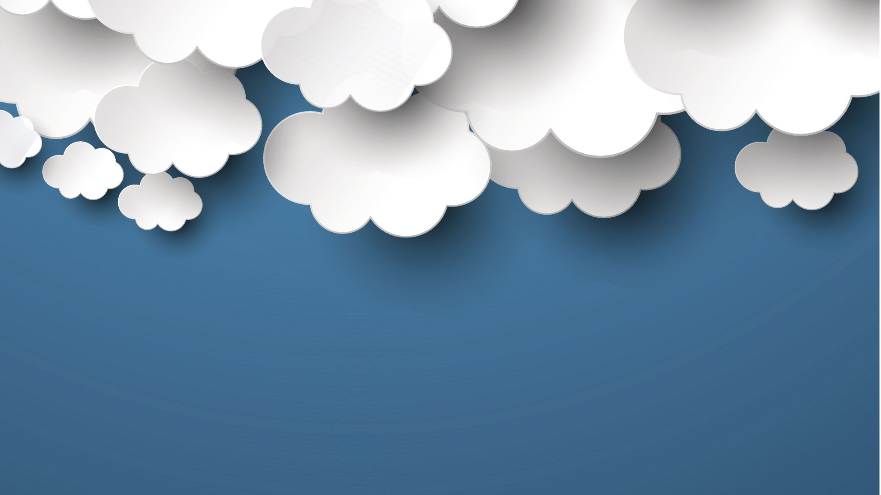
Project Overview
🌟 Goal: TrekTale is a cloud-native, full-stack web application designed to let users create, view, and manage personal travel stories. Users can upload images, add tags, and securely access their content using modern authentication techniques.

Slide 3
🧱 Technology Stack
Frontend:
React.js with Vite for fast development and Tailwind CSS for responsive design
Backend:
Node.js with Express.js to handle RESTful API logic and authentication
Database:
MongoDB Atlas for scalable, cloud-hosted document storage
☁️ Deployment Platform
The application is containerized using Docker and fully deployed on Google Kubernetes Engine (GKE), utilizing Google Cloud Platform’s infrastructure for scalability, reliability, and DevOps integration.

Slide 4

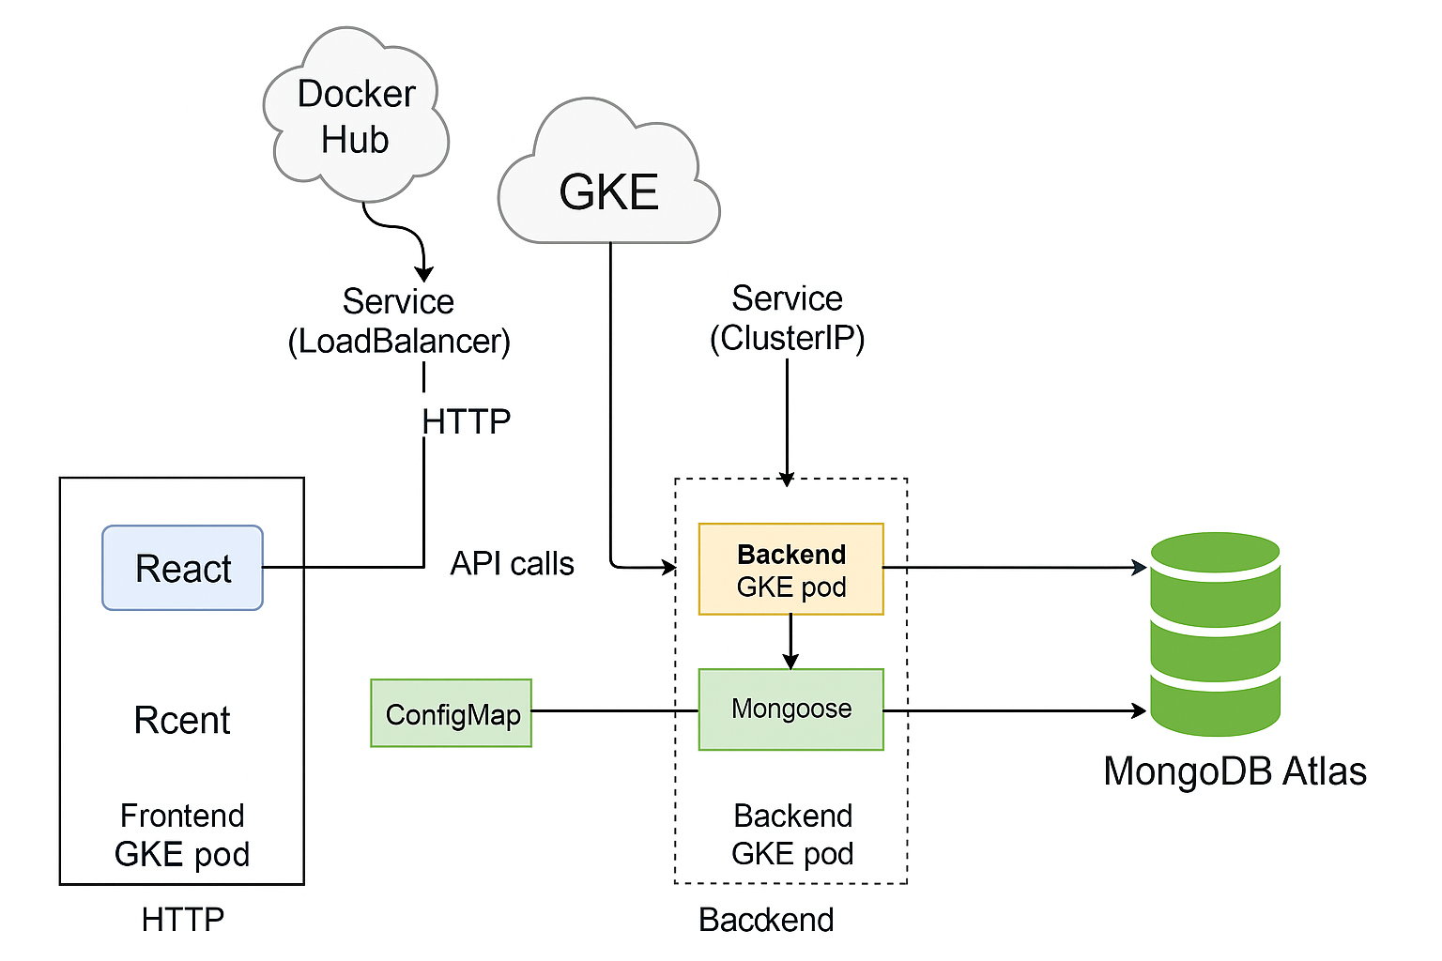
High-Level Architecture Diagram
This architecture illustrates the interaction flow between key components of the TrekTale application, all deployed in a cloud-native environment on Google Cloud Platform (GCP) using Google Kubernetes Engine (GKE).

Slide 5

GCP + GKE Setup
TrekTale is deployed on Google Kubernetes Engine (GKE), leveraging GCP's managed infrastructure to run and scale containerized frontend and backend services.
🔧 Cluster Architecture
Frontend and Backend run in separate Pods within the same GKE cluster.
Docker images are pulled from Docker Hub.
🌐 Service Exposure
Frontend is exposed via a LoadBalancer for public access.
Backend is exposed via a ClusterIP and receives API calls internally from the frontend.
🔐 Configuration Management
Environment variables like MONGO_URI and ACCESS_TOKEN_SECRET are injected into backend pods using ConfigMaps.

Slide 6
Deployment Process
TrekTale uses a streamlined, script-driven deployment workflow to build, push, and apply all Kubernetes resources.
⚙️ Build & Push
Docker files are defined for both frontend and backend. Images are built locally and pushed to Docker Hub.
🚀 Deployment Script (deploy.sh)
Builds Docker images with --no-cache
Pushes to Docker Hub
Creates ConfigMap from .env file Applies:
backend-deployment.yaml
backend-service.yaml
☁️ Kubernetes Resources
Pods and Services are created on GKE
Environment config is injected via ConfigMap
Backend and frontend services are wired and live within seconds
This setup allows consistent, reproducible deployments across environments.

Slide 7
Challenges Faced
While deploying TrekTale, several technical roadblocks were encountered and resolved during the cloud-native transition.
🔍 Missing Configuration
Backend initially failed due to a missing config.json
Replaced with .env + ConfigMap for environment-driven config injection
🧩 Vite Not Found in Frontend Container
Occurred due to missing dev Dependencies during production build
Resolved by using proper build scripts and removing dev-only vite from runtime
Each challenge improved the application's cloud-readiness, security, and deployment reliability.

Slide 8

demo

Slide 9

Conclusion & Learnings
TrekTale was an opportunity to design, build, and deploy a full-stack cloud-native web application with real-world DevOps workflows and container orchestration.
✅ Key Takeaways
Gained Hands-On Experience with GKE: Learned how to build, deploy, and manage containerized applications using Kubernetes on Google Cloud.
Mastered CI/CD-Like Deployment: Automated builds and deployments using Docker, Docker Hub, and a deploy script.
Improved Environment Configuration Handling: Switched from static JSON config to .env + ConfigMap for secure and scalable cloud-native configuration.
🚀 This project strengthened my skills in full-stack development, cloud deployment, and modern DevOps best practices.

Slide 10
Thank You

