Slide 1
Probability and Statistics : Final Project Presentation
Presented by:
Kanishta Agarwal
Sudeshna Pal
Prasad Marla
Amos Paul
Ankit Agrahari
Tarun Lohani
Sai Gokul Kanakala
Akasha Roy

Slide 2
Our Dataset
We have logs from a Hadoop cluster called OpenCloud.
OpenCloud is a research cluster at Carnegie Mellon University (CMU) managed by the CMU Parallel Data Lab.
31-month logs (April 2010 to Oct 2012).
The logs are partitioned by month. So there are 31 folders (April 2010 to Oct 2012), and each containing information of all jobs submitted in one month. Each folder contains 6 CSV files.

Slide 3
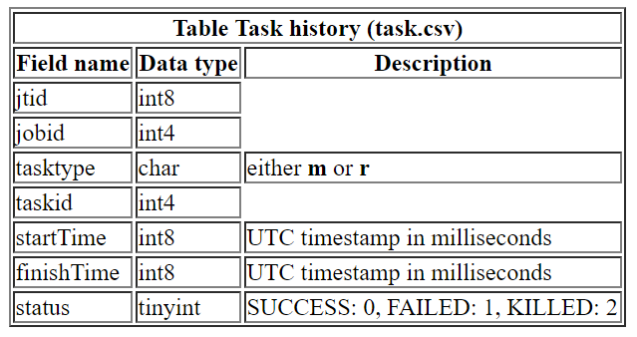
task.csv

Slide 4
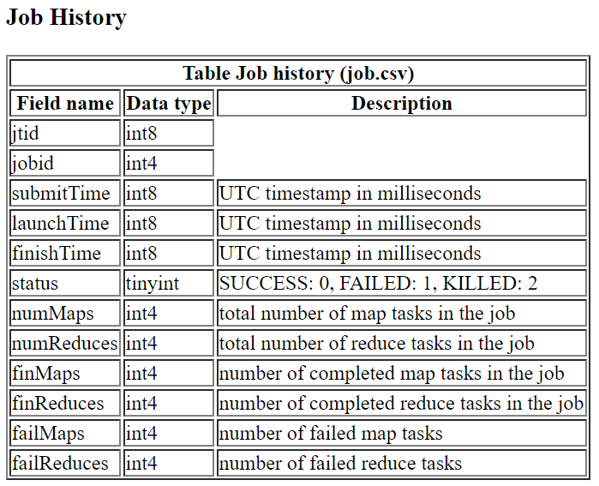
job.csv

Slide 5
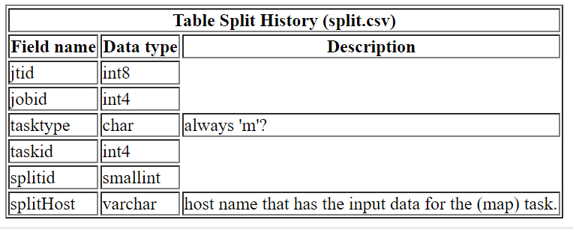
split.csv

Slide 6
Hypothesis suggested
1. regression between cleanup = f(launch time) (Ankit)(Sudeshna) - Linear regression
2.1. The number of jobs submitted during weekdays is greater than the number of jobs submitted during weekends
2.2. The number of jobs submitted during daytime is the same as the number of jobs submitted during nighttime
3. Finding the relation between input size and job time (based on clustering)
4. Predicting the probability of a job getting killed in a day or in an hour
5. Finding the inter-job submission time, and analyzing the distribution (exponential? Uniform? Normal?)
6. Finding the distribution of load on cluster over months Non parametric,parametric,KS test+ Bayesian inference.
7.split task data uniform distribution . - Non-parametric,parametric,KS test,DKW-CI.

Slide 7
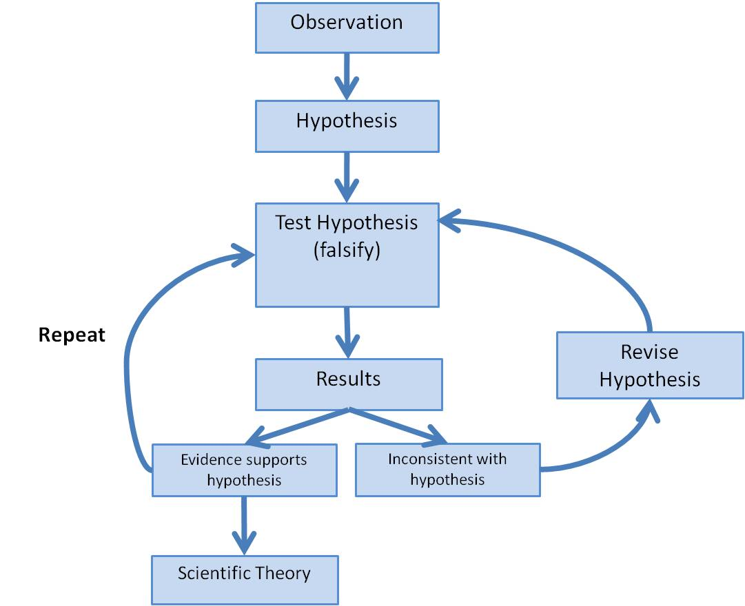
Steps in Hypothesis Testing

Slide 8
Hypothesis 1 (Ankit)

Slide 9
Hypothesis 1

Slide 10
Hypothesis 1

Slide 11
Hypothesis 2: (Hypothesis and Methods)
2.1. The number of jobs submitted during weekdays is greater than the number of jobs submitted during weekends
2.2. The number of jobs submitted during daytime is the same as the number of jobs submitted during nighttime
Used T-test for analyzing the data

Slide 12
Hypothesis 2: (Analysis)

Slide 13
Hypothesis2: (Inference)

Slide 14
Hypothesis 3: (Hypothesis and Methods)

Slide 15
Hypothesis 3 : (Analysis)

Slide 16
Hypothesis 3 : (Inference)

Slide 17
Hypothesis 4: (Hypothesis and Methods) (Kanistha) -
time series for #jobs killed, add hyp thesis against uniform model (Kanistha) - Time series

Slide 18
Hypothesis 4 : (Analysis)

Slide 19
Hypothesis 4 : (Inference)

Slide 20
Hypothesis 5: (Hypothesis and Methods)

Slide 21
Hypothesis 5 : (Analysis)

Slide 22
Hypothesis 5 : (Inference)

Slide 23
Hypothesis 6: (Hypothesis and Methods)

Slide 24
Hypothesis 6 : (Analysis)

Slide 25
Hypothesis 6 : (Inference)

