Slide 1

Shashank kumar Student (UG) IIIT BH Electronics and Telecommunication engineering
Epidemiology Research Track

Slide 2
Association between weather data and COVID-19 spread and mortality rate: Machine learning approaches
Here We will analyze collected Dataset With help of Machine Learning algorithems and Visualize in Different Mannner after that we will get some useful relation that will show the appropriate relationship among weather parameters and covid 19 spread and also we will compare this with mortality rate.

Slide 3
Introduction and Background Faced with the global pandemic of COVID-19, declared by World Health Organization (WHO) on March 11th 2020, and the need to better understand the seasonal behavior of the virus, I have conducted this systematic review to describe current knowledge about the emergence and replicability of the virus and its connection with different weather factors such as temperature and relative humidity. The correlation between weather variables in the affected regions and the spread of COVID-19 earned special attention in the upgoing research publications. Recently, researchers found that a notable association between the weather variables (temperature and humidity) and the regions that have major COVID-19 out Moreover,these regions are located at the same temperature zone in the northern hemisphere. Even though the pandemic is becoming a global issue, the most infected areas include outbreak epicentres such as parts of Northeastern United States, China’s central province of Hubei, South Korea, Japan, Iran, Italy, Spain, Germany, and England, all of which share an average temperature of 5 C to 11 C and 47% to 79% humidity in January and February 2020. For Italy, regions with a temperature higher than 15 degrees Celsius and 75% humidity have less spread of COVID-19 cases.

Slide 4
Hypothesise and Methodology
We hypothesise that the spread of the virus will decrease in the area with higher temperature and humidity than areas with average records.
Our work to find dataset which contains weather report ,location report and also covid cases and death.
Find the best predictive model for analyzing daily confirmed cases in countries with the highest number of COVID-19 cases in the world.
Predict the number of confirmed cases to have more readiness in healthcare systems and make forecast using advanced machine learning algorithms.
To validate the propose model, we have includes more number of weather and climatic condition features that can influence the spread of the COVID-19 virus

Slide 5
Data collection
2.https://www.kaggle.com/imdevskp/corona-virus-report
From here we are collecting covid cleand dataset along with country lattitude and longitude
columns:
Data columns (total 11 columns):
state 49068 non-null object
country 49068 non-null object
Lat 49068 non-null float64
Long 49068 non-null float64
date 49068 non-null object
confirmed 49068 non-null int64
deaths 49068 non-null int64
recovered 49068 non-null int64
Active 49068 non-null int64
WHO Region 49068 non-null object
active 49068 non-null int64
1.https://www.kaggle.com/winterpierre91/covid19-global-weather-data
From here we are collecting weather data for different country at different date .
Columns:
index 16556 non-null int64
country 16556 non-null object
state 16556 non-null object
date 16556 non-null object
humidity 16379 non-null float64
sunHour 16379 non-null float64
tempC 16379 non-null float64
windspeedKmph 16379 non-null float64

Slide 6
Methods
In this work, we developed machine learning models used to investigate and understand the real effect of temperature and humidity on the spread of COVID-19 .
We have selected Decision tree as our predicting machine learning model.
We are visualizing the data with help of scatter_geo which is visualizing the data on world map and with help of lattitude and longitude.
This algorithms were selected as they are the most widely used for predicting the spread of COVID-19 and other prediction related analysis. This models was trained with the features such as Population Density, Fertility Rate, Median Age, Infection Ratio, Urban Percentage, Temperature, Humidity, Hours of Sunlight, and Wind Speed.

Slide 7
Variables
Variable name | Dependancy
1. Humidity | Independent
2.Temprature | Independent
3.Windspeed | Independent
4.Sunhour | Independent
5.Confirmed | dependent
6.Deaths | dependent
7.Population | Independent
8.Density | Independent

Slide 8
Experimental results for virus infection
Feature ranking: Importance
tempC, Importance: 0.2570790052197829
sunHour, Importance: 0.25045373563517775
humidity, Importance: 0.2058261530927998
population, Importance: 0.13502776591200336
windspeedKmph, Importance: 0.1296412831706275
density, Importance: 0.015430137214657047
age, Importance: 0.004753024036007128
urban_percentage, Importance: 0.0014065283754076364
fertility, Importance: 0.0003823673435367415

Slide 9
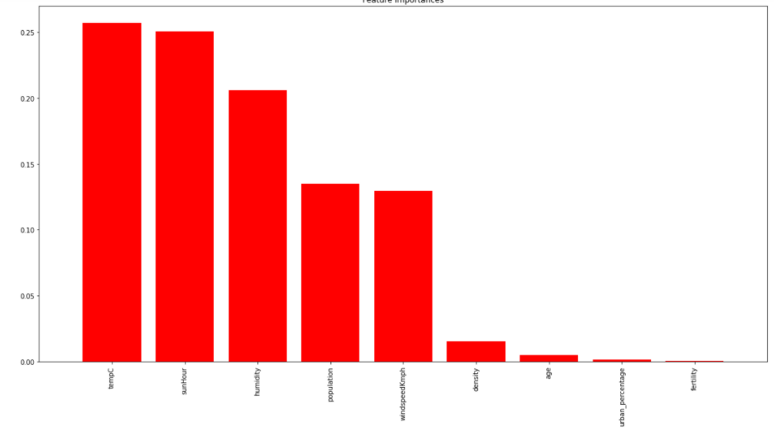

Slide 10
Experimental results for Death
Feature ranking:
tempC, Importance: 0.2783188108662247
sunHour, Importance: 0.23116350589441223
population, Importance: 0.2234751409533564
4, Feature: humidity, Importance: 0.12045105074320783
5, Feature: windspeedKmph, Importance: 0.10199897488467109
6, Feature: density, Importance: 0.024602767811378688
7, Feature: age, Importance: 0.01230138390568934
8, Feature: urban_percentage, Importance: 0.004100461301900208
9, Feature: fertility, Importance: 0.0035879036391593903

