Slide 1
Adult Data Analysis

Slide 2
Independent Variables
Age
Workclass
Fnlwgt
Education
Education Num
Marital status
Occupation
Relationship
Race
Sex
Capital gain
Capital loss
Hours per week
Native Country
Dependent Variables
Y(Salary):
0 for <=50
1 for >50

Slide 3
Removing Missing Values
data = data.dropna()
data = data.drop(data[data.occupation ==' ?'].index)
data = data.drop(data[data['native-country'] ==' ?'].index)
data = data.drop(data[data.workclass ==' ?'].index)
print(data.shape)
Output:
No of Rows remaining : (30162, 15)

Slide 4
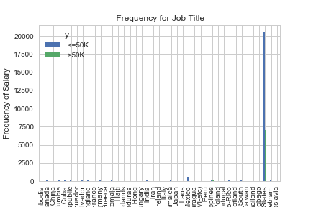

Slide 5
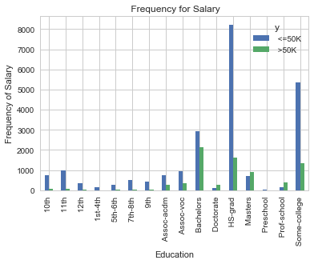

Slide 6
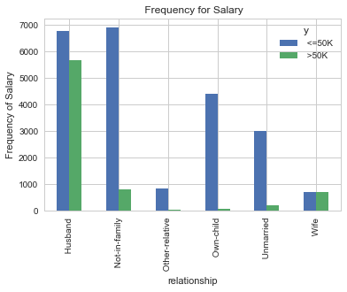

Slide 7
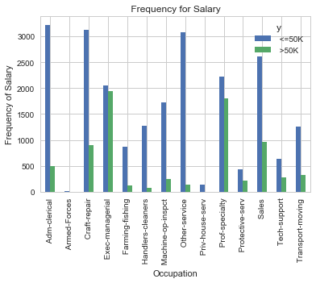

Slide 8
Creating Dummy Variables
Categorical Data:
['occupation','marital-status','native-country','sex','race','workclass']
Removed redundant data
Total Dummy variables : 83
[‘age’,’fnlwgt’,’education-num’,’capital-gain’,’capital-loss’,’hours-per-week’,
’y’,’occupation_ Adm-clerical’,’occupation_ Armed-Forces’,’occupation_ Craft-repair’,
‘occupation_ Exec-managerial’,’occupation_ Farming-fishing’,
‘occupation_ Handlers-cleaners’,’occupation_ Machine-op-inspct’,
‘occupation_ Other-service’,’occupation_ Priv-house-serv’,
‘occupation_ Prof-specialty’,’occupation_ Protective-serv’,
‘occupation_ Sales’,’occupation_ Tech-support’,’occupation_ Transport-moving’,
‘marital-status_ Divorced’,’marital-status_ Married-AF-spouse’…..]

Slide 9
Recursive Feature Elimination
After RFE
["occupation_ Craft-repair", "occupation_ Farming-fishing", "occupation_ Machine-op-inspct","occupation_ Other-service","occupation_ Priv-house-serv","occupation_ Prof-specialty","occupation_ Protective-serv",
"occupation_ Sales", "marital-status_ Divorced","marital-status_ Married-AF-spouse","native-country_ China","native-country_ Cuba","native-country_ Laos","native-country_ Mexico","native-country_ Nicaragua","native-country_ Outlying-US(Guam-USVI-etc)",
"native-country_ United-States","sex_ Male","race_ Black","workclass_ Without-pay"]

Slide 10
Splitting the dataset into Training And Test set
70% of the data is Training Set
30% of the data is Testing Set
Fitting logistic regression to Training set
Accuracy of logistic regression classifier on test set: 0.76

Slide 11
Cross Validation :
10-fold cross validation average accuracy: 0.765
Confusion Matrix :
[[6469 295]
[1887 398]]

Slide 12
Classification Report
precision recall f1-score support
0 0.77 0.96 0.86 6764
1 0.57 0.17 0.27 2285
avg / total 0.72 0.76 0.71 9049

Slide 13
