Slide 1
Unified Voice Analysis and Comparison System
ICT Engineering Capstone (2025–26)
Marwadi University
Department of ICT
[Akash Chudasama] | [92200133044]

Slide 2
Introduction
Voice is an important biometric used in communication, authentication, and forensic science.
Technologies like speech recognition, speaker verification, and voice biometrics are rapidly growing.
However, most available tools are either highly costly or technically complex.
Our system provides a unified platform to upload, store, search, and compare voices in a simple and affordable way.
It bridges the gap between high-end commercial systems and limited research tools.

Slide 3
Problem Statement
Existing tools are either:
Commercial APIs (costly, limited access for students).
Research scripts (technical, not user-friendly).
There is no single, unified platform combining:
Voice library creation.
Search and matching features.
Direct voice-to-voice comparison with accuracy scoring.
Research gap:
Lack of accessible, free, and integrated solution for academics and small organizations.

Slide 4
Relevance to ICT Domain
Signal Processing:
Extraction of Mel Frequency Cepstral Coefficients (MFCC).
Database Management:
Using SQLite for structured voice sample storage.
Web Development:
Interactive UI built using Streamlit.
Cybersecurity & Forensics:
Helps in speaker verification and identity confirmation.
Healthcare & IoT:
Can be integrated into assistive technologies or smart devices.

Slide 5
Feasibility Analysis
Technical Feasibility:
Python, Librosa, Streamlit, and SQLite are robust open-source tools.
Economic Feasibility:
No licensing cost, entirely free software stack.
Operational Feasibility:
User-friendly interface, minimal training required.
Conclusion:
Project is feasible in all aspects for academic and professional use.

Slide 6
Market/User Needs Analysis
Target Users: Students, researchers, forensic labs, and small enterprises.
Identified Needs:
Affordable and accessible system.
Easy-to-use interface without technical complexity.
Real-time or near real-time processing.
Our System Addresses These Needs By:
Providing free and unified access.
Offering search, library, and comparison features in one platform.
Ensuring simple UI for broad adoption.

Slide 7
System Architecture
System Flow:
1. User uploads voice sample.
2. Features extracted (MFCC).
3. Features stored in SQLite database.
4. Matching engine compares features.
5. Output displayed with similarity score and verdict.
Frontend: Streamlit Web Interface.
Backend: Python processing + SQLite database.

Slide 8
Implementation and Demo
Technology Stack: Python, Librosa, Streamlit, SQLite.
Features Implemented:
Upload and store voice samples in a library.
Search for existing voice samples.
Compare two samples with similarity score and verdict.
Live Demo:
• System hosted on Streamlit.
• Shows real-time comparison results.
Fallback: Screenshots/video in case of network or technical issues.

Slide 9
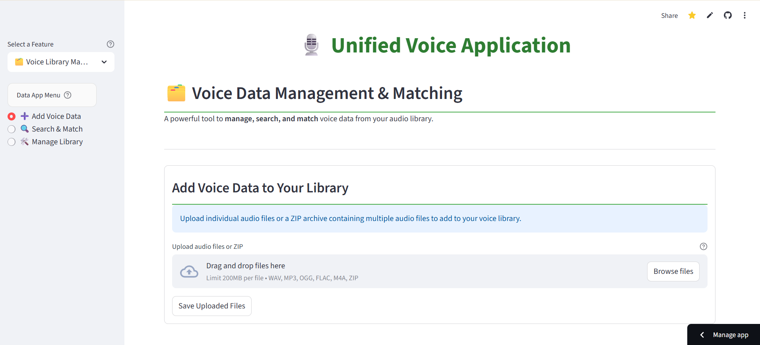
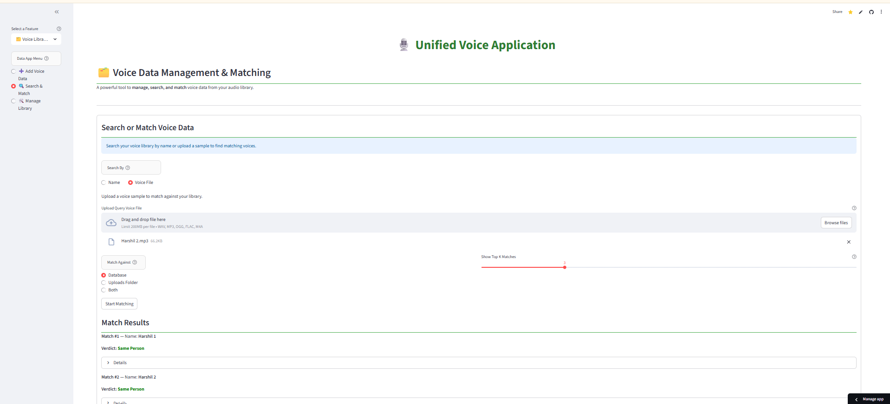

Slide 10
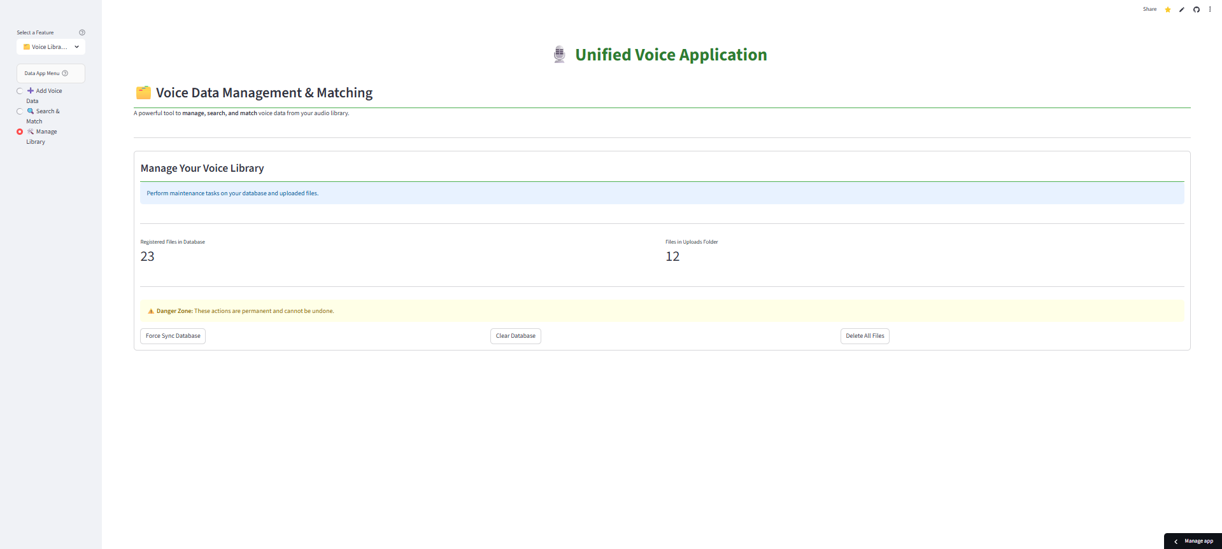

Slide 11
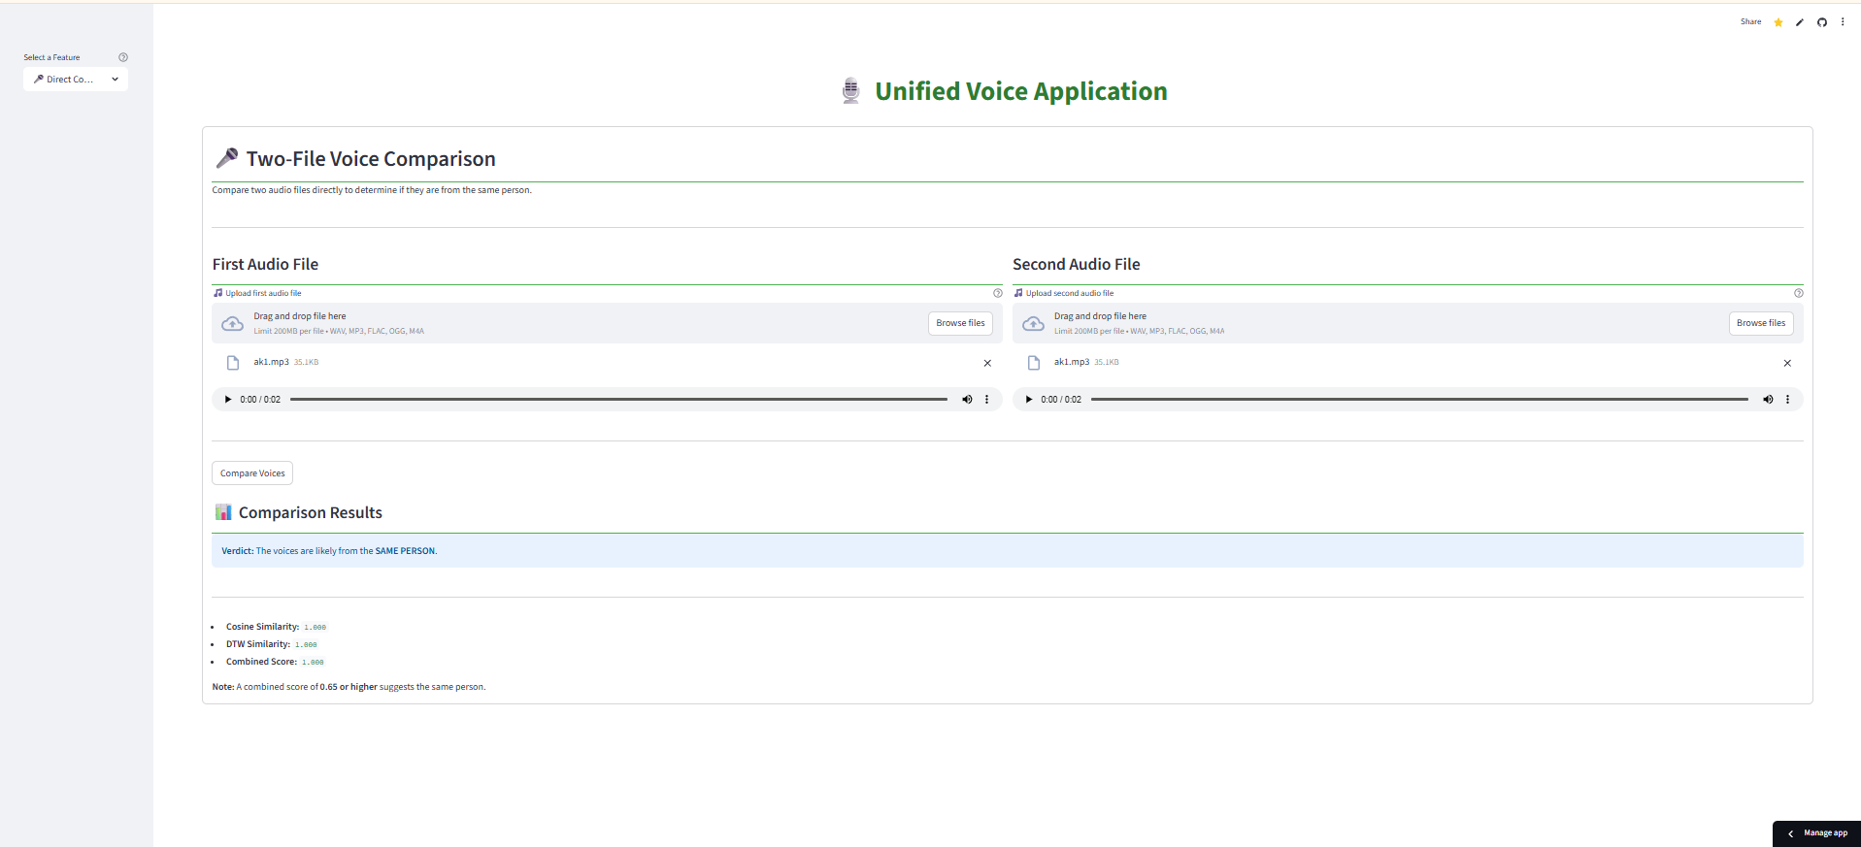


Slide 12
Results and Comparison
Output includes:
Similarity Score (Cosine Similarity + DTW).
Verdict: Same / Likely Same / Different.
Performance:
High accuracy on sample dataset.
Robust for academic-level projects.
Comparison with Alternatives:
Commercial APIs: High accuracy but costly.
Our System: Free, accurate enough, easy to use.

Slide 13
Conclusion & Future Scope
Conclusion:
Developed a free, unified system for voice management and comparison.
Accessible for students, researchers, and small organizations.
Future Scope:
Extend to larger datasets and cloud deployment.
Apply deep learning for higher accuracy.
Integration with IoT and real-time forensic applications.
Multi-language and multi-speaker support.

