Slide 1
SECURE DATA HIDING IN IMAGE USING STEGANOGRAPHY
CAPSTONE PROJECT
Presented By: Akashdeep
College Name & Department : CT Groups of Institutions (CS)

Slide 2
OUTLINE
Problem Statement
Technology used
Wow factor
End users
Result
Conclusion
Git-hub Link
Future scope

Slide 3
Problem Statement
In this project, we are going to demonstrate the use of Steganography in the field of Cyber Security. Here, we will try to hide our confidential data within an image file so that an attacker will not able to read the message even if they are performing attacks like MITM.

Slide 4
Technology used
Python (IDLE)
Python Libraries :- OpenCV, OS, Strings
Git hub
JPG Image File

Slide 5
Wow factors
This project demonstrates the implementation of Steganography. We have implemented it using Python which is a well known and a vast using Coding language.

Slide 6
End users
Small, Medium and Large-Scale industries.
Journalists/ Detectives/ Spies.
Military
Normal users who wants to send something highly confidential without getting this data being hacked by hackers.
Researchers, who wants to explore this field.
Students or Learners, who are new in Cyber Security.

Slide 7
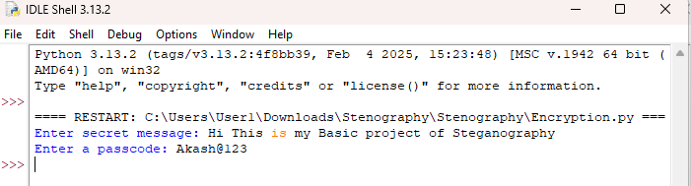
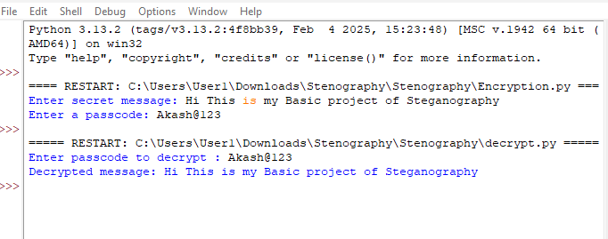
Results
Here, we hide our secret message in an image file using our python script, that can be only be decoded by the correct Receiver.
Encrypting File with a hidden text:-
Decrypting with Correct Password:-

Slide 8
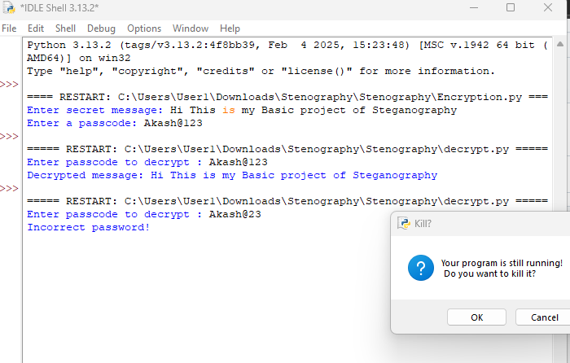
Results
Decrypting with Wrong Password:-

Slide 9
Conclusion
This is just a basic project on Steganography. Confidentiality and Integrity of the data is very important. Using Steganography concept, we can encrypt our data that can be only decoded by the correct receiver.

Slide 10
GitHub Link
Make sure that there should be readme file

Slide 11
Future scope(optional)
We can make it more complex as this is just a basic technique and can be hacked by hackers using their skills.SO, we can use more encryption techniques, bind in bound security features of coding language itself to make it secure and efficient.

Slide 12
THANK YOU

