Slide 1
Use of Exploratory Data Analysis techniques to perform Credit Risk Analytics for LendingClub
By
Agnel Raj
Akashdeep Howladar

Slide 2
LendingCLub Company Information
Lending Club, a peer-to-peer lending company based in the United States, was reviewed. Here, investors fund potential borrowers and earn profits based on the risks associated with the borrower's credit score. The company serves as a bridge between investors and borrowers.

Slide 3
Problem statement
Introduction
To develop a basic understanding of risk analytics in banking and financial services and understand how data is used to minimise the risk of losing money while lending to customers.
Business Risks
If the applicant is likely to repay the loan, then not approving the loan results in a loss of business to the company.
If the applicant is not likely to repay the loan, i.e. he/she is likely to default, then approving the loan may lead to a financial loss for the company.

Slide 4
Problem statement
Business Objectives
The company wants to understand the driving factors (or driver variables) behind loan default, i.e. the variables which are strong indicators of default.
Aim of this Case Study
To identify "risky applicants" so that loans can be reduced thereby cutting down the amount of credit loss. [Credit loss it the amount of money lost by the lender when the borrower refuses to pay or runs away with the money that needs to be paid to the company]

Slide 5
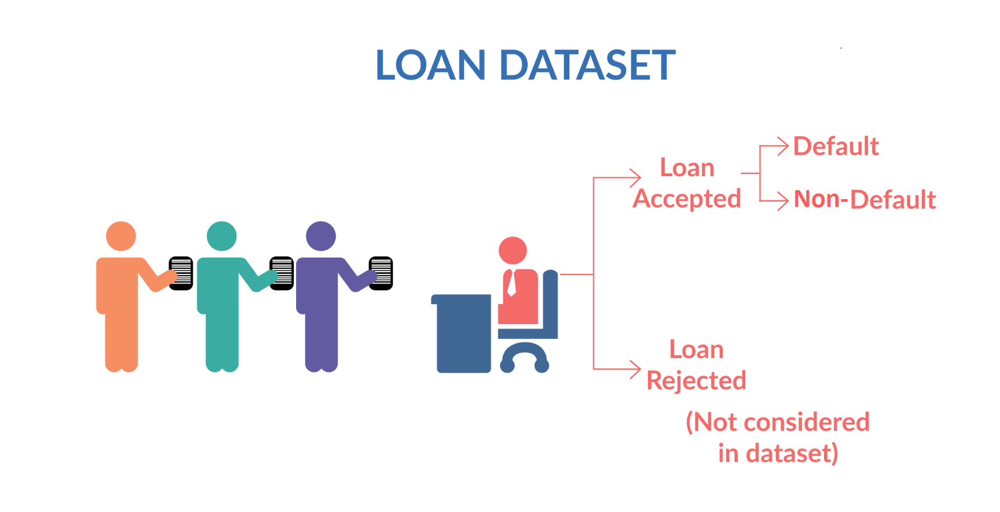
Diagram as per problem statement

Slide 6
To understand the meaning of variables the data dictionary was used
acc_now_delinq | The number of accounts on which the borrower is now delinquent.
acc_open_past_24mths | Number of trades opened in past 24 months.
addr_state | The state provided by the borrower in the loan application
all_util | Balance to credit limit on all trades
annual_inc | The self-reported annual income provided by the borrower during registration.
annual_inc_joint | The combined self-reported annual income provided by the co-borrowers during registration

Slide 7
Understanding Data
The code snippets in subsequent slides provide various methods to explore and understand the structure and content of a DataFrame named `loan_df`.
First, is configured to display all columns without truncation. Then the `shape` method is used to retrieve the dimensions of the DataFrame, giving the total count of rows and columns. The `info()` method provides details about the DataFrame, such as data types and non-null counts. `loan_df.columns` lists all column names.
The `describe()` method generates descriptive statistics for numeric columns. `loan_df.dtypes` returns the data type of each column.
Lastly, `loan_df.isnull().sum().sum()` calculates the total number of missing values across all columns, which totals 2,263,366 missing entries, indicating areas that may require data cleaning or imputation.
Many other steps are carried out till cell no. 146 which are commented in the python notebook

Slide 8
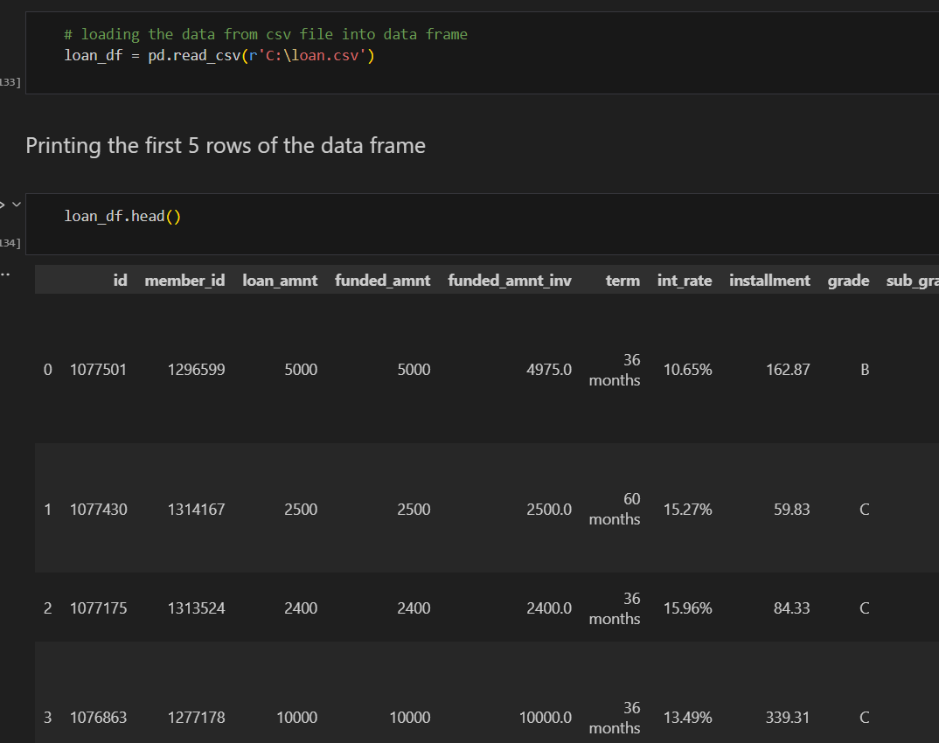
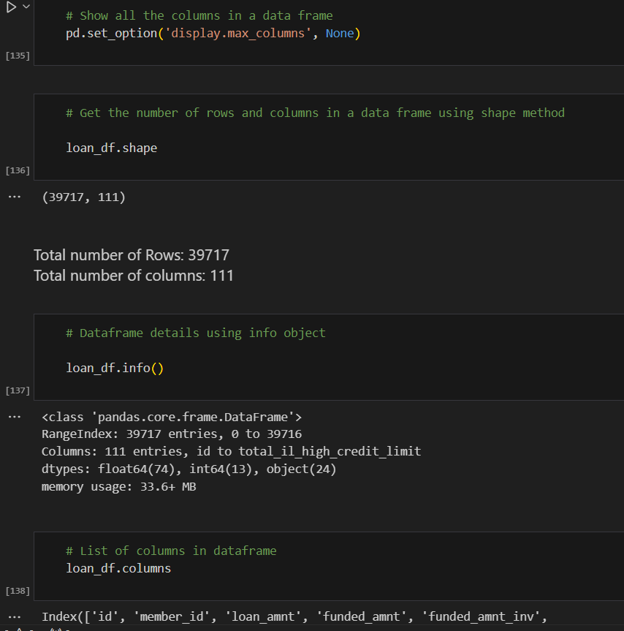
Understanding Data

Slide 9
Data Cleaning & Manipulation

Slide 10
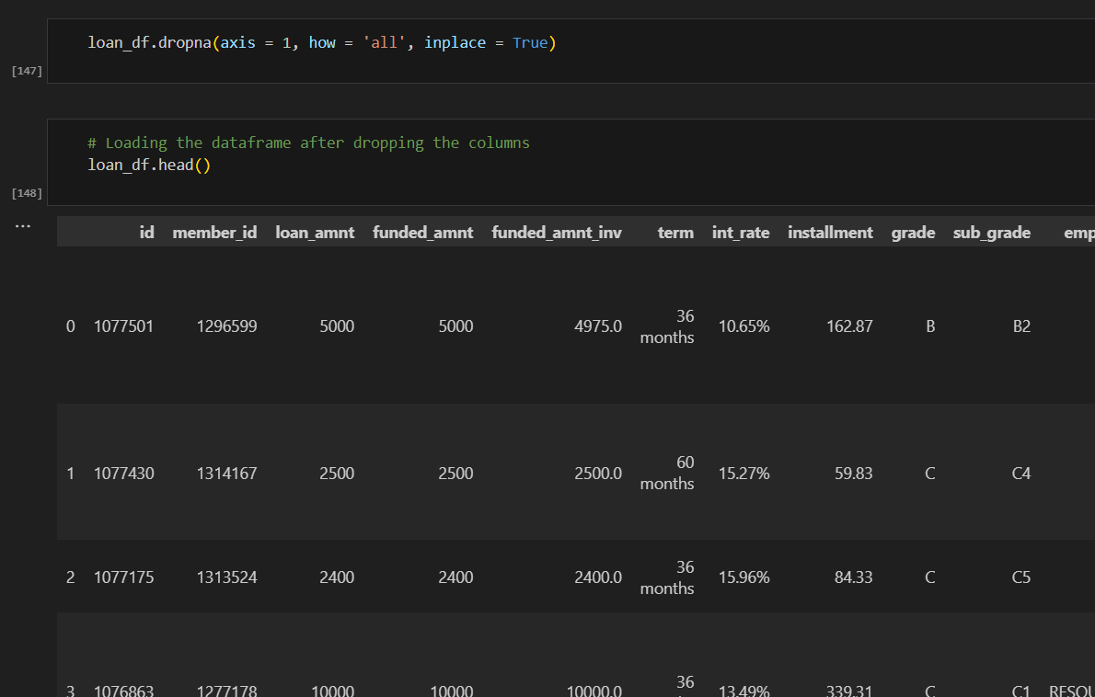
Step 1: Dropping the (54) Columns with all null values

Slide 11
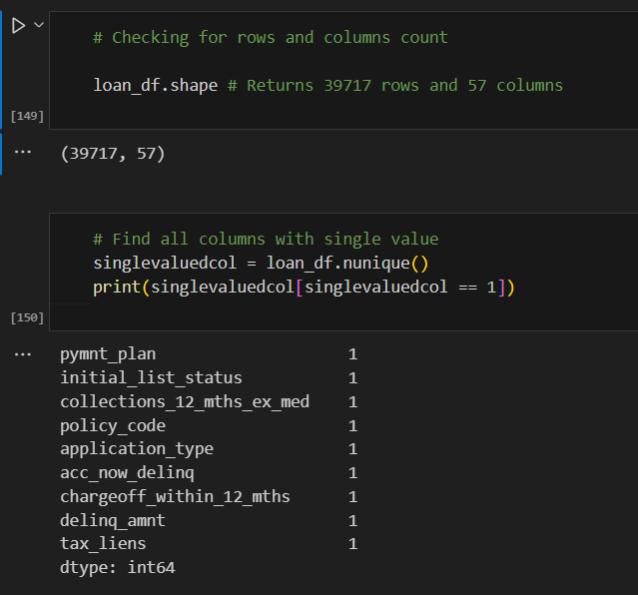
Step 1: Dropping the (54) Columns with all null values

Slide 12
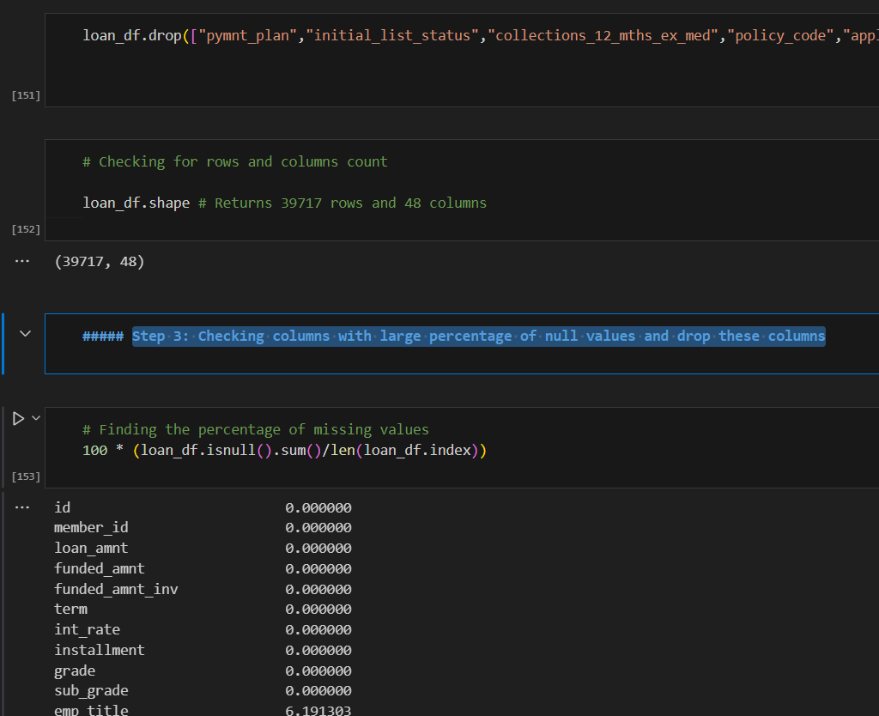
Step 2: Dropping columns with same values that is unique value count is 1

Slide 13
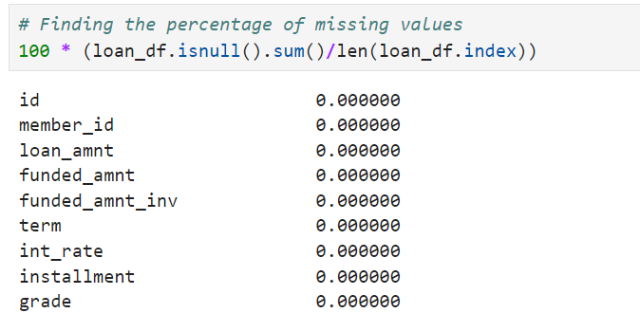
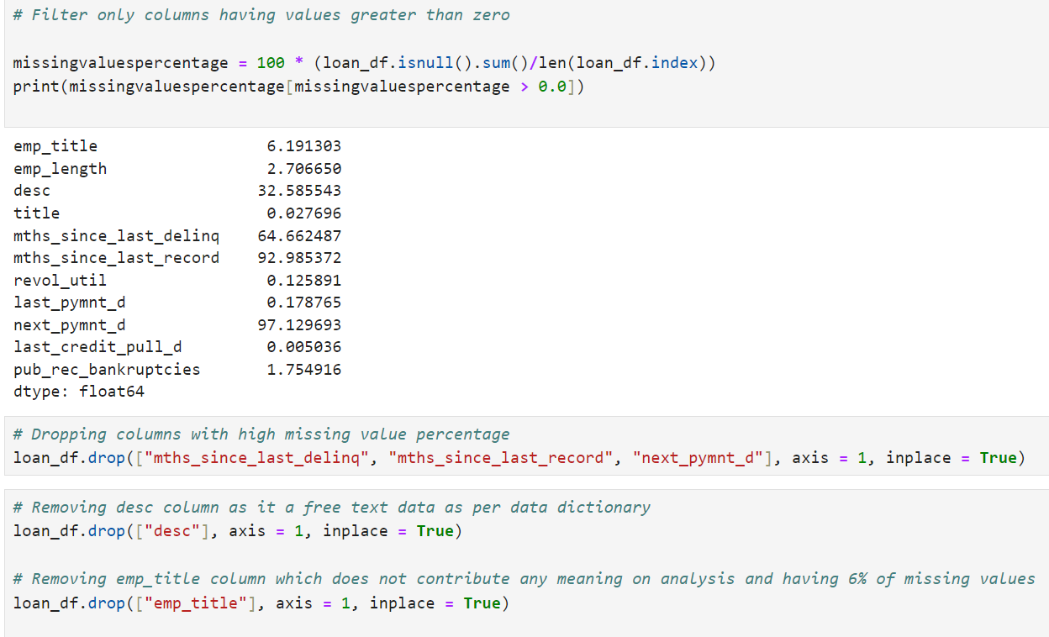
Step 3: Checking columns with large percentage of null values and drop these columns

Slide 14
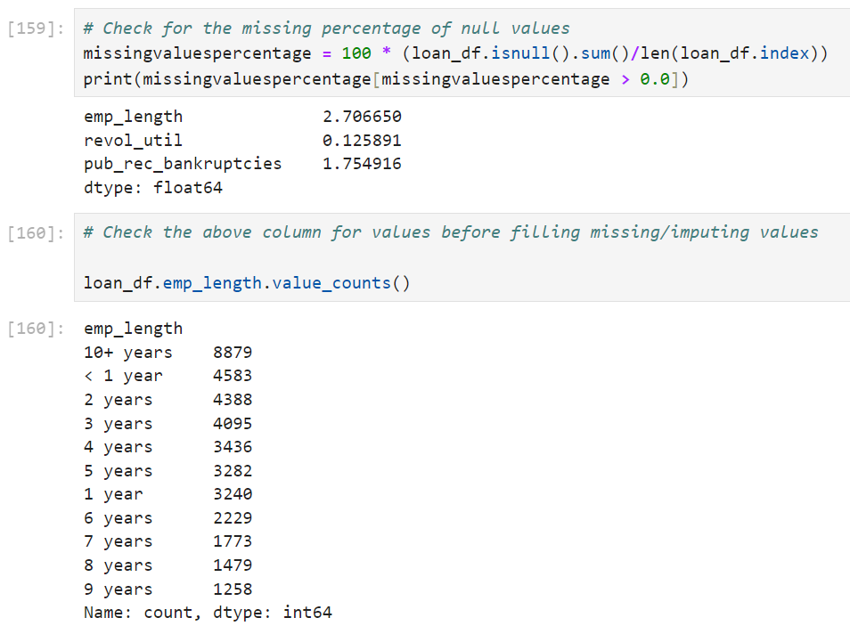
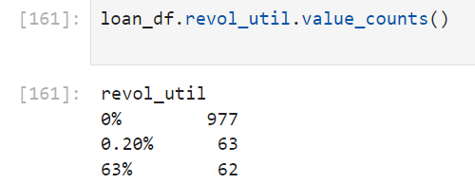
Step 4: Checking columns for the percentage of null values and fill missing values

Slide 15
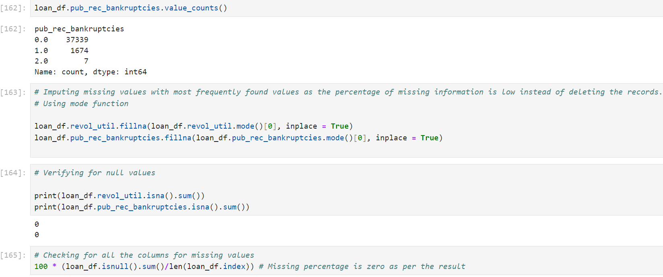
Step 4: Checking columns for the percentage of null values and fill missing values

Slide 16
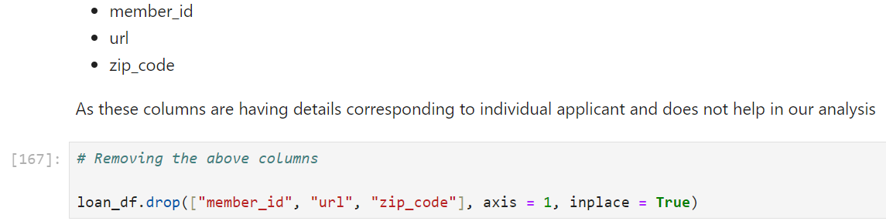
Step 5: Checking columns that are not necessary and dropping them.

Slide 17
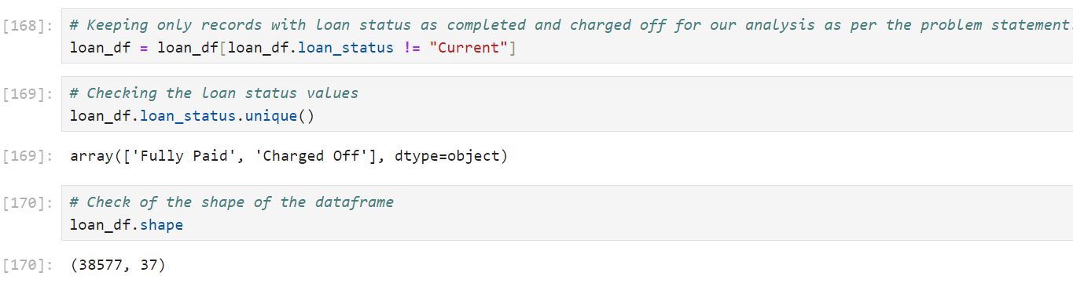
Step 6: Removing records that are not needed (Cleaning Rows)

Slide 18
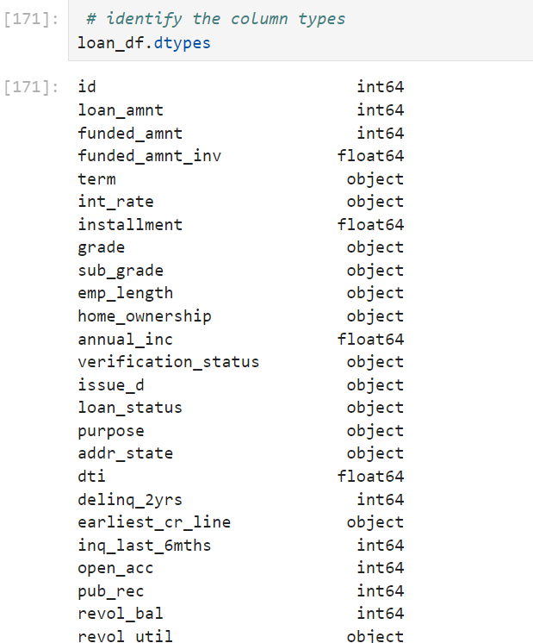
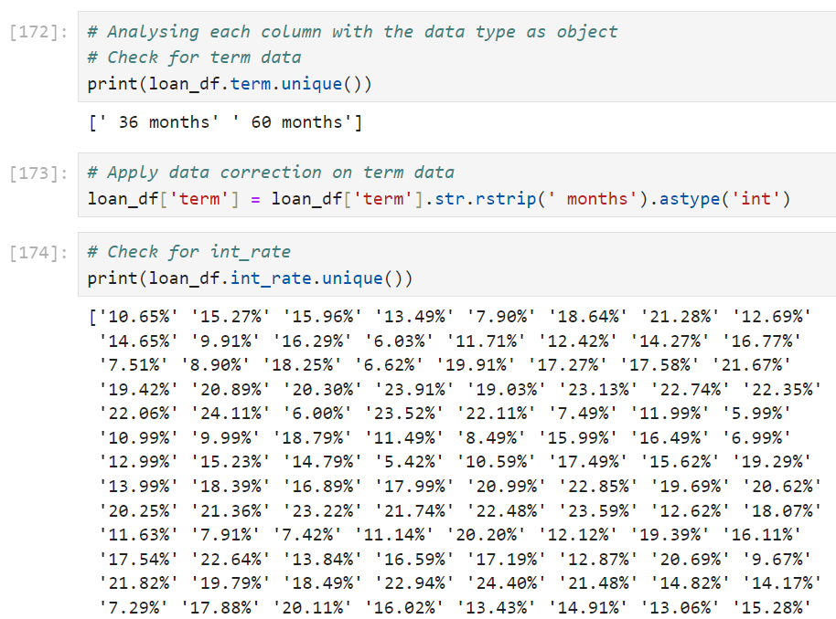
Step 7: Correcting the datatype and value of columns that are invalid
And several other steps up to cell 195

Slide 19
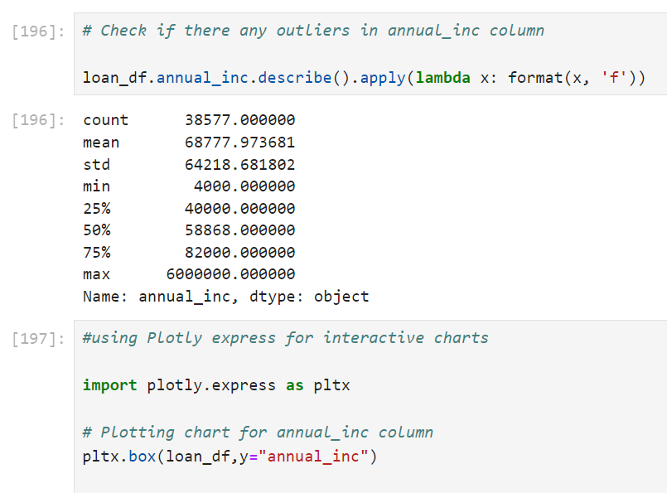
Step 8: Identifying Outliers and removing those records
And several other steps up to cell 207

Slide 20
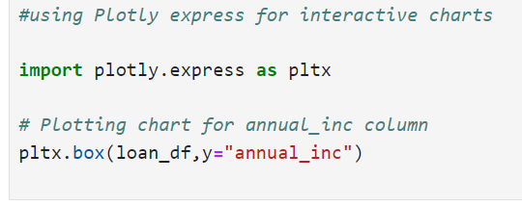
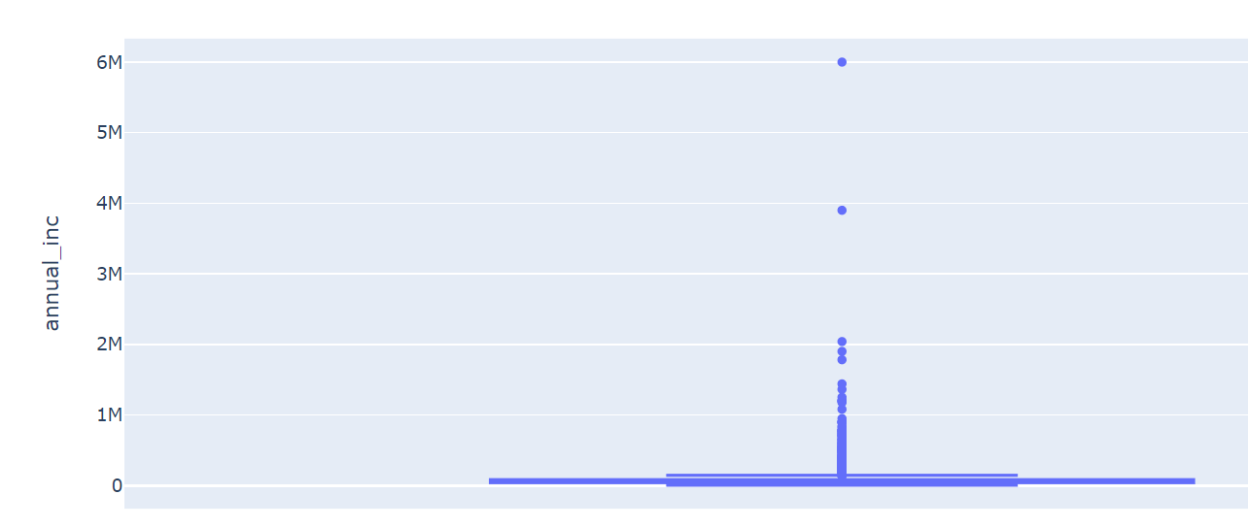
Step 8: Identifying Outliers and removing those records
And several other steps up to cell 207

Slide 21
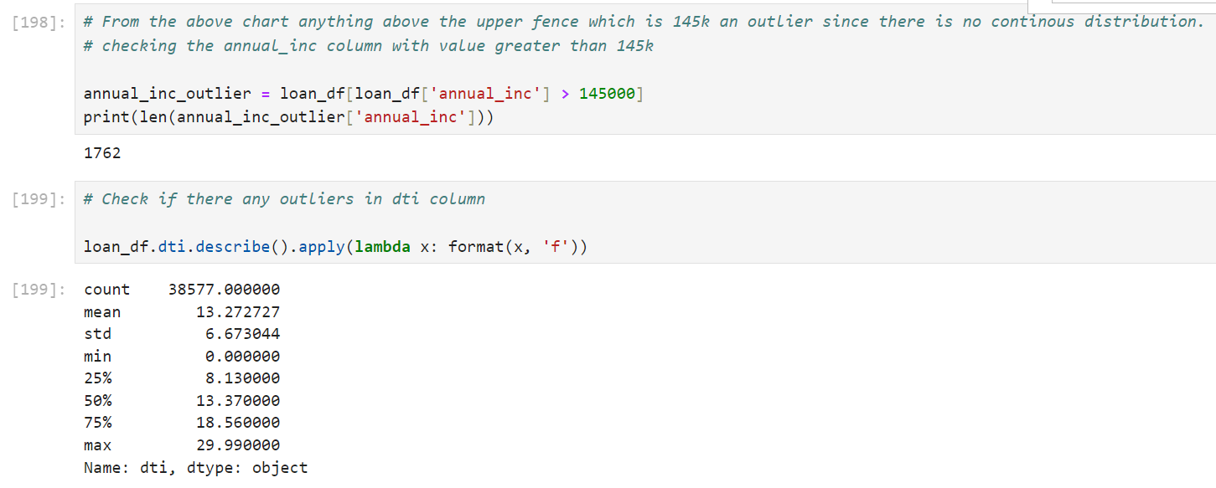
Step 8: Identifying Outliers and removing those records
And several other steps up to cell 207

Slide 22
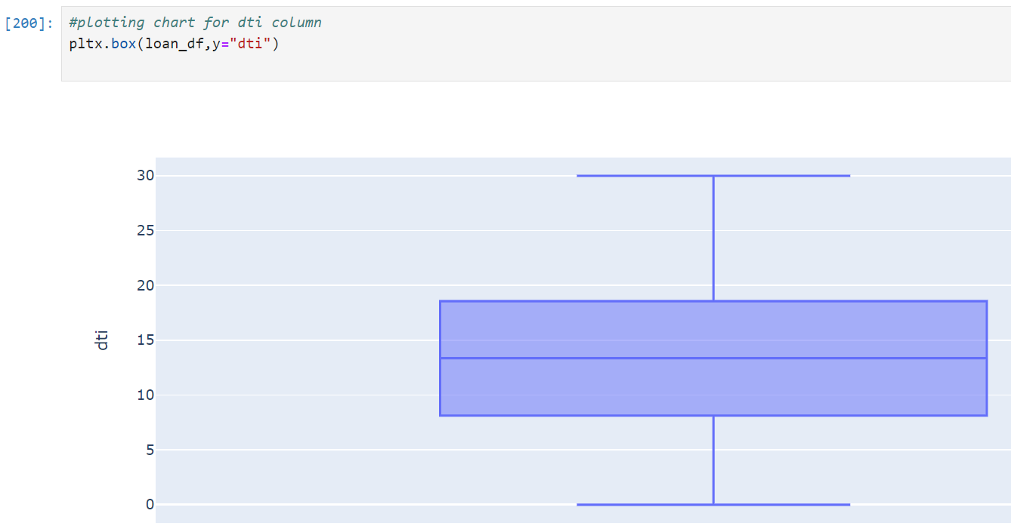
Step 8:For dti column we see the values are evenly spread hence no outliers cleanup required for this column
And several other steps up to cell 207

Slide 23
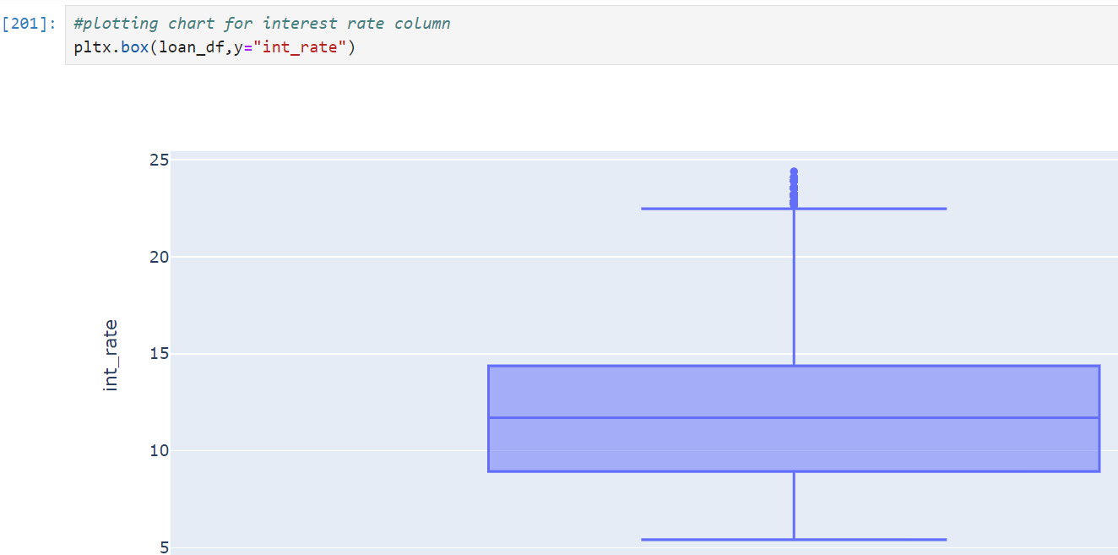
Step 8: Identifying Outliers and removing those records
For int_rate column we see the values are evenly spread with some outliers seen above the upper fence.
since the difference is not that huge we can skip the cleanup for this column.
And several other steps up to cell 207

Slide 24
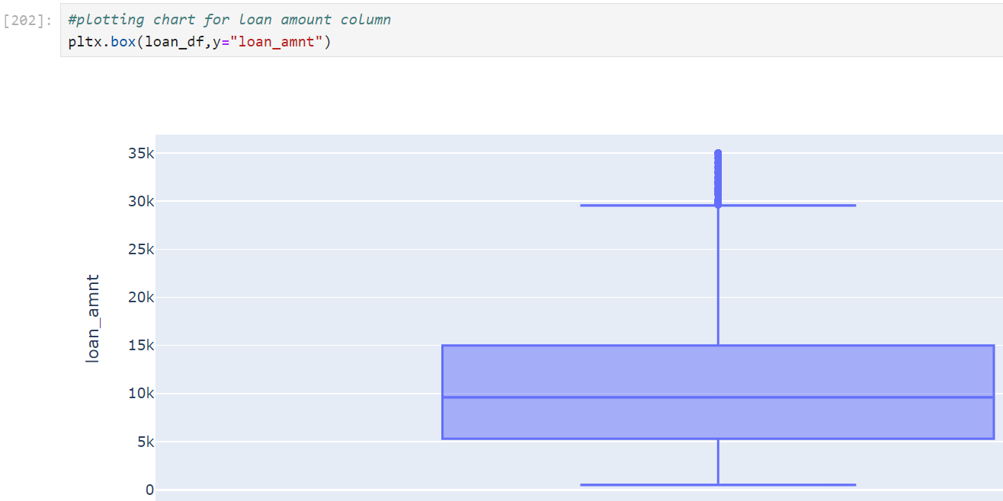
Step 8: Identifying Outliers and removing those records
For loan amount column we see the values are evenly spread with some outliers seen above the upper fence.
Since the difference is not that huge we can skip the cleanup for this column.
And several other steps up to cell 207

Slide 25
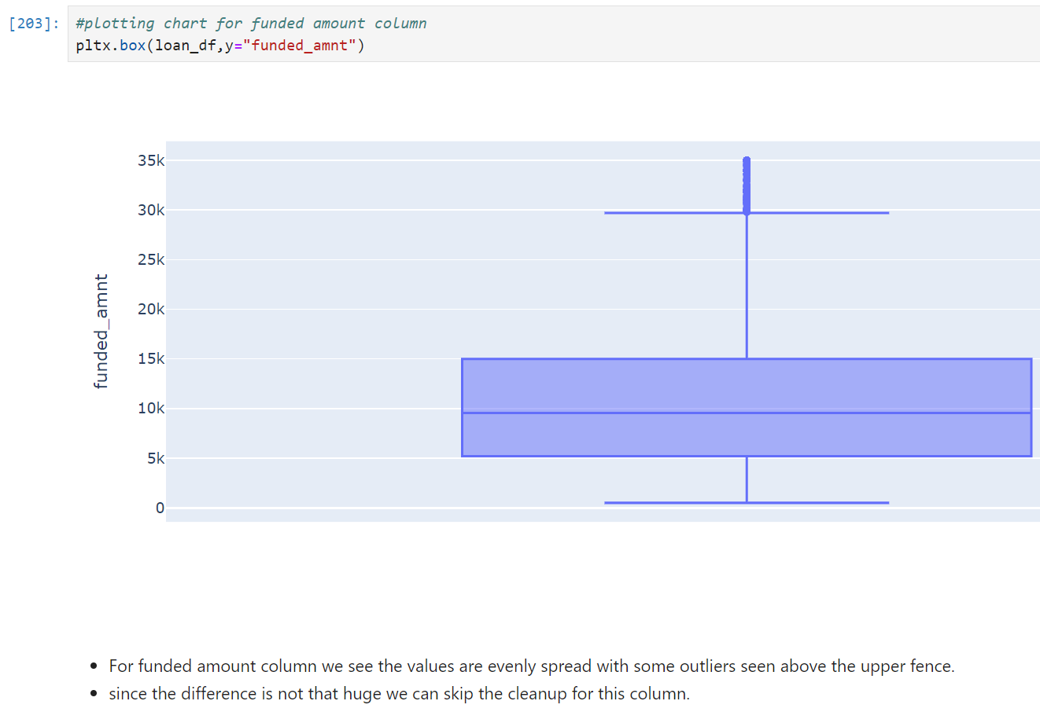
Step 8: Identifying Outliers and removing those records

Slide 26
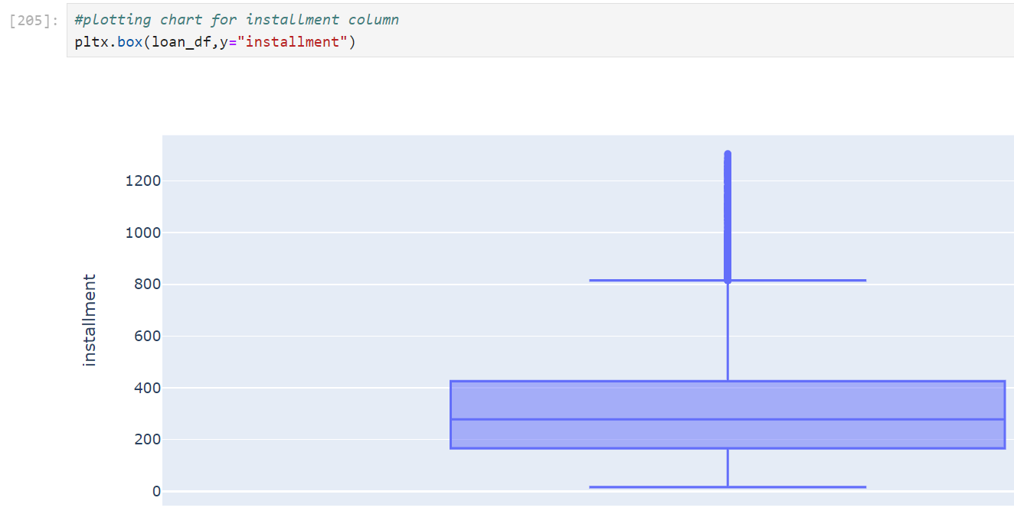
Step 8: Identifying Outliers and removing those records
For installment column we see the values are evenly spread with some outliers seen above the upper fence.
We see a huge difference between upper fence and max value but this column will not be that useful for our analysis
hence skipping cleanup of the outliers

Slide 27
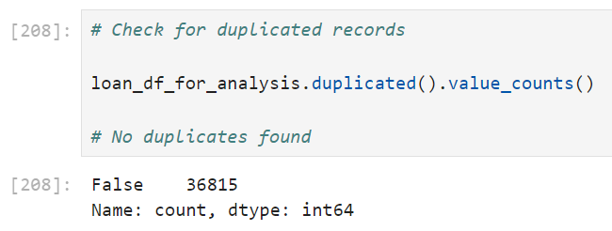
Step 9: Check for the duplicated records after cleanup activity
The code snippet checks for duplicated records in the `loan_df_for_analysis` DataFrame by applying the `.duplicated()` method, which identifies duplicate rows.
The `.value_counts()` method is then used to count how many rows are unique versus duplicates. The output indicates that there are 36,815 unique rows and no duplicates (`False` indicates no duplicates).
This confirms the data cleanup was effective, and the dataset is now ready for further analysis without redundancy issues.

Slide 28
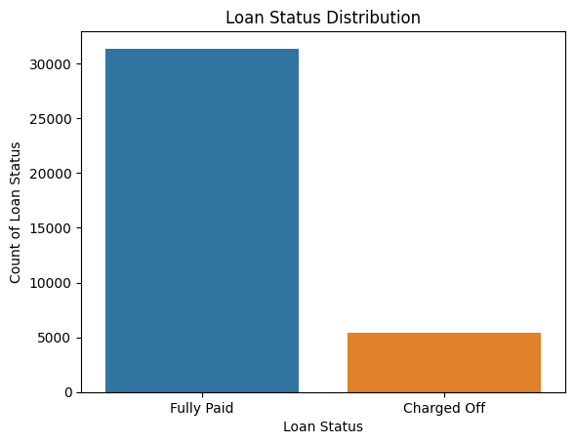
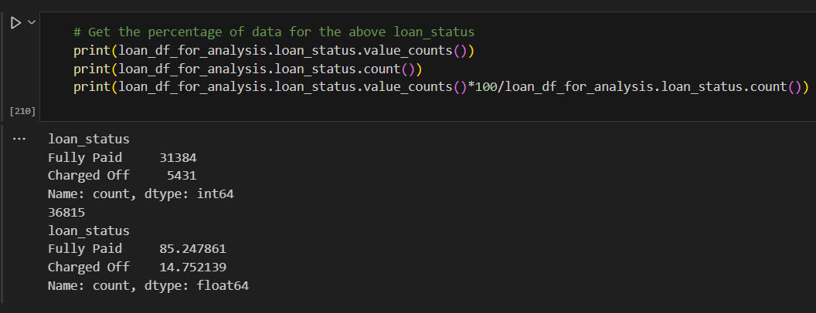
Univariate Analysis : Determining charged off loan percentage vs. fully paid.
As per the graph, charged off loan percentage is less compared to fully paid.

Slide 29
Categorical Variable Analaysis on Charged Off (Default Customers)

Slide 30
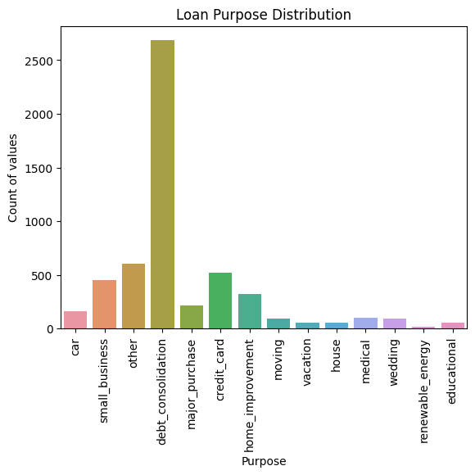
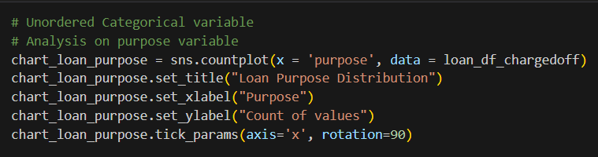
Observation 1: Majority of Charged off loans with "purpose" variable indicates that applicant took loans to pay off other debts

Slide 31
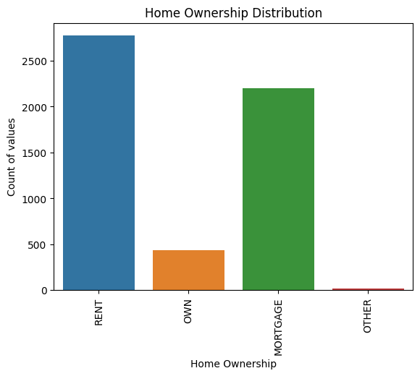
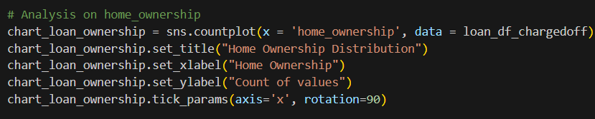
Observation 2: Majority of Charged off loans with "home_ownership" variable indicates that applicant either stayed in rent or mortgaged house

Slide 32
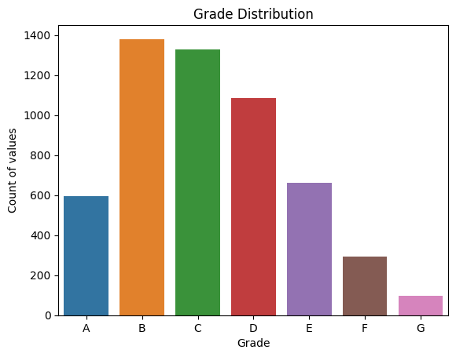
Observation 3: Majority of Charged off loans with "grade" variable indicates that applicant with grade "B" defaulted the most, followed by "C" & "D"
# Ordered Categorical variable
# Analysis on grade
chart_loan_grade= sns.countplot(x = 'grade', data = loan_df_chargedoff, order = ['A', 'B', 'C', 'D', 'E', 'F', 'G'])
chart_loan_grade.set_title("Grade Distribution")
chart_loan_grade.set_xlabel("Grade")
chart_loan_grade.set_ylabel("Count of values")

Slide 33
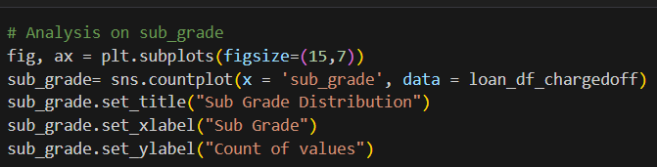
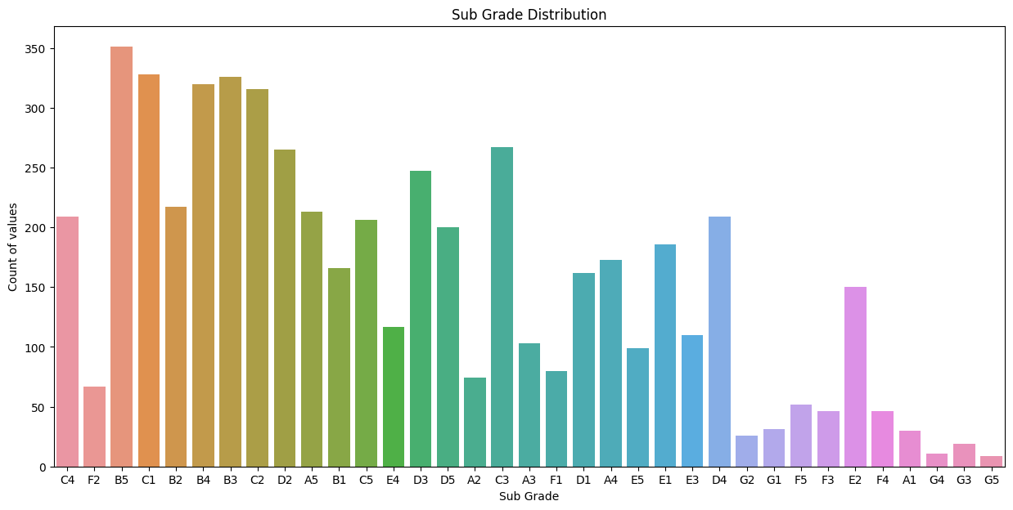
Observation 4: "sub_grade" variable indicates that applicant with sub grade "B5" defaulted the most, followed by "C2" & "D2"

Slide 34
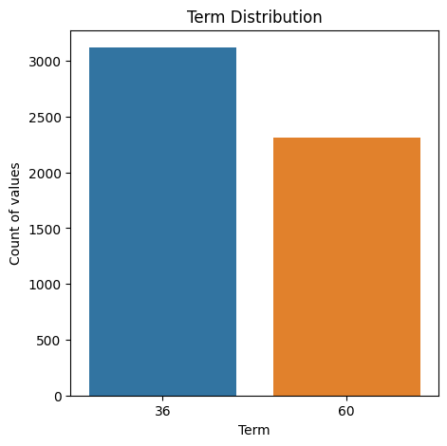
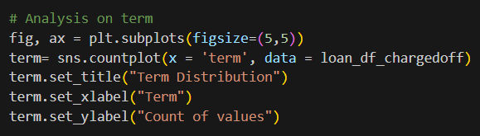
Observation 5: "term" variable indicates that the applicant with term of 36 months defaulted the most.

Slide 35
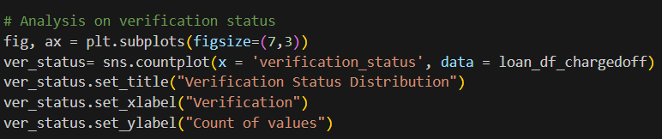
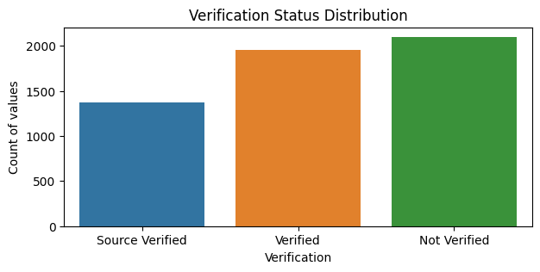
Observation 6: Borrowers whose income was not verified defaulted more then verified

Slide 36
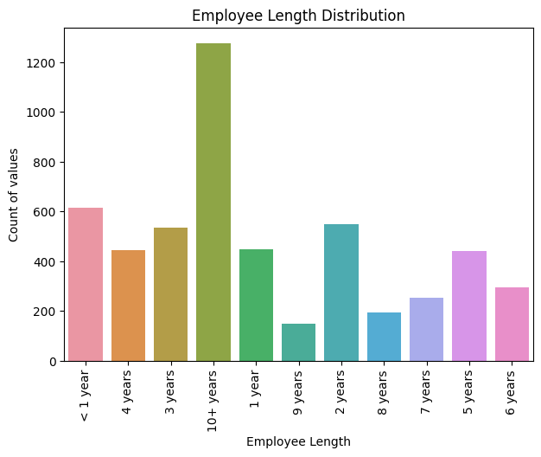
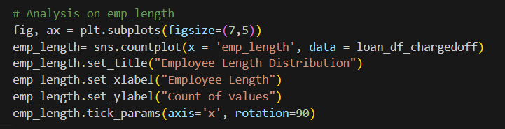
Observation 7: Numerical Variable Analaysis on Charged Off (Default Customers)
Borrowers whose experience is more 10 years or more defaulted the most.

Slide 37
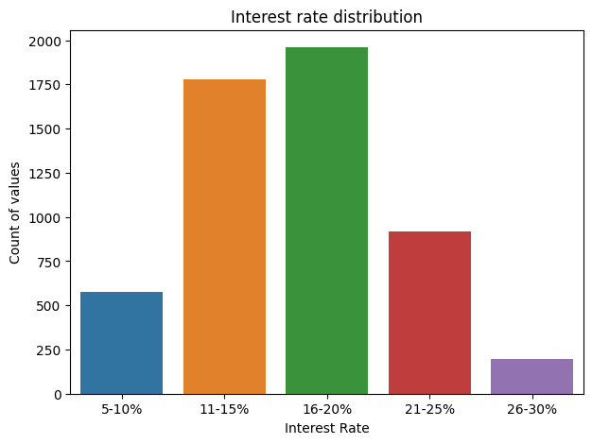
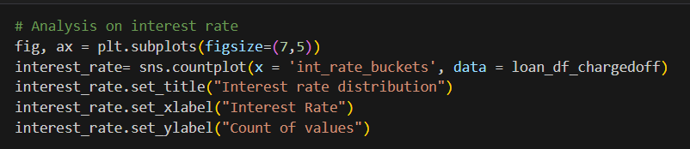
Observation 8: Borrowers who took loans at an interest rate between 16-20% defaulted the most.

Slide 38
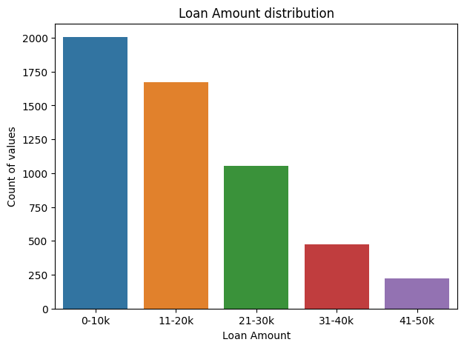
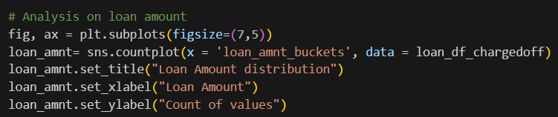
Observation 9: Borrowers who took loans amount between 0-10k defaulted the most.

Slide 39
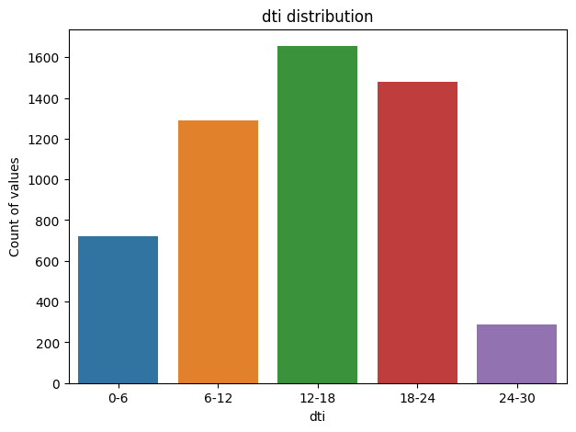
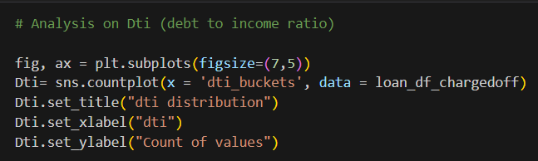
Observation 10: Borrowers with dti range between 12-18 defaulted the most

Slide 40
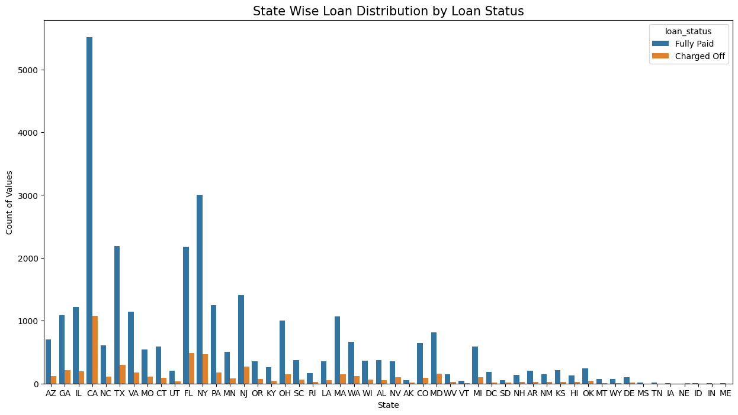
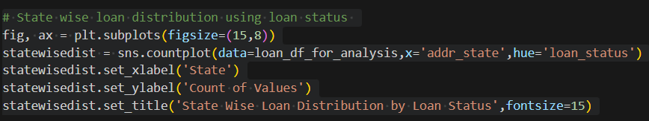
Segmented Univariate Analysis Observation 10: Most of the borrowers are from the state "CA","NY","TX" and "FL" where major defaulters are from "CA", "FL" and "NY".

Slide 41
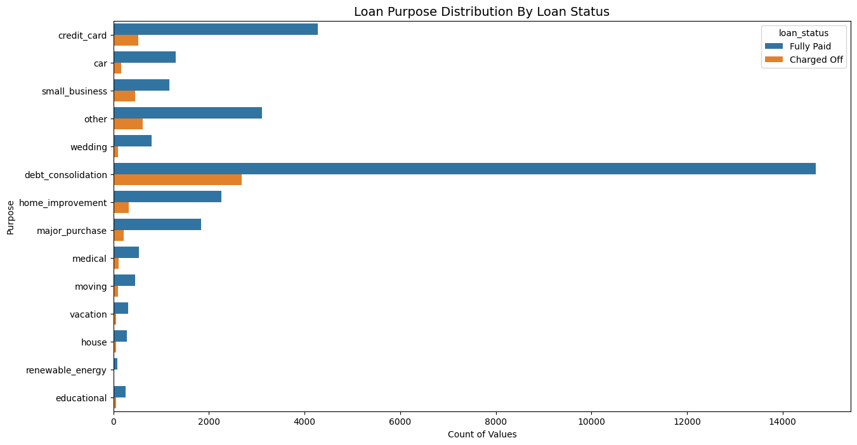
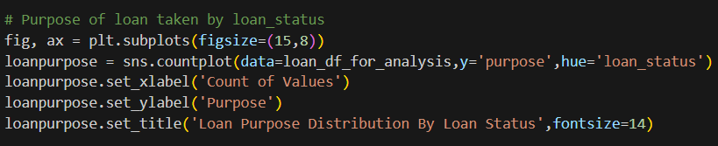
Observation 11: Debt consolidation is the major reason for both fully paid and charged off loan applicant.

Slide 42

Observation 12: DTI between 10-20 indicates a higher risks in terms of defaulters
# Dti (Debt to Income ratio) Vs Loan Status
fig, ax = plt.subplots(figsize=(7,5))
Dti = sns.histplot(data=loan_df_for_analysis,x='dti',hue='loan_status', bins=5,kde=True)
Dti.set_xlabel('DTI')
Dti.set_ylabel('Count of Values')
Dti.set_title('DTI By Loan Status',fontsize=12)

Slide 43

Observation 13: Interest Rate between 10-17.5 has more number of defaulters
# Interest Rate Vs Loan Status
fig, ax = plt.subplots(figsize=(7,5))
Interest_Rate = sns.histplot(data=loan_df_for_analysis,x='int_rate',hue='loan_status', bins=15,kde=True)
Interest_Rate.set_xlabel('Interest Rate')
Interest_Rate.set_ylabel('Count of Values')
Interest_Rate.set_title('Interest Rate By Loan Status',fontsize=12)

Slide 44

Observation 14: Borowwers with Annual Income greater than 20K and less than 50k are more prone to default.
# Annual Income Vs Loan Status
fig, ax = plt.subplots(figsize=(7,5))
Annual_Income = sns.histplot(data=loan_df_for_analysis,x='annual_inc',hue='loan_status', bins=10,kde=True)
Annual_Income.set_xlabel('Annual Income')
Annual_Income.set_ylabel('Count of Values')
Annual_Income.set_title('Annual Income By Loan Status',fontsize=12)

Slide 45

Categorical Bivariate Analysis Observation 15:
# On Employee Length and Home Ownership
# Creating a cross tab
cross_emplen_homeowner = pd.crosstab(loan_df_chargedoff['emp_length'],loan_df_chargedoff['home_ownership'])
fig, ax = plt.subplots(figsize=(7,5))
emplen_homeowner = sns.heatmap(cross_emplen_homeowner, fmt='d', cmap='Purples', annot=True)
emplen_homeowner.set_xlabel('Home Ownership')
emplen_homeowner.set_ylabel('Employee Length')
emplen_homeowner.set_title('Employee Length Vs Home Ownership',fontsize=12)
Observation 15:
Borrowers who have more than 10+ years of experience and live on rent or mortgages have high default rate

Slide 46

Observation 16: Borrowers with assigned grade B,C & D fall in higher catergory of defaulters
# On Home Ownership Vs Grade
# Creating a cross tab
cross_grade_homeowner = pd.crosstab(loan_df_chargedoff['home_ownership'], loan_df_chargedoff['grade'])
fig, ax = plt.subplots(figsize=(7,5))
cross_grade_homeowner = sns.heatmap(cross_grade_homeowner, fmt='d', cmap='BuPu', annot=True)
cross_grade_homeowner.set_xlabel('Grade')
cross_grade_homeowner.set_ylabel('Home Ownership')
cross_grade_homeowner.set_title('Home Ownership Vs Grade',fontsize=12)

Slide 47

Observation 17: Borrowers staying on Rent and with shorter loan term tend to default more.
# Home Ownership Vs Loan Term
# Creating a cross tab
ctab_term_homeownership = pd.crosstab(loan_df_chargedoff['term'], loan_df_chargedoff['home_ownership'])
fig, ax = plt.subplots(figsize=(7,4))
ctab_term_homeownership = sns.heatmap(ctab_term_homeownership, annot=True, fmt='d', cmap='YlGnBu')
ctab_term_homeownership.set_xlabel('Home Ownership')
ctab_term_homeownership.set_ylabel('Loan Term')
ctab_term_homeownership.set_title('Home Ownership Vs Loan Term',fontsize=15)

Slide 48


Numerical Bivariate Analysis Observation 18:
Observation 18:
As per the above data points we see can interest rate is high for the charged off loan_status compared to fully paid.

Slide 49


Numerical Bivariate Analysis Observation 19:
Interest rate vs delinq
It is observed that 2-year delinq with value 6 has the highest interest rate.

Slide 50

Using pair plot for understanding the distribution accross different numerical variables
sns.pairplot(loan_df_chargedoff, vars=['revol_util', 'int_rate', 'loan_amnt', 'dti', 'annual_inc'])

Slide 51


Multivariate Analysis
The code generates a heatmap visualizing the correlation among 'loan_amnt', 'annual_inc', and 'int_rate' within `loan_df_chargedoff`.
It selects these numerical columns, computes their correlation matrix, and uses Seaborn's `heatmap` function to display the results with annotations, helping identify relationships between these financial variables.

Slide 52

Multivariate Analysis
This code snippet visualizes the correlation among selected financial attributes—loan amount, annual income, installment, interest rate, debt-to-income ratio (DTI), and delinquencies over the past two years—for loans that have been charged off.
It defines these attributes in a list, calculates their correlation matrix from the `loan_df_chargedoff` DataFrame, and then uses Seaborn's `heatmap` function to create a heatmap. Annotations are enabled to display the correlation coefficients on the heatmap. The `plt.show()` function is used to display the plot.

Slide 53

Multivariate Analysis
By calculating and visualizing the correlation matrix for these variables from the loan_df_chargedoff DataFrame, the code helps identify stronger or newer relationships that could impact the likelihood of a loan charge-off, enhancing the understanding of factors influencing loan defaults.
The annot=True parameter in the heatmap function ensures that correlation values are displayed on the heatmap, making it easier to interpret the relationships visually.

Slide 54


Observation 20: Maximum charged off loans were issued in the month of Dec
The code creates a line plot to visualize the distribution of charged-off loans by month using Matplotlib and Seaborn.
It sets the figure size, plots 'loan_amnt' against 'loan_issue_month' from `loan_df_chargedoff`, and labels the axes and title, helping identify the peak month for loan defaults.

Slide 55


Obsevation 21: Maximum charged off loans were issued in the year 2011

Slide 56
Conclusion
The completion of this assignment has provided an understanding of how real business problems are addressed using EDA. In this case study, techniques learned in EDA were applied, and a basic comprehension of risk analytics in banking and financial services was developed. It was also understood how data is utilized to minimize the risk of financial losses while lending to customers.
The data provided contains information about past loan applicants and whether they defaulted or not. The aim was to identify patterns that indicate whether a person is likely to default, which could be used for taking actions such as denying the loan, reducing the loan amount, or lending to risky applicants at a higher interest rate.
In this case study, EDA was utilized to understand how consumer attributes and loan attributes influence the tendency to default.

