Slide 1

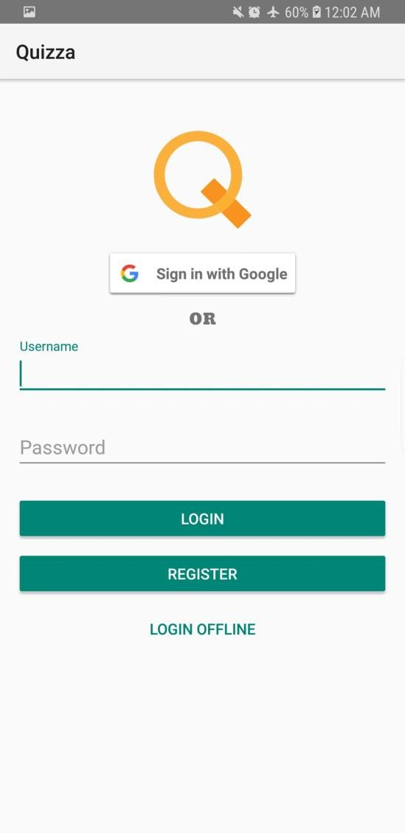
Quizza
An overview of the development and
planning process

Slide 2
Objective and Features
◆ Modern and interactive approach to learning

Slide 3
Objective and Features
◆ Modern and interactive approach to learning
◆ Creatable user accounts

Slide 4
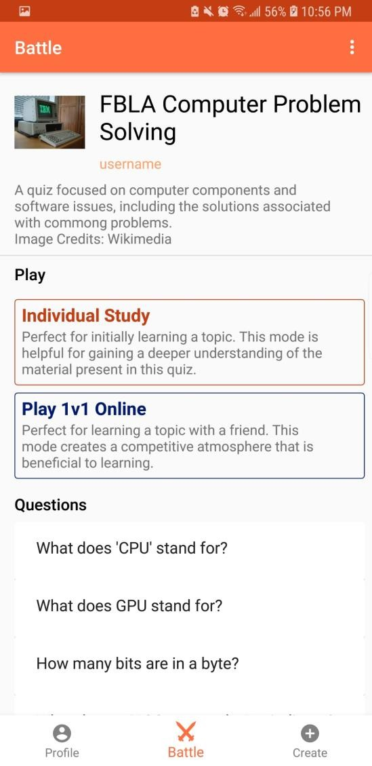
Objective and Features
◆ Modern and interactive approach to learning
◆ Creatable user accounts
◆ Online and offline quiz creation and battles

Slide 5
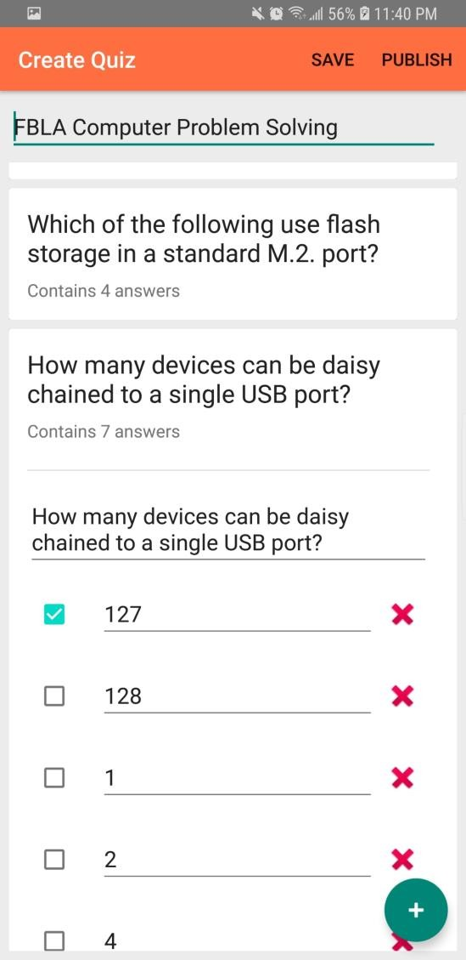
Objective and Features
◆ Modern and interactive approach to learning
◆ Creatable user accounts
◆ Online and offline quiz creation and battles
◆ In-app quiz editor

Slide 6
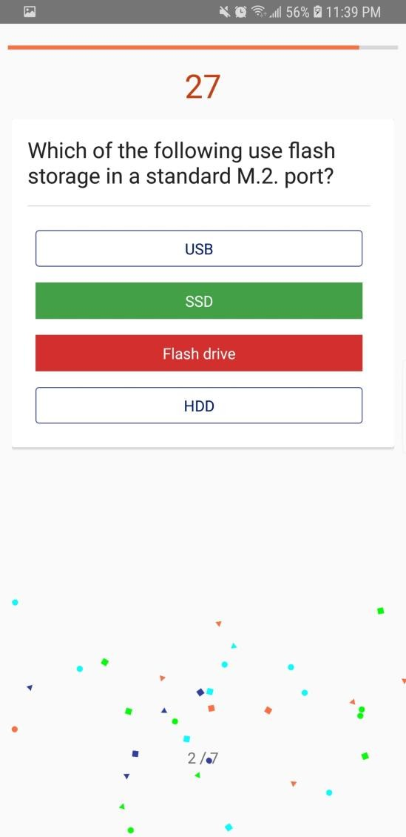
Objective and Features
◆ Modern and interactive approach to learning
◆ Creatable user accounts
◆ Online and offline quiz creation and battles
◆ In-app quiz editor
◆ Instant feedback on answers
◆ Easy-to-use bug reporting system

Slide 7
App Usefulness
◆ Target Audience: FBLA members
◆ Benefits:
◆ Modern and interactive method of learning
◆ Multiplayer offers a competitive setting
◆ In app creation of quizzes allows for the sharing of knowledge

Slide 8
App Usefulness
◆ Target Audience: FBLA members
◆ Effects:
◆ FBLA members will get higher scores in events
◆ FBLA members will gain an additional method of interaction with the organization
◆ FBLA members will gain a deeper understanding of FBLA and its goals and vision

Slide 9
Code Design and Planning
◆ Strategies
◆ Offline First Approach
◆ Dependency Injection
◆ Feature Based Approach
◆ Model View ViewModel (MVVM)
◆ Decoupled Classes
◆ Object Oriented Approach

Slide 10
ViewModel
View
Model
Project Structure - App

Slide 11
Game Server
Connects to
MongoDB
ViewModel
API
Connects to
MongoDB
View Model
Project Structure - Project

Slide 12
User Interface Planning
◆ Goals:
◆ Modern
◆ Intuitive
◆ Extensive user testing took place
◆ Planning included mock layouts and design sketches

Slide 13


Alternate Platforms – iOS/Swift
Pros
◆ Most users are on the latest version
◆ Device compatibility issues are limited
Cons
◆ Development requires an Mac development machine
◆ Closed nature of the app store

Slide 14


Alternate Platforms – Flutter/Android+iOS
Pros
◆ Cross-Platform (supports iOS and Android)
◆ Hot-reload capabilities, allowing
for quick development cycles
Cons
◆ At the start of development of Quizza, Flutter was still in alpha

Slide 15

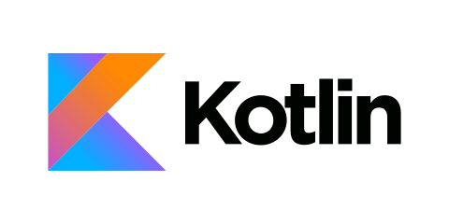
Alternate Platforms – Kotlin/Android
Pros
◆ Can be compile to support cross- platform use
◆ Language features enable quick
development
◆ Large number of compatible resources
Cons
◆ Slower compilation times

Slide 16
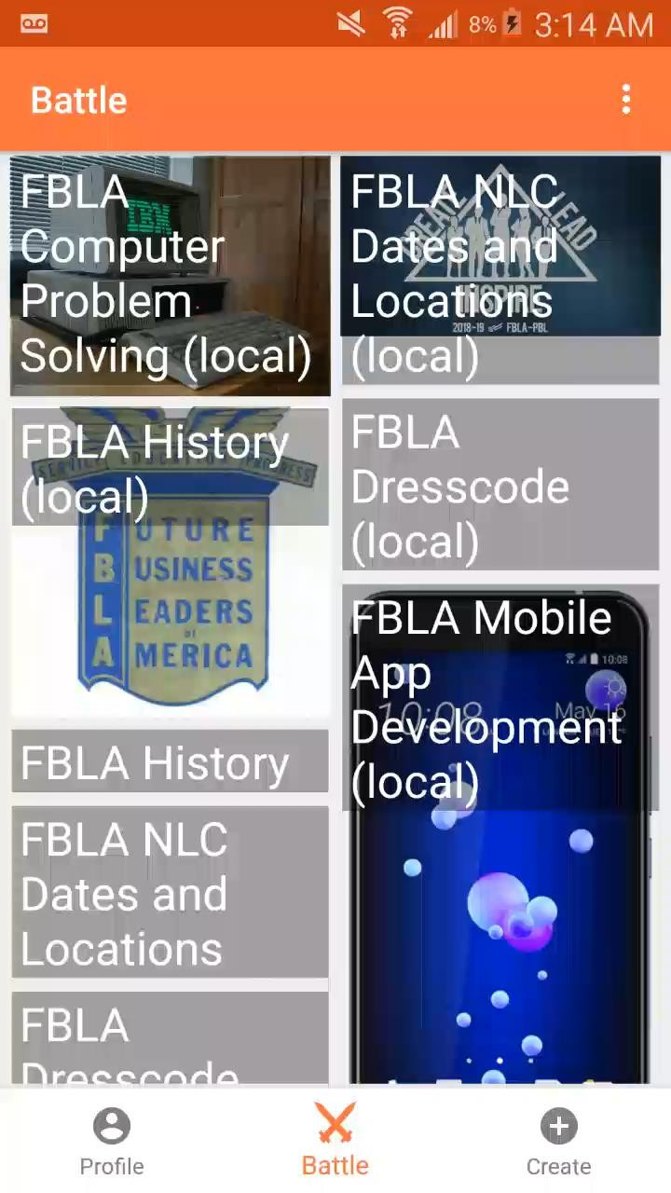
Example Usage – Offline Play

Slide 17
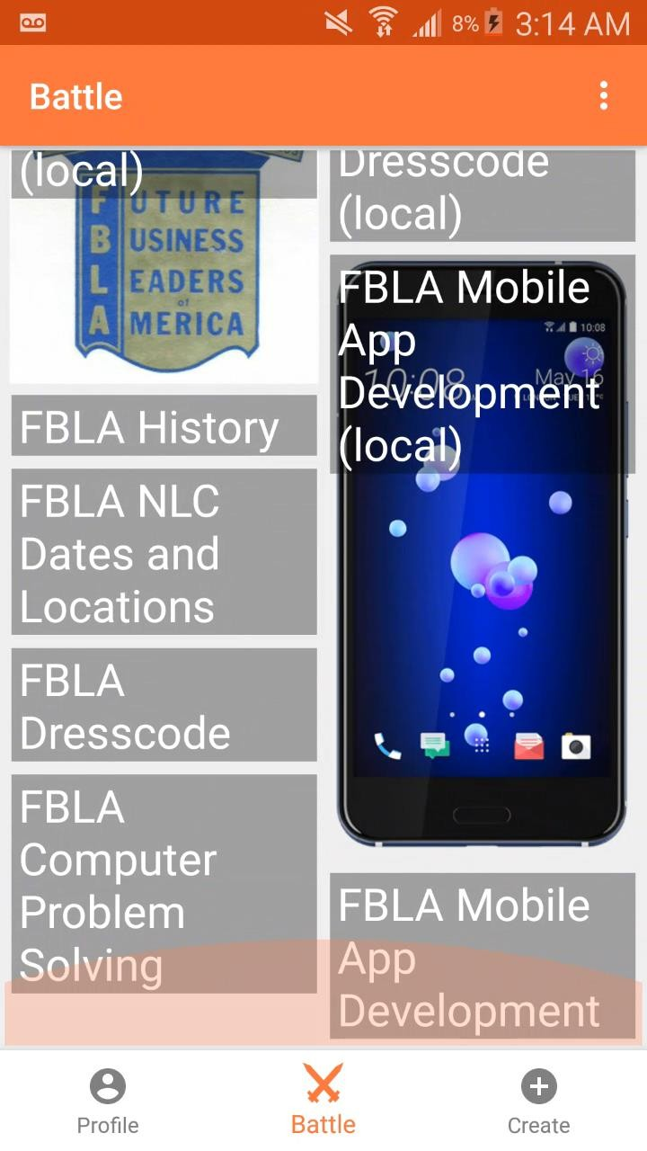

Slide 18
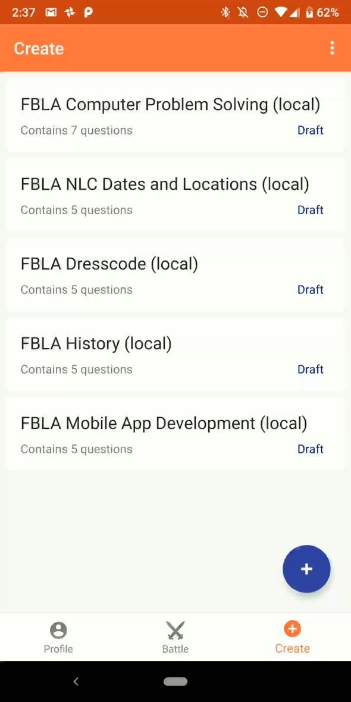
Example Usage – Quiz Creation

Slide 19
