Slide 1
Welcome
Topic:-Image classification and manipulation in python using machine learning
Academic Year 2019-2020
Department of computer science and engineering
Submitted By:krishna kakade
Roll no:36017(TE-A)
Subject:-Machine Learning using python/r
Teachers Sign:

Slide 2
Image Classification in python
In this section first i imported tensorflow and numpy from tensorflow i imported keras library for accessing data images from ibuilt dataset
Command for accessing data=fashion_mnist=keras.datasets.fashion_mnist
(train_images, train_labels), (test_images, test_labels) = fashion_mnist.load_data()
After that i accessed images by their class names and after that showed py using plt.show()
After that i preprocessed that data and setupping the layers image flattening and other operations are done
After that model compilation means using sparse_categorical_crossentropy we can classify multiclass tasks using that
Then i setted epoches for number of time that learning algorithm work after that plotted images using functions

Slide 3
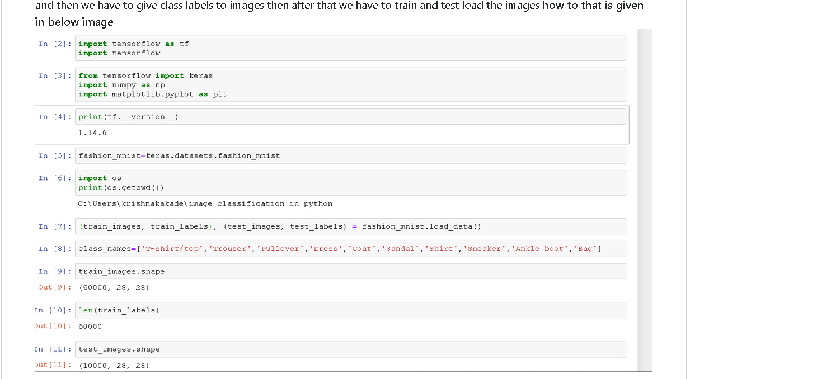
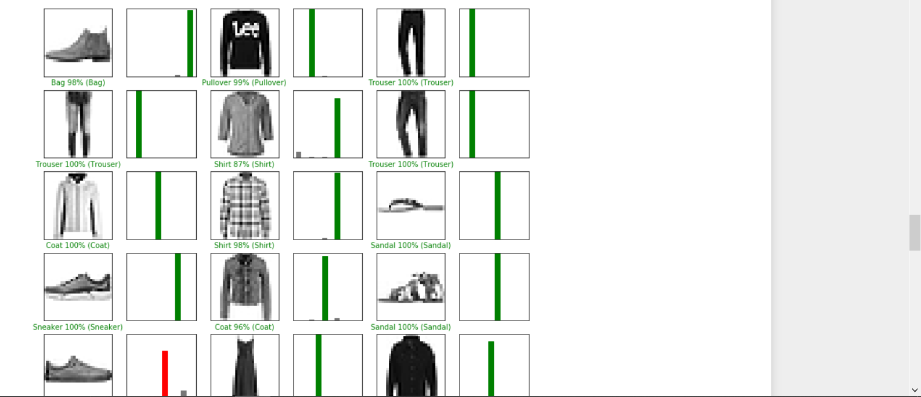
Code Snippets/images

Slide 4
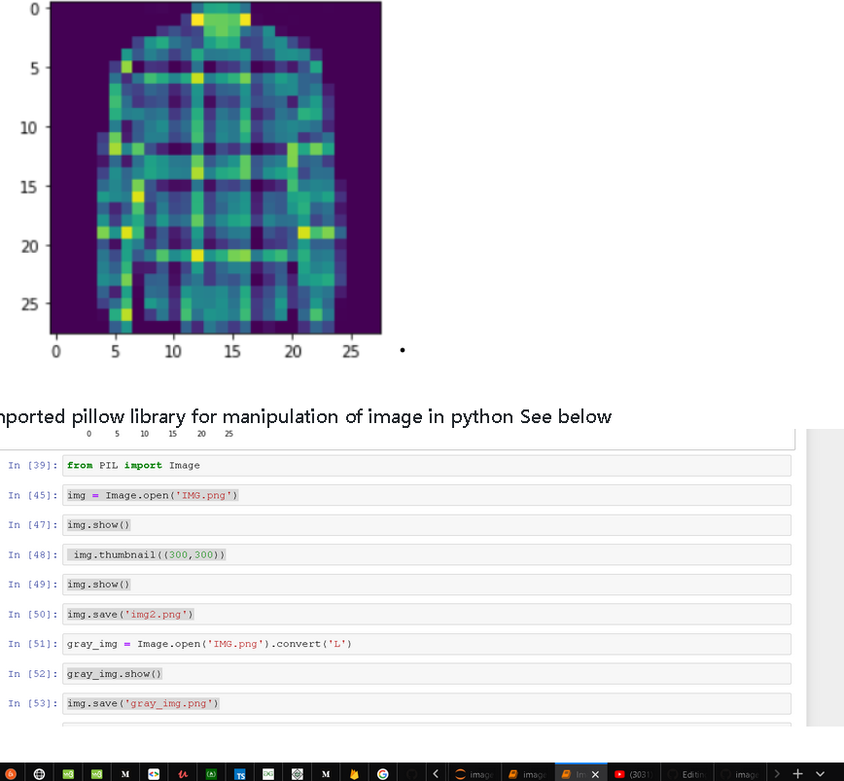
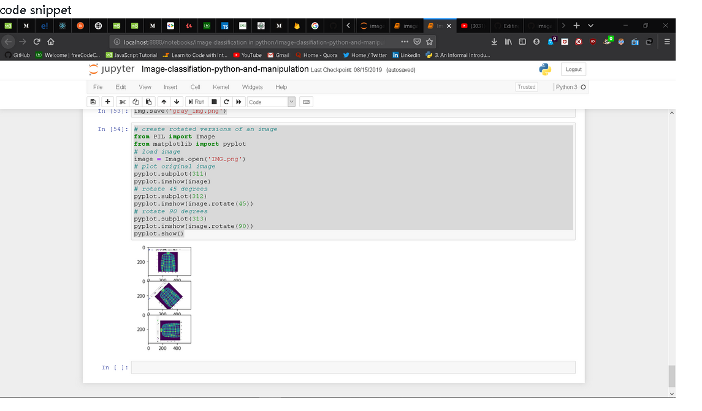
Image manipulation in python
In this section i simply performed manipulation on images using pillow library in python see below images how it works

Slide 5
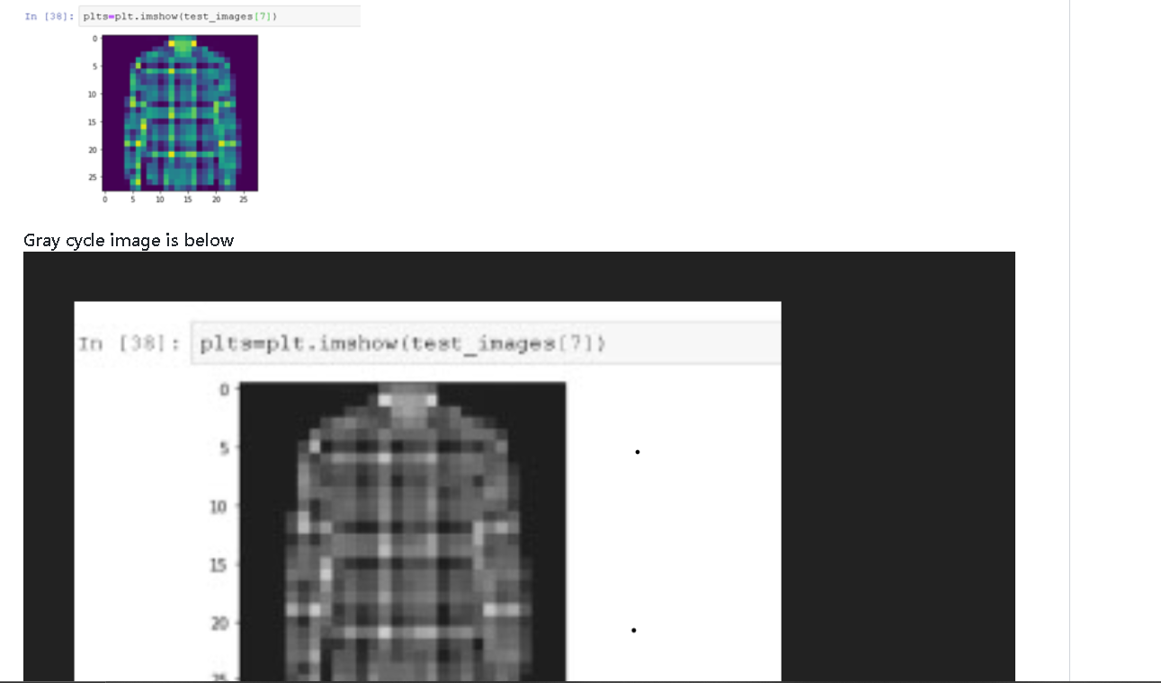
Output images of image manipulation

Slide 6
Thank you

