Slide 1

Real world application of RSA Algorithm
By Victor Mayekar & Akash Nair

Slide 2
Introduction
The RSA algorithm, named after its inventors, Ron Rivest, Adi Shamir, and Leonard Adleman, stands as a cornerstone of modern cryptography
It plays a pivotal role in securing our digital world
In this presentation, we will delve into the real-world applications of the RSA algorithm and understand how it contributes to secure communication in the digital age

Slide 3
How It Works
Key Components: Public key and private key are vital
Mathematics: RSA relies on modular exponentiation, a secure but computationally intensive operation
Prime Numbers: Security hinges on the difficulty of factoring the modulus, a product of two large prime numbers

Slide 4
Encryption Process
Encryption Process
Preparation: The sender prepares to send a secure message.
Recipient's Public Key: The sender uses the recipient's public key for encryption.
Message Encryption: The sender encrypts the message using the public key.
Secure Transmission: The encrypted message can safely travel through public networks.
Recipient's Private Key: Only the recipient, with their private key, can decrypt and read the message.
Security Strength: The encryption process relies on the difficulty of factoring large numbers, ensuring high security.
Data Protection: RSA encryption guarantees data confidentiality during transmission.

Slide 5
Decryption Process
Decryption Process
Access Encrypted Data: Recipient gains access to encrypted data, often a received message or file.
Private Key: Recipient uses their confidential private key corresponding to the sender's public key.
Mathematical Operation: A complex mathematical operation is applied, decrypting the message.
Original Message: The result is the original, readable message.
Private Key Security: The private key must be kept secure to maintain the integrity of the decryption process.
Data Confidentiality: RSA encryption ensures data remains confidential, even if intercepted during transmission.

Slide 6
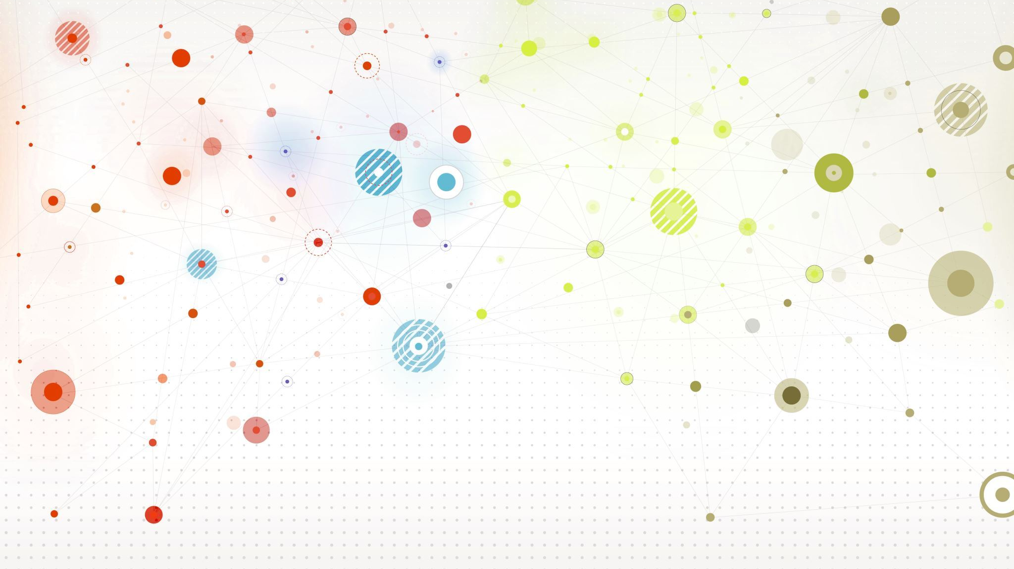
Real-World Applications

Slide 7
RSA SecureID Authentication
Combines "something you know" (username and PIN/password) with "something you have" (physical or software-based token).
Tokens generate a new six-digit code every minute based on a unique secret key and current time.
Users enter the current token-generated code for authentication.
Where RSA SecureID is Used:
Corporate Networks: Used for securing remote access to corporate networks.
Web Applications: Integrated into web apps and online services for enhanced security.
Cloud Services: Ensures secure access to sensitive data in cloud storage.
RSA SecureID provides robust authentication for various applications and services, enhancing overall security.

Slide 8
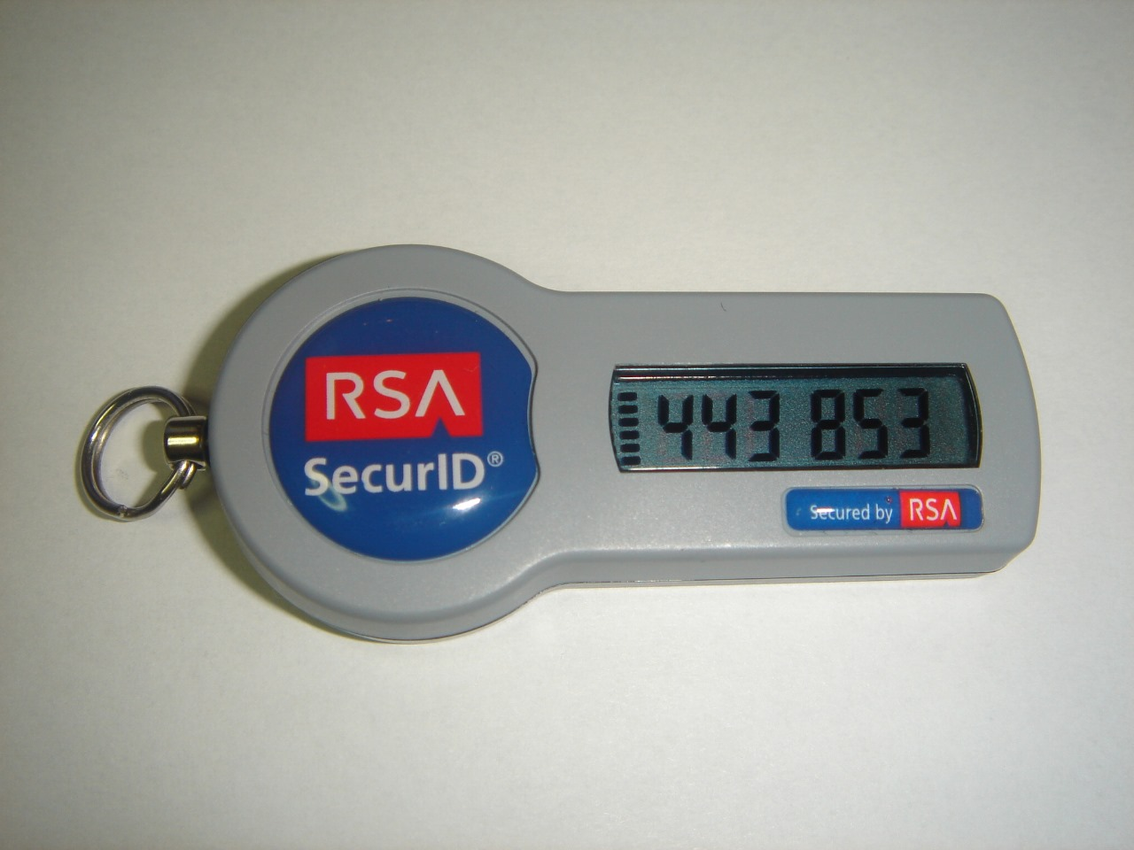

Slide 9
RSA Email Encryption
1)Two Keys: There are two keys: a public one (openly shared) and a private one (kept secret).
2)Encryption: The sender uses the recipient's public key to encrypt the email. Only the recipient's private key can unlock and read the message.
3)Safe Transit: The encrypted email can travel safely over the internet without revealing its contents.
4)Recipient Access: The recipient uses their private key to read the email.
5)Security Strength: RSA email encryption is strong due to complex math involving large prime numbers.
6)Protection: It keeps emails confidential and ensures they haven't been tampered with.

Slide 10
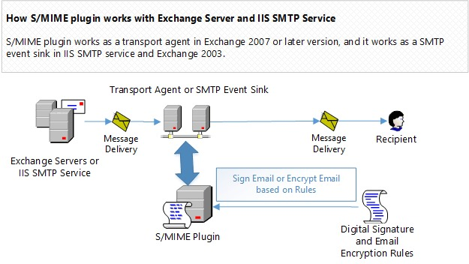

Slide 11
RSA in VPNs
1)Secure Communication: VPNs ensure secure and private online communication.
2)Establishing a Secure Tunnel: When you connect to a VPN, your device creates a secure tunnel with a remote server.
3)RSA Encryption: RSA encryption plays a crucial role in this process.
4)Server Authentication: The VPN server has an RSA key pair. It authenticates itself by providing your device with its public key.
5)Identity Verification: Your device uses the server's public key to verify its identity. Ensures your connection is with a legitimate VPN server.
6) Security: RSA encryption helps maintain the privacy and security of your online activities when using a VPN.

Slide 12
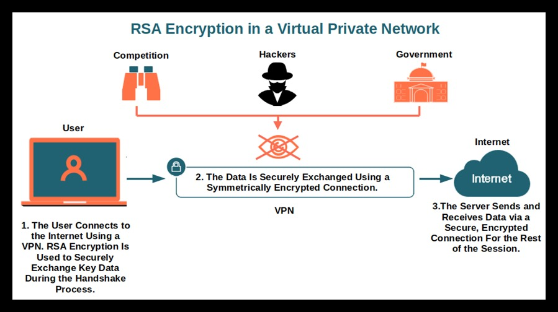

Slide 13
Conclusion
To conclude, the RSA algorithm is not just a mathematical concept; it's a real-world guardian of our digital lives
From secure email communication to online banking, e-commerce, VPNs, and healthcare, RSA encryption underpins our daily activities, safeguarding our information in an increasingly interconnected world
Its importance in securing digital communication cannot be overstated, making it a cornerstone of the modern digital age

