Slide 1

Gandhi Institue of Technological Advancement, Bhubaneswar
Department of Electrical Engineering
CIRCUIT THEORY
DESIGN PROJECT

Slide 2


SUBMITTED BY
NAME: | AKASH KUMAR
REGISTRATION NO.: BRANCH – SECTION: SEMESTER:
 | 2210001
 |  | EE
 | ₄th

Slide 3
DECLARATION
I certify that
The work contained in this report is original and has been done by me.
I have followed the guidelines provided by the Institute in preparing the report.
I have conformed to the norms and guidelines given in the Ethical Code of
Conduct of the Institute.
I have tried to complete the work with minimum possible cost.
Whenever I have used materials (data, theoretical analysis, figures, and text)
from other sources, I have given due credit to them by citing them in the text of the report and giving their details in the references.
Submitted By:
Name:AKASH KUMAR
Regd No: 2210001
Branch: EE
Signature

Slide 4
PROBLEM STATEMENT
Design a circuit which shall provide a constant dc output voltage of 5 V, with 5% permissible voltage fluctuation.
CIRCUIT OPERATING CONSTRAINTS
The circuit is designed to produce a DC output voltage of 5V with an error of 5%.
This design theoretically comes up to 5V but due to small fluctuation in transformer (Here the 15V transformer is providing more or less than 5V due to unstable voltage supply), also the Zener diode we are using is not ideal. All the factors makes the fluctuation of the output voltage.
ACKGROUTHEORETICAL BND.
a) INTRODUCTION
As our objective is to gain Dc voltage from Ac voltage supply. First of all we need to have some knowledge on basic blocks of the circuit.
1. Rectifier: A full wave rectifier is defined as a type of rectifier that converts both halves of each cycle of an alternating wave (AC signal) into a pulsating DC signal. Full-wave rectifiers are used to convert AC voltage to DC voltage, requiring multiple diodes to construct. Full wave rectification is the process of converting an AC signal to a DC signal. Circuits that convert alternating current (AC) into direct current (DC) are known as rectifiers. If such rectifiers rectify both the positive and negative half cycles of an input alternating waveform, the rectifiers are full-wave rectifiers.
Full-wave rectifiers achieve this by using a group of diode.A diode
permits current in one direction only and blocks the current in the other direction. We use this principle to construct various rectifiers.
We can classify rectifiers into two types:

Slide 5



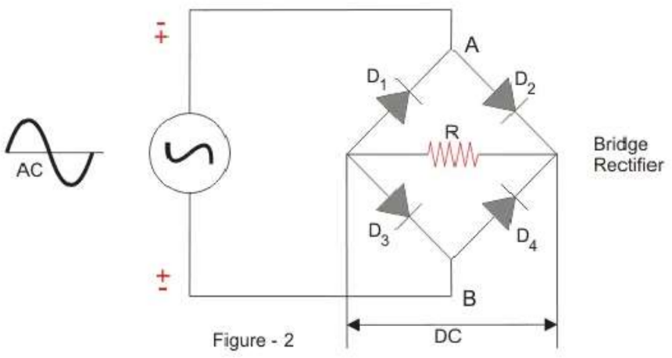


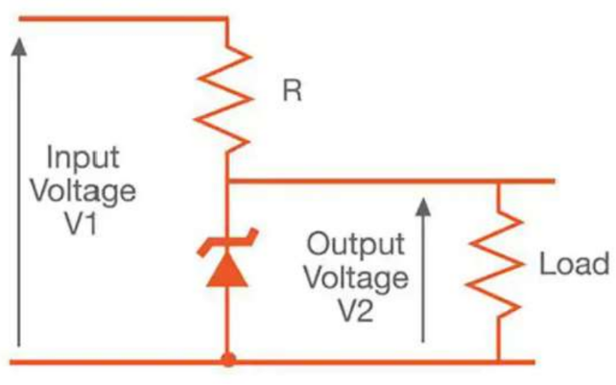
Half Wave Rectifier
Full Wave Rectifier
When we use a Half Wave Rectifier, a significant amount of ower gets wasted as only one half of each cycle passes through, and the other cycle gets blocked. Moreover, the half-wave rectifier is not efficient (40.6%), and we can not use it for applications that need a smooth and steady C output. For a more efficient and steady DC output, a full wave rectifier is used.
The type of Full Wave Rectifier we will use here is: Centre-tapped Full Wave Rectifier
2. Use of Zener iode: The Zener diode has a well-defined reverse- breakdown voltage, at which it starts conducting current, and continues operating continuously in the reverse-bias mode without getting damaged. Additionally, the voltage drop across the diode remains constant over a wide range of voltages, a feature that makes Zener diodes suitable for use in voltage regulation.
The load voltage equals breakdown voltage VZ of the diode. The series resistor limits the current through the diode and drops the excess voltage when the diode is conducting.

Slide 6





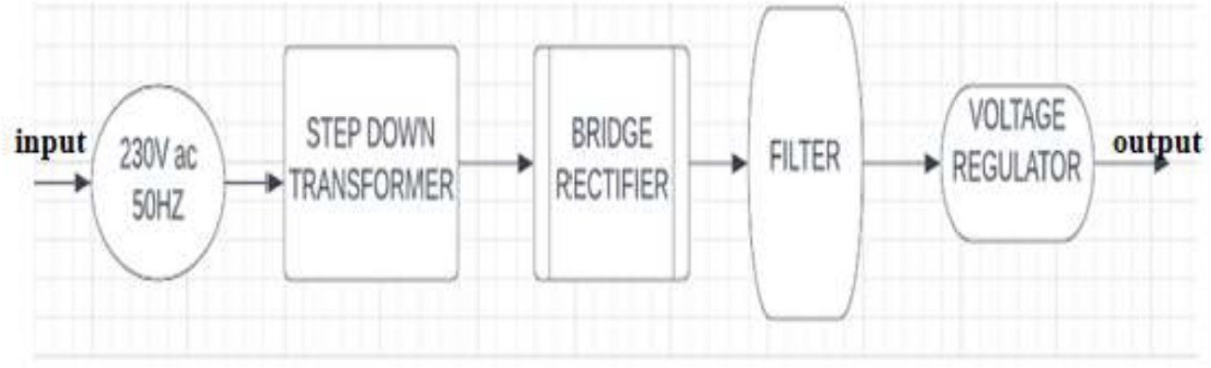
STEP 1: Converting 230V Ac to 5 V Ac
Generally there is a high voltage AC supply as it is easy to transfer with minimum losses. However our devices need a low voltage supply so use a step down transformer for this purpose. In step down transformer the primary coil have higher number o loops as compared to the secondary coil.
Thus this will convert 230V AC to 5 V AC which we will further use.
STEP 2: Converting 15v AC into 5v DC using Full Wave Rectifier
Here the outer two terminals of the step down transformer are connected to the bridge rectifier circuit. Rectifier circuit converts ac supply in to dc supply. It is generally made up of diode which acts here as switches.
STEP 3: Smoothing the voltage.
The DC Waveforms generated in the above step don’t have pure dc waveforms. It is in the form of pulses and has fluctuating supply. Capacitors are devices that are used to do this task. The capacitor is used to store energy when th input voltage is increasing from zero to highest value. The energy from the capacitor can be discharged when the input voltage is decreasing to zero. This straightens the waveform to a good extent.
STEP 4: Fixing up the dc voltage:
Finally Dc voltage is converted to the fixed desired value by using a voltage regulator by using a 5V Zener diode. It is one of the application f Zener diode.
b) BLOCK DIAGRAM

Slide 7
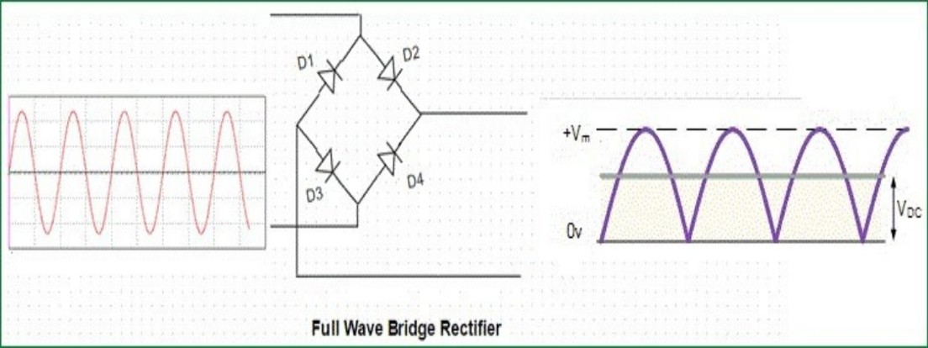
MATHEMATICAL MODELLING / ANALYSIS
The value of capacitor,Voltage rating.
We know that ,
C= it/v
;
And here we know the values of i,t,v respectively,
I=750m A,(as marked in transformer) V calculation:
After stepping down we get ac 15Vrms, thus we get 15 × √2 =21.213 Now the voltage across the capacitor will be, V=21.213-0.7-0.7=20.513V
(as two diode of threshold frequency 0.7V are in path the voltage drop will decrease by 1.4V)
As here we require a minimum of 5 V output, so capacitor can’t discharge below 5 V thus,
The voltage difference will be V=20.513-115=5.513V
T calculation:
Here we know the frequency of input is 50Hz, thus t=1/50=20ms (for input)
Now after the rectification the curve becomes as:

Slide 8
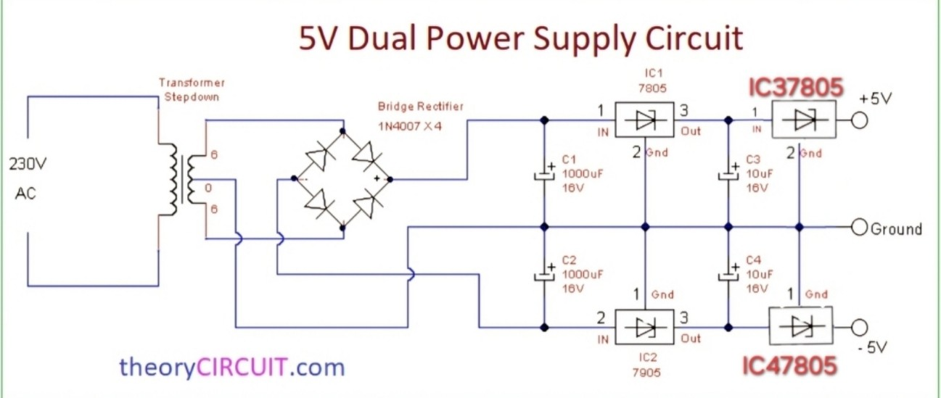
Thus the time period gets half here so t=10ms After getting all the parameters,
C=(750×10^-3×10×10^-3)/(3.568)=2101×10^-6 F
So we will take 30% more value the calculated one which will be=
2731.6×10^-6 F,
Similarly will will take voltage rating as 50%more value of Max Voltage
=23.352V
As these values are not present in the market we will try to take the nearest value possible.
4. CIRCUIT DIAGRAM

Slide 9
5. DESIGN SPECIFICATION
Sl. No. | Component Name | Specification | No. of units
1 | 15V Transformer | 15:0:15 V Output | 1
2 | Diode | 1N4007 | 4
3 | Capacitor | 1000u F, 50V | 2
4 | Capacitor | 10uF,25 V | 2
5 | Veroboard | 4×4 inch | 1
6 | IC | 7805 | 4

Slide 10
6. HARDWARE DESCRIPTION
Implementation of the circuit on the breadboar

Slide 11
7.What is a DC 5V power supply?
A DC 5V power supply is a type of power supply that provides a regulated and stable 5V DC (direct current) output voltage. This low-voltage power supply is commonly used to power electronic devices that require a 5V DC supply, including microcontrollers, sensors, LED lights, USB charging devices, and other low-power electronic components.
8.How does a DC 5V power supply work?
A DC 5V power supply works by converting an input voltage, typically AC (alternating current), to a regulated 5V DC (direct current) output. Several components and techniques are involved in the process of converting the input voltage to a 5V DC output, as explained below:
Rectification: Rectifying the AC input voltage to DC using a rectifier circuit is the first step in the process. A diode bridge or full wave rectifier circuit is typically used for this purpose.
Filtering: The output of the rectifier circuit is a pulsating DC voltage that still has a lot of ripple and noise in it. To remove the ripple and noise, the output voltage is filtered by means of a capacitor.
Voltage regulation: A voltage regulator circuit is then used to regulate the filtered DC voltage to a constant 5V DC output. Linear and switching are the two main types of voltage regulation. Linear regulation reduces the voltage to the desired level using a linear voltage regulator, which is a simple and inexpensive method. Switch regulation, however, uses a switching regulator to convert the voltage to the desired level by rapidly turning the input voltage on and off.
Protection features: To protect the connected device from damage, some DC 5V power supplies also provide protection functions such as over-current protection, over-voltage protection, and short-circuit protection.

Slide 12
9.Applications for DC 5V power supply
DC 5V Power Supplies are widely used in a variety of electronic devices that require a stable and regulated 5V DC power source, Some typical applications for DC 5V Power Supplies are as follows:
Microcontrollers: Most microcontrollers, such as the Arduino and Raspberry Pi, require a 5V DC power source to function properly.
Sensors: Many sensors, such as temperature and pressure sensors, require a 5V DC power source to operate.
LED lighting: 5V DC power supplies are often used to power LED strips or modules in LED lighting systems.
USB Charging: Many USB charging devices require a 5V DC power source, such as smartphones and tablets.
Audio equipment: Some audio equipment requires a 5V DC power source for certain components, such as mixers and preamps.
Industrial automation: 5V DC power supplies are often used in industrial automation systems to power sensors, controllers, and other components that require low power consumption.
Medical devices: Some medical devices require a 5V DC power source, such as glucometers and pulse oximeters.

Slide 13
10. The benefits of a DC 5V power supply
DC 5V power supplies are beneficial because of their stable and regulated output, efficiency, compact size, wide input voltage range, protection functions, compatibility, versatility, and safety certifications. Because of these characteristics, they are an essential power supply for a wide range of electronic equipment.
11. RESULT

Slide 14
COMMENTS
As per the result and analysis, we observed that bridge rectifiers are the best method to convert an ac voltage to dc voltage.
Also we have known a very useful application of the capacitor as an filter which smoothes/stabilizes the unstable voltage provided by the rectifier.
At the end the use of the IC as a voltage regulator as it will only allow the Rated voltage as per the IC we will take, as here we have used 7805 IC Zener thus we have got an output of 5V.
In the objective it was given that it can have a maximum of 5% of error.
Thus the range will be 4.5V to 5.6V. So as we have got an output of 5V we have achieved our objective.
REFERENCE
I have taken guide and references from the following sources listed below:
Geeksforgeeks: Basic explanation of conversion of ac-dc circuits, Available on: https://www.geeksforgeeks.org/how-to-convert-from-ac-to- dc/ , Accessed on: 10 March 2024
Wikihow: Circuit help and reference. Available on : https://www.wikihow.com/Convert- AC-to-DC ,Accessed on: 15 March 2024
Youtube: Capacitor value calculation, Available on:18 March 2024
https://www.youtube.com/watch?v=Hr8ZOBOyTHk ,accessed on
Electrical 4 U: Rectifier : https://www.electrical4u.com/full-wave-rectifiers/
,accessed on 18 March 202

Slide 15
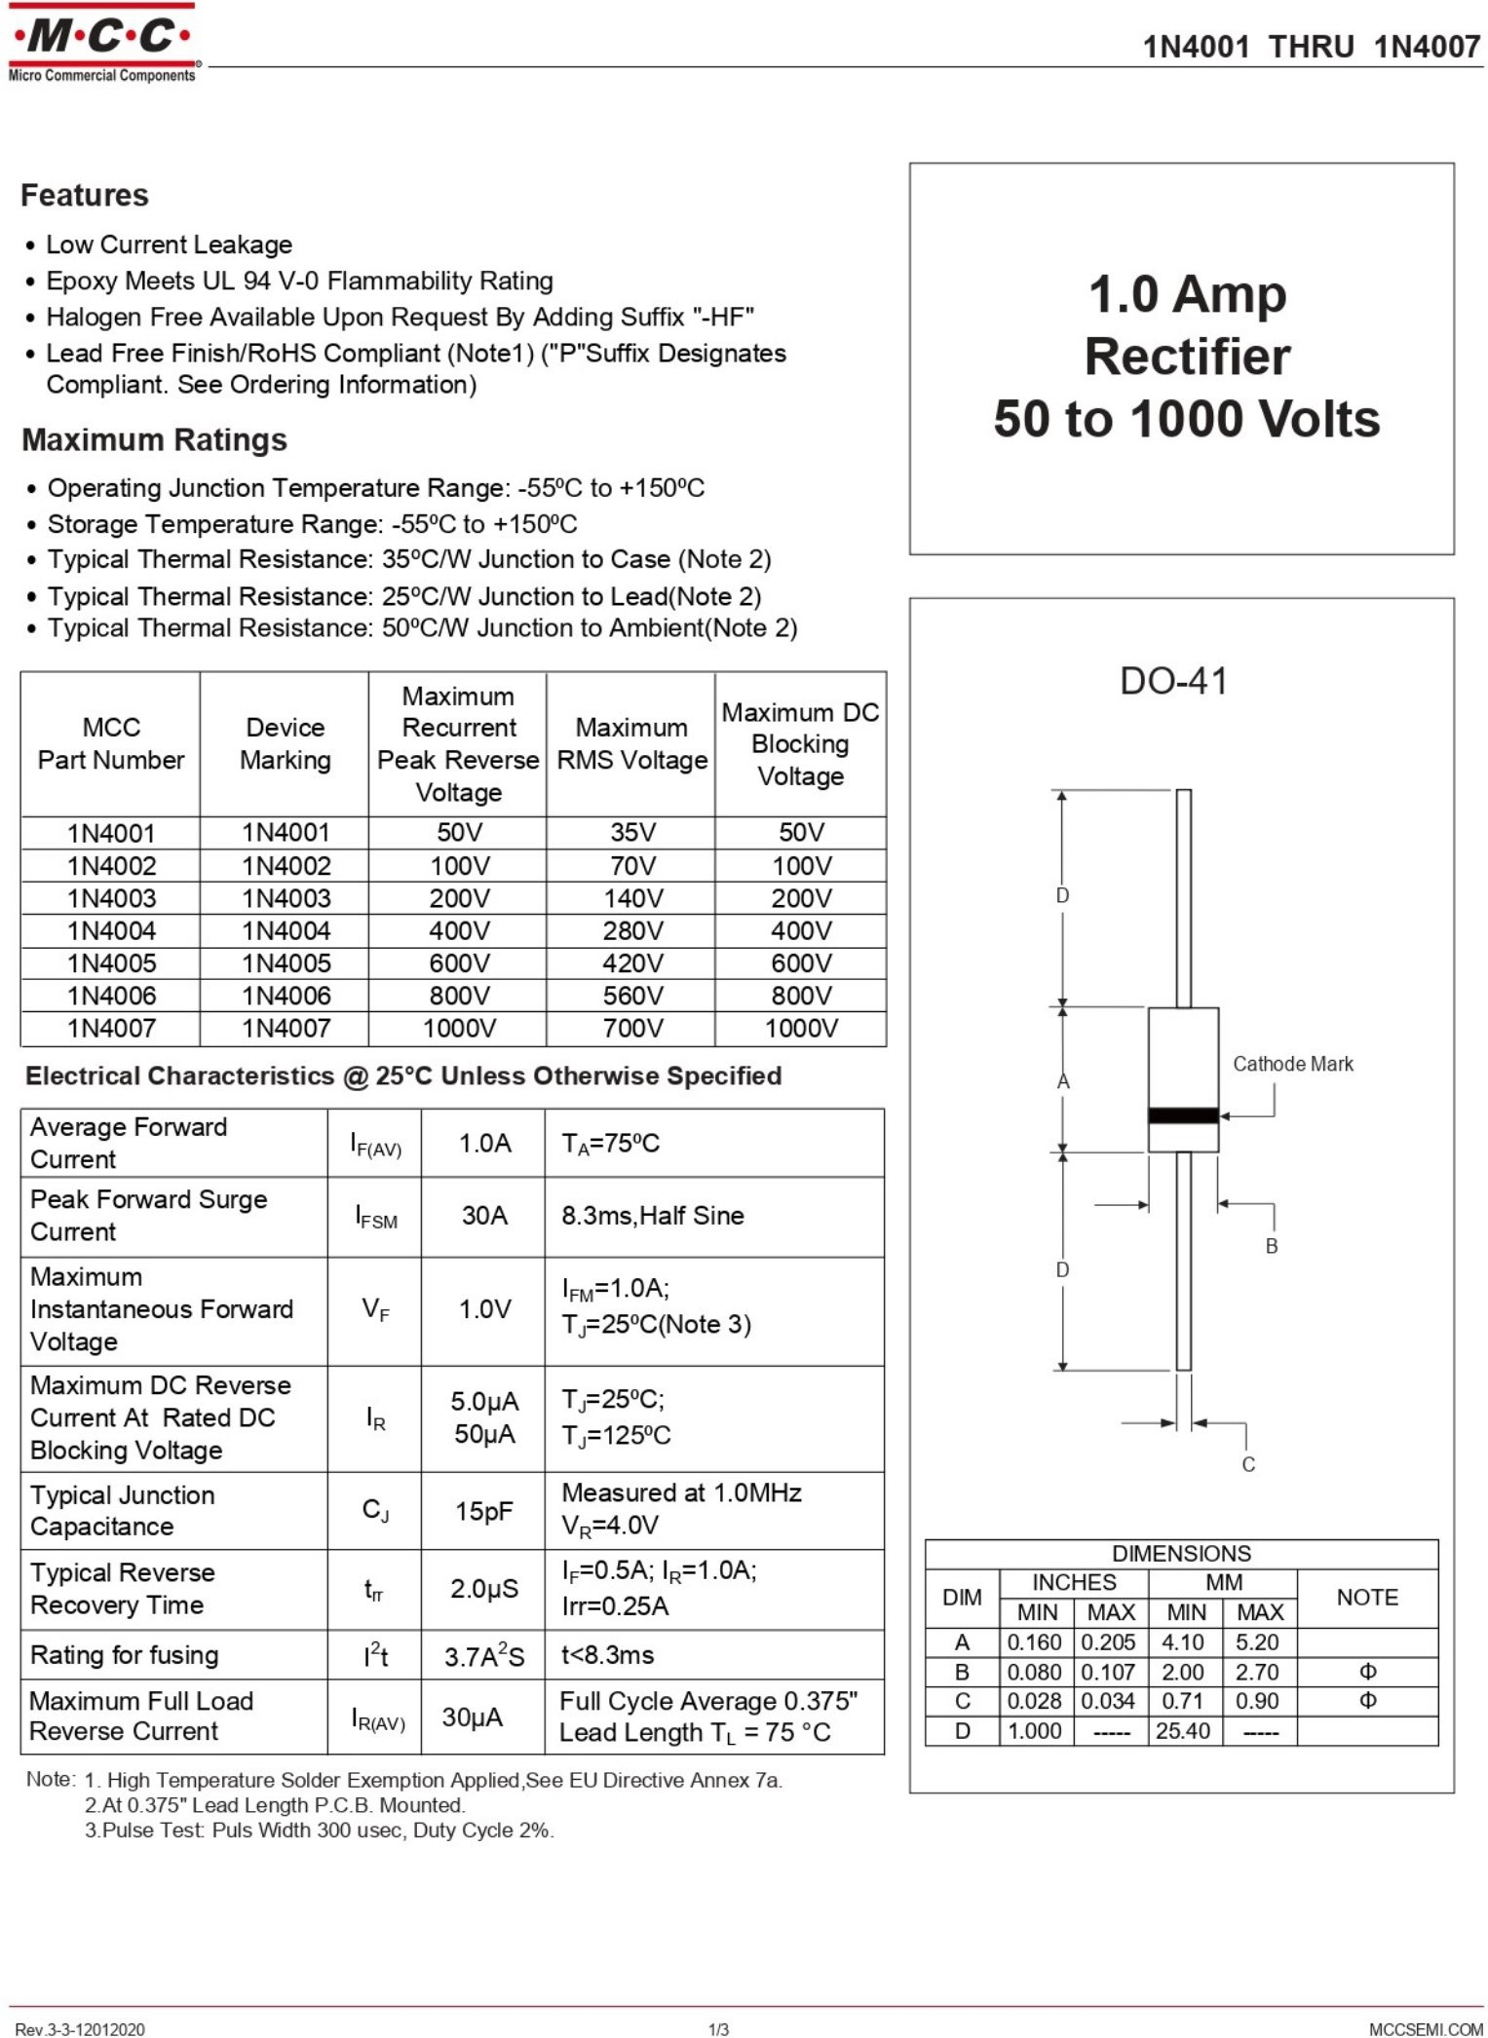
DATA SHEET
1N4007 DIODE

Slide 16
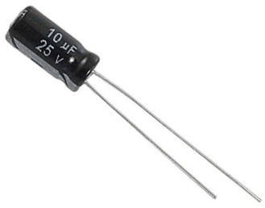
b. 10uF 25V Electrolytic Capacitor
A capacitor (originally known as a condenser) is a passive two-terminal electrical component used to store energy electrostatically in an electric field. This Product is known as 10uF 25V Capacitor, 10uF/25V Electrolytic Capacitor, 10uF Capacitor, 10uF Electrolytic Capacitor, 10uF Capacitor, 10uF Electrolytic Capacitor.
Feature/Specs:
Capacitor Type: Radial Aluminium Electrolytic
Capacitance Value: 10uF
Voltage Rating: 25V
Tolerance: ±20%
Max Temperature: -40~+85°C
Mounting Type: Through Hole
Lead Spacing pitch: 2.5 mm
capacitor diameter: 5 mm
capacitor Height: 11 mm
Approx Weight: 2 gm
Compliance: RoHS

Slide 17
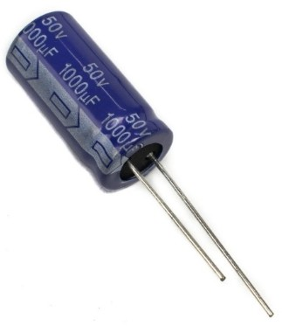
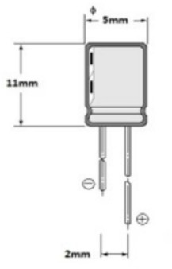
c. 1000UF 50V ELECTROLYTIC CAPACITOR
1000μF 50V Electrolytic Capacitor for smoothing out, filtering and performance tuning low frequency circuits and signals up to around 1KHz or less.
This 1000uF 50V capacitor is a good quality radial polarized Electrolytic capacitor. Electrolytic capacitors are widely used in switched-mode power supplies, DC-DC converters, and power supplies. This capacitor has a long life, low leakage current, and wide operating range.
Features of 1000uF 50V Electrolytic Capacitor
Capacitance: 1000uF
Maximum Voltage: 50 Volts
Tolerance: ±15%
Capacitor Type: Radial Through Hole Electrolytic
Polarization: Yes. Line with ‘-‘ denotes negative lead
Max Temperature: +85°C
Mechanical Drawing of 1000uF 50V Electrolytic Capacitor
4.7uF 50V Electrolytic Capacitor
Additional Resources
1000uF 50V Electrolytic Capacitor datasheet
Package Contents

Slide 18
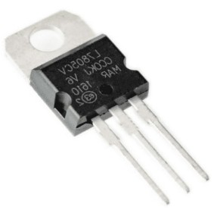
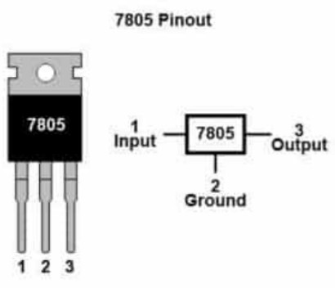
1 x 1000uF 50V Electrolytic Capacitor
d. IC
7805 Voltage Regulator IC
The 7805 voltage regulator IC is a three-terminal voltage regulator IC. In various applications, a 7805 voltage regulator with a fixed output voltage is used. The availability of this is through various packages like SOT-223, TO- 263, TO-220, and TO-3. Among these, TO-220 is the most used one. There are many important features in the IC regulator 7805.
The ic 7805 is a three-terminal positive regulator available in the TO220 package. It employs built-in current limiting, thermal shutdown, and safe operating area protection which makes them virtually immune to damage from output overloads.
7805 voltage regulator, although designed primarily as a fixed voltage regulator and can also be used with external components for adjustable voltages and currents. With adequate heatsinking, they can deliver in excess of 0.5A output current.
Features:
Three-terminal positive voltage regulator IC
Available in TO220 package
Built-in current limiting, thermal shutdown, and safe operating area protection
Primarily designed as a fixed voltage regulator
Can be used for adjustable voltages and currents with external components
Can deliver over 0.5A output current with adequate heatsinking
Pinout:
LM7805 IC
Voltage regulator IC 7805 Pin Diagram

Slide 19
Applications:
Also check 7812 Voltage Regulator IC available on Robocraze. It is a commonly used linear regulator with an operating output voltage of 12V.
Also check the 7809 Voltage Regulator (Pack of 5) available on the Robocraze website. It is a monolithic 3-terminal positive voltage regulator, specifically the LM7809 model.
Also check 7812 voltage regulator, which operates with an input voltage range of 12 – 35VDC and outputs a fixed 12V
Package Includes:
1 x 7805 IC
Specifications:
Input voltage 7v to 25v
Output voltage range
Typical output voltage
Maximum output current
Dimensions
Weight 2g
4.8 v to 5.2v 5v
1.5A
30 x 10 x 5 mm
e.15-0-15V 1A Step Down Transformer

Slide 20
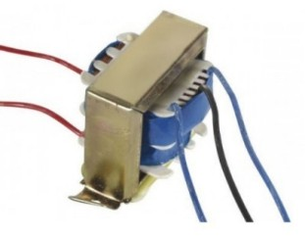
•
Output current: 1A
Supply voltage: 220-230VAC
Output voltage: 15-0-15VAC
Soft Iron Core
1 A Current Drains
15V 0V 15V 1A Step Down Transformer
15-0-15V 1A Step Down Transformer
It is a general-purpose chassis mounting mains transformer. The transformer has 230 V primary windings and secondary winding. The transformer has flying-colored insulated connecting leads ( Approx 100 mm long ). The Transformer act as step-down transformer reducing AC 230V to AC 15V.
The Transformer gives two outputs of 15V, 15V and 0V. The Transformer’s construction is written below with details of Solid Core and Winding.
The transformer is a static electrical device that transfers energy by inductive coupling between its winding circuits. A varying current in the primary winding creates a varying magnetic flux in the transformer’s core and thus a varying magnetic flux through the secondary winding. This varying magnetic flux induces a varying electromotive force (E.M.F) or voltage in the secondary winding. The transformer has cores made of high permeability silicon steel. The steel has a permeability many times that of free space and the core thus serves to greatly reduce the magnetizing current and confine the flux to a path which closely couples the windings.
Features/Specs:
Output current: 1A
Supply voltage: 220-230VAC
Output voltage: 15-0-15VAC
Soft Iron Core
1 A Current Drains
Application:
DIY projects Requiring In-Application High current drain
On chassis AC/AC converter
Designing a Battery Charger

