Slide 1
Using VQE to Find Ground State Energy of LiH
Molecule with Parity Mapping and Exploiting the
Symmetry of Molecule to Reduce the Number of
Qubits Required for Simulation

Slide 2
Abstract
We test the parity mapping algorithm of VQE to solve the ground state energy of the LiH molecule. We further use the two qubit reduction by using the Z2 logical symmetry to reduce the no. of qubits and compare with the exact energy. Further, we exploit the more general point group symmetries of the molecule to taper off more qubits for the simulation using QML package of pennylane. We present our results followed by the conclusion.

Slide 3
Our team
Saptarshi Mandal
Ayan Hutui
Akash Kumar
Ronit Dutta
21PH40045
21PH40014
20PH20003
20PH20035

Slide 4
Introduction

Slide 5
What is VQE?
Variational Quantum Eigensolver is an algorithm which uses the Variational Principle to compute the ground state energy of a hamiltonian, a problem that is central to Quantum Chemistry and Condensed Matter Physics.
The method consists of choosing a "trial wavefunction" depending on one or more parameters, and finding the values of these parameters for which the expectation value of the energy is the lowest possible.

Slide 6


Provided a Hamiltonian , and a trial wavefunction |ψ⟩, the ground state energy associated with this Hamiltonian, E₀ is bounded by
The objective of the VQE is, therefore to find a parameterization of |ψ⟩, such that the expectation value of the Hamiltonian is minimized.
We hence express |ψ⟩ as the application of a generic parameterized unitary U(θ) to an initial state for N qubits, with θ denoting a set of parameters.
Hence, VQE optimization problem can be written as:

Slide 7
The pipeline of the VQE can be written as:
Hamiltonian construction and representation
Encoding of operators
Measurement strategy and grouping
Ansatz and state preparation
Parameter optimization

Slide 8
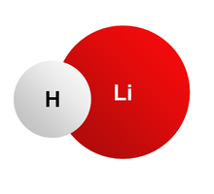
The Symmetry of LiH Molecule

Slide 9
There are Various type of Point Group Symmetry
Nonrotional Group
C1= asymmetric
Ci= identity and one inversion symmetry
Cs= identity and ane plane symmetry
Group(C1,Ci,Cs)
Rational Group
Cn=n-fold Principal axis rotation
Cnv=n-fold Rotation and one vertical plane symmetry
Cnh= n-fold rotation and one horizontal plane symmetry
C∞v = 2 infinity fold axis rotation and infinity vertical plane
Group(Cn,Cnv,Cnh,C∞v)

Slide 10
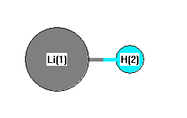
LiH is a linear Molecule
It belongs to C∞v Point Group
Diagram of LiH
It has two infinity Pricipal axis Rotation and infinity Vertical Plane symmetry

Slide 11
Represent Point Group Symmetries
AS Pauli Operators
Use the Available Tools to Taper off
Qubits from The Pauli Strings

Slide 12
Qubit Tapering

Slide 13
The amount of qubits required to express wave functions severely limits the performance of variational quantum algorithms. This constraint impedes the handling of big molecules with algorithms such as the variational quantum eigensolver in the context of quantum chemistry (VQE).
One such ingenious techniques employed to reduce the number of qubits working upon the molecular Hamiltonian is the symmetry based Qubit tapering technique.
Based on the Z_2 symmetries found in molecular Hamiltonians, the symmetry-based qubit tapering strategy allows for a reduction in the number of qubits necessary to run molecular quantum simulations.

Slide 14
A molecular Hamiltonian in the qubit basis can be expressed as a linear combination of Pauli words as H is the sum of h and P coefficients where i-th h is a real coefficient and i-th P is a tensor product of Pauli and identity operators acting on M qubits where any element of P ∈ ±{ I, X, Y, Z }^(⊗M).
The main idea in the symmetry-based qubit tapering approach is to find a unitary operator U that transforms H to a new Hamiltonian H which has the same eigenvalues as H. [basically H = U†HU]
More generally, we can construct the unitary U such that each μi term acts with a Pauli-X operator on a set of qubits {j}, j ∈ l, ̇.., k where j is the qubit label. This guarantees that each term of the transformed Hamiltonian commutes with each of the Pauli-X operators applied to the j-th qubit: [H_new, Xj ] = 0

Slide 15
The Results

Slide 16
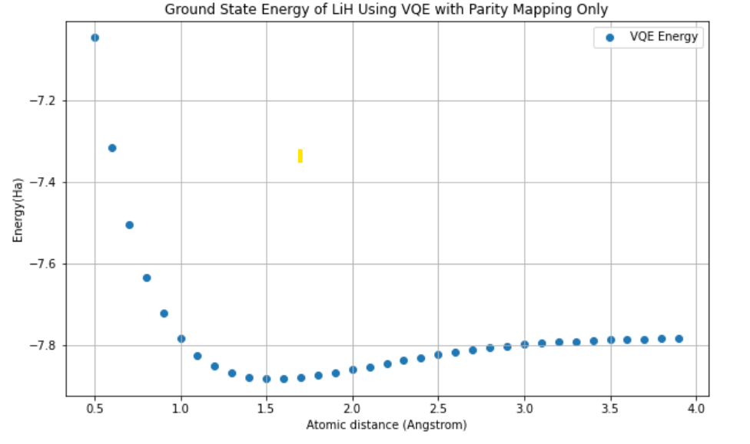
Using Parity Mapping
Major Interface
The minimum Energy corresponding to this configuration is Ground state Energy and this distance is equilibrium distance
Equilibrium Distance is 1.5 angstrom obtaining by the plot
Ground State Energy is -7.8821 Ha obtaining by the plot

Slide 17
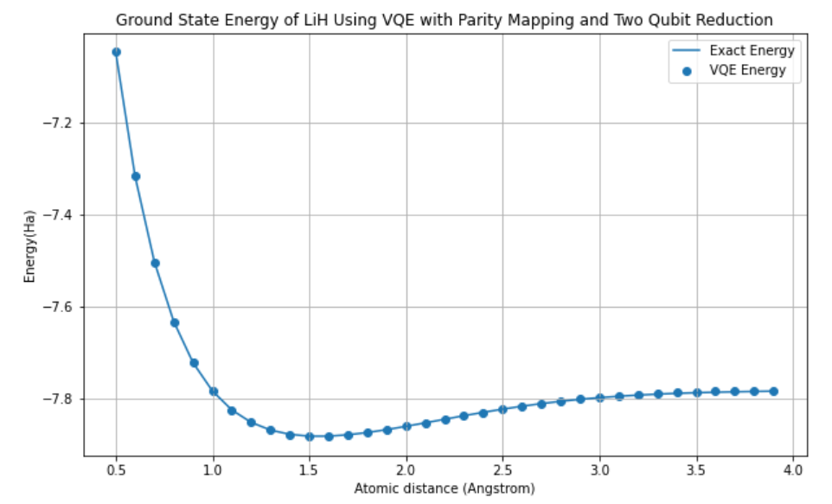
The Two Qubit Reduction
Major Interface
Using two qubit reduction gives same result but then, two qubits have been trapped from Pauli String.
The Result are very good match upto two decimal places with exact Ground State Energy

Slide 18
Qubit Tapering using Symmetries
Major Interface
No of qubits are reduced from 12 to 8 by tapering off 4 qubits in the standard STO-3G basis
After Tapering off exact Ground state Energy is -7.66 Ha with equilibrium distance 1.55 angstrom which is same as previous result
(In the QML package of Pennylane)

Slide 19
Conclusions

Slide 20
Parity Mapping is an excellent method to simulate ground state energy of the molecule by using VQE
The two qubit Reduction Method is enhanced version of Parity Mapping with two qubit tapered such that result is almost same with exact value.
Point Group Symmetry can be used to taper off more operators, thereby off more qubits requiring the less no. of qubits for simulation.

Slide 21
References:
[1]
Ville Bergholm et al. “PennyLane: Automatic differentiation of hybrid quantum-classical computations”. In: (Nov. 2018).
arXiv: 1811.04968[quant-ph]
[2]
Dmitry A. Fedorov et al. “VQE method: a short survey and recent developments”. In:Materials Theory 6.1, 2 (Dec. 2022), p. 2.
doi:10.1186/s41313- 021- 00032- 6, arXiv: 2103.08505[quant-ph].
[3]
Qiskit contributors. Qiskit: An Open-source Framework for Quantum Computing. 2023.
Doi: 10.5281/zenodo.2573505.
[4]
Kanav Setia et al. “Reducing qubit requirements for quantum simulation using molecular point group symmetries”. In: arXiv e-prints, arXiv:1910.14644 (Oct. 2019), arXiv:1910.14644.
Doi: 10.48550/arXiv.1910.14644. arXiv: 1910.14644[quant-ph]
[5]
Jules Tilly et al. “The Variational Quantum Eigensolver: A review of methods and best practices”. In: Phys. Rept. 986 (2022), pp. 1–128.
doi: 10.1016/j.physrep.2022.08.003. arXiv: 2111.05176[quant-ph]

