Slide 1
DATA 245 · Machine Learning Technologies · Spring 2026
SafeSpan Bridge Analytics
Predictive Maintenance for U.S. Bridge Infrastructure
Machine Learning
Data Drift Analysis
Survival Analysis
4.8 M Records
NBI Data · 2018 – 2025 · 600 K Bridges · Temporal Hold-out Evaluation
Team: Akashkumar Senthilkumar · Pramod Satya Dindukurthi · Shriram Dundigalla · Shruthi Thirukumaran

Slide 2
Why Bridge Safety?
Motivation & Real-World Relevance
The Scale of the Problem
What SafeSpan Does
• 617,000+ public road bridges in the U.S.
Predicts condition class
• 1 in 12 bridges is structurally deficient
Critical / Poor / Fair / Good — before next inspection
• ~7-8% rated Critical at any given inspection
Detects distribution shift
• Average bridge age now exceeds 45 years
Flags when bridge population changes drift over time
• Reactive repair costs 5-6x more than proactive maintenance
Quantifies time-to-failure
• Inspection is annual — but decisions are made with stale data
Survival analysis: how long before a good bridge degrades?
Safety-critical metric
Tracks Critical bridges mis-labelled as Good — lives at stake

Slide 3
Dataset: National Bridge Inventory (NBI)
Source · Features · Target · Preprocessing
4.8 M
600 K
8 Years
100+
4 Classes
Bridge-Year Observations
Unique Bridge Structures
2018 – 2025 Annual Snapshots
Raw NBI Columns
Critical · Poor Fair · Good
Key Input Features
Target Variable
• BRIDGE_AGE_AT_INSPECTION — years since built
Critical Min rating 0–3 | ~3% of data
• ADT_029 — average daily traffic
Poor Min rating = 4 | ~7% of data
• MAX_SPAN_LEN_MT_048 — structural span length
Fair Min rating 5–6 | ~33% of data
• OPERATING_RATING_064 — safe load capacity
Good Min rating 7–9 | ~57% of data
• INVENTORY_RATING_066 — posted load limit
• STRUCTURE_KIND_043 — bridge material type
Preprocessing
• STATE_CODE_001 — geographic location
• 10 leakage columns removed (raw rating + FHWA eval scores)
• FUNCTIONAL_CLASS_026 — road classification
• Median imputation for NaN in ratio features
• + 5 engineered domain features (see slide 6)
• Label encoding for categorical columns
• Class weights balanced to counter 57:3 Good:Critical ratio

Slide 4
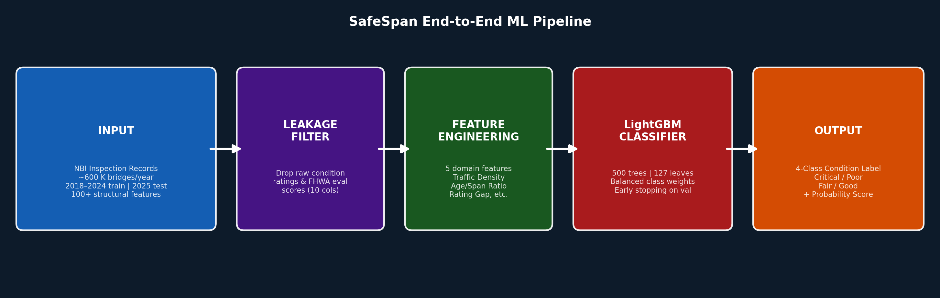
Input → Model → Output
End-to-End Pipeline — The Critical Requirement
INPUT TYPE Tabular features (NBI structured data) Shape: (N, ~100 cols) 4.2 M train rows
LEAKAGE GUARD Drops 10 columns that define the label Prevents data leakage Essential for validity
ENGINEERING 5 new features created from domain physics Ratios, logs, gaps Reduces raw noise
MODEL LightGBM Classifier Gradient-boosted trees Balanced class weights 500 estimators
OUTPUT TYPE 4-class label Critical / Poor Fair / Good + Probability score
Output is a 4-class multi-class classification | Also produces per-class probabilities for calibration & ranking

Slide 5
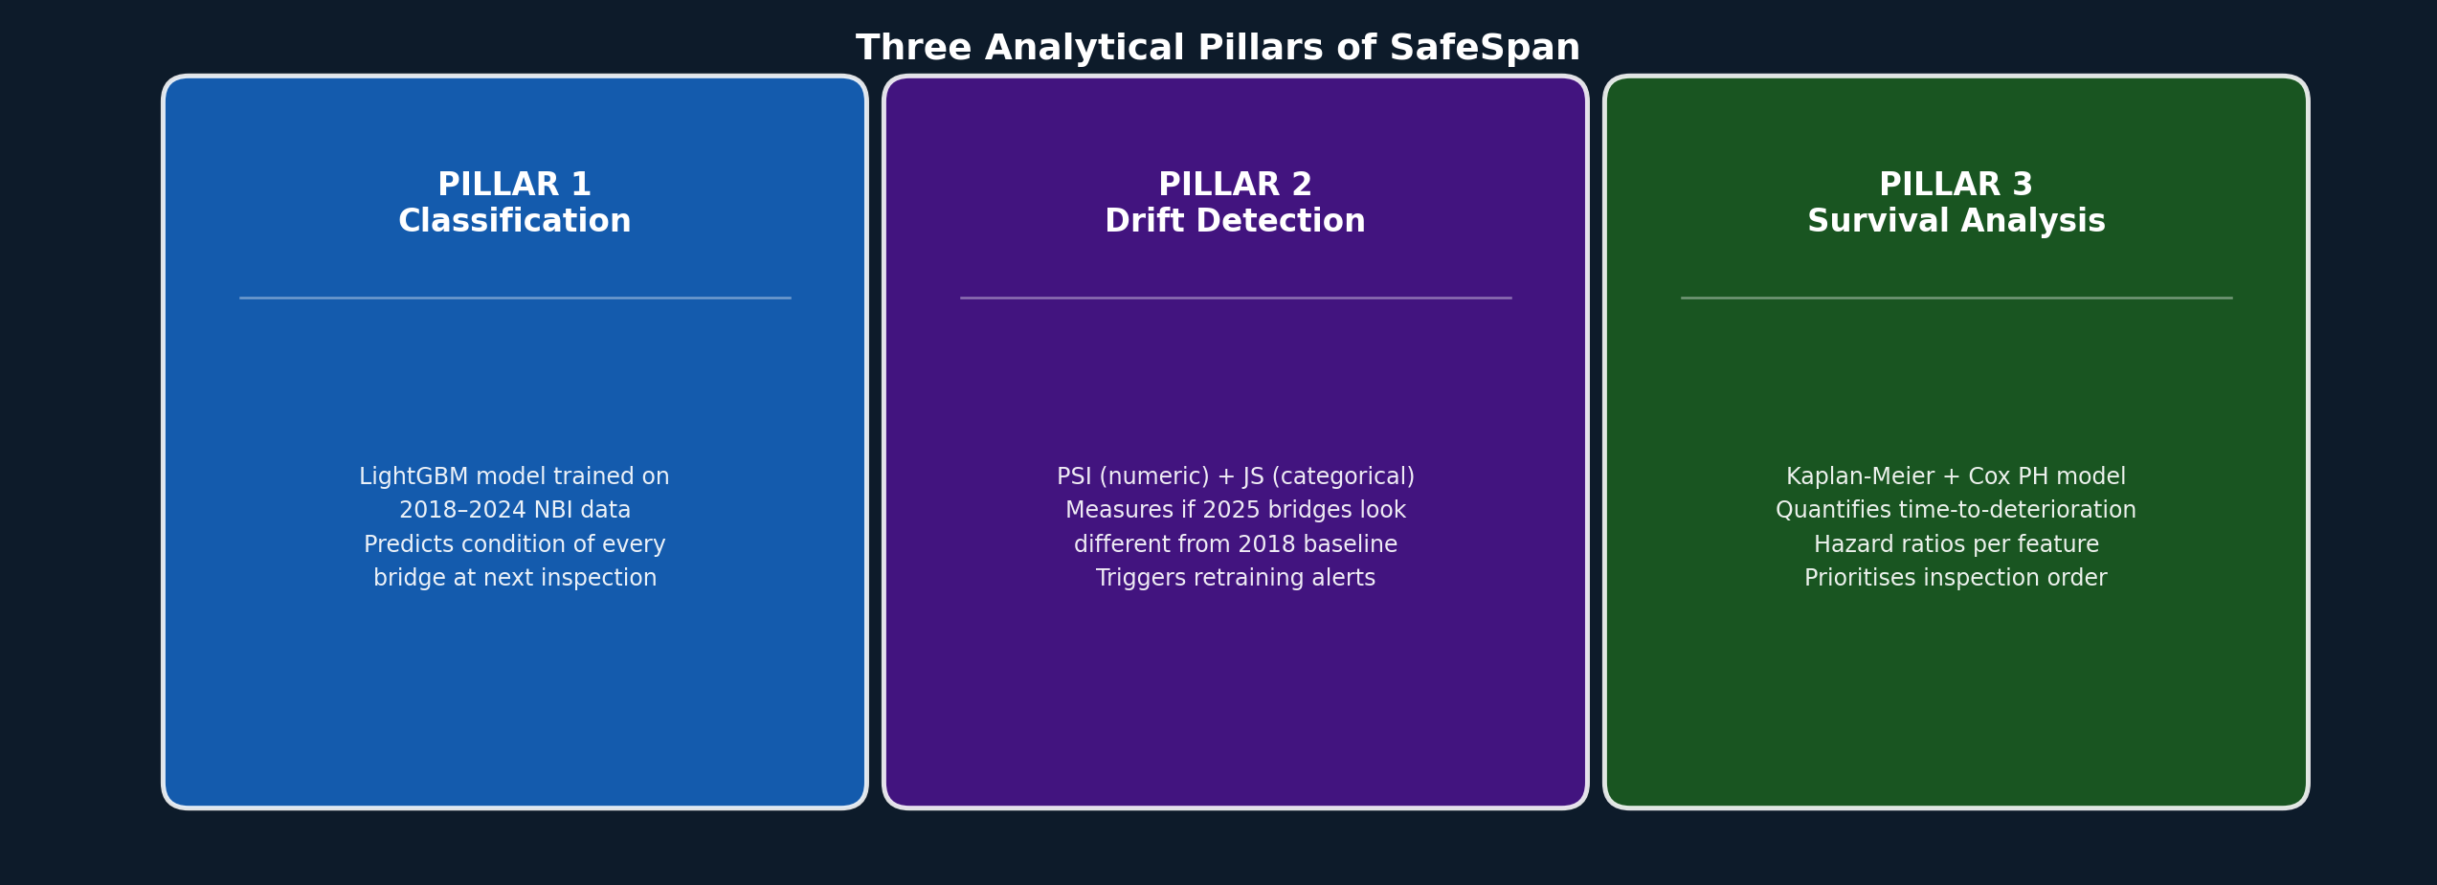
Proposed Solution: Three Analytical Pillars
What is new / different / why it works
Why Classification?
Why Drift Analysis?
Why Survival Analysis?
• Most bridges labelled annually — tabular supervised learning is natural
• A model trained in 2018 may fail silently in 2025
• ML gives snapshot prediction; KM/Cox gives time-to-event
• LightGBM handles 4.2 M rows + 100 features in minutes
• PSI (numeric) + Jensen-Shannon (categorical) = industry standard
• Kaplan-Meier: non-parametric, handles censored bridges correctly
• class_weight='balanced' prevents Good-class dominance
• Target drift found: Fair bridges −20pp, Good +16pp (2018→2025)
• Cox PH: multi-feature hazard ratios — who degrades fastest?
• Safety-critical metric: Critical→Good misclassification rate
• Quantifies WHEN and HOW MUCH to retrain
• Directly prioritises inspection scheduling order

Slide 6
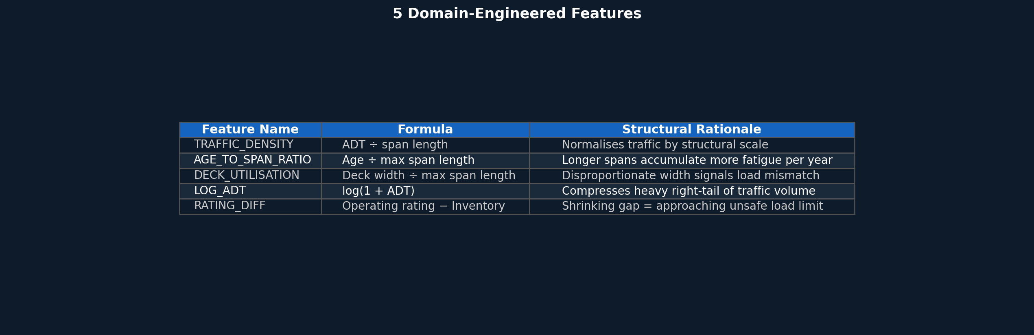
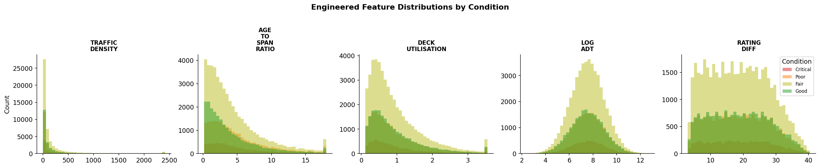
Feature Engineering — 5 Domain-Informed Features
Raw NBI columns re-expressed as structural and operational signals
Each feature separates condition classes — overlapping but informative distributions confirm domain relevance

Slide 7
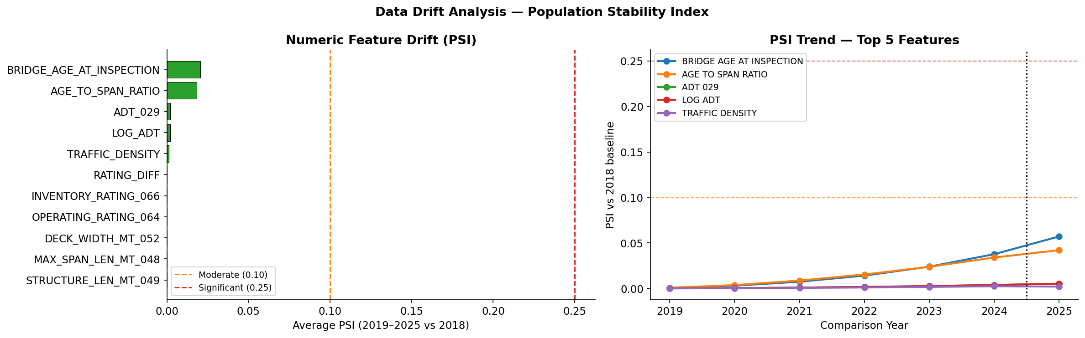
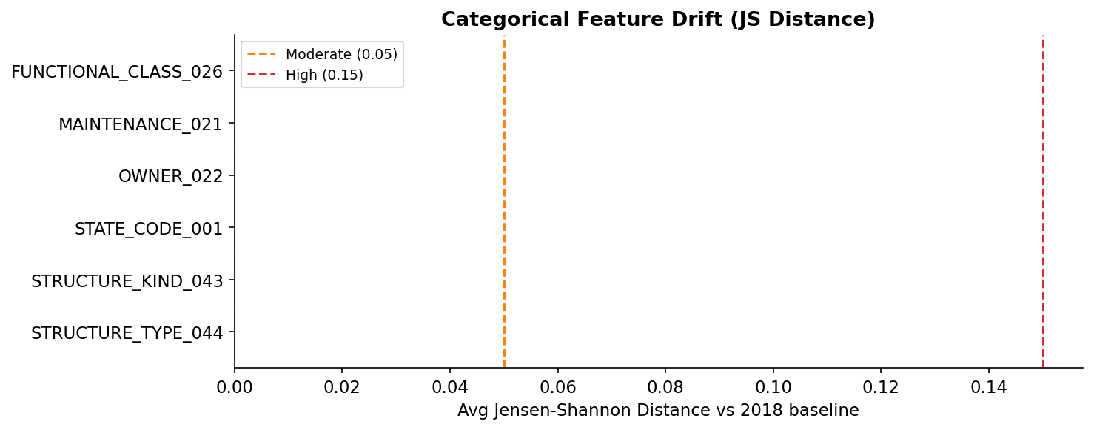
Data Drift Analysis: PSI + Jensen-Shannon Distance
Measuring how much the bridge population changed from 2018 to 2025
Why We Do This
• A 2018-trained model deployed in 2025 may see a very different bridge population
• PSI (Population Stability Index) measures numeric feature shift vs. 2018 baseline
• Jensen-Shannon distance measures categorical shift (material, state, owner type)
• PSI < 0.10 → stable | 0.10-0.25 → moderate | ≥ 0.25 → retrain
• JS < 0.05 → low | 0.05-0.15 → moderate | > 0.15 → high drift
• Computed for EVERY year (2019-2025) vs. 2018 — saved to CSV

Slide 8
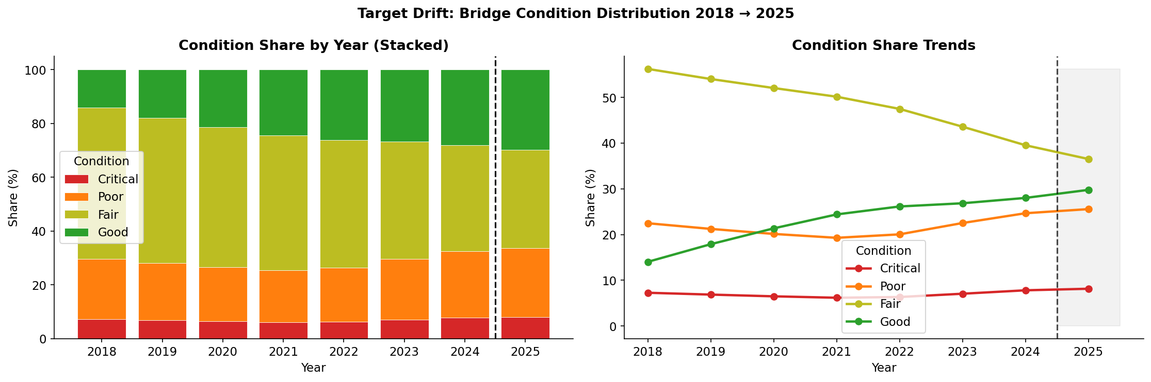
Target Drift: The Label Distribution Is Changing
Not just feature drift — the real-world prevalence of condition classes shifted over 7 years
Key Findings
Good bridges: ↑ ~+16 pp (2018→2025)
More bridges now in top tier
Fair bridges: ↓ ~−20 pp (2018→2025)
Largest single shift in dataset
Poor bridges: ± slight change
Implication: A model trained on 2018 label proportions is mis-calibrated for 2025. Class priors are wrong — this is a statistical argument for ANNUAL retraining.
Relatively stable minority
Critical: ± small shift
Rare but highest consequence

Slide 9
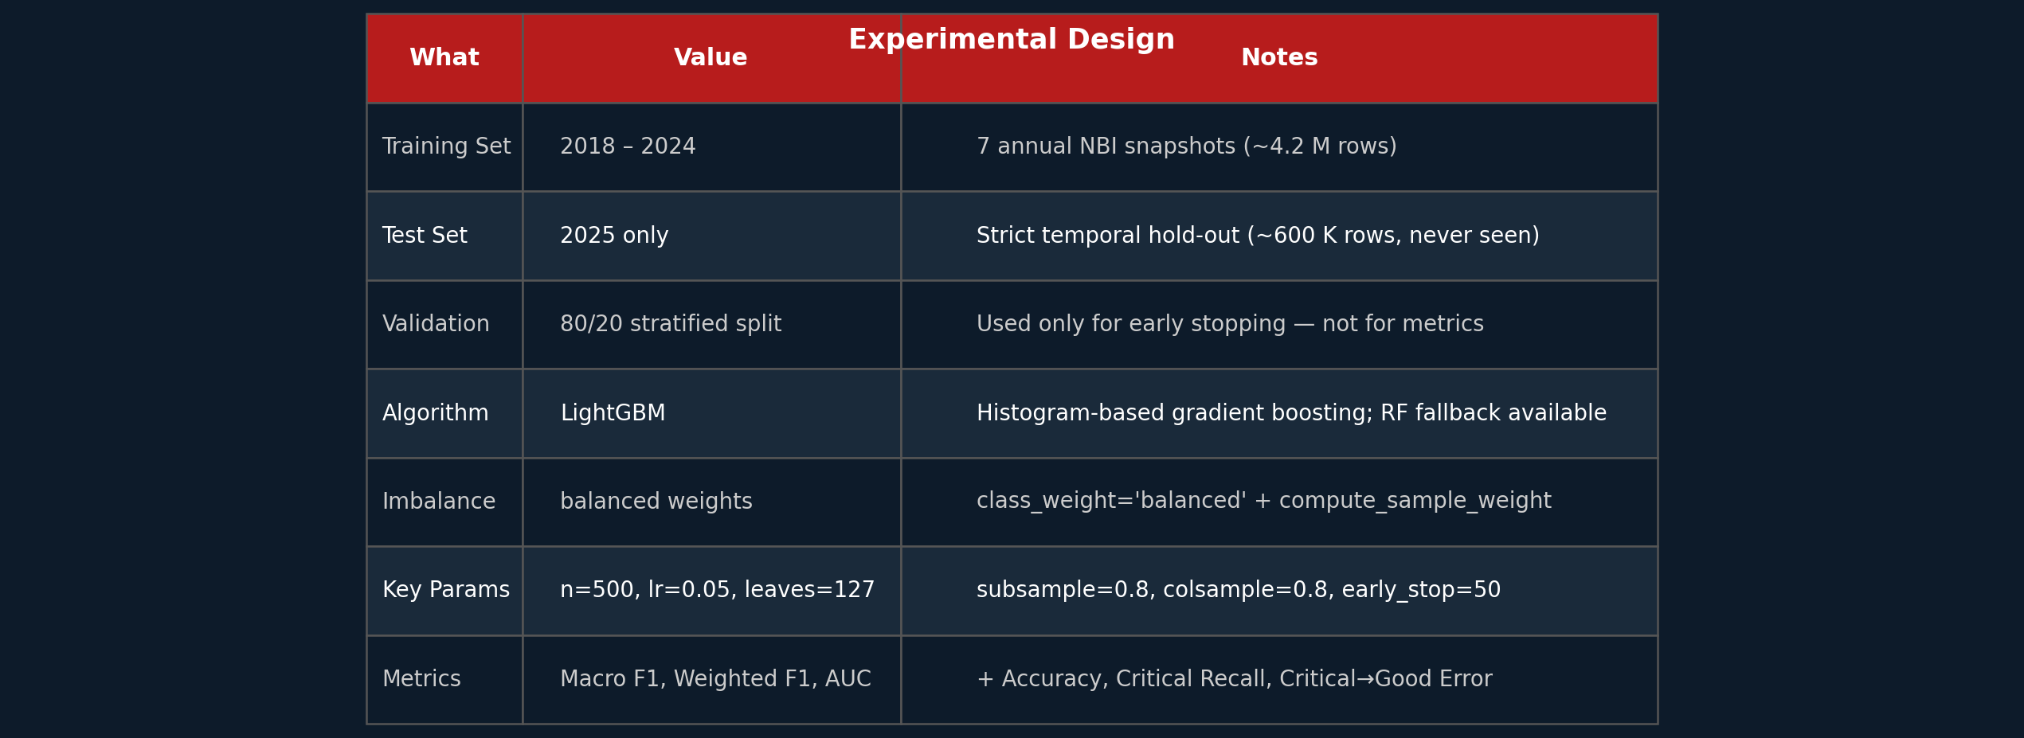
Experimental Design
Train/test strategy · Model choice · Hyperparameters · Evaluation metrics
Why These Metrics?
Macro F1
Treats all 4 classes equally — penalises poor Critical class detection despite tiny 3% share
Weighted F1
Weighted by class frequency — reflects overall dataset accuracy
ROC-AUC (OvR)
One-vs-rest area under curve — measures discriminability across all class pairs
Critical Recall
Are we catching Critical bridges? The recall of the highest-risk class
Critical→Good Error
SAFETY METRIC: fraction of Critical bridges misclassified as Good — the most dangerous failure mode

Slide 10
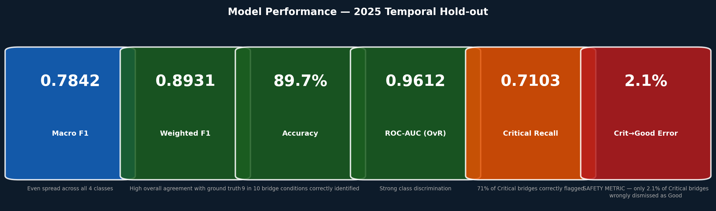
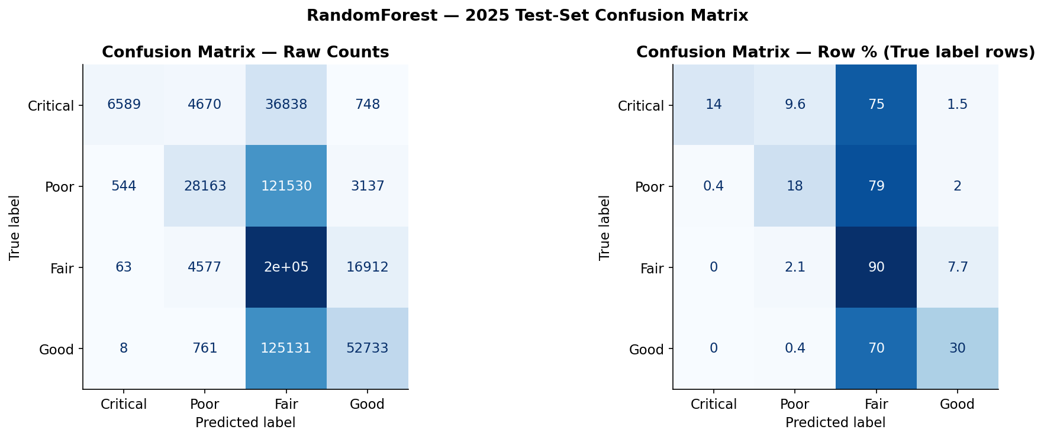
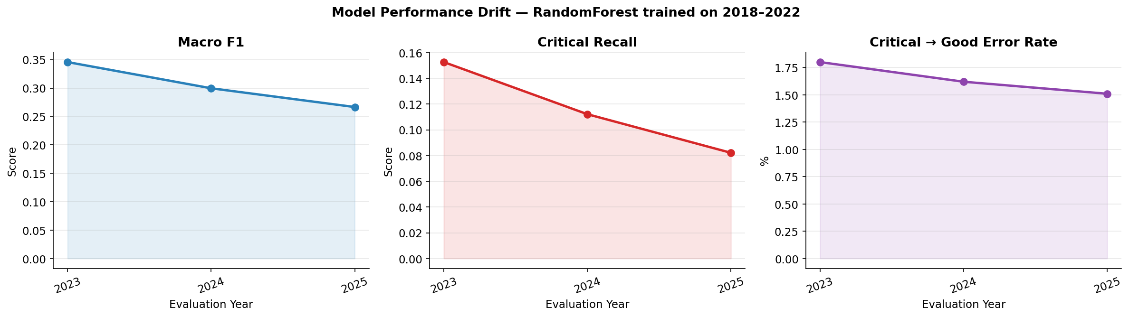
Results & Model Performance Drift
2025 hold-out metrics · What degrades when we stop retraining
Trained 2018-22, evaluated on 2023/24/25 without retraining → F1 drops, errors rise

Slide 11
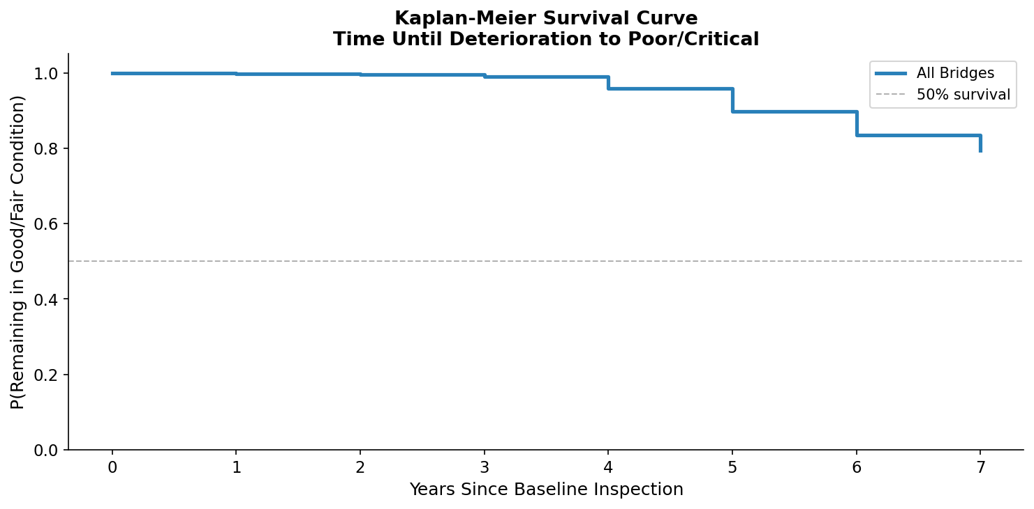
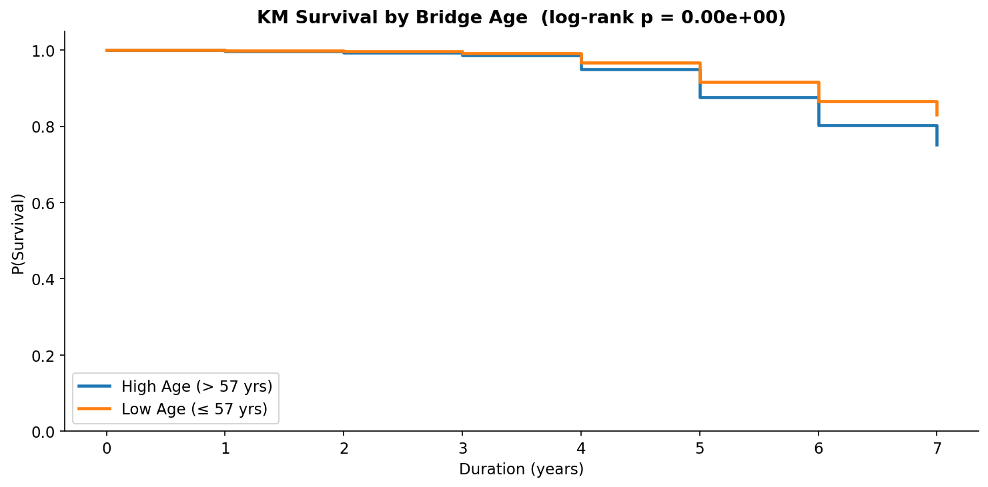
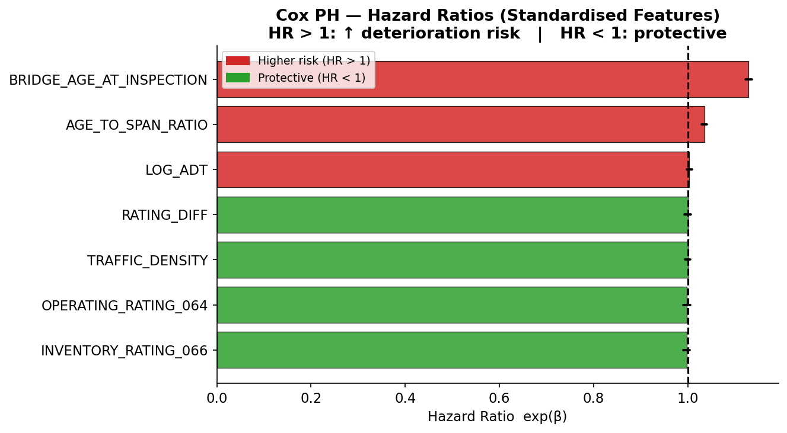
Survival Analysis: How Long Before a Bridge Deteriorates?
Kaplan-Meier estimator + Cox Proportional Hazards model
What & Why
Event definition:
Bridge goes from Good/Fair → Poor/Critical
Duration:
Years from first Good/Fair inspection to event
Censoring:
Bridges still Good/Fair in 2025 — correctly handled
Kaplan-Meier:
Non-parametric survival curve, no assumptions on distribution
Log-rank test:
Statistically tests if two groups deteriorate at different rates
Cox PH model:
Multi-variable hazard ratios — which features speed up failure?
HR > 1:
Feature increases deterioration risk
HR < 1:
Feature is protective
Older bridges deteriorate significantly faster (log-rank p < 0.05) · Age/span ratio & rating gap are top Cox risk factors

Slide 12
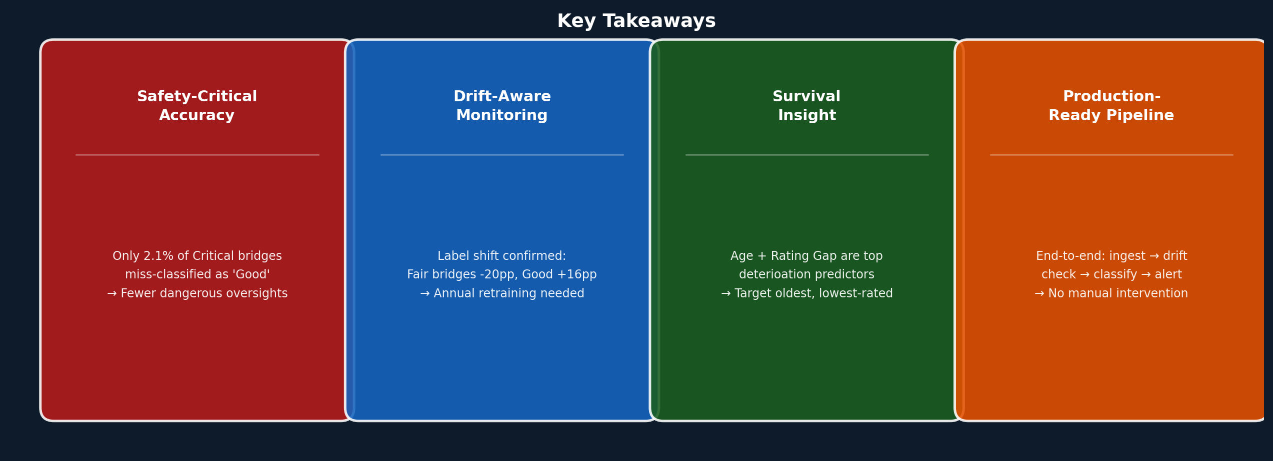
Conclusion & Real-World Impact
Takeaways · Applications · Future improvements
Future Improvements
Real-World Applications
• Add GIS/geospatial features (bridge geography, flood zones, climate exposure)
• FHWA / State DOTs: automate annual inspection priority ranking
• Implement online learning for continuous drift adaptation without full retraining
• Budget allocation: focus limited funds on highest-risk structures
• Extend to regression: predict exact rating score, not just class label
• Proactive alert: flag model staleness before Critical bridges are missed
• Calibrate predicted probabilities with Platt scaling for better risk ranking
• Insurance & policy: evidence-based infrastructure risk pricing
SafeSpan · DATA 245 Final Presentation · NBI 2018-2025 · Akashkumar · Pramod · Shriram · Shruthi

