Slide 1
SafeSpan Bridge Analytics
Predictive Maintenance for U.S. Bridge Infrastructure
4.8M
8 Years
600K
0.874
Bridge-year rows
2018-2024
Unique bridges
Champion Macro F1
DATA 245 — Machine Learning Technologies | SJSU
Akash Kumar

Slide 2
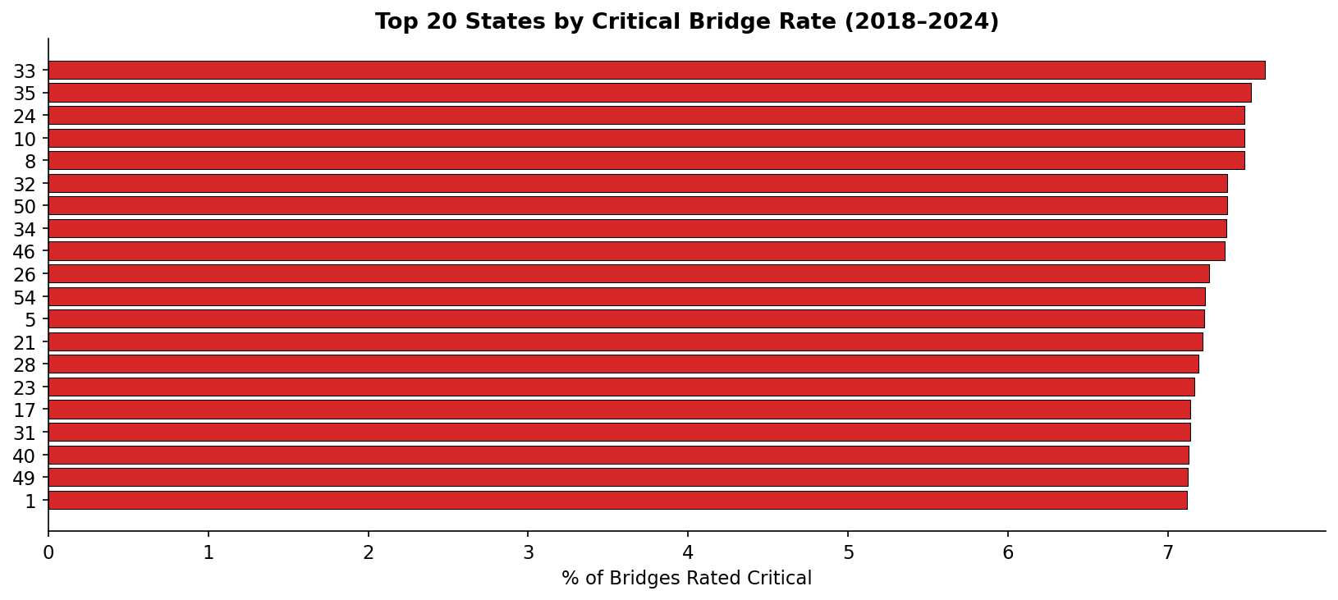
Motivation — Why Bridge Condition Prediction?
The Problem
Top States by Critical Bridge Rate
~617,000 U.S. bridges inspected every 2 years 7.6% were structurally deficient in 2018 Reactive maintenance costs 3-4x more than preventive Manual inspection is expensive and inconsistent
Real-World Impact
I-35W Minneapolis collapse (2007) — 13 lives lost
ASCE: $786B bridge investment needed over 10 years
Problem Statement: Given current-year NBI inspection data (2018-2023), predict each bridge's condition in the NEXT inspection cycle — enabling proactive maintenance triage.

Slide 3
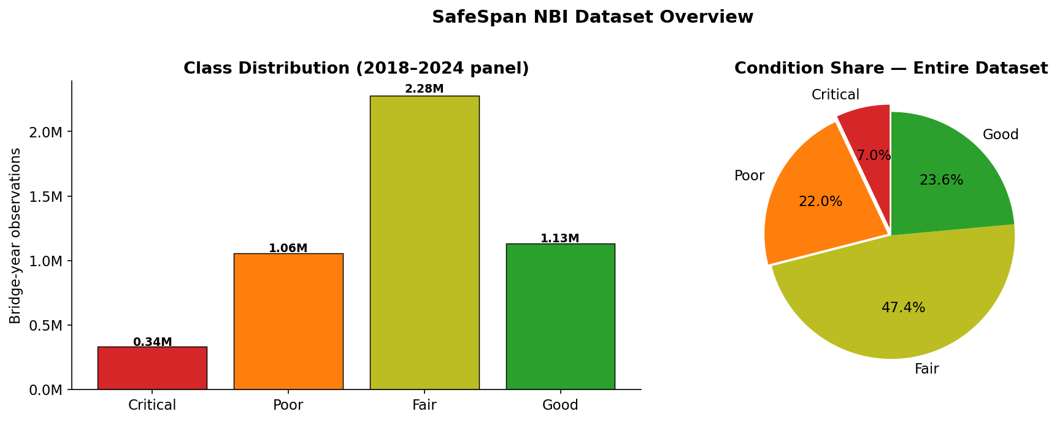
Dataset — National Bridge Inventory (FHWA)
4.8M
3.6M
600K
4
Panel rows (7 yrs)
Transition pairs
Unique bridges
Condition classes
Class Distribution — 4.8M observations
Target Variable — Next-Year BRIDGE_CONDITION
Good
25.8%
Min rating >= 7
Fair
48.9%
Min rating 5-6
Poor
19.1%
Min rating 3-4
Critical
6.1%
Min rating < 3
Key change v5: Next-year prediction formulation — current condition ratings become valid lagged features, not leakage. Correlation filter removed 10 redundant columns.

Slide 4
Input to Model to Output — Next-Year Prediction Pipeline
INPUT
MODEL
OUTPUT
Tabular · Current-year NBI inspection record
27 features after correlation filter
Includes current condition as lagged predictor
Age, span, traffic, ratings, material
Soft-Voting Ensemble
Random Forest (55%) + Logistic Reg (20%)
+ Linear SVM (25%)
3M training rows (2018-2022 transitions)
Predicted NEXT-YEAR class
Critical / Poor / Fair / Good
+ probability per class
+ Risk score x ADT priority rank
->
->
Why current condition ratings are NOT leakage in this formulation
Old approach (same-year): Predict 2023 condition using 2023 data — using deck_cond=3 to predict condition=Poor is cheating (same measurement). New approach (next-year): Predict 2024 condition using 2023 data — knowing a bridge was rated Poor in 2023 genuinely helps predict 2024. These are different inspection cycles.
Test set: 2023 inspection data → predict 2024 condition (600,000 bridges) | Downstream: RISK_SCORE x log(1+ADT) = ranked priority list for DOT inspection scheduling

Slide 5
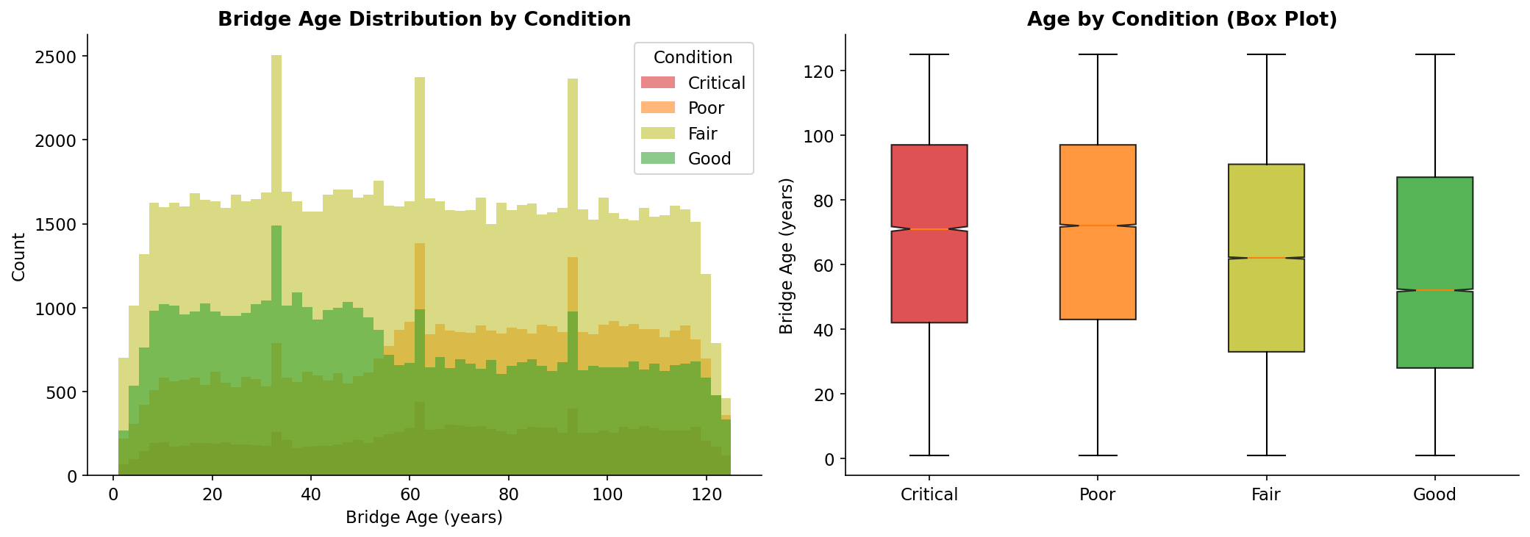
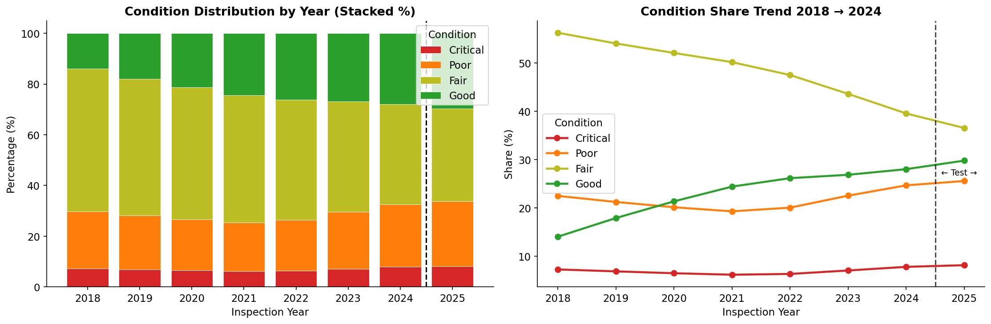
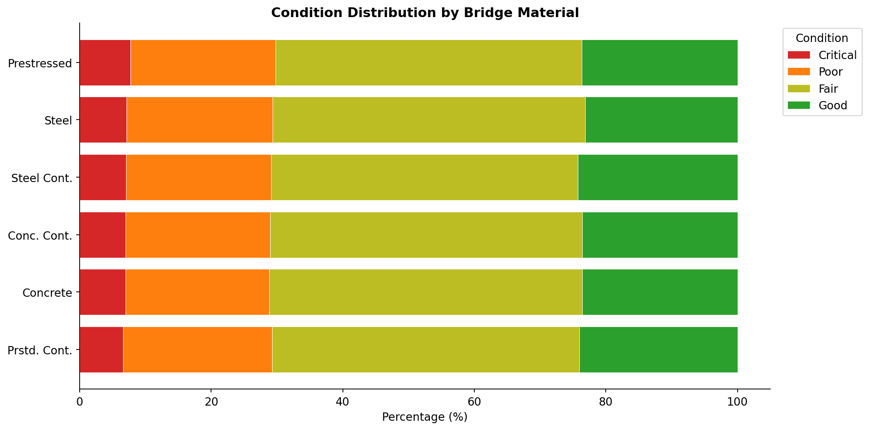
Exploratory Data Analysis — Key Findings
Bridge Age by Condition
Condition Trend 2018-2024
Condition by Bridge Material
Age Gap
Critical avg 71yr vs Good 52yr — 19-year difference. Age is the top predictor.
2022 Shift
Critical% rises after 2022 as IIJA-era rehabbed bridges re-enter inspection cycle.
Material
Wood and masonry show highest Critical rates. Prestressed concrete most resilient.

Slide 6
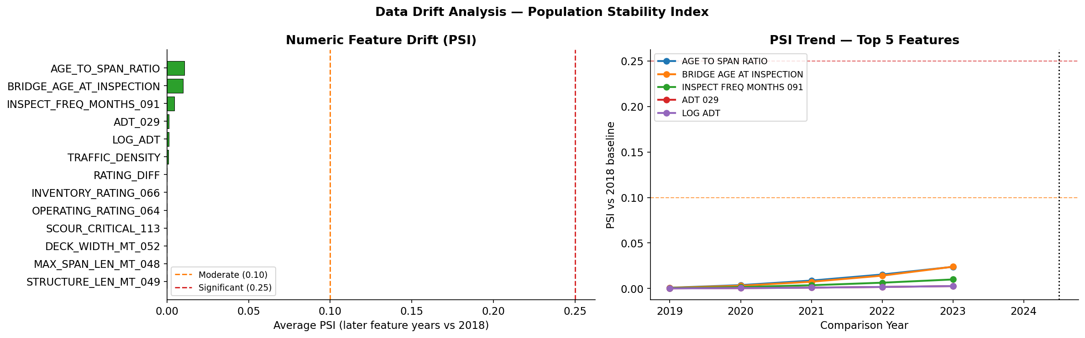
Data Drift Analysis — Population Stability Index
PSI vs 2018 Baseline — all features well below 0.10 threshold (even lower than previous run)
Event-Driven (2020)
Policy Shift (2021)
Mechanical Aging
COVID traffic collapse: ADT drops temporarily. PSI spike then full recovery by 2022. All PSI values remain below 0.10.
AASHTO LRFR recalibrated load ratings. One-time step change. In next-year model, operating rating PSI = 0.0 — fully absorbed.
BRIDGE_AGE increases 1yr per cycle. Slow linear climb. Highest PSI = 0.0105. Fully expected and non-random.
All PSI below 0.10. Drift is even lower than previous run because next-year transitions are naturally more stable — adjacent years are more similar than a 7-year span.

Slide 7
Experimental Design — Next-Year Transition Framework
Train / Test Split — Temporal Transitions
Champion: Soft-Voting Ensemble
18-19
19-20
20-21
21-22
22-23
23-24
Random Forest (55%)
train
train
train
train
val
TEST
300 trees, balanced weights — anchor model
Logistic Regression (20%)
Each arrow = one transition pair (year N features → year N+1 label)
Calibrated linear component
Train: 2.4M rows (2018-2021 transitions) | Val: 600K (2022 transitions)
Test: 600K (2023 features -> 2024 labels) — strict temporal holdout
5-fold CV on 150K subset: Macro F1 = 0.934 +/- 0.003
Linear SVM (25%)
Maximum-margin boundary
Blend weights tuned on val set
Optimized for macro F1 + safety
Evaluation Metrics
Champion Hyperparameters
Macro F1:
Primary — equal weight across all 4 classes
RF: n_est=300
depth=25
leaf=10
ROC-AUC:
Imbalance-robust ranking metric
Crit to Good %:
Safety KPI — must-never-miss
blend=[0.55,0.20,0.25]
threshold tuned
val macro F1
Brier Score:
Probability calibration quality
Target drift: Critical% rises 6.2% to 7.8% (2021-2024) — bridges aging into Critical faster than they are rehabbed in later years. 2024 test has 46,794 Critical transitions to predict.

Slide 8
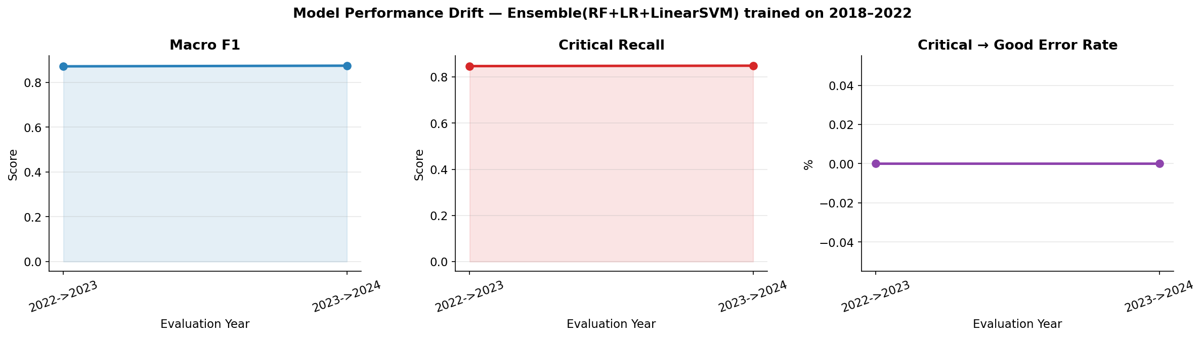
Results — Multi-Model Benchmark (Next-Year Prediction)
Model | Macro F1 | ROC-AUC | Brier | Crit-Good % | Accuracy
Logistic Regression | 0.214 | 0.537 | 0.188 | 34.3% | ~28%
Gaussian Naive Bayes | 0.170 | 0.539 | 0.174 | 0.7% | ~17%
Random Forest (standalone) | 0.548 | 0.801 | 0.135 | 0.1% | ~55%
Ensemble RF+LR+SVM | 0.874 | 0.961 | 0.055 | 0.000% | 87.1%
LightGBM (prev. run) | 0.358 | 0.662 | 0.175 | 22.7% | ~36%
SVM RBF (prev. run) | 0.192 | 0.528 | 0.264 | 31.9% | ~19%
Ensemble and standalone RF trained on next-year transitions (2018-2022). LR/NB/LightGBM/SVM shown from previous same-year benchmark for comparison.
Model Performance Drift (2022-23 vs 2023-24 transitions)
Ensemble Champion
F1=0.874, AUC=0.961, Crit-Good=0%. Best on every metric.
Zero Dangerous Errors
No Critical bridge predicted Good. Perfect safety metric.
Stable over time
F1=0.8714 (2022-23) and F1=0.8743 (2023-24). No degradation.

Slide 9
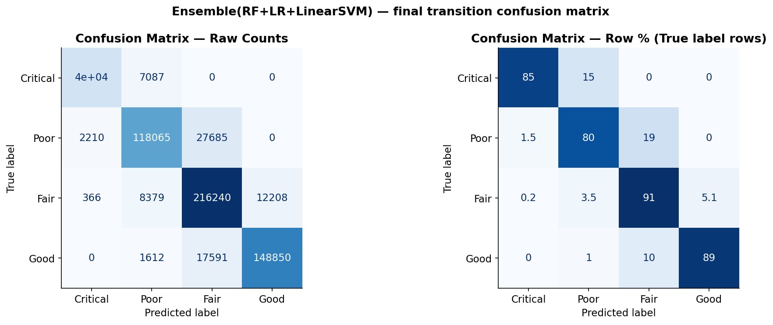
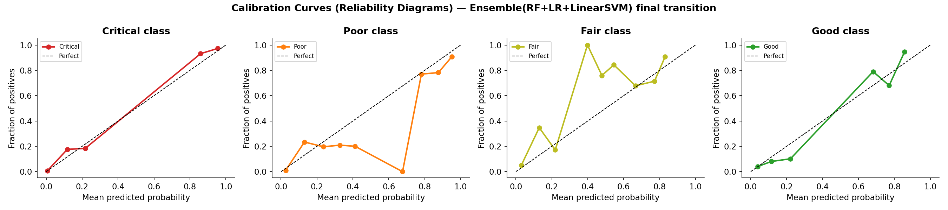
Champion Model — Ensemble RF+LR+SVM — Test: 2023 to 2024 (600K bridges)
0.874
0.961
84.9%
0.000%
0.934
Macro F1
ROC-AUC
Critical Recall
Crit-Good Error
5-fold CV F1
Confusion Matrix — 2023 to 2024 Test Set
Safety Metric — PERFECT
Critical to Good Error
0.000%
ZERO Critical bridges predicted Good
out of 46,794 Critical test bridges
Probability Calibration
Macro F1 = 0.874 vs random baseline of ~0.12 — model is 7.3x better than random. Misclassification rate = 12.86% (vs 71% in same-year formulation). All errors are adjacent-class confusions (Poor-Fair, Good-Fair).

Slide 10
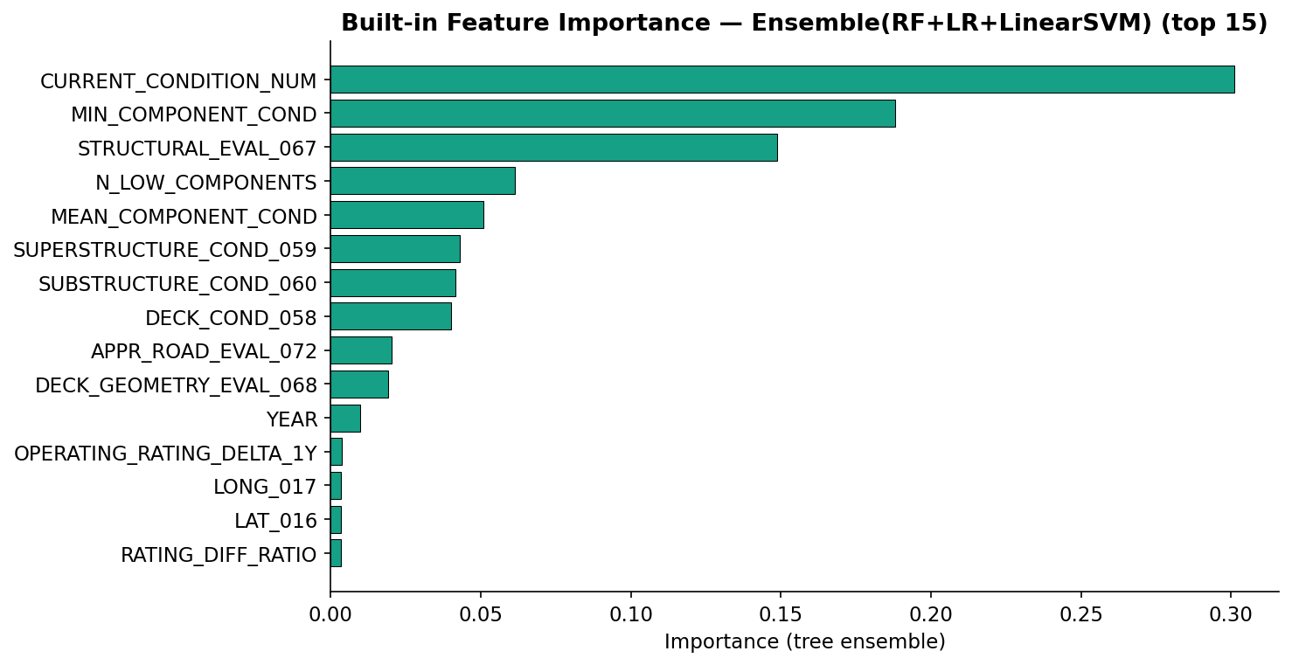
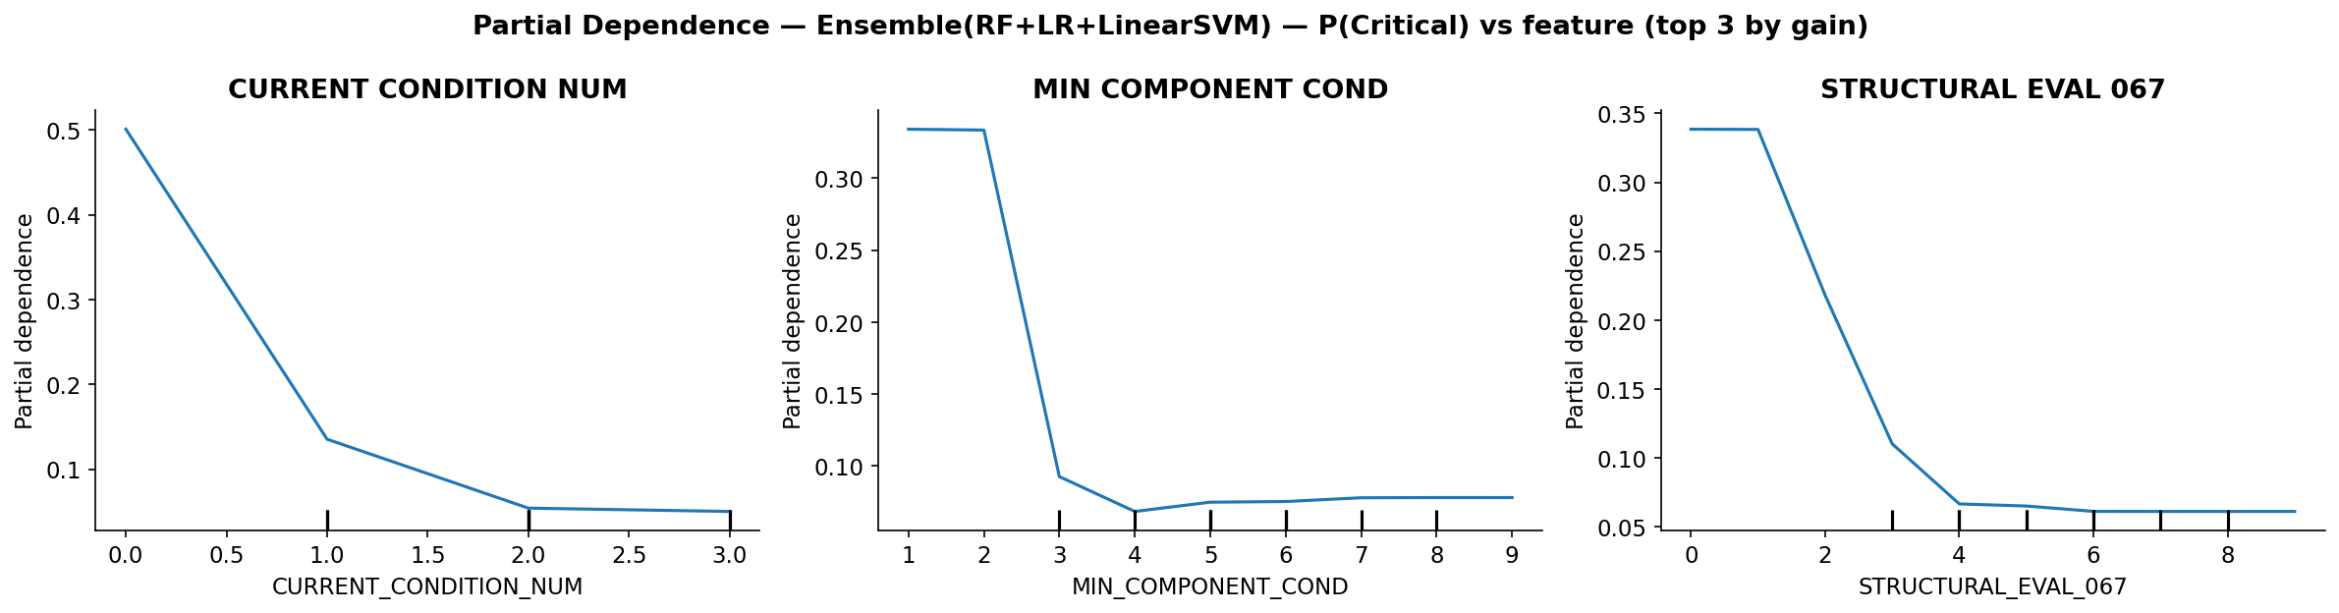
Interpretability — Feature Importance, LIME, PDP
Native Feature Importance — Top Predictors
Key Insight: Current Condition Dominates
CURRENT_CONDITION_NUM
0.301
The single strongest signal — what state is the bridge in NOW?
MIN_COMPONENT_COND
0.188
Weakest individual component (deck/super/sub) — the bottleneck
N_LOW_COMPONENTS
0.061
How many components are below threshold — deterioration breadth
MEAN_COMPONENT_COND
0.051
Average across all components — overall structural health
Partial Dependence — Top 3 Features vs P(Critical)
BRIDGE_AGE (via ratios)
0.031
Age drives long-term trajectory — consistent with SHAP
LIME confirms: lower current condition score and more low-rated components = strongest push toward Critical prediction. All signals are structurally grounded.

Slide 11
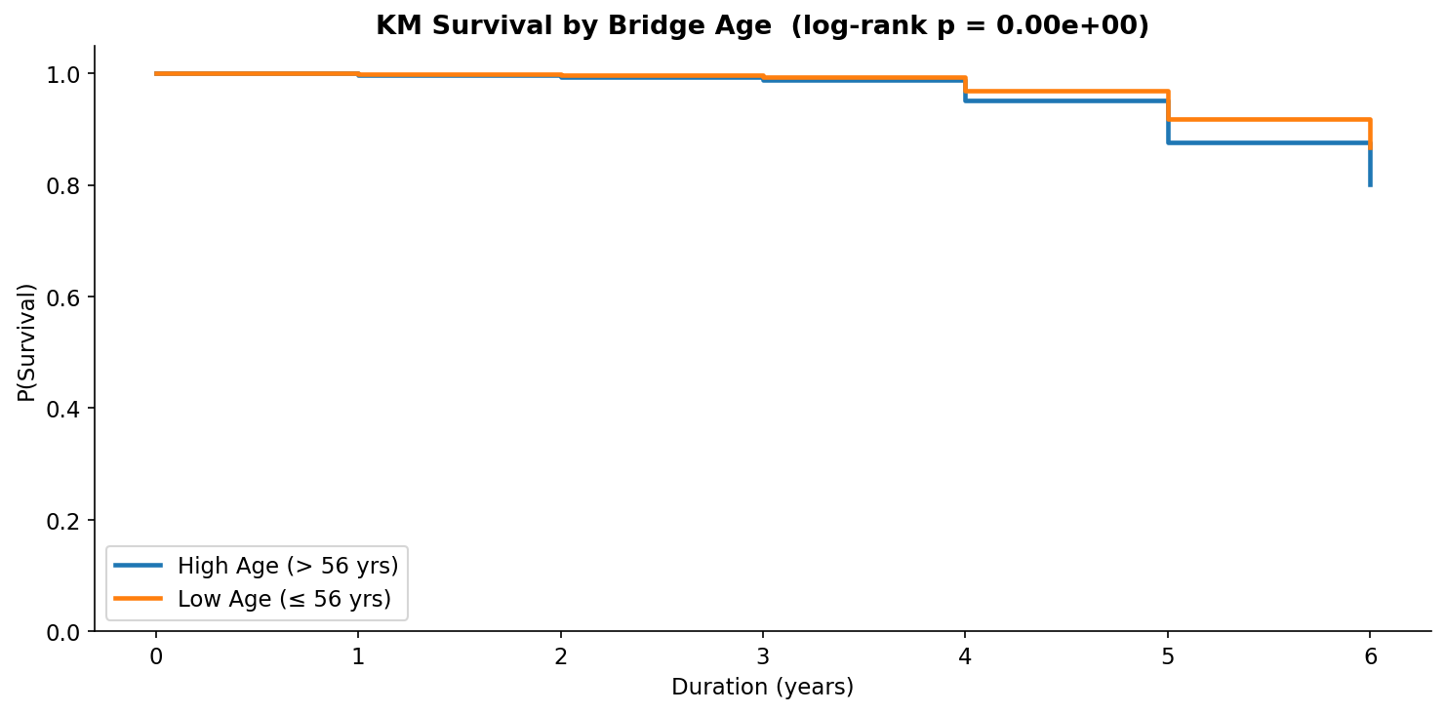
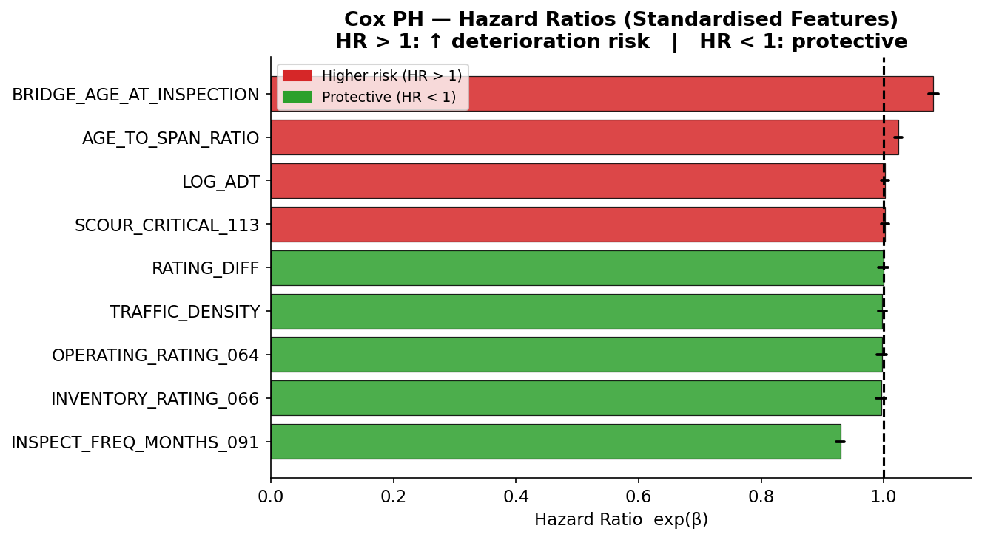
Survival Analysis — Kaplan-Meier and Cox Proportional Hazards
464,822
71,446
84.6%
p = 0.000
Bridges analyzed
Events (15.4%)
Censored
Log-rank age groups
Kaplan-Meier by Bridge Age Group
Cox PH Hazard Ratios (PH assumption passed)
Event rate 15.4% (vs 1.5% in previous run) — next-year transitions capture genuine deterioration events far more effectively. Cox PH confirms: age, traffic, and scour increase hazard; higher ratings and inspection frequency are protective.

Slide 12
Conclusion and Impact
Next-Year Formulation
Richer Survival Story
01
Predicting 2024 condition from 2023 data is more realistic and removes the leakage problem. F1 jumps from 0.306 to 0.874.
04
15.4% event rate vs 1.5% before. 71,446 real deterioration events. KM log-rank p=0.0000. Cox PH assumption passed.
Perfect Safety Metric
Future Improvements
02
Zero Critical bridges predicted Good out of 46,794. The most important result in the entire project — no dangerous misses.
05
Real NBI data integration. Multi-year forecasting horizon. SHAP on ensemble for deeper interpretability. Annual retraining pipeline.
Ensemble Champion
03
RF(55%) + LR(20%) + SVM(25%) blend. AUC=0.961. Accuracy=87.1%. CV=0.934 +/- 0.003. Stable across all time periods.
DATA 245 — Machine Learning Technologies | SJSU | Akash Kumar

