Slide 1
Injury Prediction in Mining Industry through Applied Machine Learning Approaches
Name: Akash Manjunatha
Student ID: 21141797
Lecturer – Christian Horn

Slide 2
Title and content
Introduction
Research Question
Previous Research Study
Research Methodology
Design Specification
Implementation and Evaluation
Case studies
Conclusion

Slide 3
Introduction
The mining industry is one of the most significant sectors of the American economy.
Roughly 301,464 miners were working in about 12,592 active mines in 2021, producing about 577 million tons of coal in 2021 alone
Creation of the mine safety and health administration (MSHA) and the occupational safety and health administration (OSHA).
In this research, the degree of injury will be predicted by machine learning and deep learning techniques to improve health and safety in mining industry
Stake holders: Mining workers, mining companies and the government.

Slide 4
Research Question
“How effective are machine learning and deep learning algorithms at accurately predicting the degree of injuries in the mining industry and how can these predictions be used to improve health and safety measures?”

Slide 5
Previous Research
Analytical Techniques for Measuring the Health and Safety Risks in the Mining Industry
Forecasting Workplace Injuries by the Application of Machine Learning Techniques.
Deep Learning and Machine Learning Techniques’ Dependability in Answering the Research Question.
Limits and Take away

Slide 6
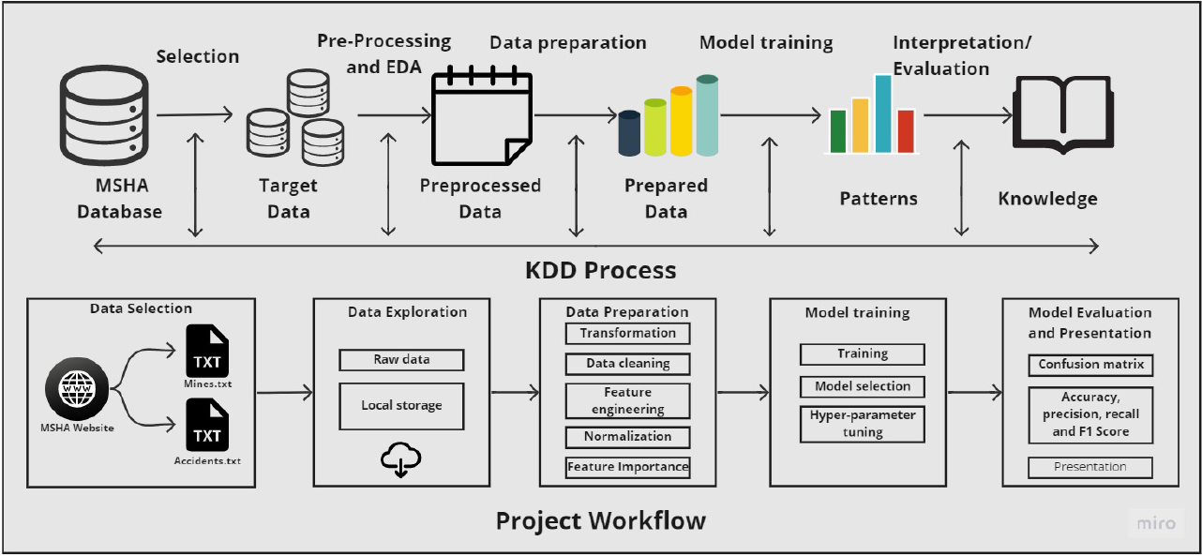
Research Methodology
Knowledge discovery in the database methodology
Knowledge discovery in the database(KDD) workflow

Slide 7
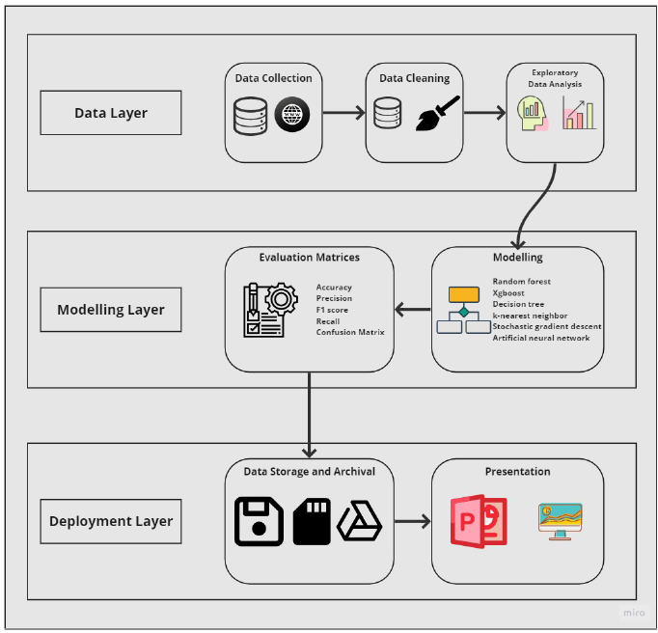
Design Specification

Slide 8
Implementation and Evaluation
A. Five machine learning, one deep learning are used in this project
Random Forest Classifier(RF)
Decision Tree Classifier(DT)
K-nearest neighbors(KNN)
Extreme Gradient Boosting(XGBoost)
Stochastic Gradient Descent classifier(SGD)
Artificiel Neural network(ANN)
B. Evaluation Matrix
Confusion matrix
Accuracy
Precision
Recall
F1 score
Model training

Slide 9
Target Variable Case study 1

Slide 10
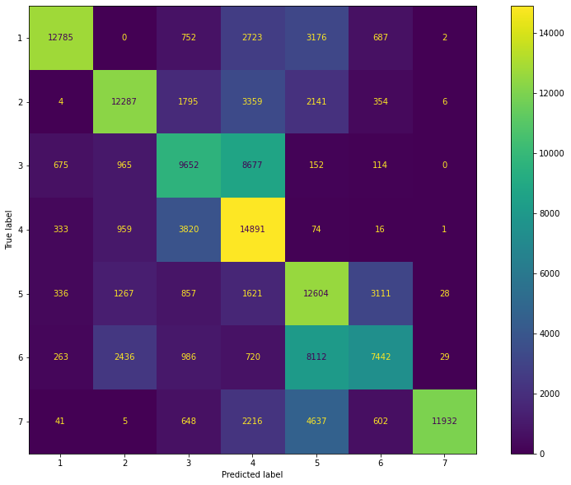
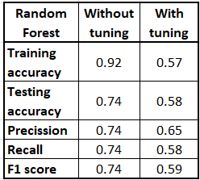
Case Study 1: Injury Prediction with all the Degrees of Injury Categories
Model results
Confusion-Matrix

Slide 11
Target Variable Case study 2
Merged outcome
0
Merged outcome
1
Outcome: whether workers will take a day off work or not due to their injuries.

Slide 12
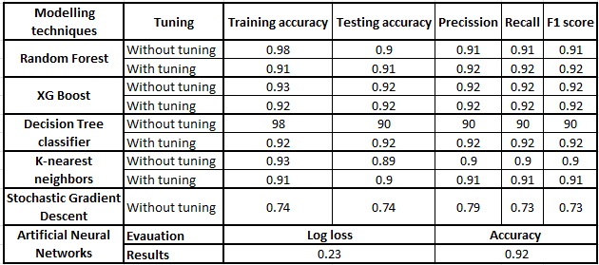
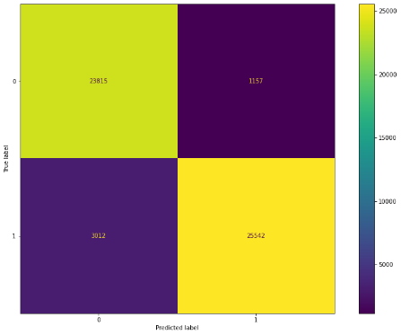
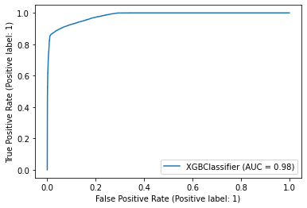
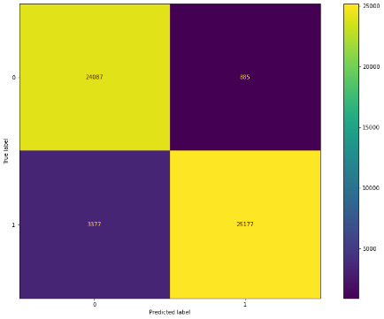
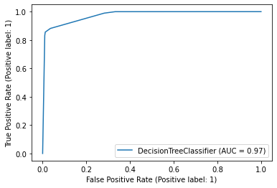
Case Study 2: Injury Prediction by Merging the two categories
Model results
XG Boost hyper
parameter tuning
results
Decision tree
hyper parameter tuning
results
Confusion-Matrix

Slide 13
Target Variable Case study 2
Addition to case study 2
Merged outcome
1
Merged outcome
4
Merged outcome
6

Slide 14
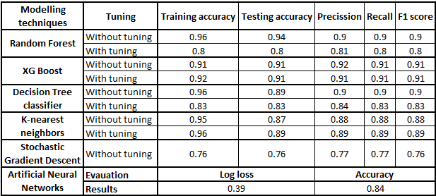
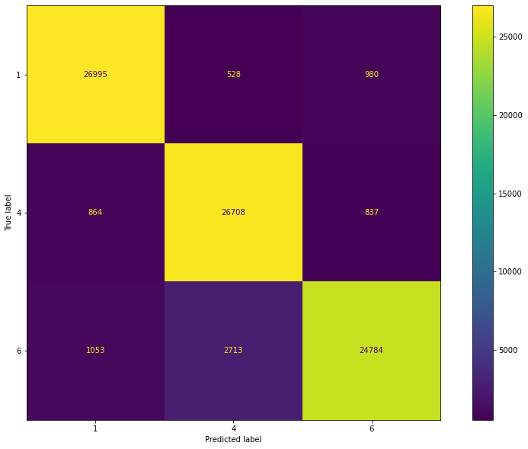
Case Study 3: Injury Prediction by Merging the three categories
Model results
Confusion-Matrix

Slide 15
Conclusion
To summarize, this study will aid in the comprehension and application to improve the health and safety of mining industry employees.
Case study 1 analysis evaluation helped in making assumptions.
In the second case study, similar categories were combined, binary classification was carried out, and XGboost, decision tree, and ANN algorithms produced results with about 92 percent accuracy.
In the third case study, additional death and permanent injury were combined and added to the case study two categories hyperparameter tweaking the XGBoost algorithm and helped the research reach its goals.
This information can be used by companies to better predict and prevent injuries and to improve their health and safety measures.

Slide 16
Thank You

