Slide 1

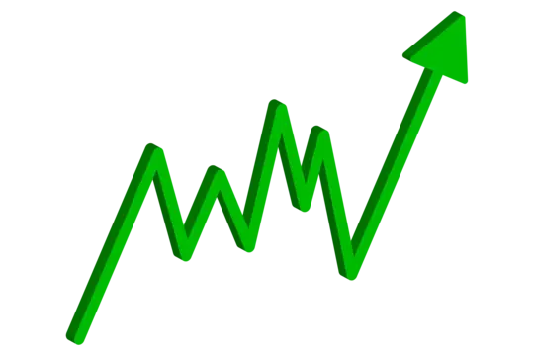

The Standard and Poor's 500
Analysis

Slide 2

S&P500 ?
Standard & Poor's 500, is a stock market index that tracks the performance of 500 of the largest publicly traded companies in the United States

Slide 3






Insights
Index
Stocks
The CAGR of the S&P 500
Index is 10.84%.
Best Year: 2021, with an increase
of 1,010 points.
Worst Year: 2022, with a drop
of 926 points. In 2023, the index
rebounded with a gain of 930
points. Recent times have seen
significant volatility.
NVIDIA leads in market cap and revenue
growth.
Tesla is highly volatile.
Biggest Employers: Walmart
(2,100,000 employees), Amazon
(1,525,000 employees), and Accenture
(742,000 employees). 322 companies
have outperformed the index (10.84%
CAGR).
Top Stocks: NVIDIA, Tesla, and Broadcom
Inc. have the highest CAGR at 49%, 40%,
and 40%, respectively. NVIDIA and
Broadcom Inc. are in the technology
sector and semiconductor industry,
indicating a booming sector.

Slide 4
10.92%
Index CAGR

Slide 5
Index Growth by Year
In 2018, the index dropped by 166 points. After that, it rose continuously for several years until 2022, when it dropped by 926 points. The next year, the market recovered and gained 930 points. The biggest jump from 2016 to 2024 was in 2021, just after COVID, with a gain of 1,010 points.

Slide 6
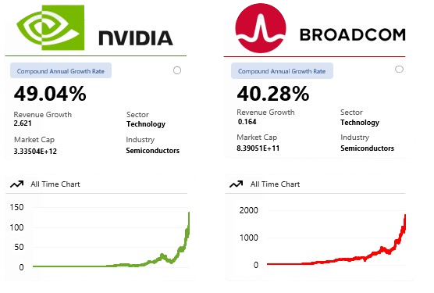
Best Stocks
Top Stocks: NVIDIA, Tesla, and Broadcom Inc. have the highest CAGR at 49%, 40%, and 40%, respectively. NVIDIA and Broadcom Inc. are in the technology sector and semiconductor industry, indicating a booming sector.
NVIDIA leads in market cap and revenue growth.
Tesla is highly volatile.

Slide 7
Companies by Country
Countries
449
9
449
4
3
United States
2
1
1

Slide 8

Employees Count
Walmart : 2,100,000
Amazon : 1,525,000
Accenture : 742,000
United Parcel Service : 500,000
Home Depot : 465,000

Slide 9



Thanks!
Do you have any questions?
akashm8606@gmail.com

