Slide 1

Department of CSE(AI&ML)
Academic year: 2023-24
Mini Project (21AIMP67) – Review 1 Presentation
Project Title : Human Stress Analyzer
PROJECT TEAM:
1. Akash Ningaiah Sthavaramatha (1DB21CI005)
2. Mithun M (1DB21CI044)
GUIDE:
Dr.Kursheed B
Assistant Professor
Department of CSE(AI&ML)
DBIT, Bengaluru

Slide 2
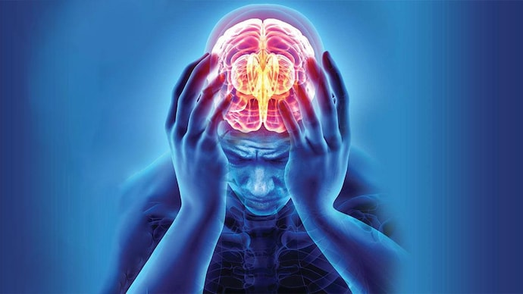
Contents
Index
Introduction
Problem Statement
Objectives
Prototype
Hardware & Software Requirements
Conclusion and Future Scope
References

Slide 3
INTRODUCTION
This web app offers a simple and accessible way to understand your stress levels.
Unlike other methods that rely on video or sensors, this app uses sliders to gather information about your current state (mood, sleep, workload, etc.).
Behind the scenes, a machine learning model analyzes your input and estimates your stress level.
With clear results and potential next steps, this app empowers you to take charge of your well-being and explore stress management strategies.
Interactive Human Stress Level Assessment using Python

Slide 4
PROBLEM STATEMENT
While various methods exist for stress detection, such as video analysis or physiological monitoring, they can be intrusive and expensive. There is a need for a more accessible and user-friendly approach to assess stress levels for individuals seeking to manage their well-being.
Our goal is to address this need by developing an advanced real-time human stress analysis system. This innovative tool aims to provide a comprehensive understanding of stress levels by accurately monitoring and analyzing physiological data.
In today's fast-paced world, understanding and managing human stress is crucial across various domains such as workplace productivity, healthcare, and personal well-being.

Slide 5
OBJECTIVES
Primary Objective: Develop a web application that estimates a user's current stress level based on self-reported information.
Secondary Objective: Raise awareness about stress and its associated features through informative text.
Additional Considerations: To ensure User-friendliness, increase accuracy of the model and easy Accessibility.

Slide 6
Design/Model
Data Collection
Data Preprocessing
Model Training
Personal AI Based Recommendations
Stress Analysis

Slide 7
SOFTWARE REQUIREMENTS
HARDWARE REQUIREMENTS
Laptop: PC with minimum 4GB to 8GB RAM, and with minimum 4 GB of storage space.
Wearable Devices: Such as Fitbit, Apple Watch, or specialized stress monitoring devices for collecting physiological data.
Windows 7 or more
VS Code IDE
Python version 3.11 or above

Slide 8
TOOLS USED FOR DEVELOPMENT
Language: Python - Versatile for web dev, machine learning, and data analysis.
Web Frameworks: Streamlit (Simple) - Easy to build interfaces with sliders and results.
Machine Learning Libraries: scikit-learn (Basic), TensorFlow/Keras (Advanced)
Chatbot: Conversational chatbot for Stress based recommendations.

Slide 9
OUTCOME
Empowerment: Users gain control by understanding their stress levels and exploring personalized management strategies.
Stress Awareness: The app sparks self-reflection and helps users identify stress triggers.
Well-being Boost: Reduced stress can lead to better sleep, focus, and overall mental health.

Slide 10
CONCLUSION & FUTURE SCOPE
In conclusion, the Human Stress Analyzer project has shown promising results in using technology to monitor and manage stress levels effectively. This innovation has the potential to revolutionize mental health support by providing real-time insights and personalized interventions, paving the way for healthier lifestyles and improved well-being.
Thermal Imaging Based Detection .
Workplace Applications.
Research and Development.
Integration with Other Technologies.
API based approach.

Slide 11
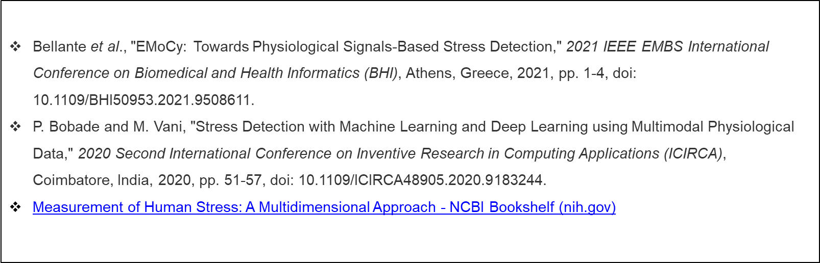
References

