Slide 1
SHOPPING BEHAVIOR ANALYSIS
What 3,900 purchases reveal about shopping behavior
A concise case study in customer signals, commercial patterns, and practical decisions.

Slide 2




THE ANALYSIS
The analysis connects customer signals to business decisions
Workflow
Dataset
Prepare
Analyze
Decide
3,900 purchases across 18 columns, four categories, 50 locations, and 25 products.
Clean in Python. Missing Review Rating values noted as 37 and imputed using the category-median method.
Analyze in PostgreSQL to connect customer, product, service, and purchase signals.
Visualize in Power BI, then translate the findings into campaigns, offers, and tests.
02

Slide 3
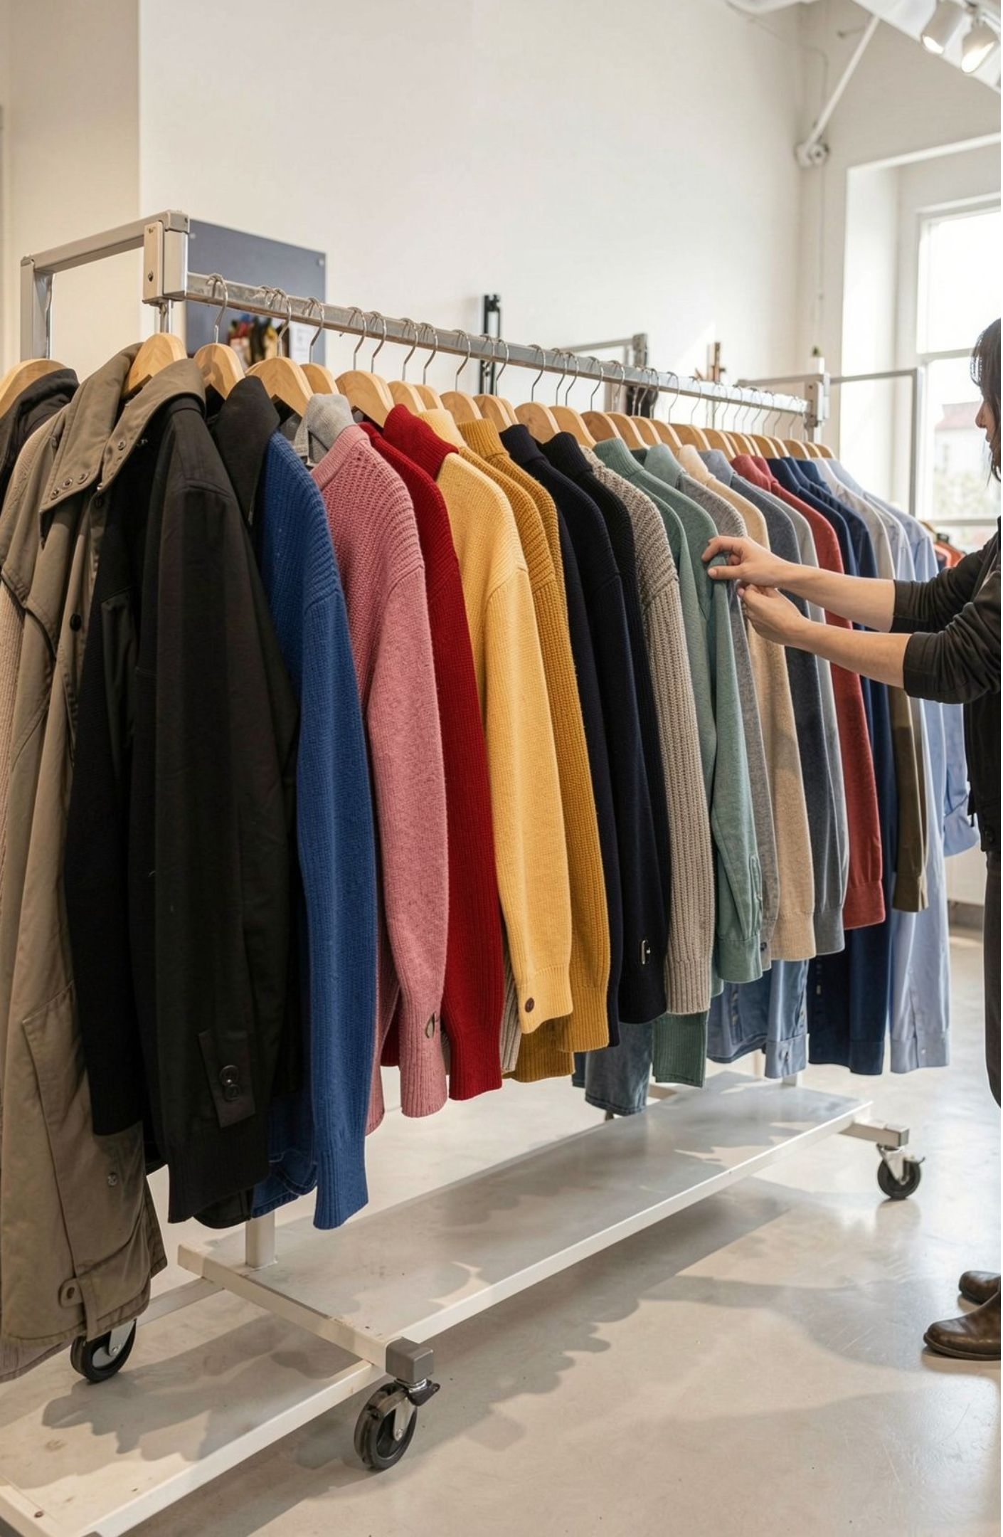
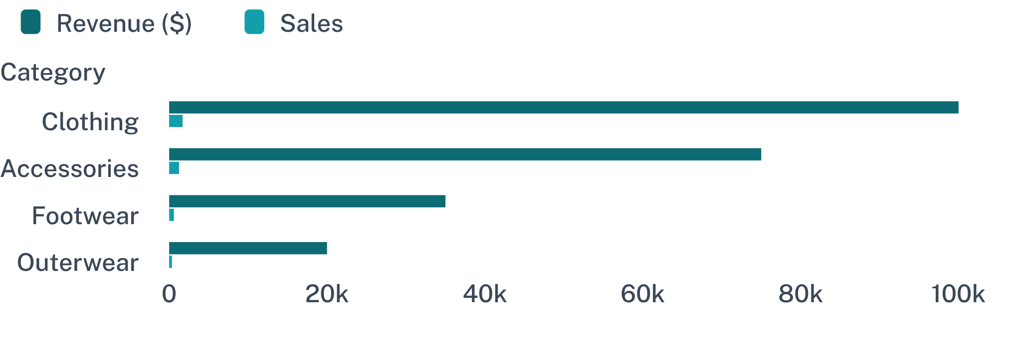
COMMERCIAL MIX
Clothing is the commercial center of gravity
Clothing leads both revenue and sales, with Accessories a clear second tier.
Revenue and sales by category
03

Slide 4

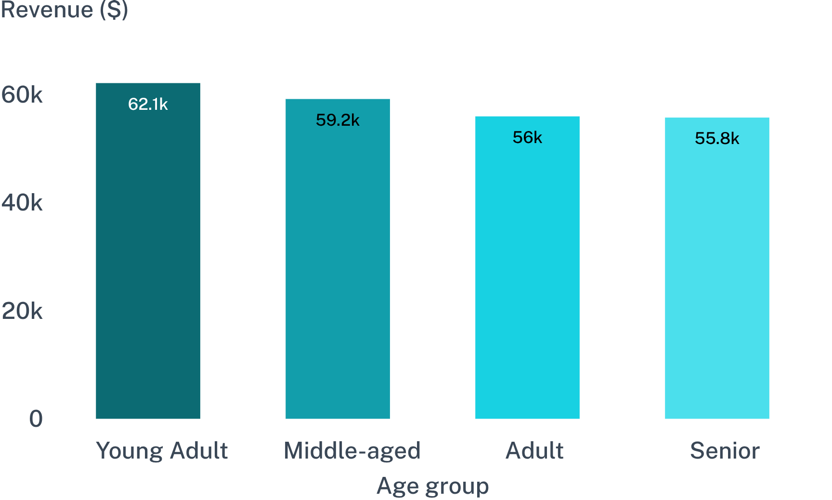
CUSTOMER COHORTS
Young adults are the strongest revenue cohort
Young Adults contribute the most revenue, with the other cohorts relatively close behind.
Revenue contribution: Young Adult $62,143; Middle-aged $59,197; Adult $55,978; Senior $55,763.
The age spread is meaningful enough to support targeted campaigns rather than one broad message.
04

Slide 5
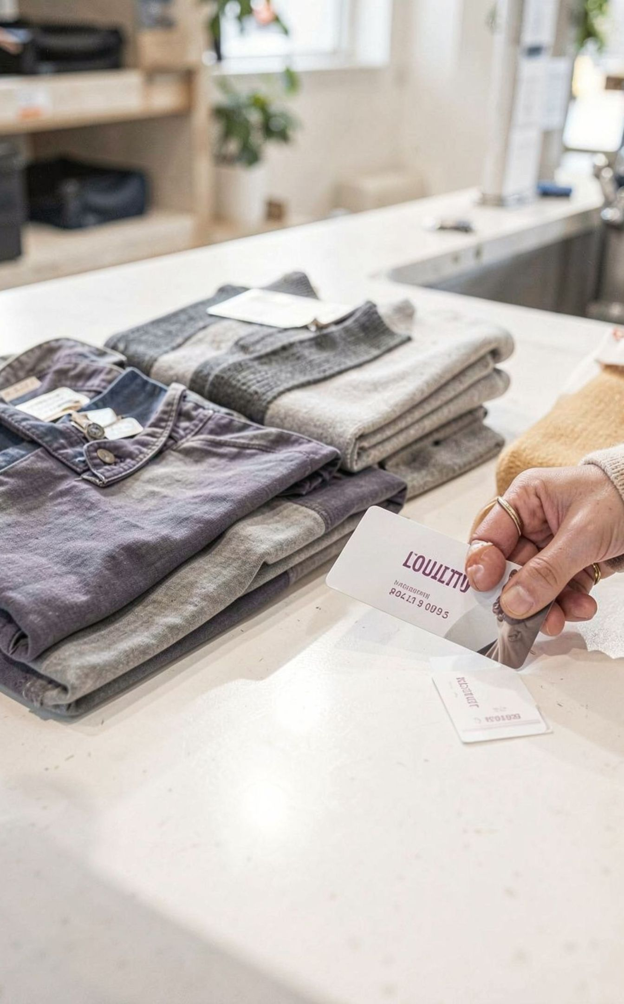
LOYALTY AND MEMBERSHIP
The business has a loyalty base, but subscriptions lag
The loyalty base is strong. The subscription relationship is still underdeveloped.
3,116
1,053
2,518
Loyal customers
Subscribers
Repeat buyers who are non-subscribers
Customer segments: 3,116 Loyal, 701 Returning, and 83 New. Subscription split: 1,053 subscribers versus 2,847 non-subscribers.
05

Slide 6
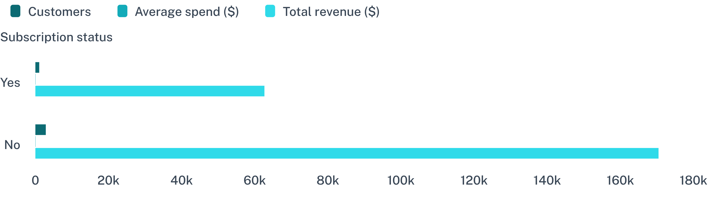
MEMBERSHIP VALUE
Subscription status is not yet lifting average spend
Subscribers and non-subscribers spend almost the same per purchase. The opportunity is to make membership benefits feel valuable, not simply available.
Non-subscribers drive more total revenue because they are the much larger group, while average spend is nearly identical.
06

Slide 7
PROMOTION ECONOMICS
Discounts can drive volume without guaranteeing value
High-spending discount users: 839 customers spent above the $59.76 average purchase amount while using discounts.
Most discount-dependent products: Hat 50.00%, Sneakers 49.66%, Coat 49.07%, Sweater 48.17%, Pants 47.37%.
Use discounting selectively where it expands demand, then protect margin on products that already convert.
07

Slide 8

PRODUCT SIGNALS
Product signals point to clear campaign candidates
Pair proof of satisfaction with proof of demand in merchandising and campaign creative.
TOP-RATED
Gloves 3.86 · Sandals 3.84 · Boots 3.82 · Hat 3.80 · Skirt 3.78
TOP SELLERS BY CATEGORY
Jewelry · Blouse · Sandals · Jacket
08

Slide 9
SERVICE SIGNALS
Small service differences can reinforce the purchase decision
Express-shipping users are a natural audience for convenience-led messaging and premium fulfillment tests.
SHIPPING OPTION | AVERAGE PURCHASE AMOUNT | WHAT IT SUGGESTS
Express shipping | $60.48 | Convenience may support a slightly higher purchase amount.
Standard shipping | $58.46 | Use as the comparison point for premium fulfillment tests.
09

Slide 10
FROM ANALYSIS TO ACTION
Five moves turn the analysis into action
Build a subscription offer around exclusive benefits and test uptake among repeat buyers.
Create loyalty rewards that move Returning customers toward Loyal status.
Rebalance discounting around products with the highest discount dependence.
Feature top-rated, high-volume products in targeted campaigns.
Prioritize Young Adult and convenience-oriented segments in acquisition and retention tests.
10

