Slide 1

SISTEC GANDHINAGAR, BHOPAL DEPARTMENT OF COMPUTER SCIENCE & ENGINEERING
MINOR PROJECT
ACTIVE FACE RECOGNITION ATTENDANCE SYSTEM
PROJECT GUIDE : GROUP MEMBERS :
PROF. BHAVNA SONI
AAVI AGRAWAL
ADNAN BAIG
AKASH PRAJAPATI
ARHAMA KHAN
AAKASH TIWARI
DIVYA DHANWANI

Slide 2
INTRODUCTION
Face recognition : Face recognition is a biometric technology that uses algorithms and machine learning to identify or verify a person by analyzing patterns based on the person's facial features. It involves detecting a human face in an image or video, extracting its unique features (such as eyes, nose, mouth, and their relative positions), and comparing them to a database of known faces to find a match.
Applications of face recognition in various industries:
Security and Surveillance: Used in public safety systems, airports, and security-sensitive zones to identify criminals or track missing persons.
Retail and Customer Service: Used to track customer preferences and deliver personalized experiences in stores or online.
Mobile Devices and Authentication: Face recognition is integrated into smartphones and laptops to unlock devices, authorize payments, and verify identity.
Banking and Finance: Employed for secure authentication in banking transactions, reducing the risks of fraud and identity theft.
Healthcare: Utilized to monitor patients, track their movements, and even diagnose certain health conditions based on facial expressions.

Slide 3

PROBLEM STATEMENT
Issues with traditional attendance methods:
Time-consuming and error-prone
Risk of proxies and human manipulation
Difficulty in managing large groups
Need for an automated system:
Faster
More Efficient
Secure

Slide 4
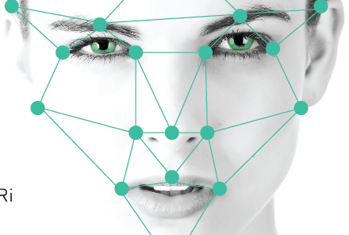








OBJECTIVE OF THE PROJECT
Primary goal:
To develop an active face recognition-based attendance system
that ensures automatic, accurate, and proxy-free attendance
marking.
Key objectives:
Real-time face detection and recognition
Integration with databases for storing attendance data
User-friendly interface for easy management

Slide 5

HOW FACE RECOGNITION WORKS
Stages in face recognition:
Face Detection: Identifying human faces in an image or video stream.
Feature Extraction: Extracting key facial features (e.g., eyes, nose, mouth).
Face Matching: Comparing the extracted features to a stored database of faces.
Technology used:
Deep learning, neural networks, and machine learning algorithms (e.g., OpenCV, TensorFlow)

Slide 6
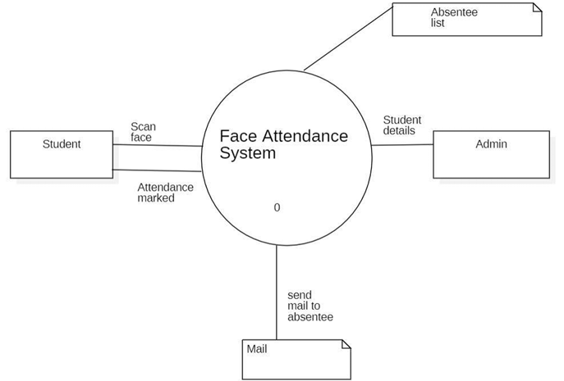
SYSTEM ARCHITECTURE
Components of the system:
Camera: Captures real-time face images
Face Recognition Module: Detects and recognizes faces
Attendance Database: Stores attendance records
User Interface: For administrators to manage attendance and records

Slide 7

TOOLS AND TECHNOLOGIES
Programming languages:
Python (for face recognition algorithms)
Libraries and frameworks:
OpenCV (for image processing)
Dlib (for face detection)
TensorFlow/Keras (for deep learning models)
Hardware:
Standard laptop/computer with a camera, or Raspberry Pi for a smaller system.

Slide 8

IMPLEMENTATION
Step-by-step process:
Set up camera input for real-time face detection.
Apply face recognition algorithms to identify registered individuals.
Automatically log attendance based on successful recognition.
Store attendance data in the database.
Admins can monitor and export the attendance report.
Challenge faced:
Lighting and background issues in image capture
Ensuring accuracy with different face angles

Slide 9
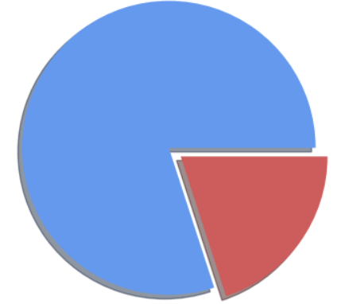

BENEFITS OF THE SYSTEM
Benefits:
Reduces time spent on manual attendance
Prevents proxy attendance
Real-time attendance tracking
Easy data management and reporting
Limitations:
May struggle with low lighting or extreme facial variations
Requires a good-quality camera for accurate detection

Slide 10

CONCLUSION
Summary:
The system provides a faster, more reliable way to manage attendance using face recognition.
Discuss future scope for improving accuracy and extending functionality.
Future enhancements:
Integration with cloud storage for scalability
Use of 3D face recognition for better accuracy

Slide 11

RESEARCH AND REFERENCES
https://www.geeksforgeeks.org/opencv-python-program-face-detection/
https://youtu.be/BYCKvM8eZGA?si=QEvUw4VYFg4-4IrO
https://www.researchgate.net/publication/326986115_Face_Detection_and_Recognition_Student_Attendance_System

