Slide 1
Project title: Handwritten Digit Recognition
By- Akash Raj

Slide 2
About Handwritten Digit Recognition
The main aim of this project is to make a system which should be capable of recognizing handwritten digits. This i am doing with the help of Artificial Neural networks also known as MULTILAYERED PERCEPTRON.
In this I have used MNIST dataset for training and testing of the data present in the dataset.
I have used Python language for this project and the ide used is Jupyter.

Slide 3
Libraries and their working
OpenCV: OpenCV is a Python library that allows you to perform image processing and computer vision tasks.
NumPy: NumPy is a Python library used for working with arrays.
Pandas: Pandas is a Python library used for working with data sets. It has functions for analyzing, cleaning, exploring, and manipulating data.
Matplotlib: Matplotlib is an amazing visualization library in Python for 2D plots of arrays.

Slide 4
Basics
w1
w5
w2
w6
Input
layer
Output layer
w3
w7
w4
w8
Hidden layer

Slide 5
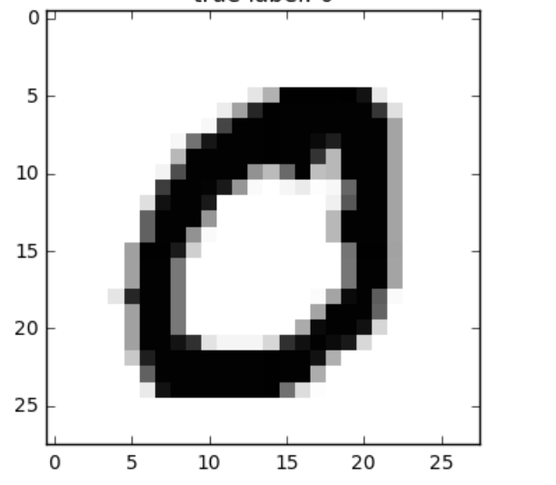
MNIST DATASET
Contains 70,000 images of different style of writing digits
Each image is present in the form of 28 x 28 row wise flatten matrix
Size of data is 70,000 x 786
Hence The Model will have 786 neurons in input layer
10 neurons in output layer
20 layers in hidden layer

Slide 6
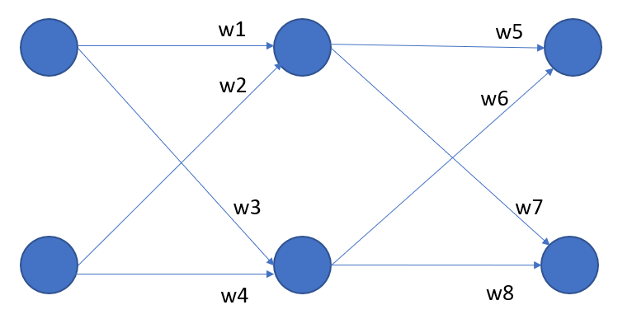
Forward Propagation
h1
x1
o1
x2
o2
h2
h1_in = x1 * w1 + x2 * w2
h1_out = sigmoid(h1_in)
h2_in = x1 * w3 + x2 * w4
h2_out = sigmoid(h2_in)
o1_in = h1_out * w5 + h2_out * w6
o1_out = softmax(o1_in)
o2_in = h1_out * w7 + h2_out * w8
o1_out = softmax(o2_in)

Slide 7
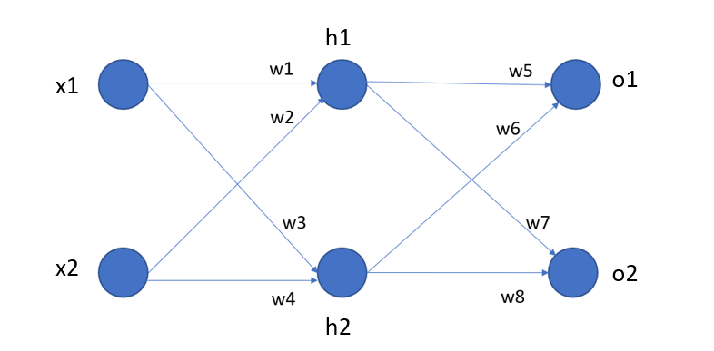
Backward Propagation
loss = (o1_out - y1)^2 + (o2_out - y2)^2 / 2
update w5 will be
w5 = w5 - learning rate * (dloss / dw5)
(dloss / do1_out) * (do1_out / do1_in) * (do1_in / dw5)
w1 = w1 - learning rate * (dloss / dw1)
(dloss / dh1_out) * (dh1_out / dh1_in) * (dh1_in / dw1)
(dloss / do1_out * do1_out / do1_in * do1_in / dh1_out )+ (dloss / do2_out * do2_out / do2_in * do2_in / dh1_out)

Slide 8
Thank you

