Slide 1
MVP Presentation: catch me if you can
Idea Title : GreenLedger-AI
Team Captain Name : Akash Chauhan
Team members Names : Atulya singh ,Ayushi, Gurleen kaur
College Name :lovely professional university , phagwara

Slide 2
GreenLedger-AI
Problem Statement
Solution Description
The data is scattered:
Electricity bills in PDF, HR payroll in Excel, supplier invoices as scanned images, governance records in Word — across 10–15 departments.
The cost is staggering:
Companies pay ₹40–80 lakhs/year to Big 4 consultants for manual data collection and spreadsheet calculations. This takes 3–6 months per filing.
The risk is massive:
Manual Excel math → calculation errors → failed audits → regulatory penalties. SEBI’s 2023 BRSR Core mandate now requires third-party assurance, and most companies are simply not ready.
.
Green Ledger AI automates the entire BRSR filing pipeline end-to-end:
Secure Cloud Storage – Every uploaded document is instantly transferred to a cryptographically isolated Amazon S3 bucket. This ensures that raw evidence (like electricity bills or payroll logs) is stored with enterprise-grade durability and security.
1. Ingest — Upload raw documents (scanned PDFs, images, Excel) through a secure role-based portal with Admin, Team Member, and Supplier access levels.
2. Extract — AWS Bedrock (Claude 3 Haiku) reads each document using vision AI and pulls out exact numbers: kWh consumed, wages paid, water used.
3. Calculate — A deterministic Python engine applies official SEBI formulas. The AI never calculates — Python always calculates. Zero hallucination risk.
4. Validate & Report — Every number has a full audit trail (source document → extracted value → formula applied → final KPI). Generates an audit-ready BRSR report.

Slide 3
GreenLedger-AI
Uniqueness / Innovativeness
Business Impact
Scanned Document Intelligence : We read raw images and messy bills directly. Competitors still require slow, manual data entry.
"AI Reads, Python Calculates" : Architecture We separate extraction from math to ensure 100% accuracy. Competitors let AI do math, which leads to hallucinations and errors.
SEBI-Native Engineering : Built specifically for Indian BRSR Core and local CEA grid factors. Global competitors use generic models that fail Indian regulatory rules.
The Live AI War Room : Monitor processing in real-time at a cost of pennies per document. Competitors are expensive, slow "black boxes" with no visibility..
Quantitative Benefits
₹40–80L → ₹2L/year
40% reduction in BRSR compliance cost per company
3–6 months → <1 week
Compliance timeline compressed by 60%+
<30 seconds per document
vs. hours of manual data entry per file
Market Opportunity
₹800 Cr+/year
Primary market: 1,000 SEBI-mandated companies
ROI: A company spending ₹50L on ESG consultants saves in the first month. At scale, the supply chain multiplier grows this to ₹4,000–40,000 Cr.

Slide 4
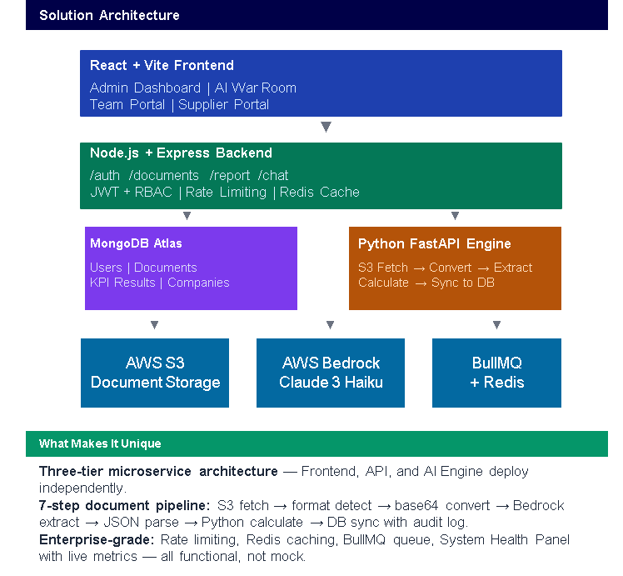
GreenLedger-AI
Technical Design and architecture
Layer | Technology | Purpose
Frontend | React + Vite + Tailwind | Responsive SPA
Backend API | Node.js + Express | REST API, JWT auth, RBAC
Database | MongoDB Atlas | Flexible KPI JSON schema
AI Engine | Python FastAPI | Async doc processing
AI Models | AWS Bedrock | Claude 3 Haiku + Sonnet
Storage | AWS S3 | Secure doc storage
Queue | BullMQ + Redis | Reliable job processing
Cache | Redis | 60s TTL, per-tenant
.
AWS / AI / GenAI Capabilities
AWS Bedrock — Claude 3 Haiku for fast extraction ($0.002/doc), Claude 3.5 Sonnet for complex documents. Vision API processes scanned PDFs directly — no OCR preprocessing.
AWS S3 — Enterprise document storage with programmatic upload, per-company key isolation.
ESG Chat (GenAI) — Natural language Q&A over KPI data. Users ask "What is our biggest ESG risk?" and Bedrock answers using live company metrics.
Deterministic Math Engine — 19 SEBI formulas in Python. The AI never calculates. Every number is traceable to a formula + source document.
** Use additional slides to include other relevant details, as required.

Slide 5
GreenLedger-AI
Scalable / Reusable
Roadmap
Scalability & Future Innovation
Auto-Scaling Backend We use EC2 now, but we are moving to Auto Scaling Groups. This means our backend grows "as you go." If 100 companies upload reports at the same minute, AWS will automatically start new servers to handle the load and shut them down later to save money. Independent Engine Scaling
Our AI Engine and our main Backend are separate. This is unique because we can give more power to the "AI Brain" during busy report seasons without affecting the speed of the user dashboard.
Global Multi-Region Ready :Our system is built to be deployed in any AWS region (like US-East or EU-West) in minutes. This makes Green Ledger ready to scale from India to the global market (GRI and CSRD standards) instantly.
Hours 0–4 : Foundation & Cloud Infrastructure
Hours 4–8 : Greedy Extraction Brain & S3 Ingestion
Hours 8–12 : The Calculation Moat & System Integration
Hours 12–16 : Audit Trail & Governance Validation
Hours 16–20 : Report Engine & Production Hardening
Hours 20–24 : Final Deployment & Stress Testing

Slide 6
Github link: https://github.com/Akashrana1001/Green_ledger-main Deployed link: https://production.d14yks62cq1zmx.amplifyapp.com

Slide 7
Thank you

Slide 8
For student’s consumption : Technoverse – MVP Evaluation Criteria
Dimension | What is Expected
Problem & Use-Case Clarity | A well-defined, industry-relevant problem statement with a clearly articulated use case aligned to a Technoverse '26 theme.
MVP Functional Completeness | A fully functional end-to-end MVP with a demonstrable core user journey, handled edge cases, and demo readiness.
Technical Design & Architecture | A clean, modular, and scalable architecture with documented design decisions and demonstrated scalability considerations.
Use of AWS / GenAI Capabilities | Thoughtful, value-adding integration of AWS services (Bedrock, Agents, Q, Kiro IDE) where GenAI meaningfully enhances core functionality. AWS is not mandatory but good if they have used understand its applicability.
Quality of Demo & Presentation | A crisp, well-structured demo with confident Q&A covering both technical and business perspectives.
Business Impact & Scalability | A strong business case with a clear deployment path, compelling ROI narrative, and a credible phased roadmap beyond the hackathon.

