Slide 1

MY24 Chevy FF Knob Development Analysis
Presented by
Monika Hanumansing Pakal

Slide 2
Acknowledgement
MY24 Chevy FF knob is the Chevy oriented program. As we know the chevy ff knob having hardware knob. We required textures, meshes, templates and shaders for implementing the gauge. upcoming slides we can discuss about textures, meshes, templates and shaders.

Slide 3
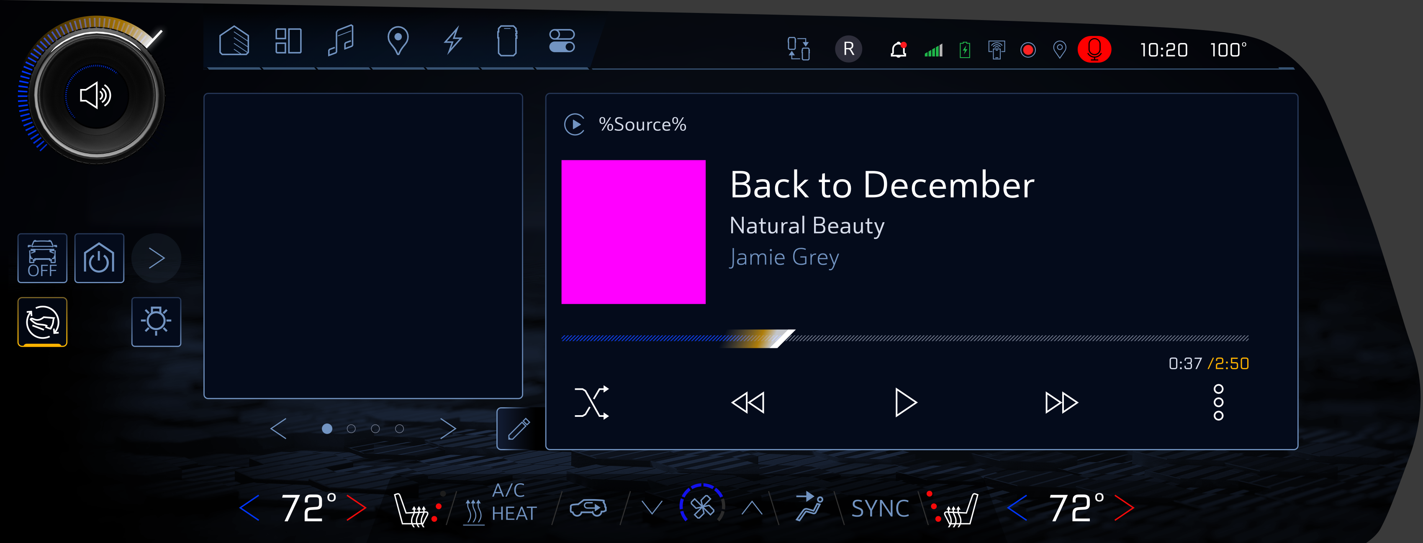
Reference Template

Slide 4
Sketch link
As per mention in that azure file actual template from my24 chevy ff knob.
file:///C:/Users/MonikaHanumansingPak/Downloads/Chevy%20FF%20Knob%20Assets%2012_21_22/Chevy%20FF%20Knob%20Assets%2012_21_22/Chevy_FF_Home_168_2/Chevy_FF_Home_186_2/Chevy_FF_Home_186_2_export/index_PX.html#s12

Slide 5
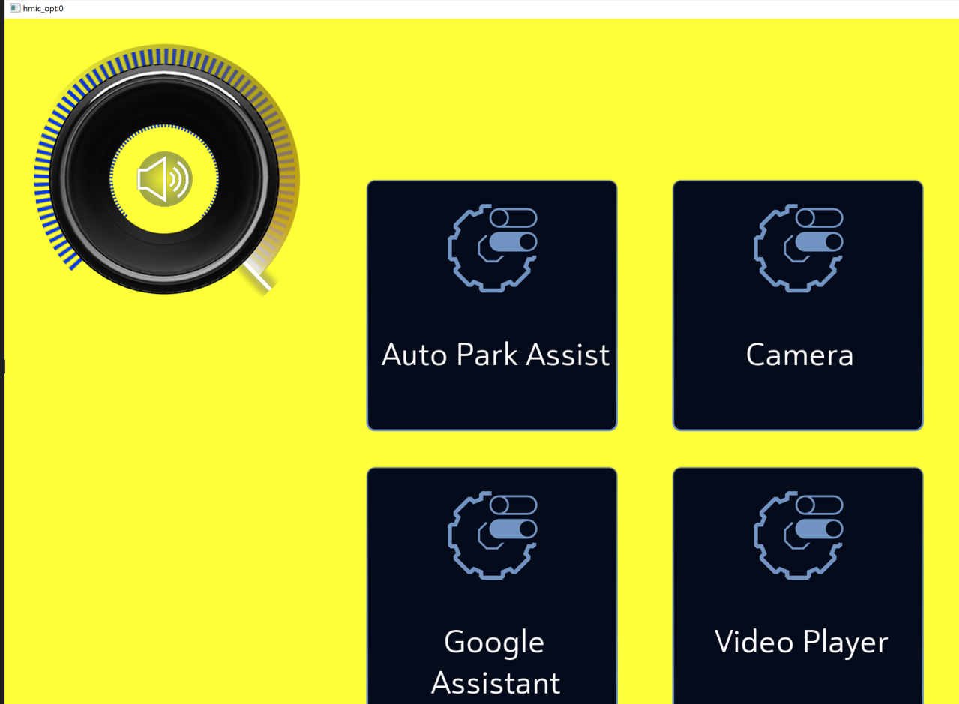
Windows Screenshot

Slide 6
Total required Meshes
Total Meshes:
1. Knob
2. Active Progress without Needle
3. Outer White Glow
4. Outer Color Glow
5. Needle with Glow
6. Blue Circles with Glow
7. Inner Blue Glow Circle
8. Icons

Slide 7
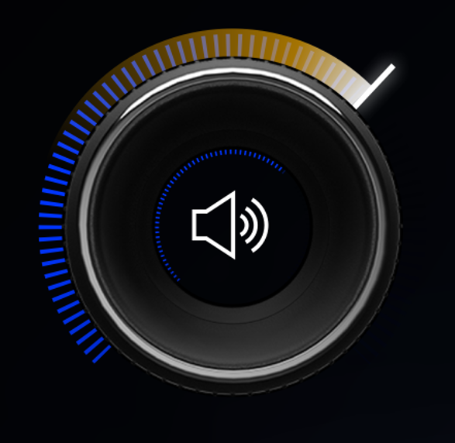





Total meshes related to knob
Audioprogress
glow
Needle
Knob
Icon

Slide 8
Total required textures
Total textures:
1. Knob
2. Active Progress without Needle
3. Outer White Glow
4. Outer Colour Glow
5. Needle with Glow
6. Blue Circles with Glow
7. Inner Blue Glow Circle
8. Icons for volume increase and decrease, mute, voice control, phone, navigation

Slide 9
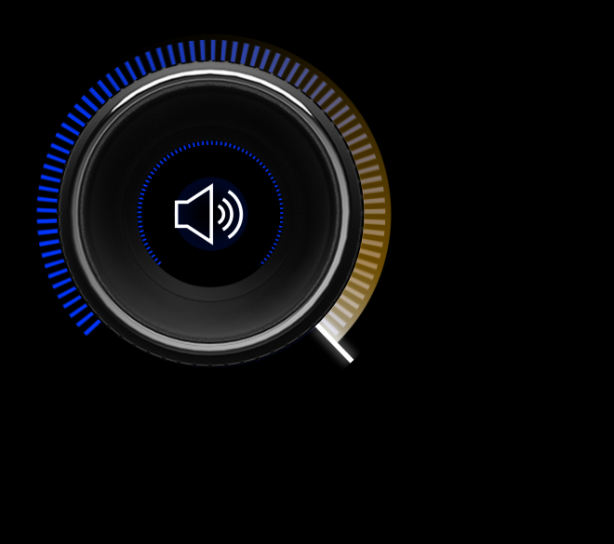
Animation names
audio_progress
Dialer_Swap_Off
Dialer_Swap_On
Mute_Swap_Off
Mute_Swap_On
Navigation_Swap_Off
Navigation_Swap_On
SetMaxLimit
SetMinLimit
Unmute_Swap_Off
Unmute_Swap_On
Voice_Swap_Off
Voice_Swap_On
mute_animation
unmute_animation
startup_shutdown

Slide 10
shaders
Currently we are using linear and radial shaders. The shaders which we are creating as per the directions of UVs. Also, it depending on Animation, if the gauge is not having animation, we can use radial shaders which is not required to animate the gauge. If we are giving any animation, we need to use UVs direction left to right or bottom to top. If there is using only emissive color, we are using code according that.
Currently below type of shaders we are using currently,
Linear UVs
Radial UVs
Emissive color

Slide 11
Impossible
Fade in fade out effect difficult to handle in 2D, So we are going to implement in 3D using shader programming.

Slide 12
Thank you

