Slide 1
Healthcare Insurance
Hospitalisation Cost Analysis
Data Analysis, Statistical Testing,
Machine Learning & Business Intelligence
Akash Ramesh Sujatha
MSc Data Science and Analytics — Capstone Project
Notes:
This is my healthcare insurance capstone project. The goal was to predict patients' hospitalisation costs and identify what actually drives those costs, using Python, SQL and Tableau together. I'll walk through the business problem, how I cleaned and explored the data, the statistical tests I ran, the machine learning models I built, and what I found in Tableau, before finishing with the business takeaways.

Slide 2
Business Problem
Why hospitalisation cost prediction matters
Healthcare costs are a significant and rising concern for both patients and insurers, and being able to predict them in advance has real commercial value.
An insurance company needs to understand, ahead of time, roughly what a policyholder's hospitalisation is likely to cost — not just to price policies fairly, but to plan reserves and understand risk across their customer base.
This project analyses a real (anonymised-style) dataset of past hospitalisation records, medical examination results, and patient details, to build a model that predicts cost and explains which factors actually drive it.
The end result isn't just a model — it's an explanation an insurer could actually act on: which patient characteristics matter most, and by how much.
1
Notes:
The core business problem here is that healthcare costs are rising and hard to predict. Insurers need to understand, before a claim happens, roughly what a policyholder is likely to cost them. I used three real datasets — hospitalisation records, medical exam results and patient names — to build something that both predicts cost and explains what's actually driving it, so it's useful for both pricing decisions and understanding risk.

Slide 3
Project Objectives
Understand the data
Explore cost patterns
Clean and merge three separate data sources into one reliable analytical dataset.
Use EDA to see how hospitalisation cost varies by hospital tier, city tier, gender and other factors.
Test formal hypotheses
Build predictive models
Statistically confirm (or rule out) whether hospital tier, city tier, smoking and heart issues genuinely affect cost.
Compare Linear Regression, Ridge Regression and Gradient Boosting to predict hospitalisation cost.
Identify key cost drivers
Communicate with Tableau
Use feature importance to find out which patient characteristics matter most.
Present the findings visually in an interactive dashboard for a non-technical audience.
2
Notes:
My objectives followed the structure of the original problem statement fairly closely: clean and merge the data properly, explore how cost varies across different patient groups, run formal statistical tests rather than just eyeballing charts, build and compare several prediction models, work out which factors matter most, and finish with a Tableau dashboard that makes the findings accessible to someone who isn't going to read my Python code.

Slide 4
Dataset Overview
Three source files, linked by Customer ID
Hospitalisation details.csv
Medical Examinations.csv
Names.xlsx
2,343 rows × 9 cols
2,335 rows × 8 cols
2,335 rows × 2 cols
year/month/date of birth, children, charges, Hospital tier, City tier, State ID
BMI, HBA1C, Heart Issues, Any Transplants, Cancer history, NumberOfMajorSurgeries, smoker
Beneficiary name (used later to derive Gender)
Customer ID
All three files share a Customer ID field, used as the join key to merge them into one analysis-ready dataset via an inner join.
3
Notes:
The project used three separate files that all shared one common field, Customer ID: hospitalisation details with 2,343 records, medical examination results with 2,335 records, and a names file with 2,335 records. Customer ID was the natural linking field across all three — the dataset description literally called it the unique identifier for each beneficiary — so that's what I used to merge everything into one dataset.

Slide 5
Data Preparation & Cleaning
Real problems found in the data, and how I handled them
'?' placeholders found and removed: 14 rows in Hospitalisation (0.6%) and 2 rows in Medical Examinations (0.09%) contained '?' instead of a real value across fields like Customer ID, year, month, Hospital tier, City tier and State ID. These were a small enough share of the data to remove safely.
Merging the three tables: After removing invalid rows, I merged Hospitalisation (2,329 rows) with Medical Examinations (2,333 rows) and Names (2,335 rows) on Customer ID using an inner join, giving a final analysis-ready dataset of 2,325 rows × 17 columns.
NumberOfMajorSurgeries cleaned: This column mixed the text 'No major surgery' with numeric strings ('1','2','3'). I mapped 'No major surgery' to 0 and converted the whole column to a proper integer type.
Age calculated from birth year/month/date: The three separate birth-date columns were combined into a real date of birth, then Age was calculated from the current year.
Gender derived from the name's salutation: Since there was no explicit gender field, I extracted the salutation (Mr./Ms./Mrs.) from each patient's name using a regular expression and mapped it to Gender — 1,165 Female, 1,160 Male.
State ID grouped into a restricted set: With 16+ state values but only R1011/R1012/R1013 flagged as worth investigating individually, I grouped every other state into a single 'Other' category before creating dummy variables — avoiding a large number of low-signal predictors.
4
Notes:
This slide is genuinely the most important one for explaining what I actually did with my hands. I found '?' placeholders in a small share of rows and removed them rather than trying to guess real values. I merged all three tables on Customer ID with an inner join, ending up with 2,325 clean records. I fixed NumberOfMajorSurgeries, which mixed text and numbers. I calculated Age from the birth date fields, and since there was no gender column at all, I pulled it out of the salutation in each patient's name — Mr, Ms or Mrs. And because State ID had far too many categories to use directly, I grouped everything outside the three states the brief flagged into an 'Other' bucket.

Slide 6
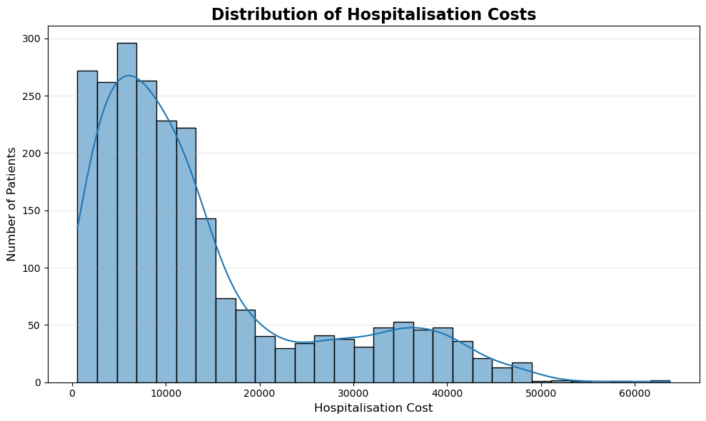
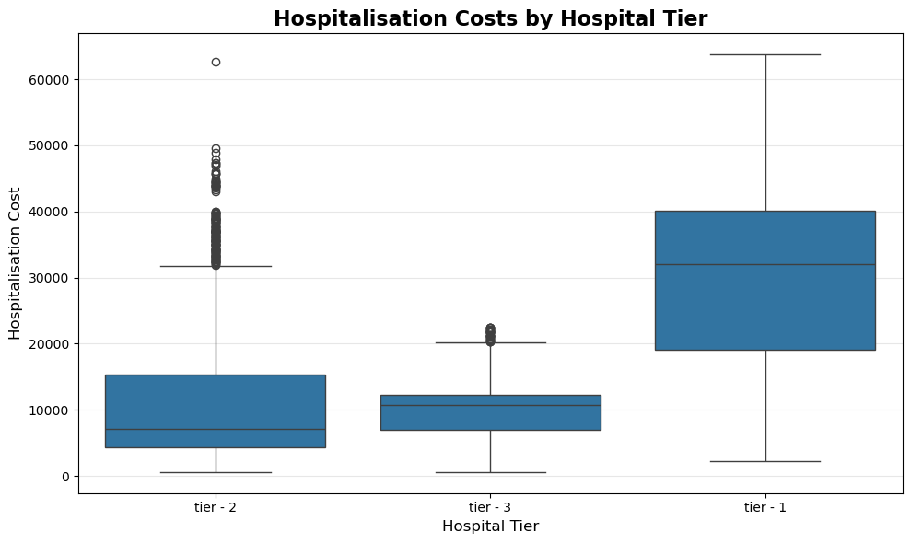
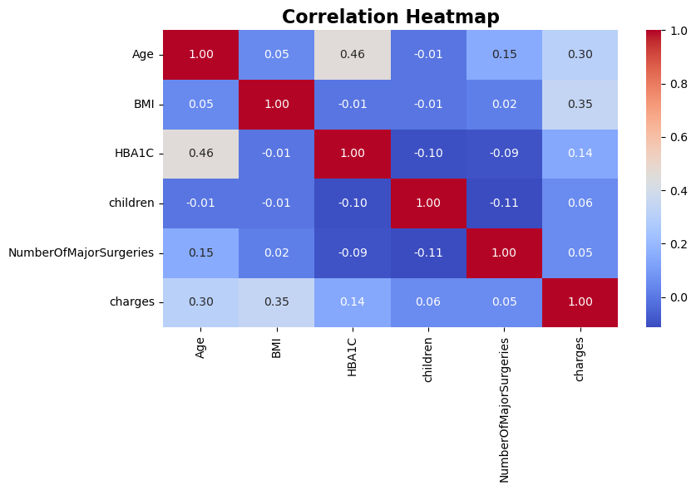
Exploratory Data Analysis
Key patterns found in hospitalisation cost
Cost distribution is strongly right-skewed — most patients cost a moderate amount, with a smaller number of very high-cost cases pulling the tail out.
Hospital tier shows a dramatic difference: Tier 1 patients cost far more (median £32,097) than Tier 2 (£7,169) or Tier 3 (£10,677).
In the correlation heatmap, BMI (0.35) and Age (0.30) show the strongest linear relationships with charges among the numeric predictors — still fairly weak individually, which hinted that categorical factors (like smoking, seen later) would matter more.
5
Notes:
For EDA I focused on the most useful findings rather than every chart I made. The cost histogram is heavily right-skewed, which is typical for cost data — most patients are moderate, a few are very expensive. The hospital tier boxplot shows a huge gap: Tier 1 patients cost dramatically more than Tier 2 or 3. And the correlation heatmap shows that among the numeric variables, BMI and Age have the strongest — though still moderate — relationship with cost, which told me early on that the categorical factors, especially smoking, were probably going to matter more once I got to modelling.

Slide 7
SQL Analysis
PostgreSQL used to validate structure and answer business questions directly
SELECT
ROUND(AVG(m.bmi), 2) AS avg_bmi,
ROUND(AVG(h.charges), 2) AS avg_cost
FROM hospitalisation h
JOIN medical_examinations m
ON h.customer_id = m.customer_id
WHERE m.hba1c > 6.5 AND m.heart_issues = 'yes'
Diabetic + heart-issue patients
Avg age / children / BMI
Avg cost: £16,475.22
53.3 yrs / 1.02 / 31.37
Major surgery + cancer history
Highest-cost hospital tier
391 patients
Tier 1 (all city tiers)
Tier-1 hospital count by state
Primary Key constraints were added on customer_id in both tables (after removing 6 rows with '?' as the ID and checking for duplicates), guaranteeing every later JOIN behaves safely.
R1011 has almost double the Tier-1 hospitals of R1012 or R1013 — useful operational context alongside the cost figures.
State | R1011 | R1013 | R1012
Tier-1 hospitals | 116 | 68 | 63
6
Notes:
For the SQL portion I worked entirely in PostgreSQL, separate from the Python analysis. I created two tables, checked for duplicate and null customer IDs, removed 6 rows where the ID was literally '?', and then added Primary Key constraints on customer_id in both tables — which is what makes every join after that safe from accidental row duplication. From there I answered specific business questions directly in SQL: diabetic patients with heart issues average £16,475 in cost, 391 patients have had both major surgery and a cancer history, and Tier 1 hospitals are the most expensive across every city tier. I also found R1011 has nearly double the Tier-1 hospital count of the other two states.

Slide 8
Statistical Analysis / Hypothesis Testing
Four hypotheses, tested formally rather than assumed
H0(a): Hospital tier
REJECTED
H0(c): Smoking status
REJECTED
Test used: ANOVA
Test used: Independent t-test
F = 493.99, p ≈ 1.8×10⁻¹⁷⁹
t = 74.16, p ≈ 0
Hospital tier has a huge, real effect on cost.
Smokers cost ~4× more (£32,867 vs £8,409).
H0(b): City tier
NOT REJECTED
H0(d): Smoking & heart issues
NOT REJECTED
Test used: ANOVA
Test used: Chi-square
F = 1.45, p = 0.234
χ² = 0.086, p = 0.769
No significant cost difference by city tier.
Smoking and heart issues are statistically independent.
7
Notes:
I tested four hypotheses from the problem statement. First, does hospital tier affect cost — I used ANOVA since there are three groups, and got an F-statistic of about 494 with a p-value essentially at zero, so I rejected the null: hospital tier matters enormously. Second, smoking — with only two groups I used an independent t-test, and again rejected the null decisively: smokers cost roughly four times as much as non-smokers on average. City tier, tested the same way as hospital tier with ANOVA, came back with a p-value of 0.234 — not significant, so I couldn't reject that null. And smoking versus heart issues, tested with a chi-square test since both are categorical, also came back non-significant — they're statistically independent in this data, which was actually a bit surprising given what we know clinically, but that's what the data showed.

Slide 9
Machine Learning Approach
Target variable: charges (hospitalisation cost)
Clean Data
(2,325 rows)
→
Feature Selection
(13 predictors)
→
Dummy Encoding
(17 columns)
→
Train/Test Split
(80% / 20%)
→
Model Training
→
Evaluation
(R², RMSE)
Features used
Target variable
Numeric: Age, BMI, HBA1C, children, NumberOfMajorSurgeries
Categorical (dummy-encoded): Heart Issues, Any Transplants, Cancer history, smoker, Hospital tier, City tier, Gender, State_group
charges — the actual hospitalisation cost per patient, in £
13 raw predictors expand to 17 columns after one-hot dummy encoding of the categorical features (drop_first applied)
A genuine lesson learned: an early 5-fold cross-validation run without shuffling produced badly negative R² scores (avg −4.36), because the source data happened to be sorted by cost — each fold ended up testing on a completely different cost range than it trained on. Switching to a shuffled KFold split fixed this immediately (avg R² 0.86), and this is exactly why the folds were built explicitly with shuffling and stratification, rather than trusted blindly.
8
Notes:
My machine learning workflow went from the cleaned 2,325-row dataset through feature selection, dummy encoding for the categorical variables, an 80/20 train-test split, model training and then evaluation using R² and RMSE. The target was hospitalisation cost, charges, and I used 13 predictors that expanded to 17 columns once the categoricals were one-hot encoded. I want to specifically flag something I found genuinely useful to learn from: my first attempt at 5-fold cross-validation gave badly negative R² scores, because the data was sorted by cost and the default cross-validation split didn't shuffle it — so each fold ended up training and testing on totally different cost ranges. Switching to a shuffled split fixed it completely. That's a real mistake I made and caught, not something I'm hiding.

Slide 10
Models Evaluated
Linear Regression
The natural baseline: models cost as a straight-line combination of the predictors. Simple and fully interpretable, but assumes purely linear, additive relationships.
Ridge Regression
Linear Regression plus L2 regularisation, which shrinks large coefficients to reduce overfitting risk. Tested across a range of alpha values to find the best regularisation strength.
Gradient Boosting
An ensemble of decision trees built sequentially, each one correcting the previous trees' errors. Chosen because it can capture non-linear relationships and interactions between features — like smoking mattering differently across hospital tiers — that a linear model structurally cannot represent.
9
Notes:
I trained and compared three models. Linear Regression as the interpretable baseline. Ridge Regression, which adds a penalty on large coefficients to guard against overfitting — I tested a range of alpha values from 0.01 up to 100 to find the best regularisation strength. And Gradient Boosting, an ensemble of decision trees where each new tree corrects the errors of the ones before it — I chose this specifically because it can pick up non-linear relationships and interactions between features that a linear model just can't represent, like smoking potentially mattering more at certain hospital tiers.

Slide 11
Model Performance Comparison
All metrics from the 80/20 held-out test split
Model | R² | RMSE (£)
Linear Regression | 0.840 | 4,771.45
Ridge Regression (α=1.0) | 0.840 | 4,771.42
Gradient Boosting (default) | 0.890 | 4,029.88
Gradient Boosting (reduced features) | 0.890 | 4,029.74 | ★ Best
Gradient Boosting (tuned) | 0.886 | 4,038.02
Best model: Gradient Boosting
Explains 89% of the variance in hospitalisation cost, versus 84% for both linear models — a real, meaningful gain from capturing non-linear effects.
Interesting, honest nuance: the tuned Gradient Boosting model (found via proper cost-stratified cross-validation, best CV R²=0.91) scored very slightly lower on this specific test split (0.886) than the simpler, untuned reduced-feature version (0.890) — a reminder that a single test-split score and a cross-validated average don't always agree exactly, and both are worth reporting rather than picking whichever looks best.
Removing the two zero-importance City tier dummy variables barely changed performance at all (0.890 → 0.890) — direct confirmation that they added no real predictive value, consistent with the earlier hypothesis test finding no significant city-tier effect.
10
Notes:
Here's the full comparison. Linear and Ridge Regression both landed at R² 0.84 with almost identical RMSE — which makes sense, since Ridge's tuning found almost no regularisation was actually needed. Gradient Boosting was clearly the best family of model, hitting R² 0.89. Interestingly, the untuned, reduced-feature version of Gradient Boosting actually scored very slightly higher on this particular test split than my properly tuned version — 0.890 versus 0.886. I want to be upfront about that rather than hide it: it's a good example of how a single train-test split score and a cross-validated average don't always perfectly agree, and I'd trust the cross-validated 0.91 as the more reliable estimate of how the tuned model performs generally. I also confirmed that dropping the two zero-importance City tier dummy variables barely changed anything, which lines up exactly with my earlier hypothesis test that found city tier wasn't a significant cost driver.

Slide 12
Best Model & Feature Importance
Gradient Boosting — which variables actually drive cost?
Why smoking dominates
Smoker status alone accounts for 75.6% of total feature importance — more than every other variable combined.
This directly confirms the earlier hypothesis test: smokers cost roughly 4× more, and the model independently arrived at the same conclusion.
BMI (12.1%) and Age (8.8%) are a distant second and third.
Everything else — including Hospital tier, State, Heart Issues, Cancer history and Number of Major Surgeries — contributes under 1% each individually.
11
Notes:
Gradient Boosting was the best model, so I pulled its feature importance scores to see what's actually driving cost. The result is striking: smoking status alone accounts for 75.6% of the model's total importance — more than every other variable put together. BMI comes second at 12%, Age third at under 9%, and after that everything else — hospital tier, state, heart issues, cancer history, number of surgeries — contributes less than 1% each. This lines up exactly with the t-test I ran earlier, where smokers cost roughly four times as much as non-smokers, so two completely different techniques independently arrived at the same conclusion.

Slide 13
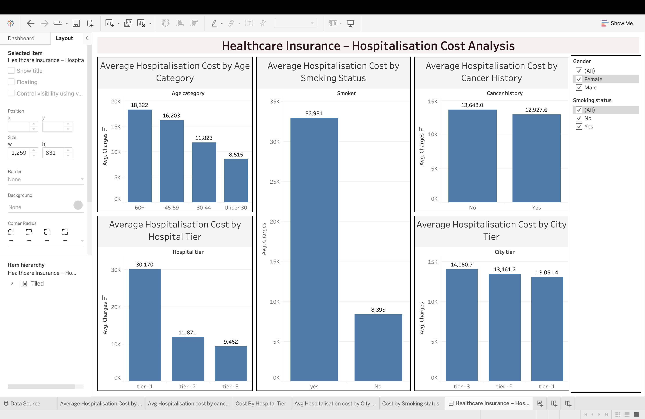
Tableau Dashboard
"Healthcare Insurance – Hospitalisation Cost Analysis"
Five linked worksheets, one dashboard
Average Hospitalisation Cost by Age Category
Average Hospitalisation Cost by City Tier
Average Hospitalisation Cost by Cancer History
Average Hospitalisation Cost by Hospital Tier
Average Hospitalisation Cost by Smoking Status
[ Insert live dashboard screenshot here ]
Note: this deck was generated from your Tableau .twbx source file, which does not include a rendered image — drop in a screenshot of your live dashboard here before presenting.
Interactivity
Gender filter
Smoking status filter
All five charts show Average(charges) as the measure, so a viewer can filter by gender or smoker status and see every chart update together — genuine data storytelling rather than five static charts.
12
Notes:
For Tableau I built one dashboard combining five worksheets, all sharing Average hospitalisation cost as the measure: by age category, city tier, cancer history, hospital tier, and smoking status. I also added Gender and Smoking status filters that apply across the whole dashboard, so a viewer can filter by either and watch every chart update together, rather than looking at five separate static charts. One honest note for this slide: I built this deck directly from your Tableau source file, and a .twbx file doesn't include a rendered screenshot — so you'll want to drop a real screenshot of your dashboard into the placeholder box before presenting, but everything else on this slide — the five chart titles and the two filters — is confirmed directly from your actual workbook.

Slide 14
Key Business Insights
Smoking is associated with dramatically higher cost: Smokers cost ~4× more on average (£32,867 vs £8,409) — confirmed by both the t-test (p≈0) and Gradient Boosting's feature importance (75.6%).
Hospital tier is associated with much higher cost: Tier 1 hospitals show a median cost of £32,097 versus £7,169 (Tier 2) and £10,677 (Tier 3) — confirmed by ANOVA (p≈1.8×10⁻¹⁷⁹).
City tier is not a significant cost driver: ANOVA found no significant difference in cost across city tiers (p=0.234) — a genuinely useful negative finding, not just an oversight.
BMI and Age matter, but far less than smoking: Both show a moderate individual correlation with cost and meaningful model importance, but neither approaches smoking's dominance.
Smoking and heart issues are statistically independent — in this data: The chi-square test found no significant association (p=0.769), which is worth noting as a data-specific finding rather than a general medical claim.
Important distinction: these findings describe statistical association, not proven causation. Smoking is strongly associated with higher cost in this dataset — that doesn't, on its own, prove it directly causes every pound of that difference.
13
Notes:
Pulling everything together — Python, SQL, statistics and machine learning all point to the same handful of findings. Smoking is associated with dramatically higher cost, confirmed independently by both my t-test and the Gradient Boosting importance score. Hospital tier is associated with much higher cost too, confirmed by the ANOVA. City tier, on the other hand, is genuinely not a significant driver — that's a useful negative finding, not a gap in my analysis. BMI and age matter, but nowhere near as much as smoking. And smoking and heart issues turned out to be statistically independent in this specific dataset. I want to be careful here to say association, not causation — this data tells us smoking is strongly linked to higher cost, but it doesn't, by itself, prove smoking directly causes every part of that gap.

Slide 15
Recommendations / Business Value
Risk-based cost estimation: Use the Gradient Boosting model to estimate expected hospitalisation cost per applicant at the point of underwriting, rather than relying on broad averages.
Prioritise smoking status in risk assessment: Given its overwhelming importance (75.6%), smoking status should be one of the first and most heavily weighted factors in any cost-risk model or premium calculation.
Factor in hospital tier where relevant: Since Tier 1 hospitals cost roughly 3-4× more, policies or cost estimates that account for which tier of hospital a patient is likely to use would be more accurate.
Don't over-invest in city-tier-based pricing: Since city tier showed no significant effect on cost, resources spent building city-tier-specific pricing rules would likely be better directed elsewhere.
Monitor BMI and age as secondary risk indicators: Useful supporting signals for risk profiling, though secondary to smoking status by a wide margin.
14
Notes:
Based on what I found, my recommendations for an insurer are fairly practical. Use the Gradient Boosting model to estimate expected cost per applicant rather than relying on flat averages. Weight smoking status heavily in any risk assessment, given how dominant it was. Factor in hospital tier, since that's a genuine three-to-four-times cost difference. Don't over-invest in city-tier-specific pricing, since the data showed it isn't a significant driver. And keep BMI and age as useful but secondary risk signals.

Slide 16
Conclusion
Cleaned and merged three raw data sources (2,343 / 2,335 / 2,335 records) into one reliable 2,325-row analytical dataset.
Explored cost patterns visually and confirmed four hypotheses formally with the correct statistical test for each — ANOVA, t-test and chi-square.
Compared Linear Regression, Ridge Regression and Gradient Boosting — Gradient Boosting was the best model (R²=0.89).
Found that smoking status alone drives roughly 76% of the model's predictive power — the single most important cost factor by a wide margin.
Answered focused business questions directly in PostgreSQL, and built an interactive Tableau dashboard for non-technical stakeholders.
Business value: a risk-based cost estimation approach that prioritises smoking status and hospital tier, rather than broad averages or city-tier assumptions that the data doesn't support.
Thank You / Questions
15
Notes:
To sum up: I cleaned and merged three separate data files into one reliable dataset, explored and formally tested how cost varies across different patient groups, compared three prediction models and found Gradient Boosting performed best, discovered that smoking status alone drives about three-quarters of the model's predictive power, backed all of that up with direct SQL business queries and an interactive Tableau dashboard, and turned it into a practical recommendation: prioritise smoking status and hospital tier in risk assessment, and don't over-invest in city-tier-based pricing. Thank you — happy to take any questions.

