Slide 1
ECE 382 Lesson 6
Lesson Outline
Example Assembly Code
In class programming
Debugging Assembly Code
Lesson 6, 7, and 8 notes
Admin
CompEx1 → due today
Might want to start Assignment 3 (due lesson 8)

Slide 2
Example Programming Worksheet
Worksheet

Slide 3
In class programming exercise
; write an example program to add the numbers 10+9+8+...+1

Slide 4
In class programming exercise
; example program to add the numbers 10+9+8+...+1
mov.w #10, r6
mov.w #0, r5
summation: add.w r6, r5
dec r6
jnz summation
mov.w r5, &0x0200
forever: jmp forever

Slide 5
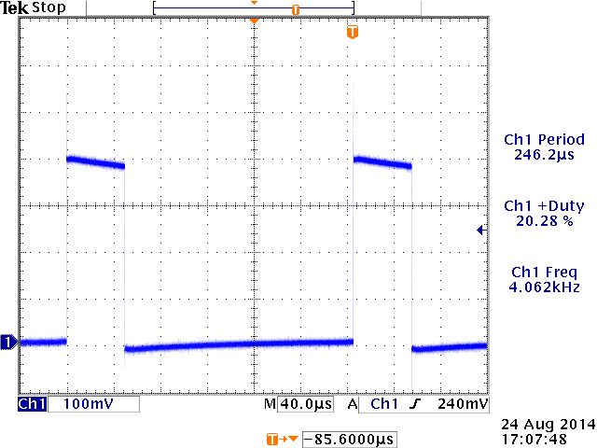
Find the errors in this program
http://ecse.bd.psu.edu/cmpen352/lecture/lecture05.html
http://ecse.bd.psu.edu/cmpen352/lecture/code/badlec5.asm
; intention was to have it generate a PWM waveform on the P1.0 pin attached
duty = 0x20;
while(1) {
cnt = 0x40;
P1.0 = 1;
while (cnt>duty)
cnt-=1;
P1.0 = 0;
while (cnt>0)
cnt-=1;
if (P1.3 == 0) {
while (P1.3 == 0);
duty += 0x08;
duty &= 0x3F;
} }

Slide 6
Sample Program – predict what happens
repeat:
mov.b #0x75, r10
add.b #0xC7, r10
adc r10
inv.b r10
mov.w #0x00aa, r10
sxt r10
inv r10
swpb r10
mov.w r10, r9
jmp repeat
c010: 7a 40 75 00 mov.b #117, r10 ;#0x0075
c014: 7a 50 c7 00 add.b #199, r10 ;#0x00c7
c018: 0a 63 adc r10
c01a: 7a e3 xor.b #-1, r10 ;r3 As==11
c01c: 3a 40 aa 00 mov #170, r10 ;#0x00aa
c020: 8a 11 sxt r10
c022: 3a e3 inv r10
c024: 8a 10 swpb r10
c026: 09 4a mov r10, r9
c028: f3 3f jmp $-24 ;abs 0xc010

Slide 7
Sample Program – predict what happens
repeat:
mov.b #0x75, r10
add.b #0xC7, r10
;result should be 0x13c, so we should see 3c in r10 and carry bit set
adc r10
;since carry bit was set, this should increment r10 to 3d
inv.b r10
;invert, so r10 should be c2
mov.w #0x00aa, r10
sxt r10
;sign extend should clear upper 8 bits
inv r10
swpb r10
mov.w r10, r9
jmp repeat
c010: 7a 40 75 00 mov.b #117, r10 ;#0x0075
c014: 7a 50 c7 00 add.b #199, r10 ;#0x00c7
c018: 0a 63 adc r10
c01a: 7a e3 xor.b #-1, r10 ;r3 As==11
c01c: 3a 40 aa 00 mov #170, r10 ;#0x00aa
c020: 8a 11 sxt r10
c022: 3a e3 inv r10
c024: 8a 10 swpb r10
c026: 09 4a mov r10, r9
c028: f3 3f jmp $-24 ;abs 0xc010

Slide 8
Intro CompEx1
CompEx1 → due next lesson

Slide 9
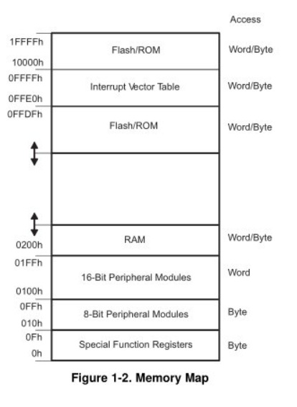
MSP430’s ISA
How many addr bits?
Msp430g2553 Memory Map
512b of RAM - 0x200-0x400 16kb of ROM - 0xc000-0xffdf
0x1100-0xc000 is empty!
- There is no memory backing it up!
- If you attempt to write to this area of memory, you'll trigger what's essentially a segmentation fault because that memory doesn't exist. It will cause the chip to do a Power-up Clear (PUC), resetting the state of your processor. This is a tough error to debug.

Slide 10
Assembly and Machine Languages
Instructions:
words in a computers language
Instruction Set:
the dictionary of the language
Assembly Language:
human-readable format of computer instructions
Machine Language:
computer-readable instructions - binary (1's and 0's)
Assembly Language Program
Assembler
Relocatable Object Code
Linker
Executable Code

Slide 11
Let's write a MSP430 program
Our chip version: Msp430g2553 → open CCS
; This program sets all pins on Port 1 to output and high. Since LEDs 1 and 2 are connected to P1.0 and P1.6 respectively, they will light up. This program turns the LEDs on and off
.text
; turn off watchdog timer
main:
bis.b #0xFF, &P1DIR ; set port1 direction to output
Turn_on:
bis.b #0xFF, &P1OUT ; turn on leds at port1, bis?
; could of: move ____ , &P1OUT
Turn_off:
bic.b #0xFF, &P1OUT ; turn on leds at port1, bic?
; could of: move ____ , &P1OUT
jmp Turn_on ; loop forever
← what?
Stack pointer?

Slide 12
Status register and Jumps
15 | 14 | 13 | 12 | 11 | 10 | 9 | 8 | 7 | 6 | 5 | 4 | 3 | 2 | 1 | 0
Reserved |  |  |  |  |  |  | V | SCG1 | SCG0 | OSCOFF | CPUOFF | GIE | N | Z | C
Condition Code | Assembly Instruction | Description
000 | JNE/JNZ | Jump if Z==0 (if !=)
001 | JEQ/JZ | Jump if Z==1 (if ==)
010 | JNC/JLO | Jump if C==0 (if unsigned <)
011 | JC/JHS | Jump if C==1 (if unsigned >)
100 | JN | Jump if N==1 - Note there is no jump if N==0
101 | JGE | Jump if N==V (if signed >=)
110 | JL | Jump if N!=V (if signed <)
111 | JMP | Jump unconditionally

