Slide 1
ECE 382 Lesson 8
Lesson Outline
Lab Guidance
Lab 1 Introduction
Assignment 3
Start Prelab
Admin
Assignment 3 (due today)
Lab#1 Prelab due BOC next lesson

Slide 2
Assembly Code Style Guidelines
Comments
Assume the reader is a competent assembly language programmer
Comment above blocks of code to convey purpose
Only comment individual lines when purpose is unclear
Labels
Descriptive!
loop or loop1 or l1 or blah - not acceptable!
Constants
Use .equ syntax for all constants!
SEVENTEEN: .equ 0x11
Don't want to see naked values

Slide 3
Assembly Code Style Guidelines
Instruction Choice
Use the instruction that makes your code readable!
JHS rather than JC
INCD rather than ADD #2
Well-written code requires few comments
Spacing
Align your code to make it readable
Put whitespace between logical blocks of code

Slide 4
Example Code
What is good and bad about this code?
http://ece382.com/notes/L8/hw_sample.html

Slide 5
Lab Notebook Expectations
Lab Noteboook Standards

Slide 6
Lab 1 Introduction
The goal of this lab is to implement a simple calculator using assembly language.
Lab 1
How This Lesson Applies
Use assembler directives:
.byte to put your test program into memory
.space to reserve space for your results
Where is this going to go?
Labels for your program / results
.equ for key constants
Modularity
Section to store results of ops
Section for each op
Testing
Specify multiple testing sequences at the beginning!
I'll test your code with a few of my own

Slide 7
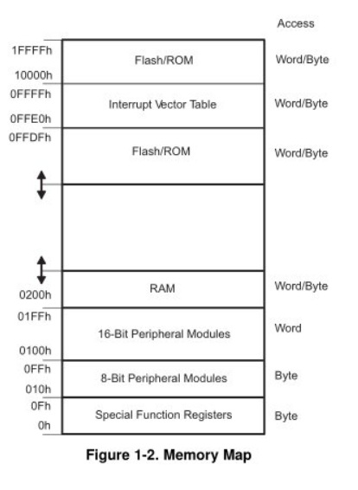
MSP430’s ISA
How many addr bits?
Msp430g2553 Memory Map
512b of RAM - 0x200-0x400 16kb of ROM - 0xc000-0xffdf
0x1100-0xc000 is empty!
- There is no memory backing it up!
- If you attempt to write to this area of memory, you'll trigger what's essentially a segmentation fault because that memory doesn't exist. It will cause the chip to do a Power-up Clear (PUC), resetting the state of your processor. This is a tough error to debug.

Slide 8
Assembly and Machine Languages
Instructions:
words in a computers language
Instruction Set:
the dictionary of the language
Assembly Language:
human-readable format of computer instructions
Machine Language:
computer-readable instructions - binary (1's and 0's)
Assembly Language Program
Assembler
Relocatable Object Code
Linker
Executable Code

Slide 9
Let's write a MSP430 program
Our chip version: Msp430g2553 → open CCS
; This program sets all pins on Port 1 to output and high. Since LEDs 1 and 2 are connected to P1.0 and P1.6 respectively, they will light up. This program turns the LEDs on and off
.text
; turn off watchdog timer
main:
bis.b #0xFF, &P1DIR ; set port1 direction to output
Turn_on:
bis.b #0xFF, &P1OUT ; turn on leds at port1, bis?
; could of: move ____ , &P1OUT
Turn_off:
bic.b #0xFF, &P1OUT ; turn on leds at port1, bic?
; could of: move ____ , &P1OUT
jmp Turn_on ; loop forever
← what?
Stack pointer?

Slide 10
Status register and Jumps
15 | 14 | 13 | 12 | 11 | 10 | 9 | 8 | 7 | 6 | 5 | 4 | 3 | 2 | 1 | 0
Reserved |  |  |  |  |  |  | V | SCG1 | SCG0 | OSCOFF | CPUOFF | GIE | N | Z | C
Condition Code | Assembly Instruction | Description
000 | JNE/JNZ | Jump if Z==0 (if !=)
001 | JEQ/JZ | Jump if Z==1 (if ==)
010 | JNC/JLO | Jump if C==0 (if unsigned <)
011 | JC/JHS | Jump if C==1 (if unsigned >)
100 | JN | Jump if N==1 - Note there is no jump if N==0
101 | JGE | Jump if N==V (if signed >=)
110 | JL | Jump if N!=V (if signed <)
111 | JMP | Jump unconditionally

