Slide 1

SETU (सेतु)
The Volunteer & Lead Management CRM for Art of Living Programs
Connecting Seekers to Courses • Empowering Teachers • Seamless Seva Coordination
A Comprehensive Guide for Art of Living Teachers & Center Coordinators

Slide 2
CURRENT REALITY & CHALLENGES
The Opportunity: Transforming How We Nurture Seekers
PAIN #1
PAIN #2
PAIN #3
The 'Spreadsheet & WhatsApp' Chaos
Leads from camps, intro talks, and kiosks are captured in paper sheets, individual phones, and fragmented Excel files.
• Nobody knows who called whom
• Overlapping or forgotten calls
• Duplicate efforts across volunteers
The 24-Hour Leaky Bucket
A seeker who attends an introductory talk has peak inspiration for 24-48 hours.
• Calls delayed by 4-5 days go cold
• 60%+ drop-off before registration
• Enthusiastic volunteers don't get numbers in time
Teacher Administrative Burnout
Teachers spend 70% of their energy on administrative follow-up coordination rather than meditation and teaching.
• Hours spent assigning numbers manually
• Zero visibility into volunteer calling status
• High stress before every course cutoff

Slide 3
THE SOLUTION
Setu: The Intelligent Bridge from Seeker to Course
1. Streamlined Lead Pipeline
Capture from kiosks, website, camp booths, and distribute fairly without manual Excel sheets.
What is Setu (सेतु)?
• Purpose-Built for Art of Living: Designed specifically around our seva dynamics, teacher coordination, and course lifecycles.
• One Single Source of Truth: Centralized cloud database (Supabase) protecting seeker data with enterprise security & privacy.
• Accessible Everywhere: Fast modern web portal + Android Mobile App (APK) for volunteers on the go.
• Smart Auto-Reassignment: If a lead isn't contacted in 24 hours, Setu automatically reassigns it to an active volunteer.
• Digital Volunteer (WhatsApp): Official WhatsApp assistant that lets volunteers request seva numbers and answers seeker FAQs.
2. Volunteer Empowerment
1-tap calling, WhatsApp templates, capacity caps, and automatic reminders.
3. Digital Volunteer AI
Official WhatsApp integration for seva requests, group management & FAQ bots.
4. Teacher Peace of Mind
Live dashboard, conversion reports, zero forgotten leads, and high course turnout.

Slide 4
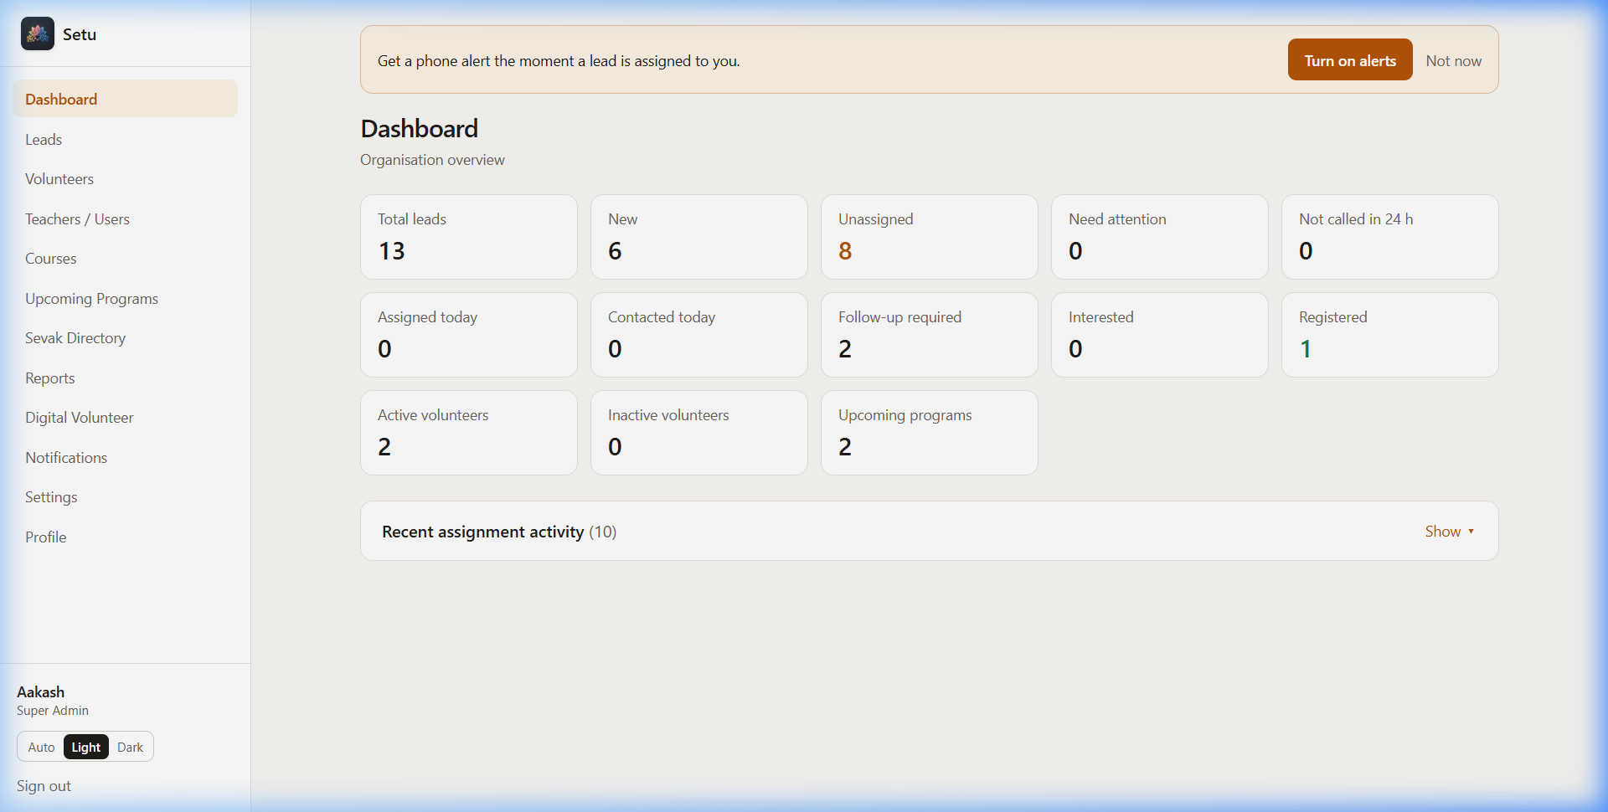
FEATURE 01
The Central Dashboard: Live Pulse of Your Chapter
At a Glance Clarity
• Real-Time KPI Cards: Instantly see Total Leads, Pending Follow-ups, and Contacted Ratios across all active programs.
• Recent Assignment Stream: Live feed showing which volunteer was assigned which lead, with exact timestamps.
• Contact Health Monitoring: Flags leads requiring attention so teachers can intervene before a course begins.
• Role-Based Views: Teachers see their chapter/team metrics; volunteers see their personal assigned seva list.

Slide 5
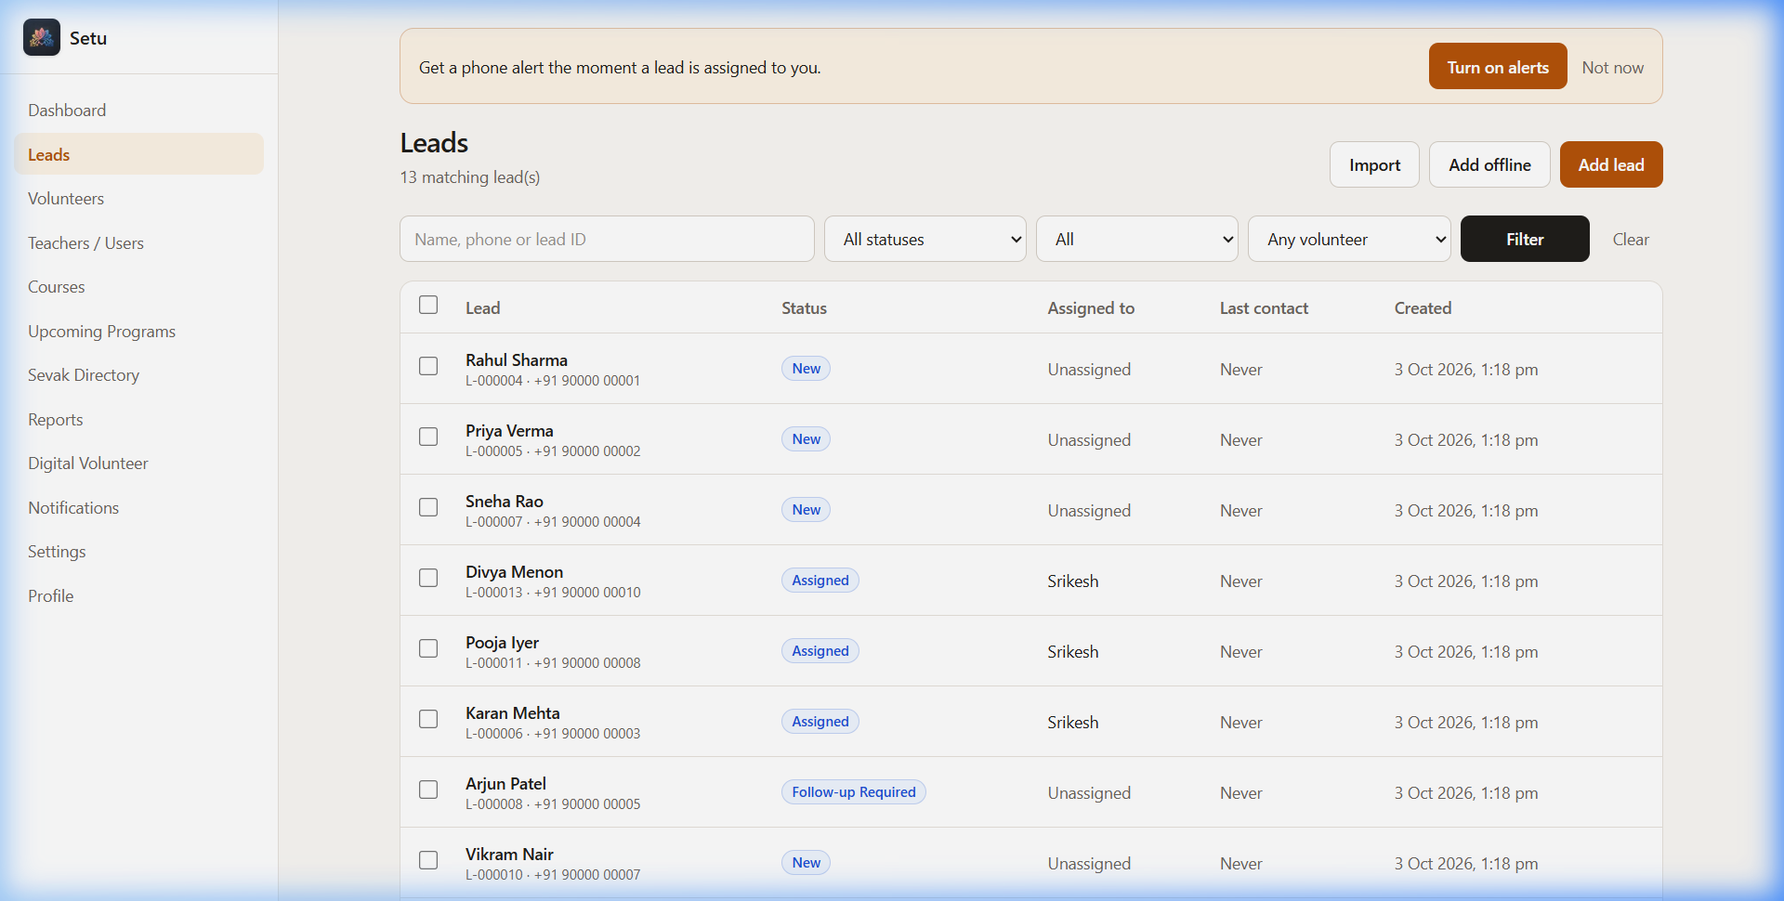
FEATURE 02
Comprehensive Lead Pipeline: Zero Inquiries Left Behind
Structured Seeker Journey
• Multi-Stage Pipeline: Categorized under: New, Contacted, Interested, Follow-up Scheduled, Registered, and Closed.
• Instant Smart Search & Filters: Filter in seconds by course (Happiness Program, Sahaj), locality, assignee, or contact status.
• Bulk Assignment in 1 Click: Teachers can select 20 or 50 leads and distribute them fairly across available volunteers.
• No Accidental Overwrites: All assignments, calls, and status updates are logged immutably in database history.

Slide 6
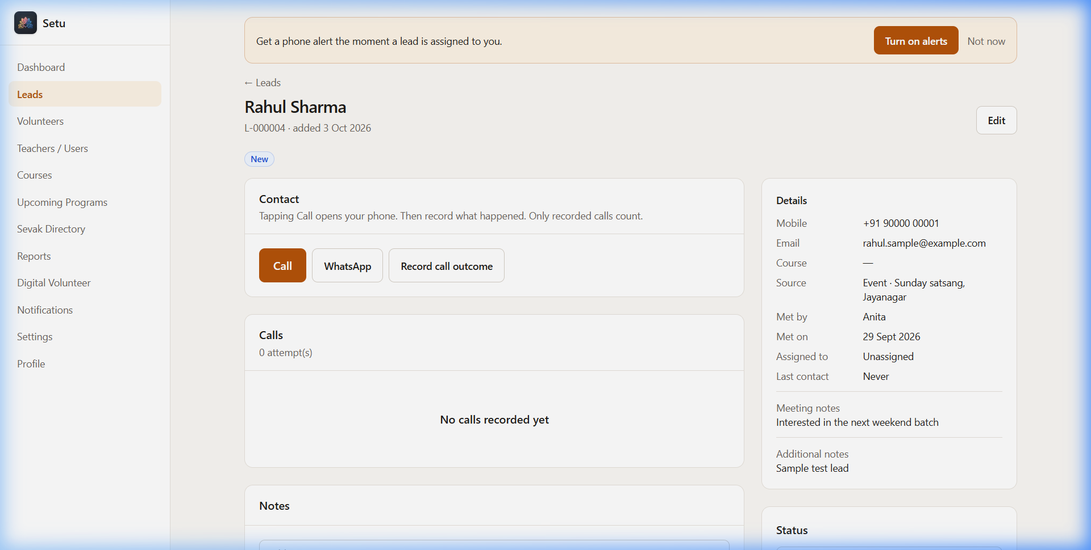
FEATURE 03
Volunteer Action View: 1-Tap Call & Meeting Notes
Designed for Fast Seva
• 1-Tap Direct Call: Volunteers tap 'Call' to trigger their phone dialer instantly without typing numbers.
• 1-Tap WhatsApp: Pre-crafted Art of Living course greeting template opened straight in WhatsApp with seeker's name.
• Call Outcome Recording: One tap to log outcome: Connected, Left Voicemail, Wrong Number, or Call Later.
• Chronological Timeline: Previous notes and call history stay permanently with the lead, even if reassigned.

Slide 7
THE SECRET TO HIGH CONVERSION
The 24-Hour First Contact Rule & Automated Reassignment
HOURS 0 - 24
IDEAL OUTCOME
FAIL-SAFE MECHANISM
Step 1: Lead Assigned
A lead is assigned to a volunteer.
• Countdown starts (default 24h)
• Volunteer receives in-app alert
• Lead details visible on their mobile app
• Lead capacity counter increases
Step 2: 1st Qualifying Call
Volunteer connects with the seeker and records the call outcome in Setu.
• First Contact timestamp locked
• Lead is SECURED to volunteer
• Auto-reassignment timer permanently turns off
• Follow-up date scheduled
Step 3: Auto-Reassignment
If no call attempt is recorded within 24 hours:
• Server cron reassigns to next available volunteer
• Previous volunteer notified gracefully
• Zero guilt, zero friction
• Seeker gets called while still interested!

Slide 8
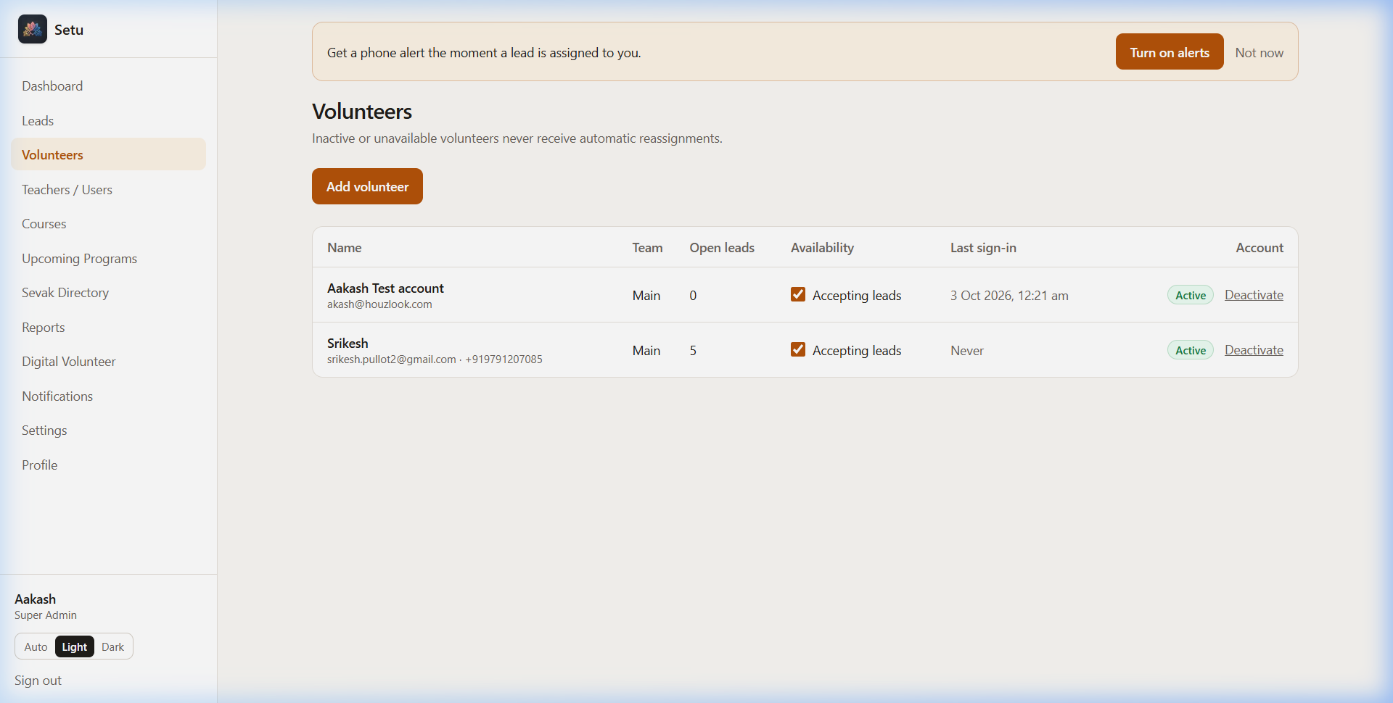
FEATURE 04
Volunteer Care & Workload Protection
Joyful & Balanced Seva
• Workload Caps (Max Open Leads): Set individual limits (e.g., 5 or 10 leads) so no volunteer feels overwhelmed.
• 'Accepting Leads' Toggle: Volunteers traveling or on silence retreats can toggle their availability OFF in 1 click.
• Real-Time Capacity Monitoring: Teachers see exactly who has bandwidth to take fresh leads before an intro talk.
• Transparent Seva History: Celebrates volunteer dedication with historical call counts and confirmed course registrations.

Slide 9
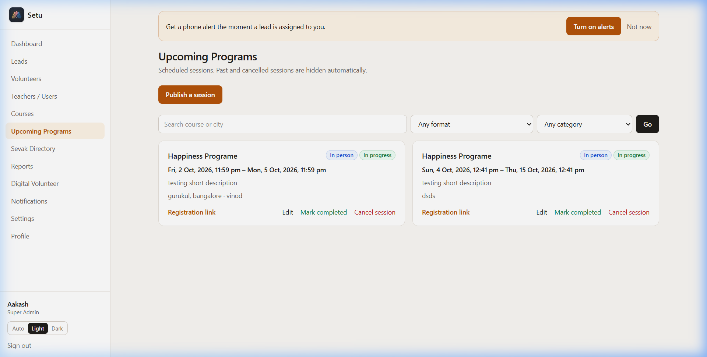
FEATURE 05
Programs & Upcoming Batches at Your Fingertips
Never Miss a Batch Date
• Course Schedule Hub: Complete calendar for Happiness Program, Sahaj Samadhi, Medha Yoga, DSN, and Sri Sri Yoga.
• Registration & Venue Links: Official portal links, Google Maps locations, and session timings stored in one spot.
• Synchronized with WhatsApp: Digital Volunteer bot uses this exact database to answer seeker queries automatically!
• Teacher Attribution: Clearly shows conducting teachers, venue coordinators, and contact persons for each batch.

Slide 10
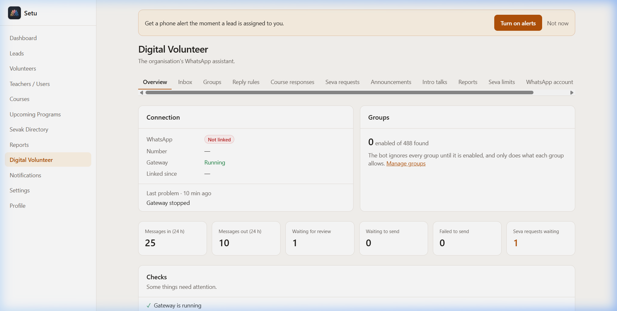
FEATURE 06
Digital Volunteer: WhatsApp Assistant for Seva
Official WhatsApp Assistant
• On-Demand Seva via WhatsApp: Volunteers message 'I want to do seva, send 5 numbers' → Setu privately shares unassigned leads!
• 1-Tap Teacher Approval: Teachers can approve seva lead requests directly by replying 'YES 12' in WhatsApp.
• Automated Course Answers: Answers questions about dates, venue, and fees using verified course data.
• Privacy & Safety First: Phone numbers are never posted into community groups; sent strictly to verified volunteers.
• Emergency Kill Switch: Single click to pause or turn off WhatsApp bot instantly if needed.

Slide 11
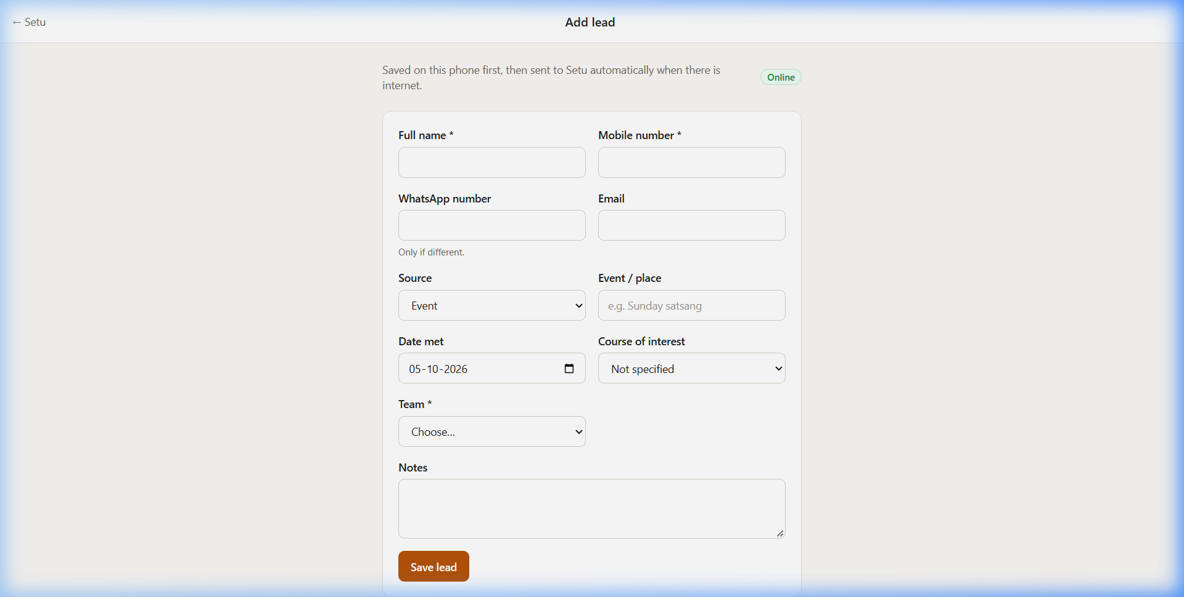
FEATURE 07
Offline Lead Capture: Perfect for Camps & Kiosks
No Wi-Fi? No Problem!
• Mobile-Optimized Fast Form: Clean, fast form designed for volunteer tablets and phones at busy event registration desks.
• Service Worker Offline Engine: Works even in basements, parks, or remote camp locations with zero internet.
• Auto-Sync on Reconnect: When the phone reconnects to 4G/Wi-Fi, all collected leads automatically sync into Setu.
• Replaces Paper Registers: Eliminates handwriting deciphering errors and lost sheets forever.

Slide 12
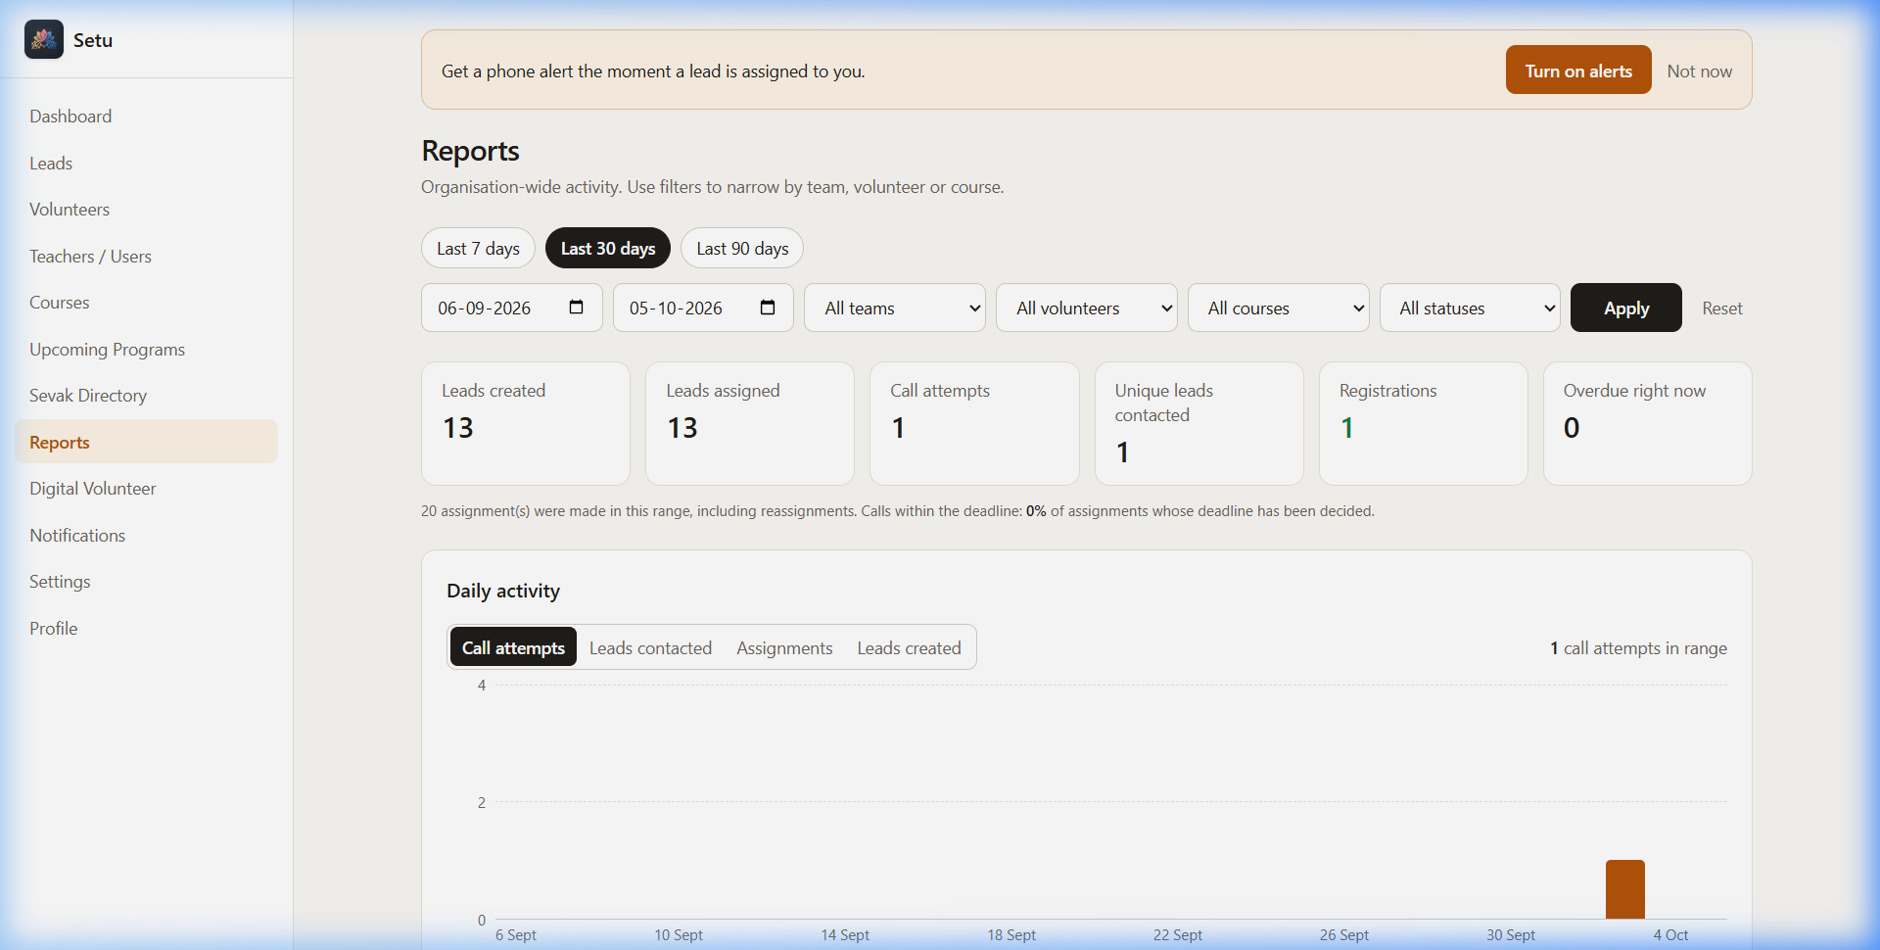
FEATURE 08
Actionable Reports: Data-Driven Seva Growth
Continuous Learning
• Daily Calling Activity Graph: See call volumes day by day in the 2 weeks leading up to course day.
• Outcome Breakdown: Understand how many inquiries converted to Registered, Callback Later, or Not Reachable.
• Lead Source Effectiveness: Pinpoint which intro talks, colleges, or flyer distributions bring real registrations.
• Team Recognition: Acknowledge and appreciate the top calling volunteers during chapter satsangs.

Slide 13
MOBILE ACCESSIBILITY
Native Android App: Setu in Every Volunteer's Pocket
The Volunteer Mobile Experience
• Direct Sideloadable APK: Downloadable directly from GitHub Releases without requiring Google Play Store.
• Capacitor 7 Architecture: High performance, secure HTTPS WebView connected directly to the live server.
• Native Integration: Tapping a phone number opens the native phone dialer; WhatsApp links open the WhatsApp app.
• Lightweight & Fast: Only ~4 MB download size, runs smoothly on any Android phone (Android 6.0 to 14+).
• Automatic Updates: Always serves the freshest features and course data with zero manual app reinstallations.
Simple 3-Step Volunteer Setup
1. Download the APK Link
Open the GitHub Release link on your Android phone and download Setu-1.0.X.apk.
2. Enable Install Unknown Apps
If prompted by Android, toggle 'Allow from this source' for your browser.
3. Log In & Start Seva
Open Setu, log in with your volunteer account, and immediately view your assigned leads!

Slide 14
TEACHER IMPACT SUMMARY
Transformation: Managing Courses Before vs. With Setu
❌ BEFORE SETU
• Multiple Excel files and paper notes scattered across volunteer phones.
• Leads go cold after 4-5 days; 60%+ dropout rate before registration.
• Teacher manually copies & pastes phone numbers to WhatsApp groups.
• Volunteers get burnt out or forget who they already called.
• Zero visibility into why people didn't register or if they were called.
• Panic and stress in the final 48 hours before course start.
✅ WITH SETU
• Single, secure cloud database accessible on web and mobile phones.
• 24-Hour Contact Rule guarantees fresh engagement and high turnout.
• 1-click bulk assignment + WhatsApp seva bot sends leads automatically.
• Workload caps and availability toggles protect volunteer energy.
• Clear timeline, call notes, and analytics for every single seeker.
• Teachers focus on teaching, meditation, and personal mentoring!

Slide 15
Getting Started: 3 Simple Steps for Teachers
How to roll out Setu for your upcoming Happiness Program or Course Batch
1
2
3
Step 1: Set Up Upcoming Batches
1. Log in to Setu Web.
2. Navigate to 'Courses & Upcoming'.
3. Add your course dates, venue, timing, and official registration link.
Step 2: Onboard Volunteers
1. Invite chapter volunteers via email or share the Setu APK link.
2. Set reasonable workload caps (e.g. 5 leads per volunteer).
3. Confirm their availability status.
Step 3: Capture & Flow Seva
1. Use /capture at upcoming satsangs or intro sessions.
2. Assign leads to volunteers in 1 click or let them request via WhatsApp.
3. Watch registrations grow seamlessly!
Jai Gurudev! • Together, Let Us Connect More Seekers to the Wisdom of the Art of Living.

