Slide 1
Module – 2: Network Layer-Part I

Slide 2
IPv4 addresses
The identifier used in the IP layer of the TCP/IP protocol suite to identify the connection of each device to the Internet is called the Internet address or IP address.
An IPv4 address is a 32-bit address that uniquely and universally defines the connection of a host or a router to the Internet.
The IP address is the address of the connection, not the host or the router, because if the device is moved to another network, the IP address may be changed.
If a device has two connections to the Internet, via two networks, it has two IPv4 addresses.

Slide 3
Address space
An address space is the total number of addresses used by the protocol.
If a protocol uses b bits to define an address, the address space is 2^b because each bit can have two different values (0 or 1).
IPv4 uses 32-bit addresses, which means that the address space is 2^32 or 4,294,967,296 (more than four billion).

Slide 4
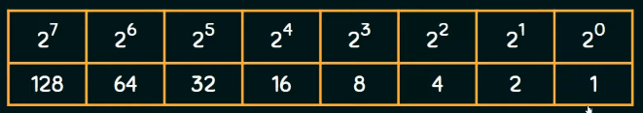
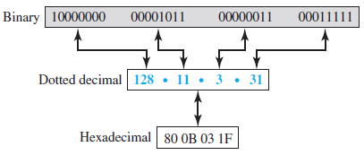
Three different notations in IPv4 addressing

Slide 5
Example
Convert the IPv4 address from binary notation to dotted-decimal
10111001 01001110 11000110 01101000
2. Convert the IPv4 address from dotted-decimal to binary notation 145.14.6.8

Slide 6
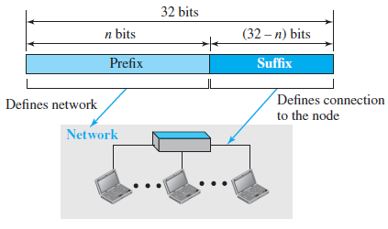
Hierarchy in Addressing
A 32-bit IPv4 address is hierarchical, but divided only into two parts.
First part of the address, called the prefix, defines the network.
Second part of the address, called the suffix, defines the node (connection of a device to the Internet).

Slide 7
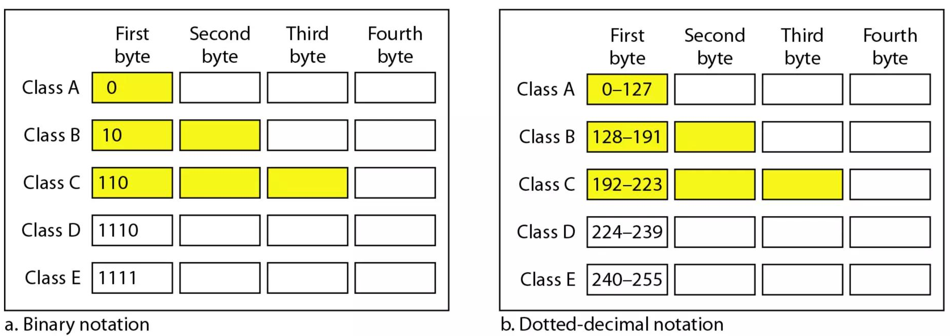
Classful Addressing
A prefix can be fixed length or variable length.
The network identifier in the IPv4 was first designed as a fixed-length prefix is
referred to as classful addressing.
The new scheme, which is referred to as classless addressing, uses a variable-length network prefix.
The whole address space was divided into five classes (class A, B, C, D, and E)

Slide 8
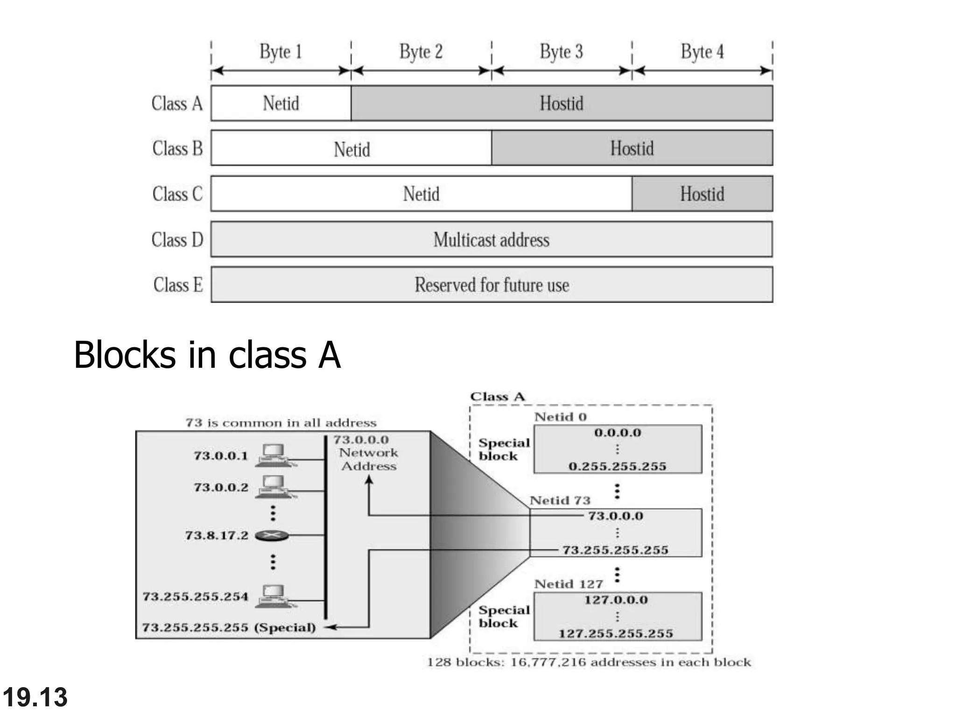
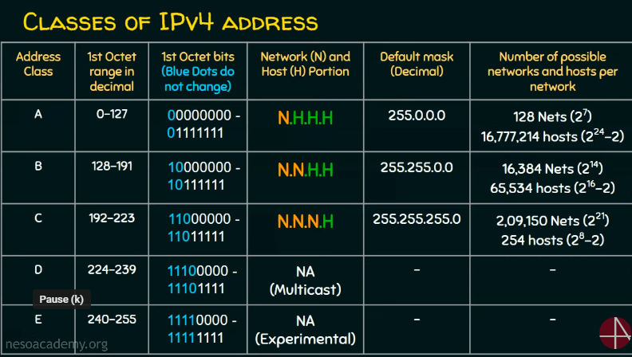

Slide 9
VALID/ INVALID IP ADDRESSES
10.10.56.80
240.230.220.89
1.2.3.4
99.88.67.89
100.200.89.90
256.195.1.156.89.1.2.5
10.065.34.56
200.28.256.8

Slide 10
Find the class of the following dotted decimal IPv4 addresses.
192.168.1.10
10.10.200.6
172.15.165.1
230.10.65.30
Find the class of the following IPv4 address:
a. 11110111 11110011 10000111 11011101
b. 10101111 11000000 11110000 00011101
c. 11011111 10110000 00011111 01011101
d. 11101111 11110111 11000111 00011101

Slide 12
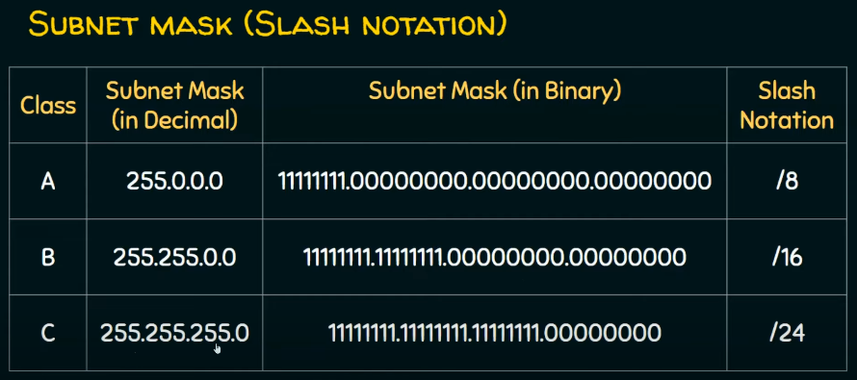

Slide 13
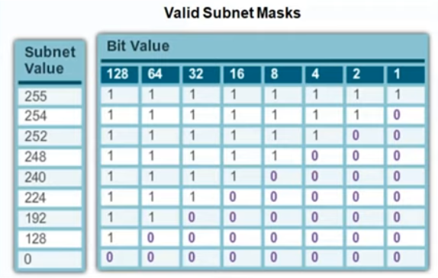
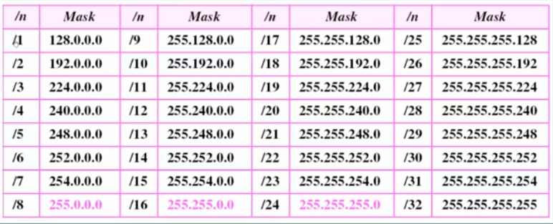

Slide 14
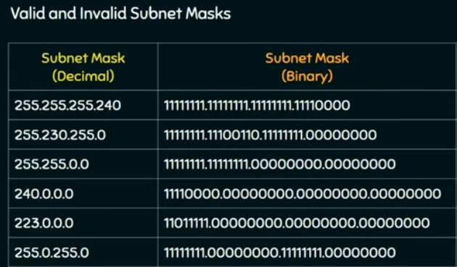

Slide 15
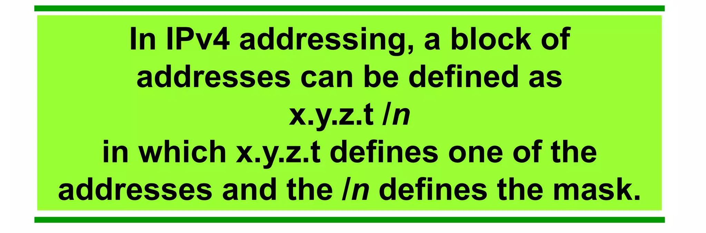

Slash notation - classless interdomain routing (CIDR)

Slide 16
Extracting Information from an Address
Normally like to know three pieces of information about the block to which the address belongs:
1.Number of addresses. 2. First address 3.Last address.
The number of addresses in the block is found as N = 2^(32−n).
To find the first address, we keep the n leftmost bits and set the (32 − n) rightmost bits all to 0s.
To find the last address, we keep the n leftmost bits and set the (32 − n) rightmost bits all to 1s.

Slide 17
Example
A classless address is given as 167.199.170.82/27.
Find the
First address
Last address
Number of address
A classless address is given as 205.16.37.39/28.
Find the
First address
Last address
Number of address

Slide 18
Address Mask
Another way to find the first and last addresses in the block is to use the address mask.
1. The number of addresses in the block N = NOT (mask) + 1.
2. The first address in the block = (Any address in the block) AND (mask).
3. The last address in the block = (Any address in the block) OR [(NOT (mask)].
A classless address is given as 167.199.170.82/27.
Find the
First address
Last address
Number of address
A classless address is given as 205.16.37.39/28.
Find the
First address
Last address
Number of address

Slide 19
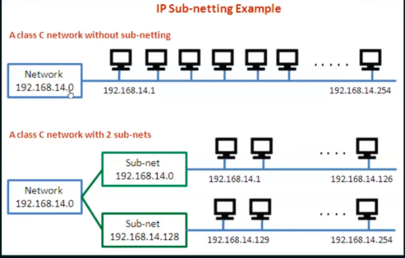
Subnetting
A subnetwork or subnet is a logical subdivision of an IP network.
The practice of dividing a network into two or more networks is called
subnetting.
Computers that belong to a subnet are addressed with an identical
most-significant bit-group in their IP addresses.

Slide 20
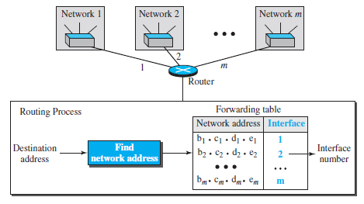
Network Address
Network Id Mask Interface
144.16.0.0 255.255.0.0 eth o
144.16.64.0 255.255.224.0 eth 1
144 16.68.0 255.255.255.0 eth 2
144.16.68.64 255.255.255.224 cth 3
IP Address of the Packet 144.16.68.117
Procedure: AND operation between Mask
and Destination IP Address

Slide 21
Block Allocation
In classless addressing, the address space is divided into variable-length blocks, and organizations can be granted one block of addresses.
3 Conditions
1. Block must be contiguous.
2. Total Number of Address must be (Power of 2)
Eg: 2^0,2^1,2^2….. 2^32
1,2,4,8, 16…….
3. First Address must be divisible by Total No. of Address.(We need to convert the IP address to decimal)
Problem: 18.14.12.0/22
N=2^32-n, Where N= total number of address, n=Prefix
N=2^32-22=2^10= 1024
Problem: An ISP has requested a block of 1000 addresses.

Slide 22
Subnetting
An organization (or an ISP) that is granted a range of addresses may divide the range into several subranges and assign each subrange to a subnetwork (or subnet).
We assume the total number of addresses granted to the organization is N, the prefix
length is n, the assigned number of addresses to each subnetwork is Nsub, and the prefix
length for each subnetwork is nsub.
Then the following steps need to be carefully followed to guarantee the proper operation of the subnetworks.
1. The number of addresses in each subnetwork should be a power of 2.
2. The prefix length for each subnetwork should be found using the following formula:
first address = Nsub=2^32-nsub.
3. The starting address in each subnetwork should be divisible by the number of
addresses in that subnetwork.

Slide 23
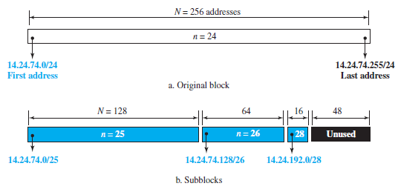
Problem
An organization is granted a block of addresses with the beginning address 14.24.74.0/24.
The organization needs to have 3 subblocks of addresses to use in its three subnets: one subblock of 10 addresses, one subblock of 60 addresses, and one subblock of 120 addresses. Design the subblocks.

Slide 24
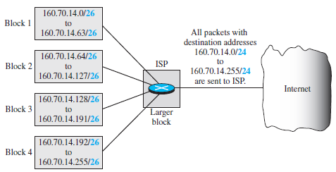
Address Aggregation
One of the advantages of the CIDR strategy is address aggregation (sometimes called address summarization or route summarization).
When blocks of addresses are combined to create a larger block, routing can be done based on the prefix of the larger block.

Slide 25
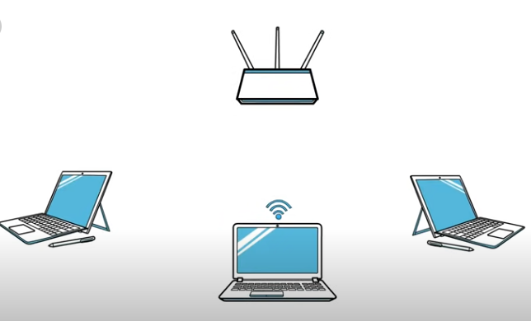
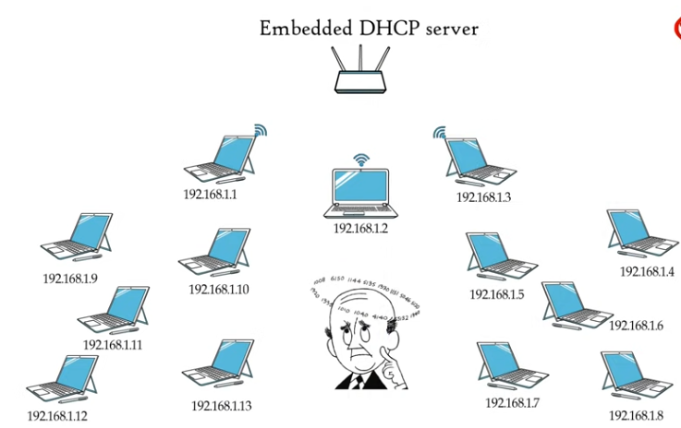
Dynamic Host Configuration Protocol (DHCP)

Slide 26
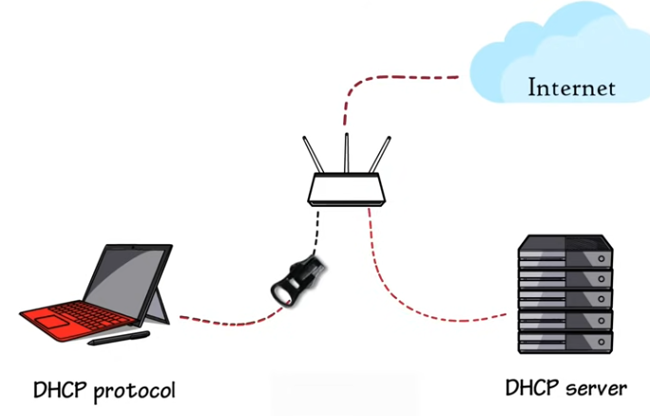

Slide 27
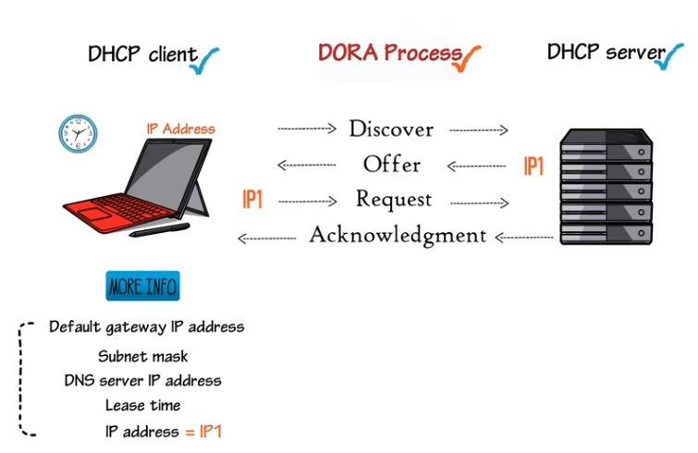

Slide 28
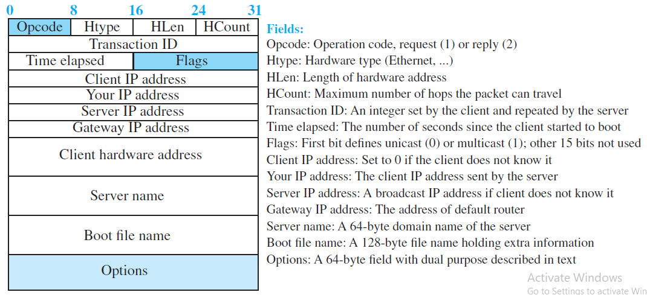
DHCP message format

Slide 29
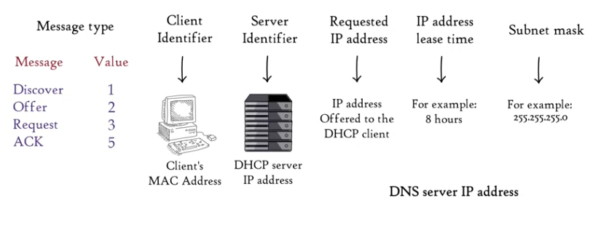
Options

Slide 30
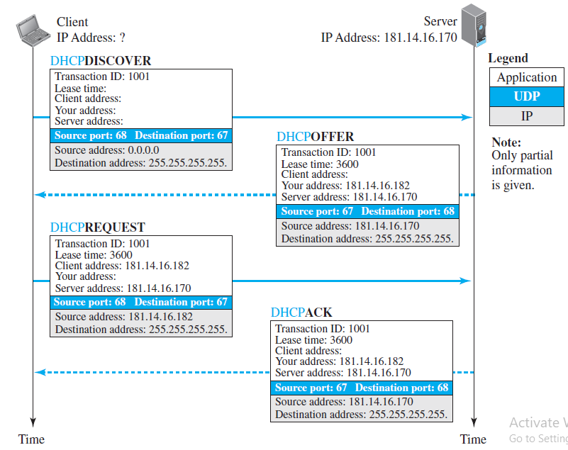
Operation of DHCP

Slide 31
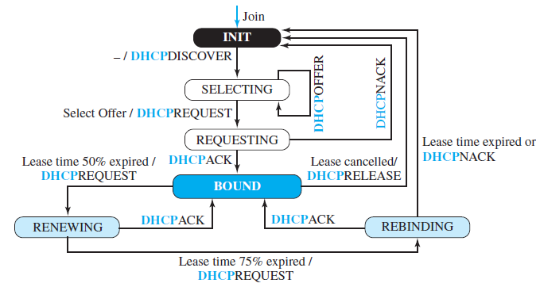
FSM for the DHCP client

Slide 32
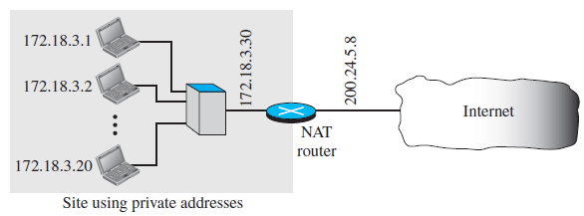
Network Address Resolution (NAT)

Slide 33
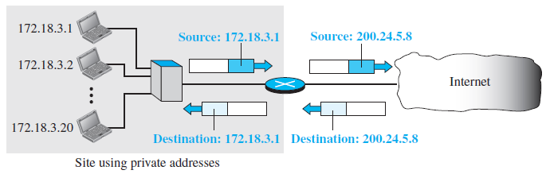
Address translation

Slide 34
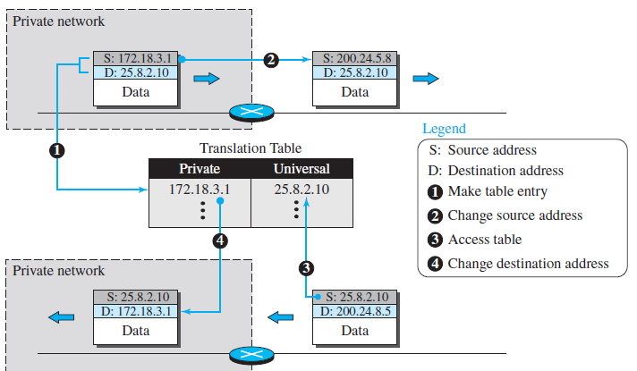

Slide 35
Using a Pool of IP Addresses
The use of only one global address by the NAT router allows only one private-network host to access a given external host.
To remove this restriction, the NAT router can use a pool of global addresses.
For example, instead of using only one global address (200.24.5.8), the NAT router can use four addresses (200.24.5.8, 200.24.5.9, 200.24.5.10, and 200.24.5.11).
In this case, four private-network hosts can communicate with the same external host at the same time because each pair of addresses defines a separate connection. However, there are still some drawbacks.
No more than four connections can be made to the same destination.

Slide 36
Special Addresses
This-host Address
The only address in the block 0.0.0.0/32 is called the this-host address. It is used whenever a host needs to send an IP datagram but it does not know its own address to use as the source address.
Limited-broadcast Address
The only address in the block 255.255.255.255/32 is called the limited-broadcast address. It is used whenever a router or a host needs to send a datagram to all devices in a network. The routers in the network, however, block the packet having this address as the destination; the packet cannot travel outside the network.
Loopback Address
The block 127.0.0.0/8 is called the loopback address. A packet with one of the addresses in this block as the destination address never leaves the host; it will remain in the host. Any address in the block is used to test a piece of software in the machine. For example, we can write a client and a server program in which one of the addresses in the block is used as the server address. We can test the programs using the same host to see if they work before running them on different computers.
Private Addresses
Four blocks are assigned as private addresses: 10.0.0.0/8, 172.16.0.0/12, 192.168.0.0/16, and 169.254.0.0/16.
Multicast Addresses The block 224.0.0.0/4 is reserved for multicast addresses.

Slide 37
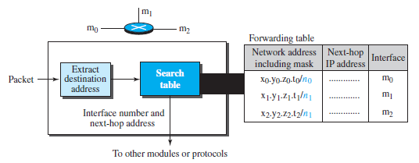
Forwarding Based on Destination Address

Slide 38
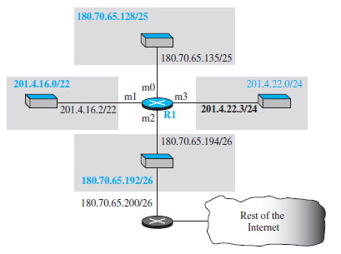
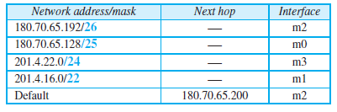

Slide 39
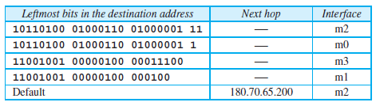
Show the forwarding process if a packet arrives at R1 with the destination
address 180.70.65.140.

Slide 40
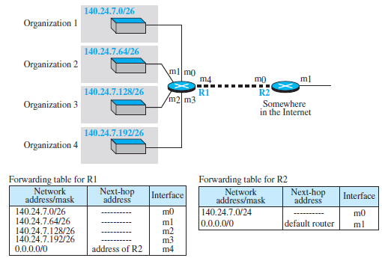
Address Aggregation

Slide 41
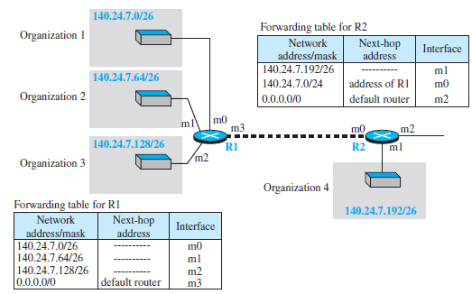
Longest Mask Matching

Slide 42
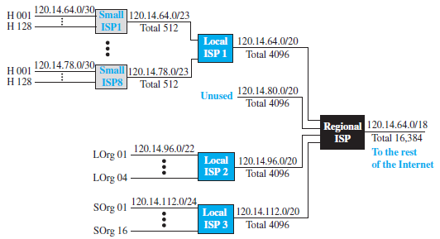
Hierarchical routing with ISPs

Slide 43

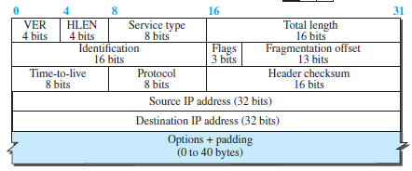
IP4- Datagram Format
Length of data = total length - (HLEN) *4

Slide 44
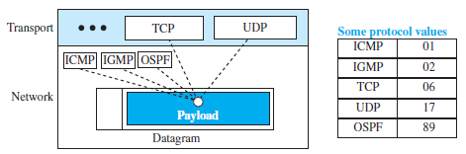
Multiplexing and demultiplexing using the value of the protocol field

Slide 45
An IPv4 packet has arrived with the first 8 bits as (01000010)2 The receiver discards the packet. Why?
In an IPv4 packet, the value of HLEN is (1000)2. How many bytes of options are being carried by this packet?
In an IPv4 packet, the value of HLEN is 5, and the value of the total length field is (0028)16. How many bytes of data are being carried by this packet?
4. An IPv4 packet has arrived with the first few hexadecimal digits as shown.
(45000028000100000102…)16 How many hops can this packet travel before being dropped? The data belong to what upper-layer protocol?

Slide 46
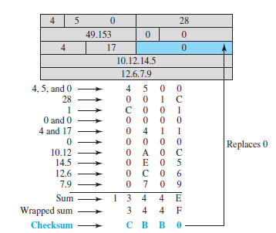

Slide 47
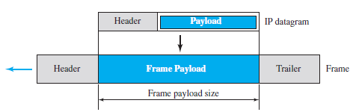
Fragmentation
The format and size of the received frame depend on the protocol used by the physical network through which the frame has just traveled.
Maximum Transfer Unit (MTU)
Each link-layer protocol has its own frame format. One of the features of each format is the maximum size of the payload that can be encapsulated. In other words, when a datagram is encapsulated in a frame, the total size of the datagram must be less than this maximum size, which is defined by the restrictions imposed by the hardware and software used in the network

Slide 48
Fields Related to Fragmentation
Identification 2. flags 3. fragmentation offset.
1. The 16-bit identification field identifies a datagram originating from the source host. The combination of the identification and source IP address must uniquely define a datagram as it leaves the source host. To guarantee uniqueness, the IP protocol uses a counter to label the datagrams.
2. The 3-bit flags field defines three flags.
The leftmost bit is reserved (not used).
The second bit (D bit) is called the do not fragment bit.
1--not fragment the datagram. If it cannot pass the datagram through any available physical
network, it discards the datagram and sends an ICMP error message to the source Host.
0--the datagram can be fragmented if necessary.
Third bit (M bit) is called the more fragment bit.
1--, it means the datagram is not the last fragment; there are more fragments after this one. If its value is 0, it means this is the last or only fragment.

Slide 49
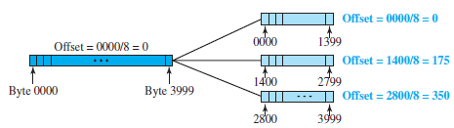
3. fragmentation offset: The 13-bit fragmentation offset field shows the relative position of this fragment with respect to the whole datagram.
It is the offset of the data in the original datagram measured in units of 8 bytes.

Slide 50
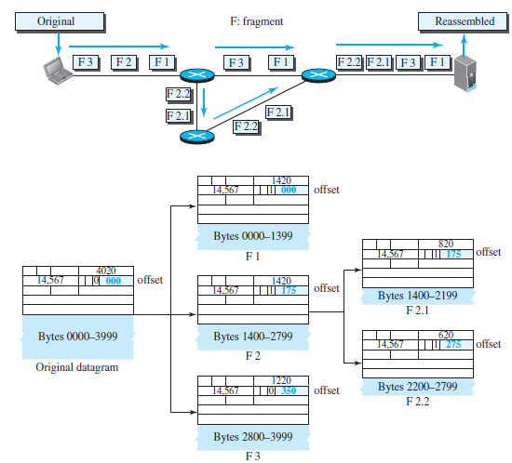

Slide 51
1.A packet has arrived with an M bit value of 0. Is this the first fragment, the last fragment, or a middle fragment? Do we know if the packet was fragmented?
2. A packet has arrived with an M bit value of 1. Is this the first fragment, the last fragment, or a middle fragment? Do we know if the packet was fragmented?
3. A packet has arrived with an M bit value of 1 and a fragmentation offset value of 0. Is this the first fragment, the last fragment, or a middle fragment?
4. A packet has arrived in which the offset value is 100. What is the number of the first byte? Do we know the number of the last byte?
5. A packet has arrived in which the offset value is 100, the value of HLEN is 5, and the value of the total length field is 100. What are the numbers of the first byte and the last byte?

Slide 52
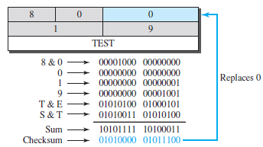
ICMP Checksum
In ICMP the checksum is calculated over the entire message (header and data).

Slide 53
IPv6 PROTOCOL

Slide 96
SUBNETTING - 5 STEPS
1. Identify the class of the IP address and note the Default Subnet Mask.
2. Convert the Default Subnet Mask into Binary.
3. Note the number of hosts required per subnet and find the Subnet
Generator (SG) and octet position.
4. Generate the new subnet mask.
5. Use the SG and generate the network ranges (subnets) in the
appropriate octet position.

Slide 97
UNDERSTAND SUBNETTING
10.10.10.1 255.255.255.0 or 255.255.0.0 or 255.0.0.0;
Same Network
10.10.10.9
but
10.10.10.1 255.255.255.248;
10.10.10.9 Different Network

