Slide 1

DELOITTE AUSTRALIA · FORAGE
Cyber Job Simulation
Internship Report
Akash Singh
Roll No. 2410031663
IILM University, Greater Noida
Completed 22 October 2026

Slide 2







Personal Details
Who completed the simulation
NAME
ROLL NUMBER
UNIVERSITY
Akash Singh
2410031663
IILM University, Greater Noida
DOMAIN
PROGRAMME
COMPLETED
Cyber Security
Deloitte Australia Cyber Job Simulation
22 October 2026

Slide 3

About the Programme
A self-paced virtual experience on Forage where participants join Deloitte Australia’s cyber team to support a client through a cyber security breach.
1
Beginner
Virtual
TASK
LEVEL
MODE

Slide 4

The Task
Supporting a client through a cyber security breach
1
Understand the situation
Reviewed the client briefing and the cyber team’s role.
2
Review web activity logs
Examined recorded activity for abnormal patterns.
3
Identify suspicious behaviour
Flagged activity likely linked to the compromise.
4
Recommend next steps
Chose sensible response and remediation actions.
5
Compare with expert answers
Checked my reasoning against Deloitte’s example answers.

Slide 5
Concepts & Observations
CONCEPTS USED
KEY OBSERVATIONS
Log analysis
1
Logs are the main evidence in an incident, and suspicious signals show up only in context.
Indicators of compromise
2
Accuracy matters more than speed: a wrong conclusion leads to the wrong response.
Incident response
3
Analysts must also explain what happened and what to do next, clearly.
Client communication

Slide 6





Learning Outcomes
Incident awareness
Log analysis
Analytical judgement
Stages of responding to a breach and the consultant’s role.
Reading activity logs and spotting abnormal behaviour.
Backing conclusions with evidence, not assumptions.
Remediation thinking
Communication
Career insight
Proposing logical steps to contain and recover.
Presenting technical findings clearly to a client.
A clearer view of cyber roles at a consulting firm.

Slide 7
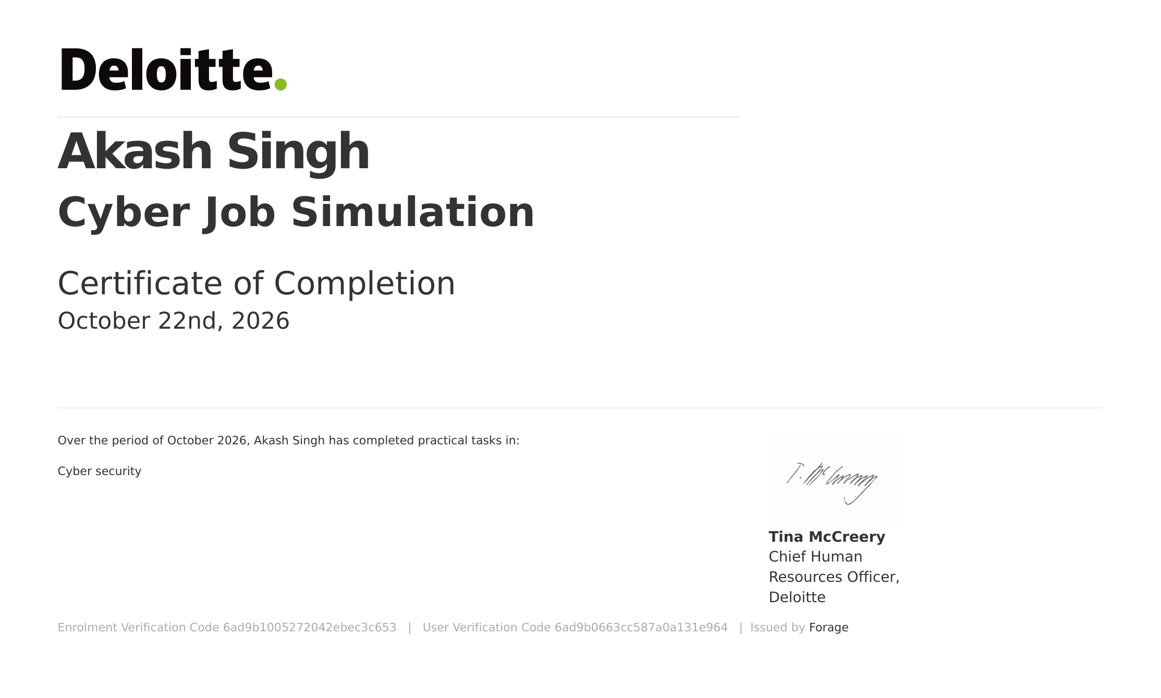
Certificate of Completion
AWARDED TO
Akash Singh
PROGRAMME
Cyber Job Simulation, Deloitte Australia
DATE
22 October 2026
ISSUED BY
Forage
ENROLMENT CODE 6ad9b1005272042ebec3c653
USER CODE 6ad9b0663cc587a0a131e964

Slide 8
Thank You
Akash Singh
Roll No. 2410031663
IILM University, Greater Noida

