Slide 1
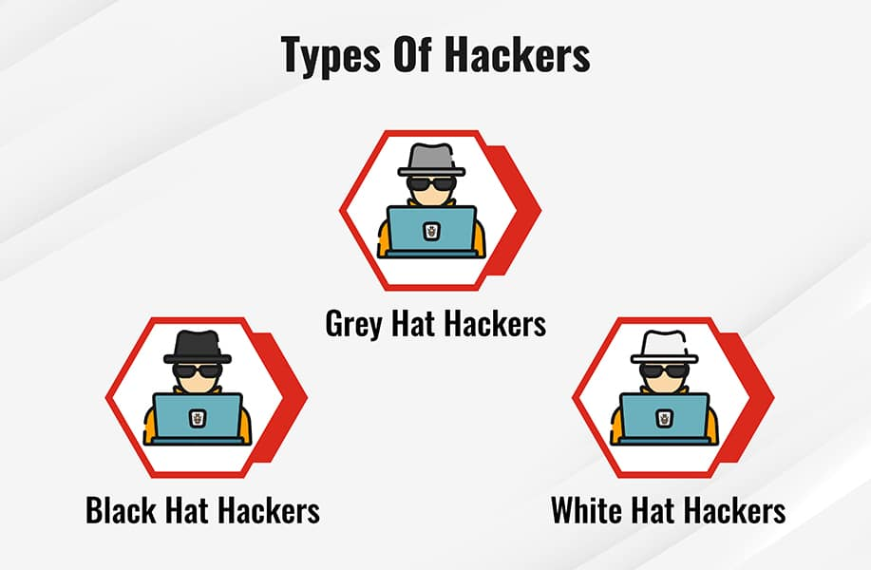
Hackings & Hackers

Slide 2
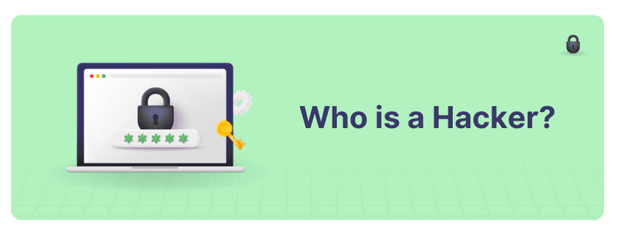
Hacking is simply the act of breaching unauthorized access to a system & a network. Hacking can be divided into two types: ethical & unethical.
Ethical hacking is when an individual or institution tests the security of a system or network to identify potential vulnerabilities that could be exploited by malicious attackers.
Unethical hacking involves attempting to gain unauthorized access to a system & a network with malicious intent.

Slide 3
Who are Hackers?
Hackers refer to individuals with exceptional computer skills who use their knowledge to exploit vulnerabilities in computer systems, exposing security vulnerabilities & gaining unauthorized access to sensitive information. Aside from popular belief, we cannot call all hackers malicious. Hacker means a broad range of individuals from black hat hackers, who cause harm & steal sensitive information, to white hat hackers, who identify weaknesses in computer systems.

Slide 4
What Do They Do?
They can do anything from stealing sensitive information, bringing down websites, gaining access to private system resources, using your computer to do illegal activities or even spying on individuals. Malicious hackers can do significant damage, & their actions can cause harm to both individuals & organizations.
Some hackers operate solely for personal gain, while others may be motivated by state-sponsored or ideological motives. Hackers employ a range of methods to gain access to systems, including phishing attacks, social engineering & exploiting unpatched vulnerabilities. Hackers pose a significant threat to individuals & organizations, & it is crucial for individuals & businesses to take steps to protect themselves from these nefarious actors.

Slide 5
The Difference Between Hackers and Cyber Attackers
Category | Hackers | Cyber Attackers
Motivation | Mostly driven by curiosity or challenge | Driven by financial gain or other malicious motives
Goals | Test system vulnerabilities, improve security measures | Exploit vulnerabilities, steal data, disrupt operations
Techniques | Use legal methods and tools to discover & report vulnerabilities | Use illegal methods & tools to breach systems & networks
Ethics | Ethical or white hat hackers disclose vulnerabilities and help patch them | Unethical or black hat attackers exploit vulnerabilities
Impact on Society | Can help improve cybersecurity measures | Can cause massive financial losses & damage to reputation
Legality | Legal | Illegal
Examples of Activities | Finding vulnerabilities in software, developing security measures | DDoS attacks, ransomware, phishing scams, stealing data

Slide 6
What Makes Someone a Hacker? / Motivations for Hacking
Financial Gain:
Political Activism
Intellectual Challenge
Revenge

Slide 7
haracteristics of a Hacker
Hackers are a unique breed of individuals who possess a distinctive set of characteristics that set them apart from the general population.
They are skilled in the art of computer programming & possess an insatiable curiosity to explore, understand & manipulate computer systems.
They have a natural tendency to question authority & often exhibit a rebellious streak, which drives them to challenge the status quo & push boundaries.
Hackers also possess a high degree of technical expertise & allows them to identify vulnerabilities in computer systems & exploit them for their own benefit.
They are skilled in a wide range of programming languages, operating systems & tools that enable them to carry out their nefarious activities.
Moreover, hackers are known for their ability to think outside the box & come up with creative solutions to complex problems.

Slide 8
Skills and Knowledge of Hackers
Some of the key skills and knowledge areas that hackers typically possess include:
Programming: Hackers are typically proficient in one or more programming languages & this allows them to write & execute custom scripts & tools to aid in their attacks.
Networking: A deep understanding of networking is crucial for many types of attacks, such as packet sniffing, DNS spoofing & man-in-the-middle attacks.
Social Engineering: Many attacks require manipulating human behavior to gain access to sensitive information or systems. Hackers are skilled at crafting convincing phishing emails, phone calls & other social engineering tactics.
Operating Systems: Hackers must be intimately familiar with the operating systems they are targeting, including Windows, macOS & various flavors of Linux.
Web Technologies: Attacks on websites often require knowledge of web development technologies, such as HTML, JavaScript & PHP.

Slide 9
What are the Types of Hackers?
White Hat hacker, who is an ethical hacker that uses their skills to identify & fix security weaknesses for companies or organizations. These hackers are also known as "ethical hackers" as they work to protect systems & data from unauthorized access.
Black Hat hackers are individuals who use their skills in unethical ways. They hack into computer systems & networks for personal gain, whether it be financial, political or malicious. Black hat hackers have bad intentions & engage in criminal activities. What is a black hat hacker? The opposite of a white hat hacker.
Grey Hat hackers are somewhere in between. They may use their skills to identify security weaknesses, but they do so without permission. Unlike black hat hackers who commit illegal activities, grey hat hackers may disclose the vulnerability to the organization, but only after exploiting it for their own gain. What is a grey hat hacker? They are a mixture of good & bad intentions.

Slide 10
Tools Hackers Use
Nowadays, hacking is not just the pastime of tech-savvy individuals, but a sophisticated & organized criminal activity that threatens companies & individuals. Hackers use a variety of tools to exploit vulnerabilities in computer systems, networks & applications. Here are some of the most common ones:
Metasploit: This open-source framework includes various exploits and payloads & makes it easier to launch attacks against systems with known vulnerabilities.
Nmap: A network mapping tool that scans the target network for active hosts & services, & provides valuable information about potential targets.
Cain and Abel: A password cracking tool that can reveal weak passwords used in online accounts, databases & Windows systems.
John the Ripper: Another password cracking tool, but with a wider scope of supported algorithms and customization options.
Wireshark: A network protocol analyzer that captures & displays network traffic & allows hackers to sniff passwords, cookies & other sensitive information.
Aircrack-ng: A suite of tools for cracking & analyzing wireless network security protocols, such as WEP & WPA.

