Slide 1
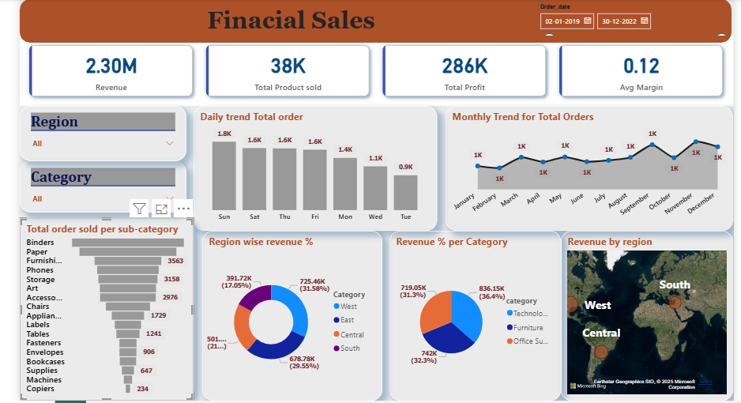
Dashboard

Slide 2
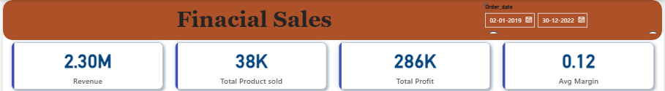
Slide 1: Financial Sales Overview (2019–2022)
Key Performance Indicators
- Revenue: 2.30M
- Total Products Sold: 38K
- Total Profit: 286K
- Average Margin: 0.12

Slide 3
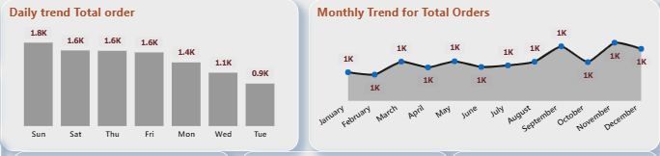
Slide 2: Sales Trend Analysis
Daily Total Orders
- Highest on Sunday (1.8K) and Saturday (1.6K)
- Lowest on Tuesday (0.9K)
Monthly Orders Trend
- Steady orders throughout the year (~1K/month)
- Peaks in August and December

Slide 4
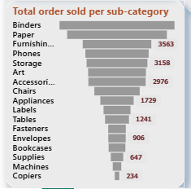
Slide 3: Top Performing Sub-Categories
Highest Total Orders
- Binders, Paper, Furnishings, Phones, Storage
- Binders top the list with 3158 orders

Slide 5
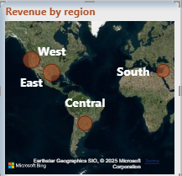
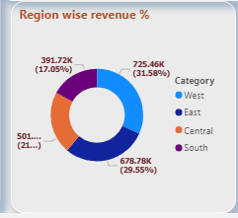
Slide 4: Regional Performance
Region-Wise Revenue %
- East: 725.6K (31.58%)
- West: 391.7K (17.03%)
- Central: 678.7K (29.54%)
- South: 501.5K (21.84%)
Revenue Distribution (Map)
- Stronger concentration in South and Central regions

Slide 6
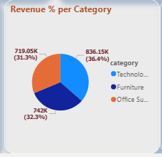
Slide 5: Revenue by Product Category
- Technology: 836.1K (36.4%)
- Office Supplies: 742K (32.3%)
- Furniture: 719.05K (31.3%)

