Slide 1
Exploratory Data Analysis
Using R
ES 218 – Spring 2015

Slide 2

I have some data!
Coefficients:
(Intercept) 3.0017 1.1239 2.671 0.02559 *
x 0.4999 0.1178 4.243 0.00216 **
Residual standard error: 1.236 on 9 degrees of freedom
Multiple R-squared: 0.6667, Adjusted R-squared: 0.6297
F-statistic: 18 on 1 and 9 DF, p-value: 0.002165
Let’s run a regression analysis
We have a model of the form Y = 0.5 x 0.12 X

Slide 3
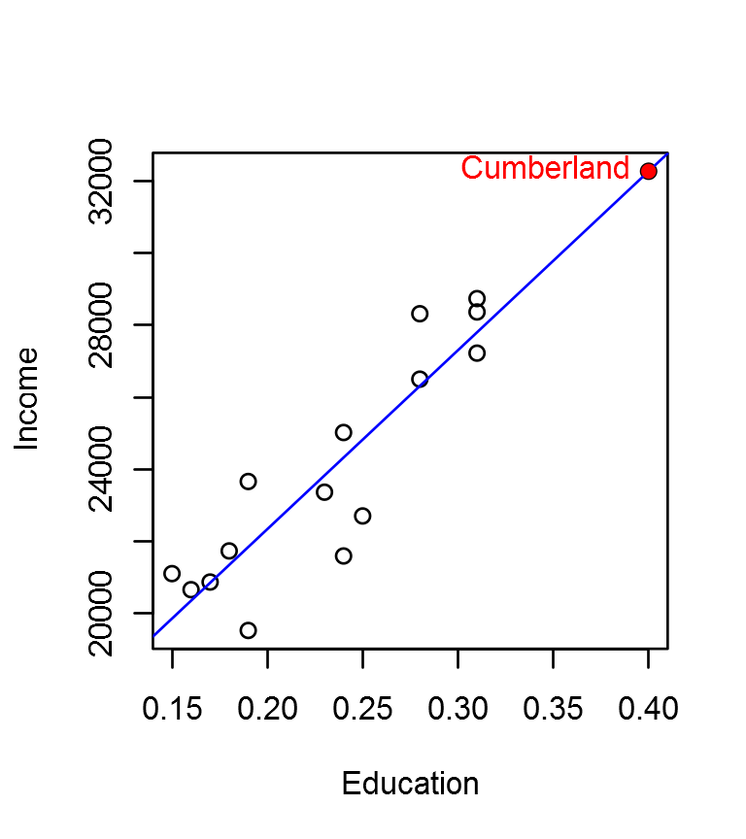
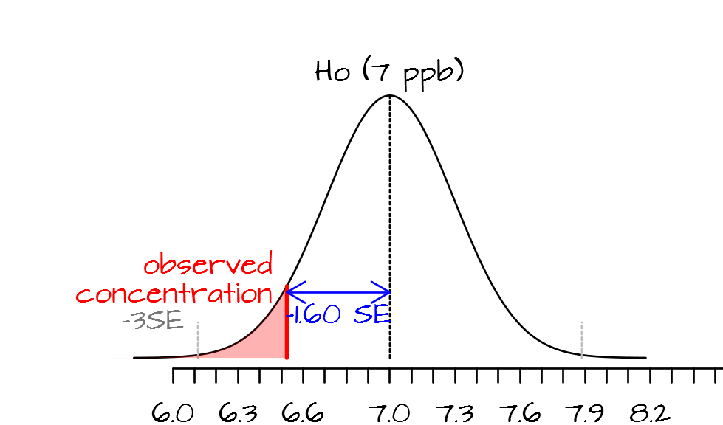
Traditional data analysis
x | y
12 | 2
3 | 7
7 | 2
4 | 8
My data
What statistic do I use?
What’s Missing?
Notes:
Traditional approaches to data analysis tend to be linear and unidirectional. It often starts with the acquisition or collection of a data set and ends with the computation of some sort of inferential or confirmatory procedure.

Slide 4
I have some data!
Coefficients:
(Intercept) 3.0017 1.1239 2.671 0.02559 *
x 0.4999 0.1178 4.243 0.00216 **
Residual standard error: 1.236 on 9 degrees of freedom
Multiple R-squared: 0.6667, Adjusted R-squared: 0.6297
F-statistic: 18 on 1 and 9 DF, p-value: 0.002165
Let’s run a regression analysis
We have a model of the form Y = 0.5 x 0.12 X
All these data sets produce the above statistics:
12
12
12
12
10
10
10
10
y1
8
y2
8
y3
8
y4
8
6
6
6
6
4
4
4
4
5
10
15
5
10
15
5
10
15
5
10
15
x1
x2
x3
x4
Notes:
Unfortunately, such data analysis practice can lead to faulty conclusions. In this example, four completely different datasets generate identical regression analysis results. This is Francis Anscombe’s famous quartet which was used to demonstrate the importance of visualizing the data before proceeding with traditional statistical analysis. Of the four plots, only the first is a sensible candidate for the regression analysis; the second dataset highlights a nonlinear relationship between X and Y; the third and fourth plots demonstrate the disproportionate influence of a single outlier.

Slide 5
EDA helps us reveal patterns in our data
x | y
12 | 2
3 | 7
7 | 2
4 | 8
Explore the data!
My data
What statistic do I use?
EDA helps us develop hypotheses
Notes:
All data analysis workflows must involve data visualization and exploration. Exploratory data analysis seeks to extract salient features about the data and to help formulate hypotheses. Only then should appropriate statistical tests be applied to the data to confirm if the dataset is saying what we think the dataset is saying. However, not all exploratory data analysis workflows result in a statistical test: We may not be seeking a hypothesis or, if a hypothesis is sought we may not have the statistical tools necessary to test the hypothesis. It’s important to realize that most statistical procedures make strong assumptions about the nature of the data and the type of hypothesis being tested; in fact, in most situations, data sets seldom meet those stringent requirements.

Slide 6
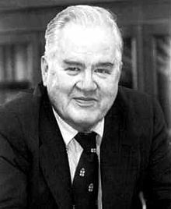
John Tukey
Exploring our data goes beyond the traditional descriptive statistics.
Exploratory data analysis makes use of our visual faculty to extract salient features about our data.
Src: Wikipedia
“Exploratory data analysis is an attitude, a flexibility, and a reliance on display, NOT a bundle of techniques.”

Slide 7
Effective data exploration requires a flexible analysis environment
Point and click environments like Excel just do not cut it. We need access to a set of data manipulation and visualization building blocks.
Notes:
Effective exploratory data analysis requires a flexible data analysis environment that does not constrain one to a limit set of data manipulation procedures or visualization tools. After all, would any good writer limit herself to a set of a hundred pre-constructed sentences? Of course not, we would be reading the same novels over and over again! So why would we limit ourselves to a limited set of pre-packaged data analysis procedures? A good data analyst needs an arsenal of data analysis building blocks much like a good writer needs an arsenal of words. EDA requires a flexible data manipulation environment, a flexible data visualization environment as well as access to a wide range of statistical procedures (both confirmatory and inferential). A scripting environment, like R, provides us with such an environment.

Slide 8


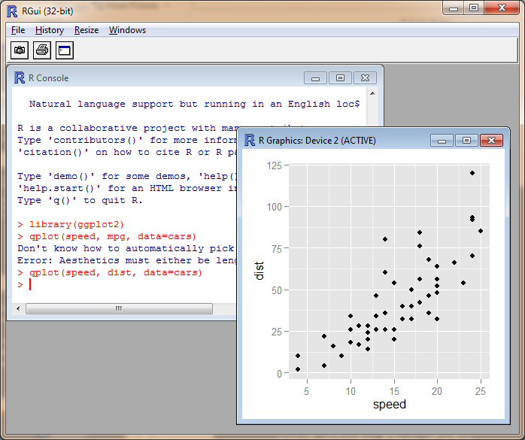
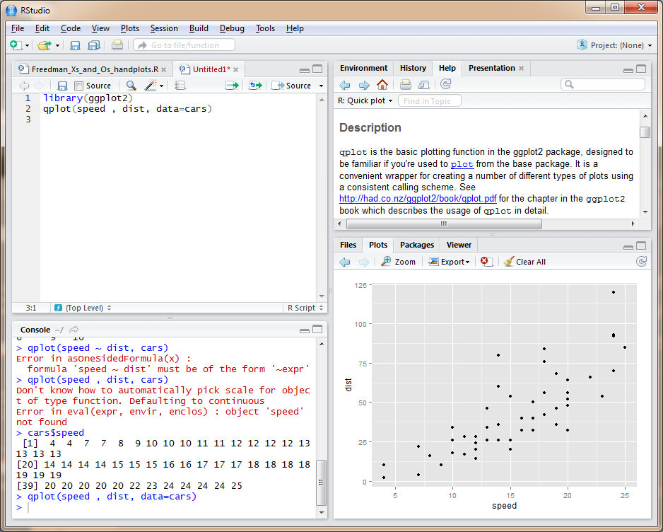
R is the programming environment. It’s the engine that processes and plots the data.
R Studio is a user friendly development environment (IDE) interface to R.
* Note that R has a functional interface, but R Studio’s interface is much easier to work with
Notes:
The data analysis environment should be, when possible, freely available and its code open to the public. The free access of the software allows anyone with the right set of skills to share in the data analysis, regardless of any budgetary constraints. The open source nature of the software ensures that any aspect of the code used for a particular task can be examined for errors when additional insight into an analytical/numerical methodology if needed. Deciphering code may not be a skill available to all researches, however, if the need to understand how a procedure is implemented is important enough, am individual with wit the appropriate programming skill can be easy to come by, even if it’s for a small fee. Open source software also ensures that the underlying code used to create the executable application can be ported to different platforms or different operating systems (even though this may require some effort and modest programming skills).

Slide 9
A basic tenet of the scientific method is reproducibility.
But what should be reproducible?
Everything! This includes the analytical workflow used to generate the results!
Notes:
Reproducible research leads credence to scientific work. The need for reproducibility is not limited to data collection or methodology but includes the actual analytical workflow that generated the results including data table manipulation and implementation of statistical procedures.
Data analysis can be complex and involve many data manipulation and analytical procedures. Each data manipulation step that involves human interaction is prone to clerical error. But error can also manifest itself in faulty implementation of an analytical procedure—both technical and theoretical. Unfortunately, the workflows are seldom available in technical reports or peer-reviewed publications. The intended audience is only left with the end product of the analysis. So how can a reader assess the validity of the author’s workflow when such information is unavailable?

Slide 10
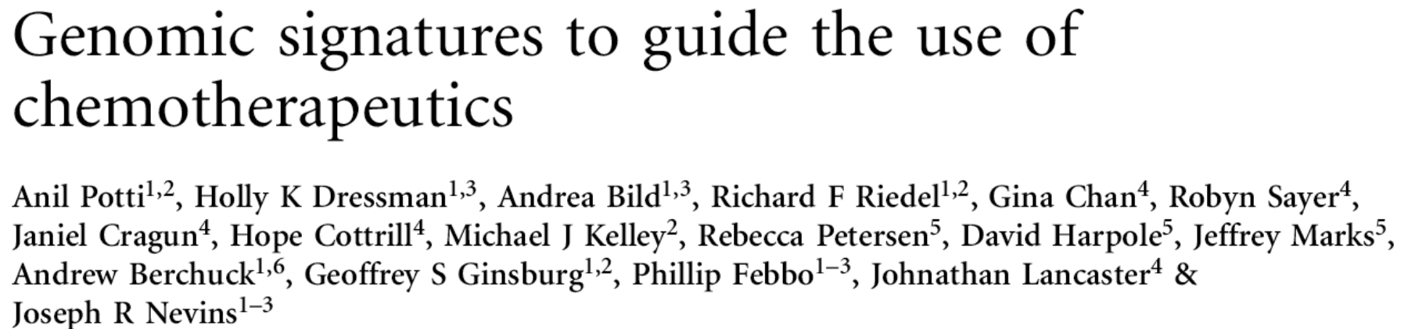
The gist of this research (out of Duke) was that a cancer cell’s gene can, via genomic tests, determine the most effective chemotherapy treatment.

Slide 11
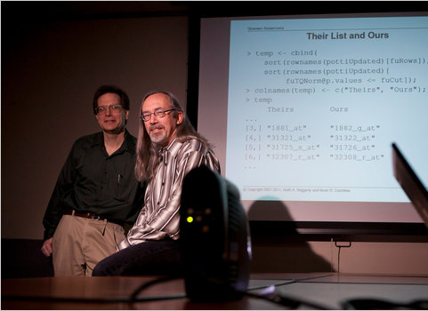
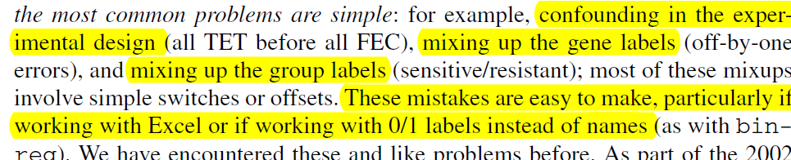
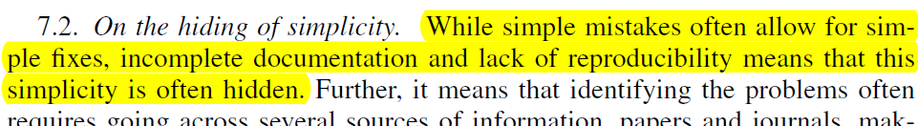
How Bright Promise in Cancer Testing Fell Apart
(NY Times, July 7, 2011)
“Dr. Baggerly and Dr. Coombes found errors almost immediately. Some seemed careless — moving a row or a column over by one in a giant spreadsheet — while others seemed inexplicable.”
Src: NY Times

Slide 12
Retracted in 2011
“We wish to retract this article because we have been unable to reproduce certain crucial experiments showing validation of signatures for predicting response to chemotherapies, including docetaxel and topotecan.”
Nature Medicine, 07 January, 2011

Slide 13
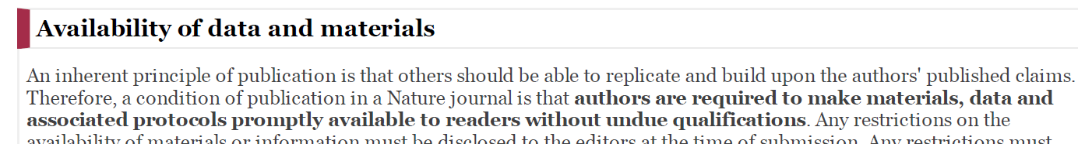
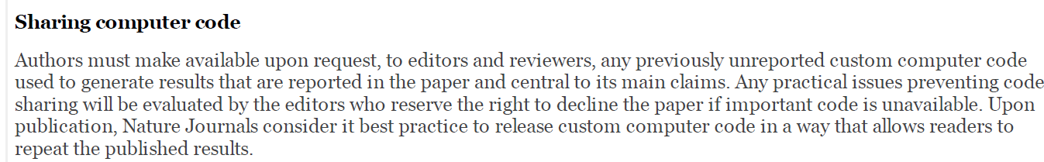
Nature journals ‘new’ policy

Slide 14
Unfortunately, errors in workflow are all too easy to make, errare humanum est (error is human).
For all the mistakes that are caught, how many more are left undiscovered?
Replicable analysis should allow anyone to recreate the results from the original, unmodified, data set.

Slide 15
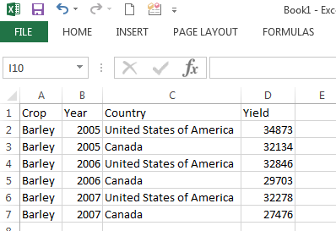
A scripting environment like R makes it easy to read each step of a workflow.
dat <- read.csv("FAO_grains_NA.csv”)
library(dplyr)
dat2 <- dat %>%
filter(Information == "Yield (Hg/Ha)",
Year >= 2005, Year <=2010) %>%
group_by(Crop, Year, Country) %>%
summarise(median_yield = round(median(Value))) %>%
arrange(Crop, desc(median_yield)) head(dat2)
VS.
Crop Year Country Yield
1 Barley 2005 United States of America 34873
2 Barley 2005 Canada 32134
3 Barley 2006 United States of America 32846
4 Barley 2006 Canada 29703
5 Barley 2007 United States of America 32278
6 Barley 2007 Canada 27476
Each step is clearly documented
What buttons were clicked?
What formulae were used?

Slide 16
Why make your work replicable?
To facilitate sharing of workflows
To catch errors
To reuse parts or all of an existing workflow

Slide 17
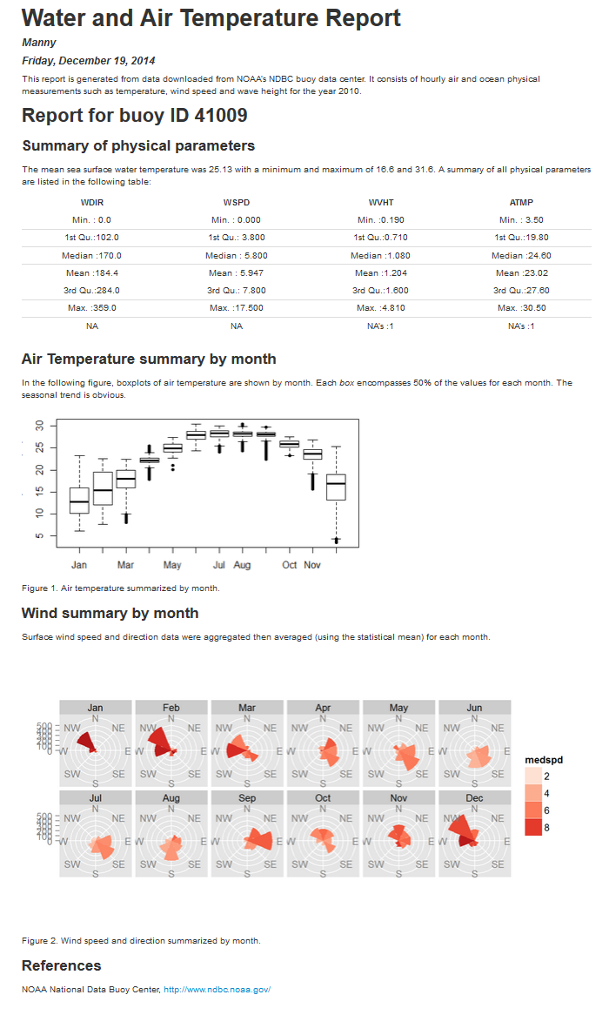
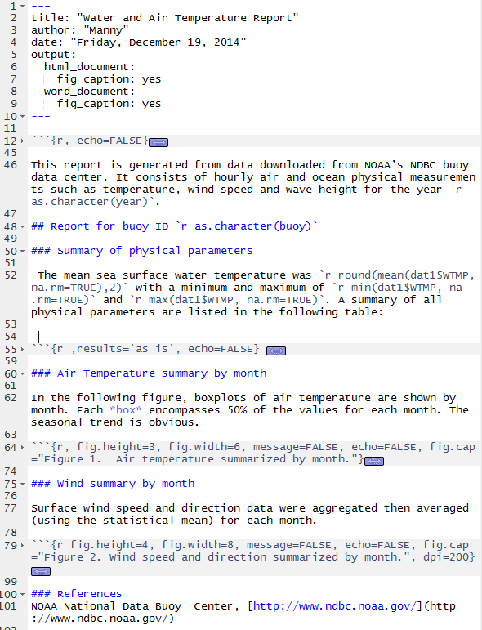
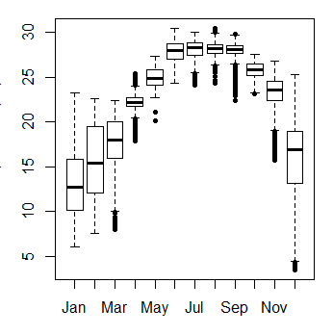
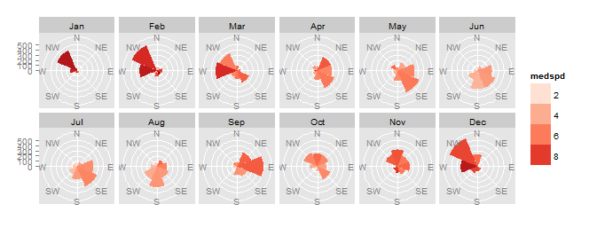
Linking analysis to the report
Both analysis and write-up
in one file using R Markdown!
--------------------------------------------------------
WDIR WSPD WVHT ATMP
------------- -------------- ------------- -------------
Min. : 0.0 Min. : 0.000 Min. :0.190 Min. : 3.50
1st Qu.:102.0 1st Qu.: 3.800 1st Qu.:0.710 1st Qu.:19.80
Median :170.0 Median : 5.800 Median :1.080 Median :24.60
Mean :184.4 Mean : 5.947 Mean :1.204 Mean :23.02
3rd Qu.:284.0 3rd Qu.: 7.800 3rd Qu.:1.600 3rd Qu.:27.60
Max. :359.0 Max. :17.500 Max. :4.810 Max. :30.50
NA NA NA's :1 NA's :1
--------------------------------------------------------
Don’t forget embedded statistical summaries
Notes:
Dynamic documents allow one to merge data processing (e.g. generation of statistical tables and graphs or maps) with the write-up. This avoids the need to copy and paste results from a spreadsheet or data analysis application into a Word document– a procedure that can be prone to clerical error if many figures, tables and embedded statistical values needed to be updated or corrected following a newer version of the source data.

Slide 18
You will learn to:
Explore Data
Program in R
Create reproducible analyses
Create dynamic reports

