Slide 1

GEM
Ein Projekt von: Luca Schäfli
Marc Hochuli
Nico Müller
Notes:
Ein Projekt von: Luca Schäfli
Marc Hochuli
Nico Müller

Slide 2
Content
Timetable
CAD and mechanical components
Schematics and electrical components
Stepper motors
Software
Gem in Action
Final statement

Slide 3
Timetable

Slide 4
CAD and mechanical components

Slide 5
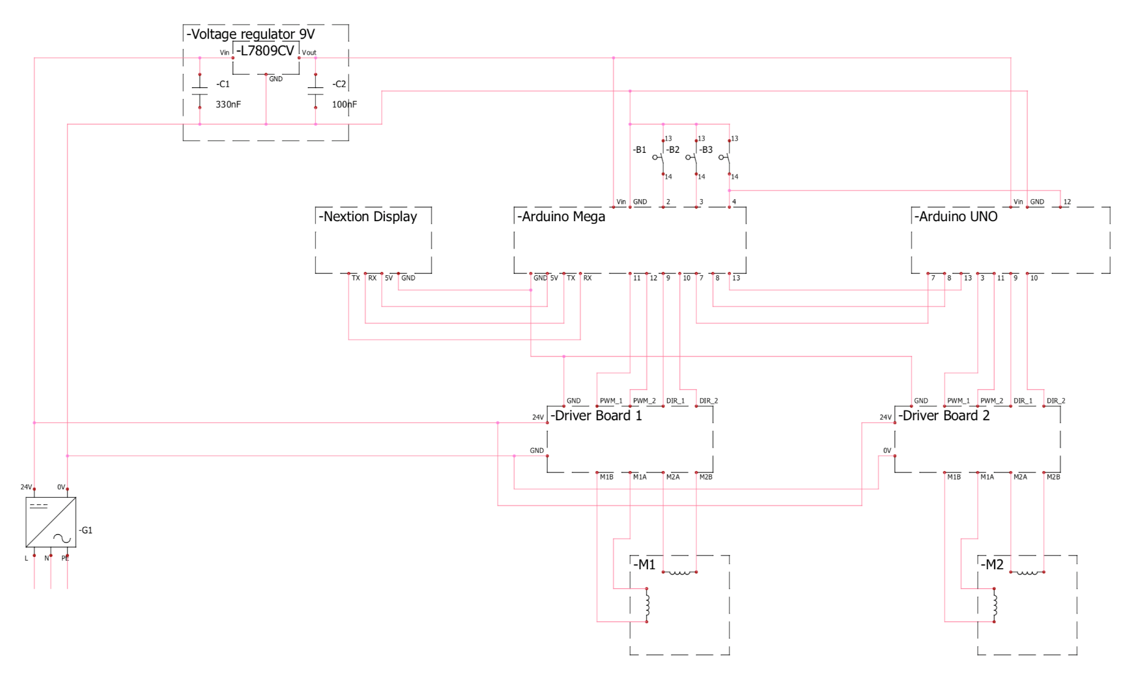
Schematics and electrical components

Slide 6
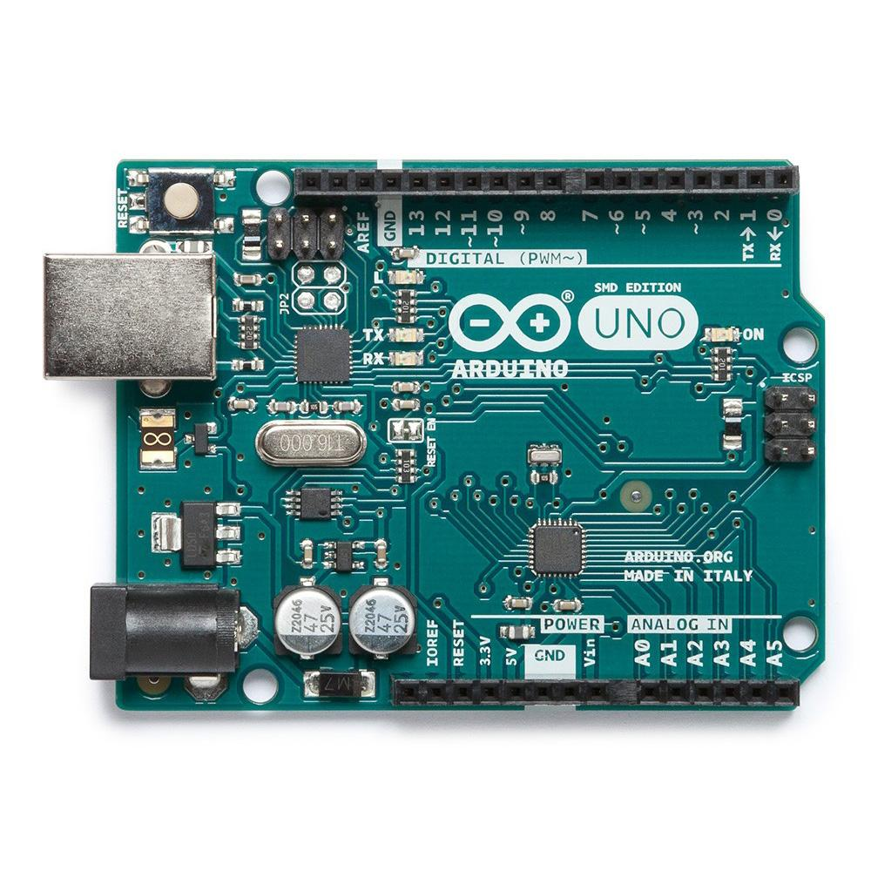
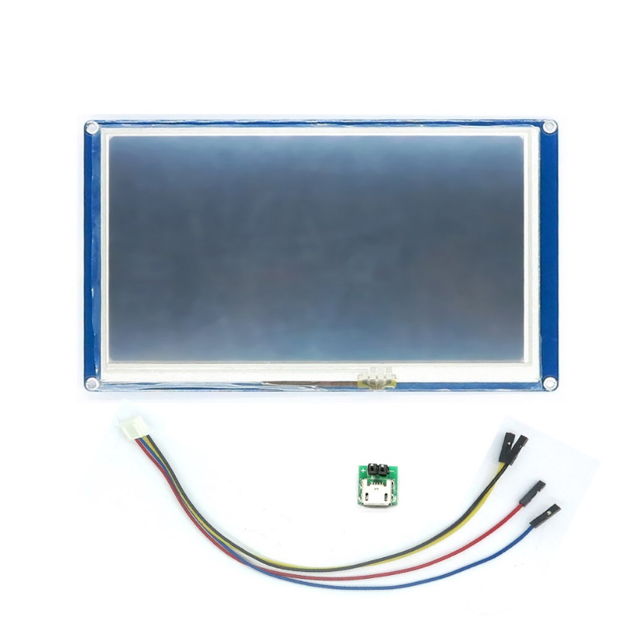
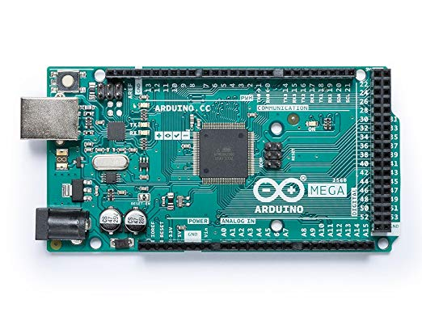
Schematics and electrical components

Slide 7
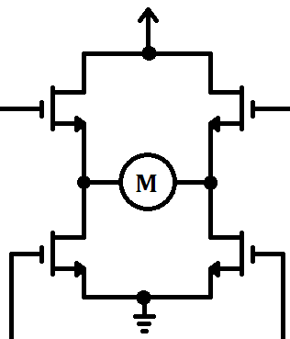
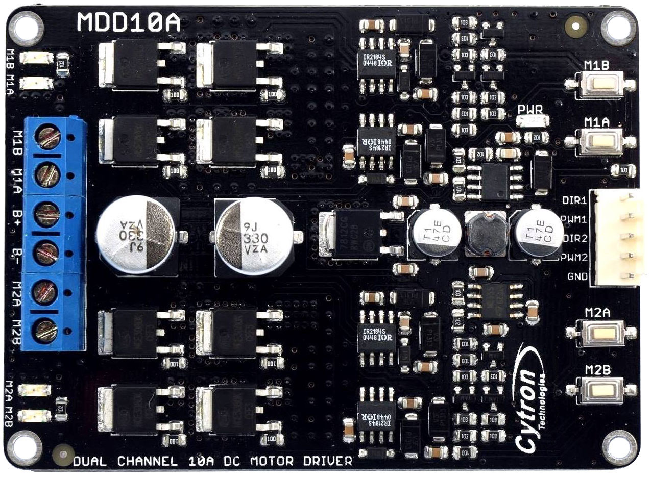
Schematics and electrical components

Slide 8
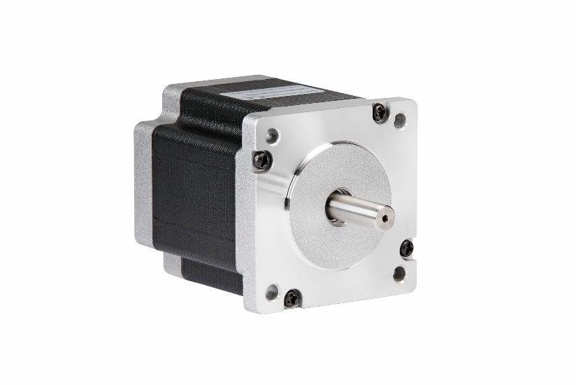
Stepper motors

Slide 9
Stepper motors

Slide 10
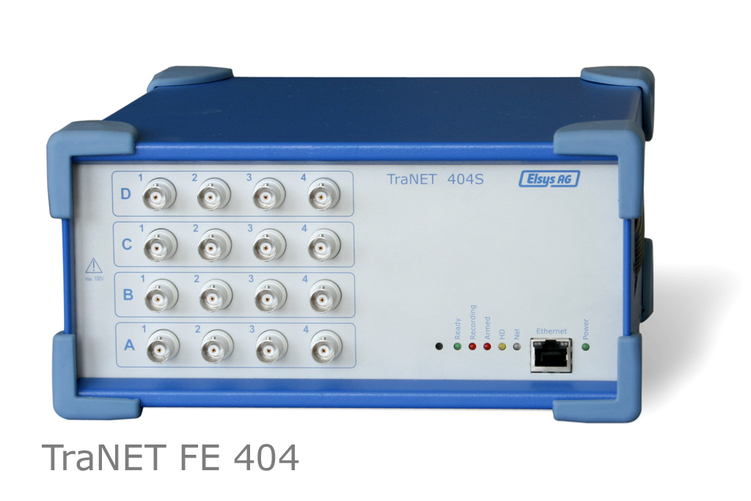
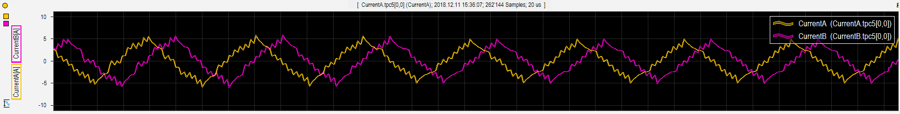
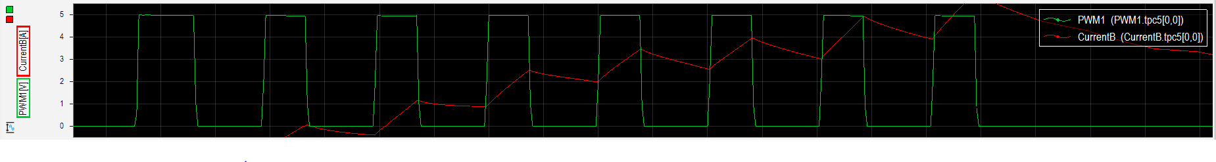
Stepper motors

Slide 11
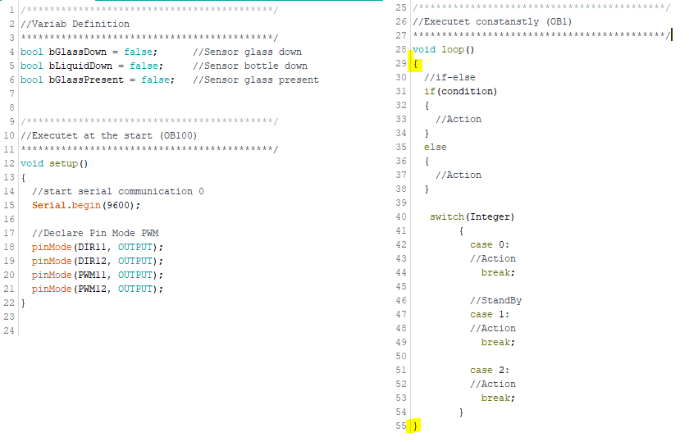
Development Environment
Arduino
Variables Definition
Keywords
Void setup
Void loop
Statements
{}

Slide 12
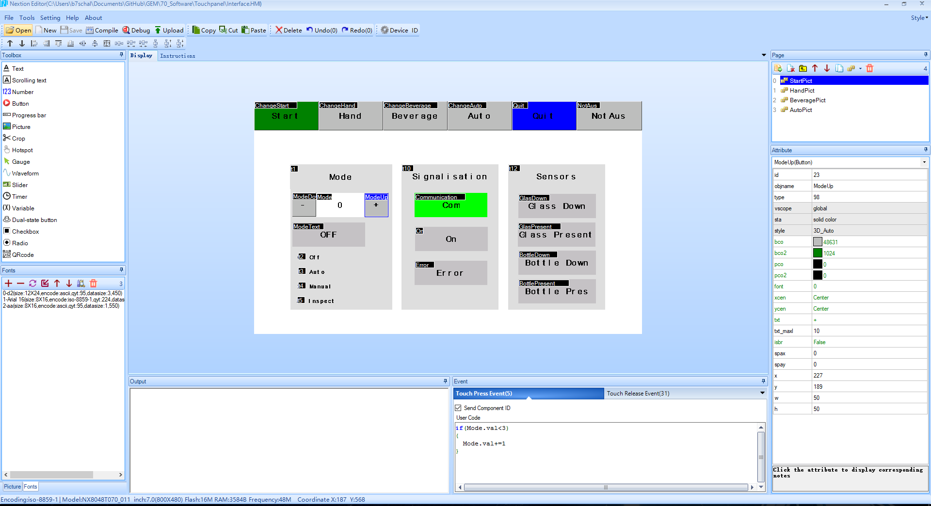
Development Environment
Nextion Editor

Slide 13
Software - Structure
Read Digital Inputs
Read Serial Communication
Update Status
Execute Operating Mode
Movement
Wirte Serial Communication
Write Digital Outputs
Reset HMI Variables

Slide 14
Software - Operating Modes
Operating Mode
Off
Auto
Hand
Insp

Slide 15
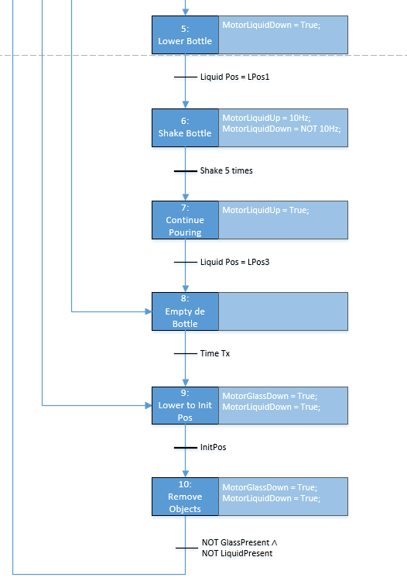
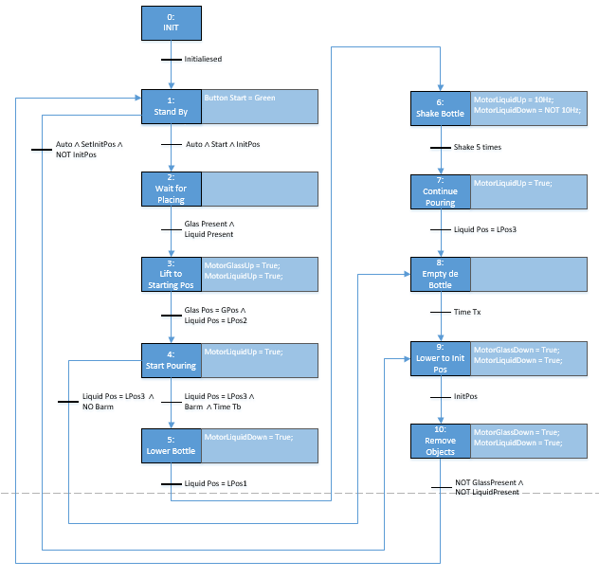
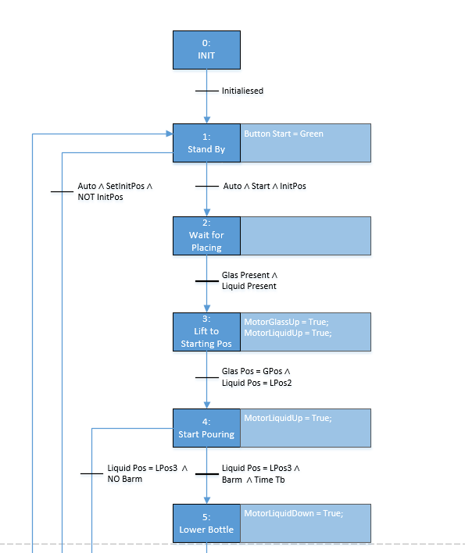
Software – Grafcet

Slide 16
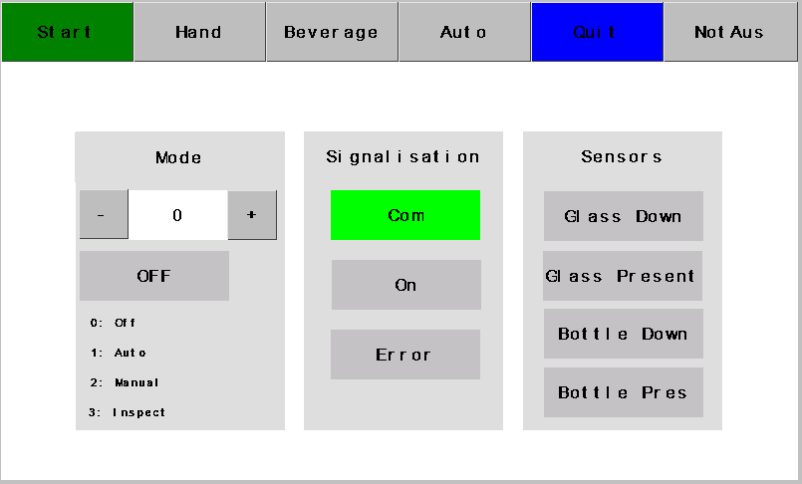
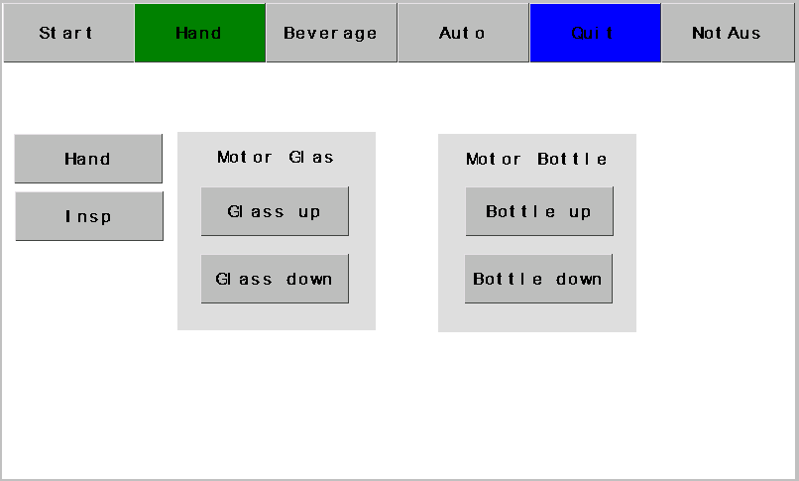
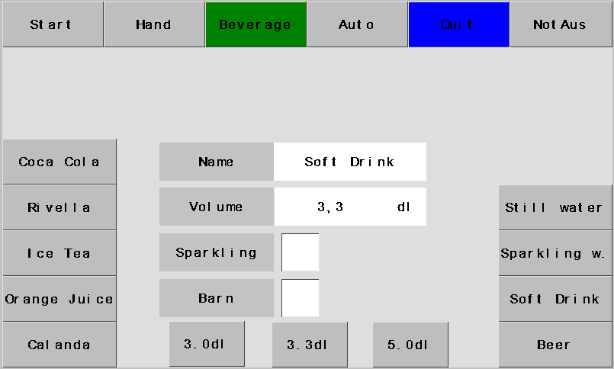
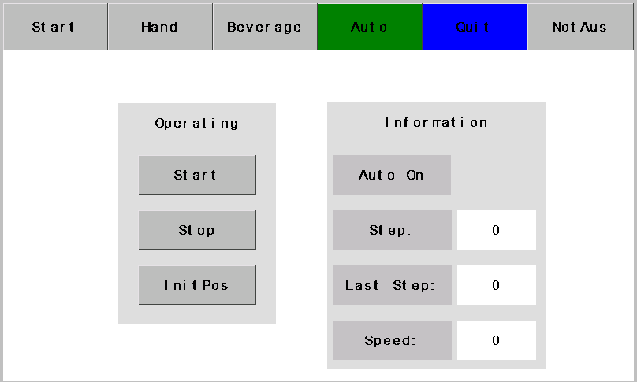
Software - HMI

Slide 17
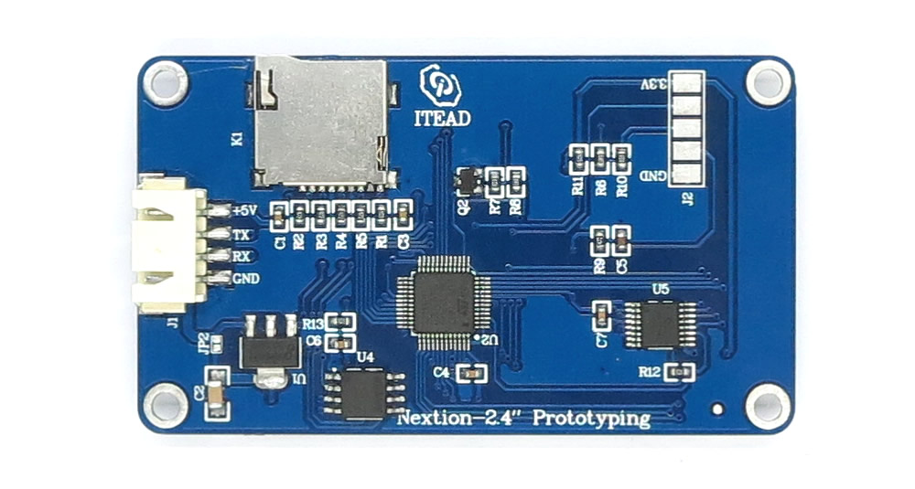
Software - Communication
Arduino Mega Serial Ports
Tx / Rx
Serial Monitor
Serial.println(variable);

Slide 18
Software - Communication
65 02 16 01 FF FF FF
65: Starting Sequence
02: Page number
16: Object ID
01: State of the pushbutton
FF: End Sequence

Slide 19
Abbildungsverzeichnis
Arduino Mega: https://images-na.ssl-images-amazon.com/images/I/71WYcNLIVpL._SX522_.jpg
Nextion HMI: https://cdn.itead.cc/media/catalog/product/i/m/im150416002_3.jpg

