Slide 1

GEM
Ein Projekt von: Luca Schäfli
Marc Hochuli
Nico Müller
Notes:
Ein Projekt von: Luca Schäfli
Marc Hochuli
Nico Müller

Slide 2
Content
Timetable
CAD and mechanical components
Schematics and electrical components
Stepper motors
Development environment
Operating modes
State machine
Final statement

Slide 3
Timetable

Slide 4
CAD and mechanical components

Slide 5
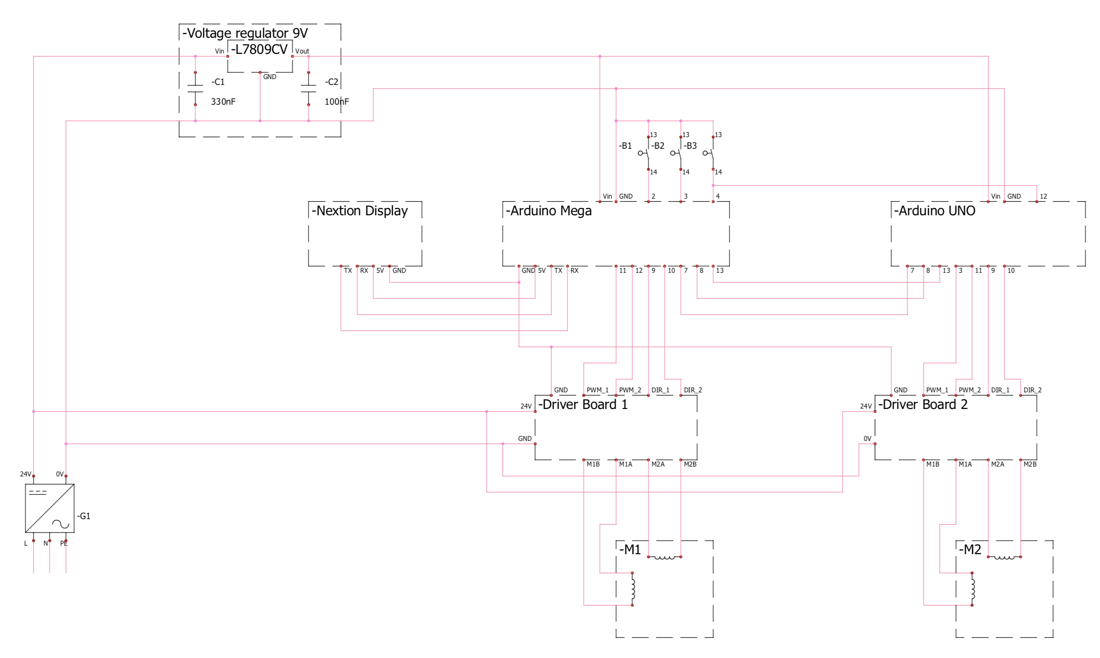
Schematics and electrical components

Slide 6
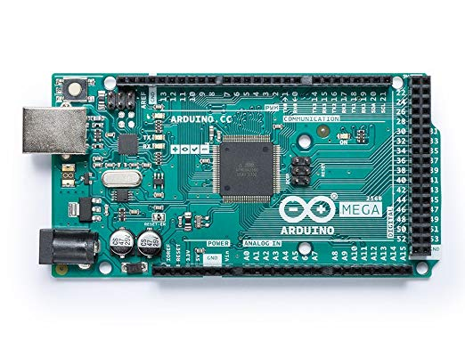
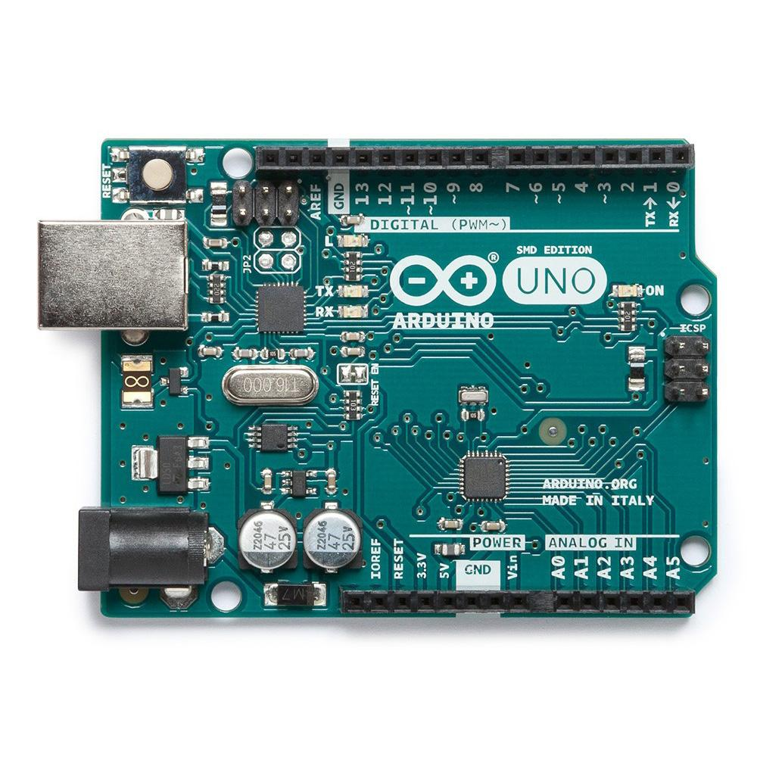
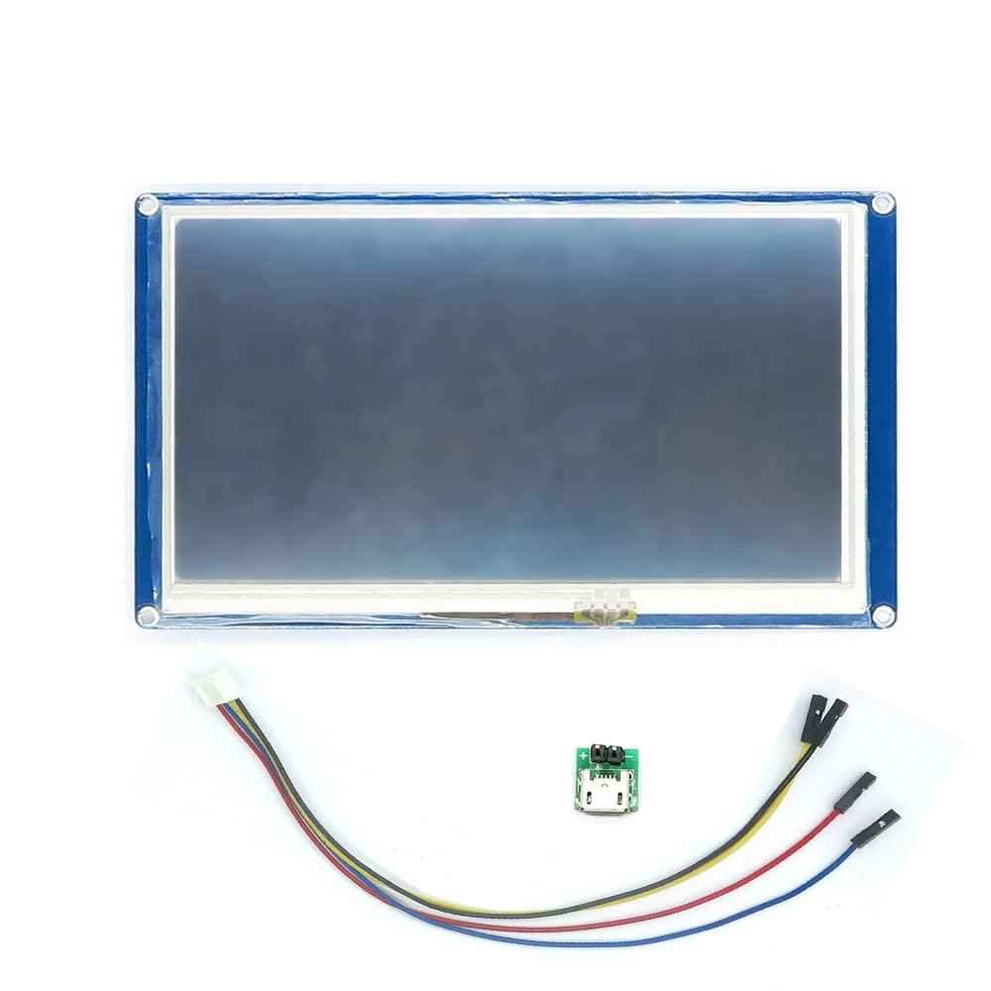
Schematics and electrical components

Slide 7
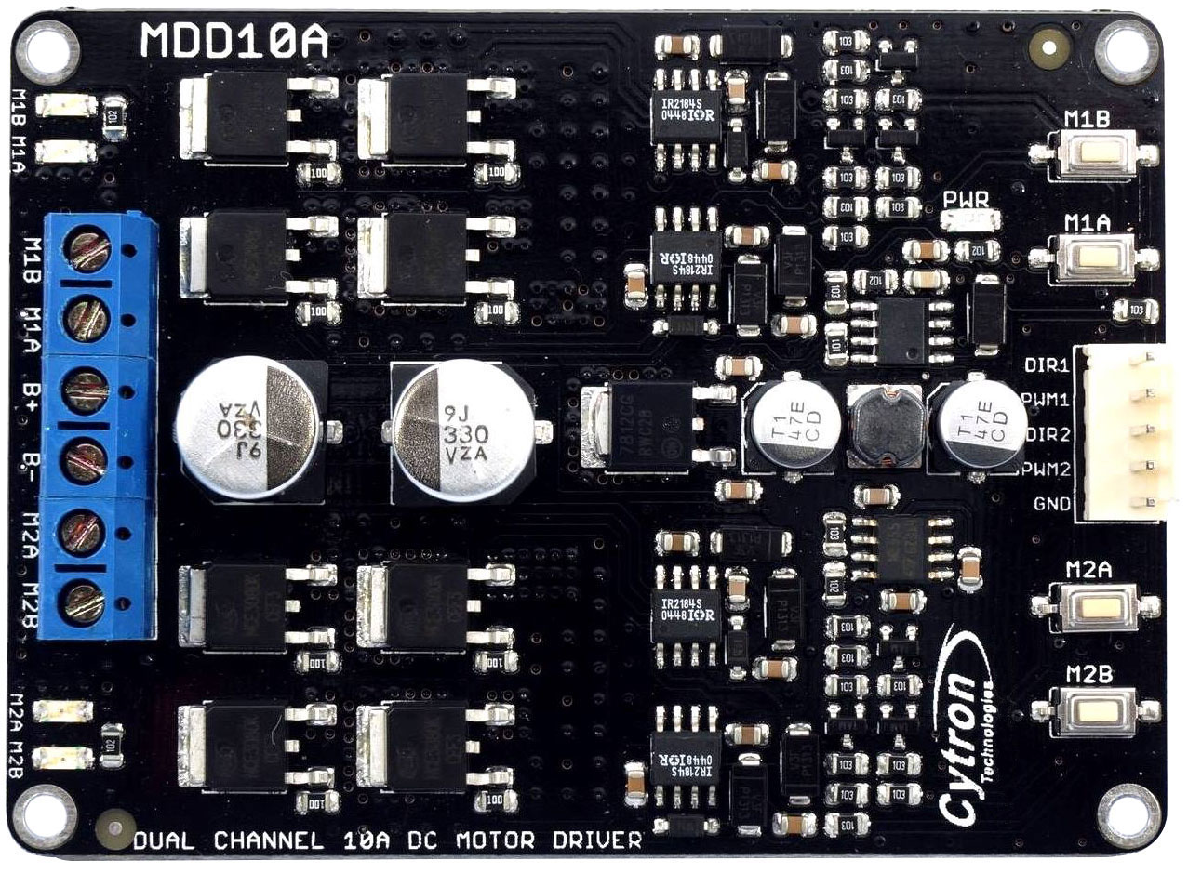
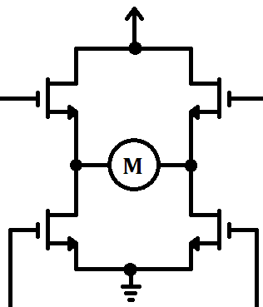
Schematics and electrical components

Slide 8
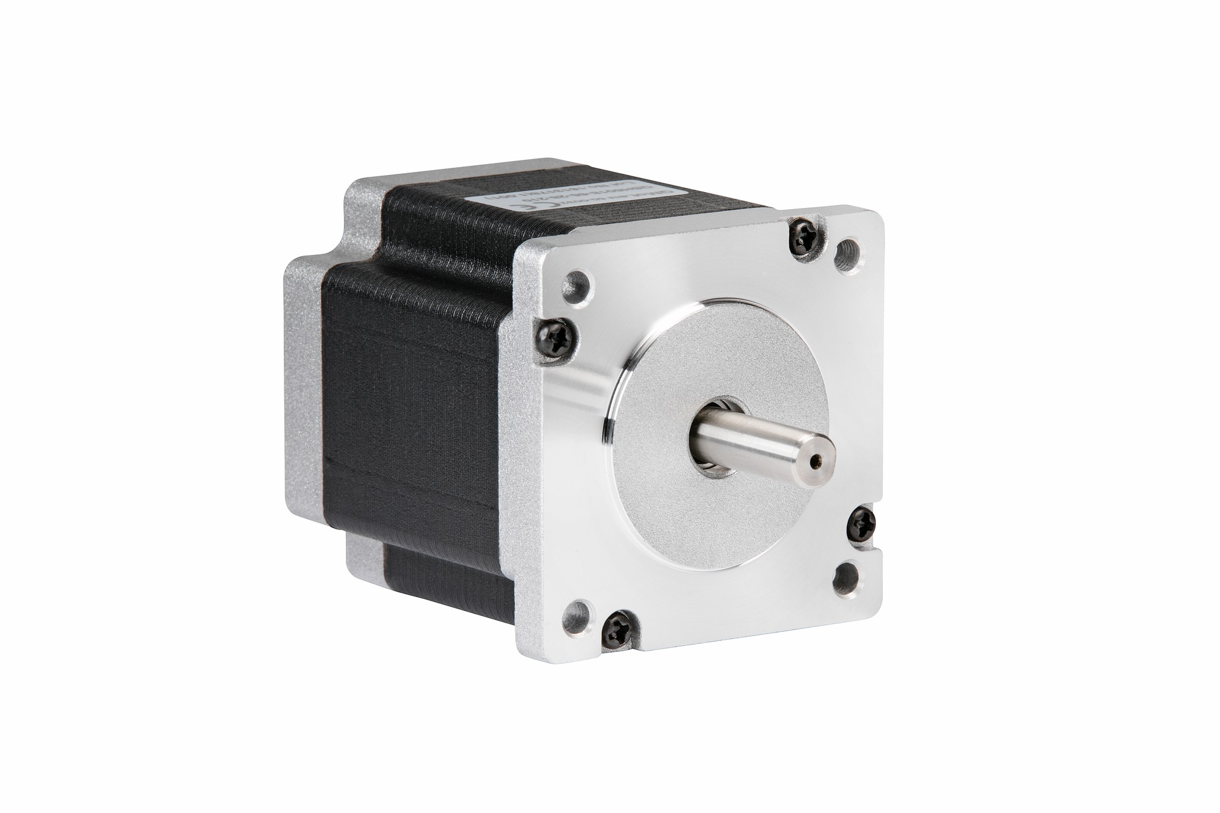
Stepper motors

Slide 9
Stepper motors

Slide 10
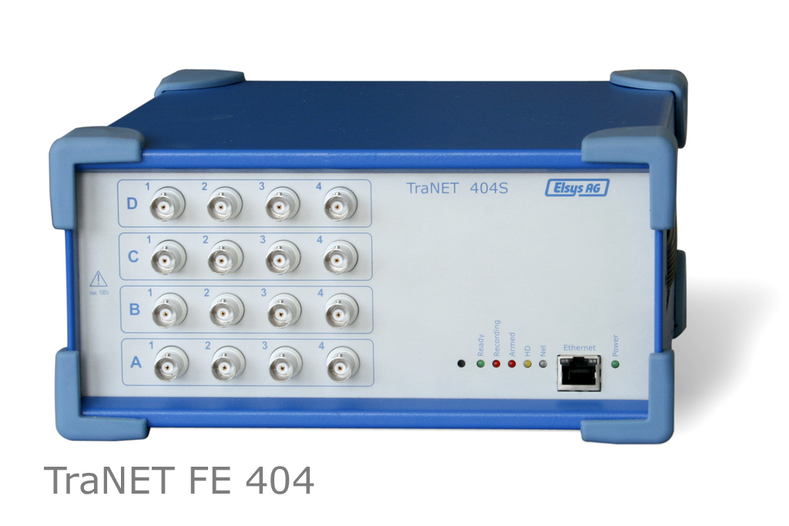
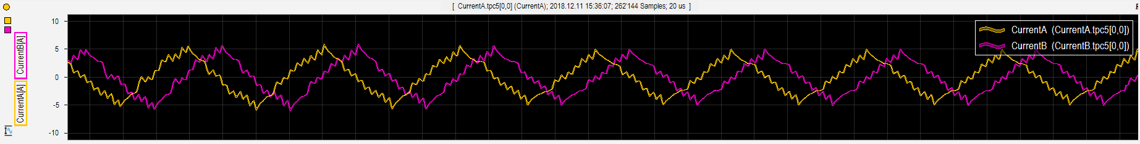
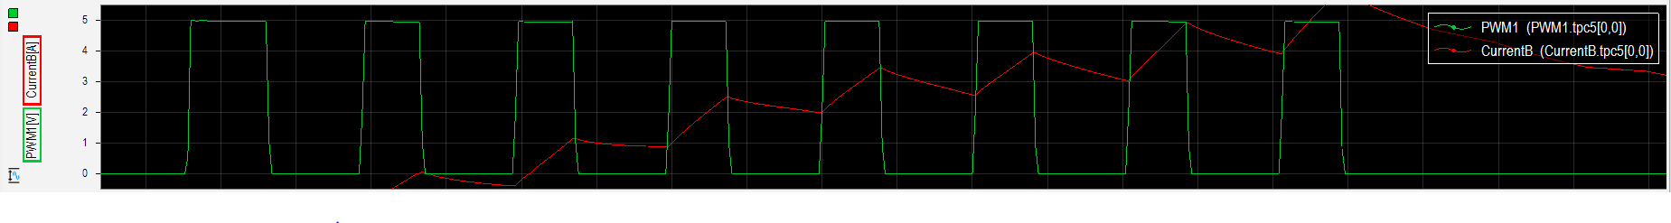
Stepper motors

Slide 11
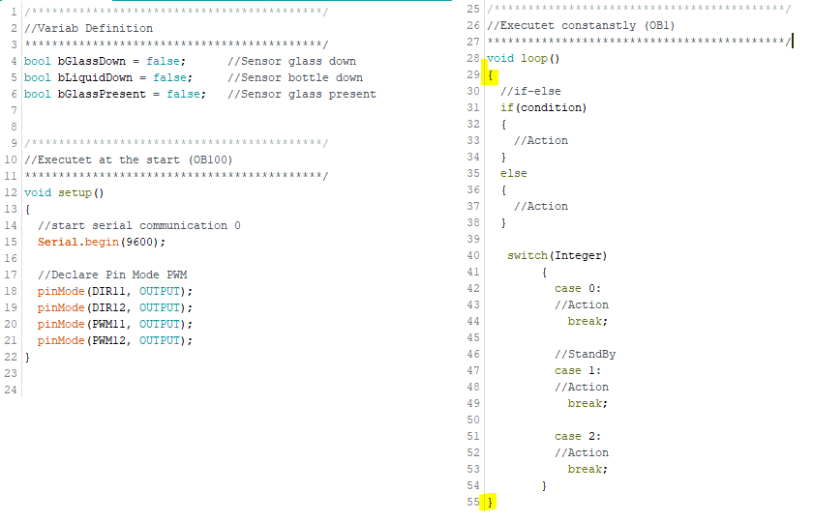
Development Environment
Arduino
Nextion Editor
Variables Definition
Keywords
Void setup
Void loop
Statements
{}

Slide 12
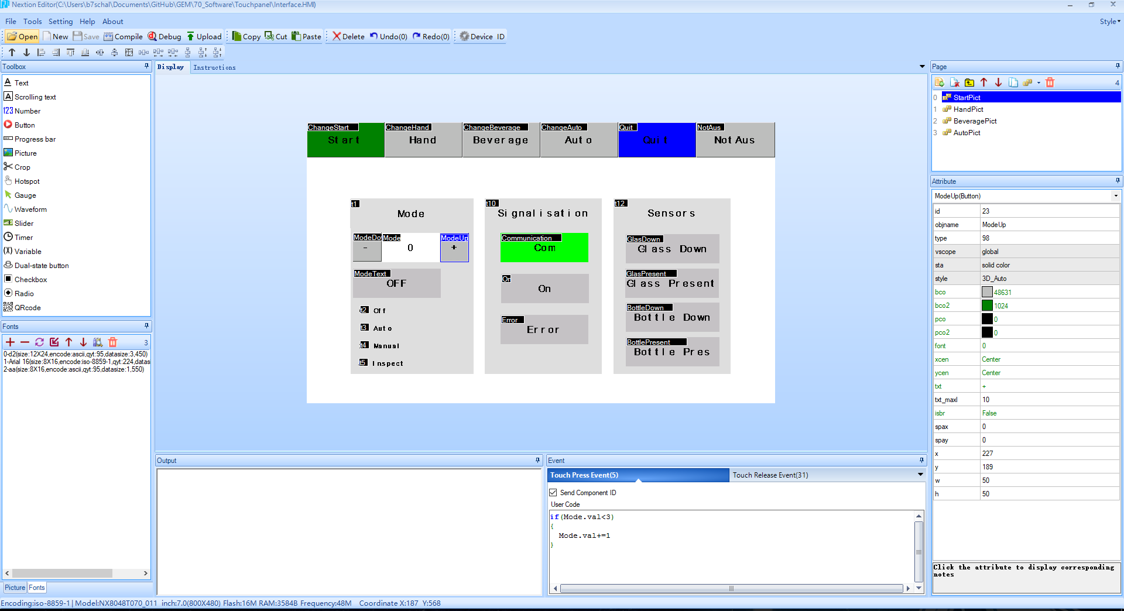
Development Environment
Nextion Editor

Slide 13
Operating Mode
Off
Auto
Hand
Insp

Slide 14
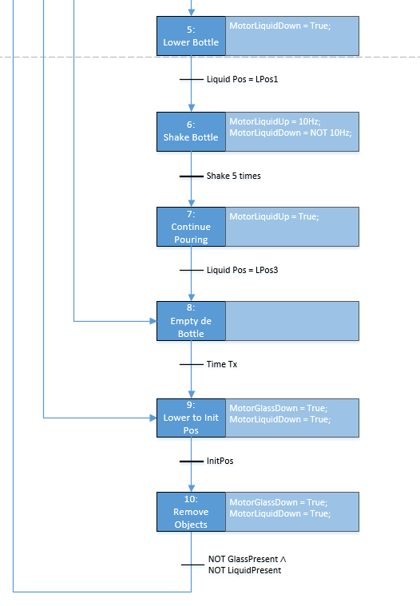
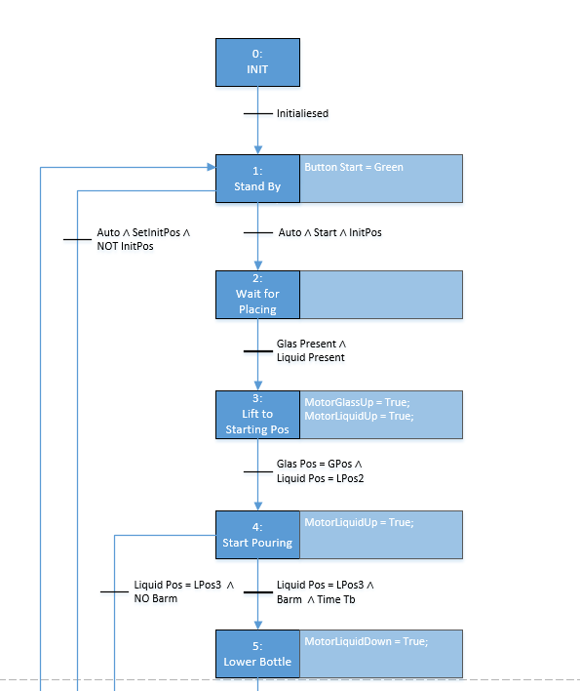
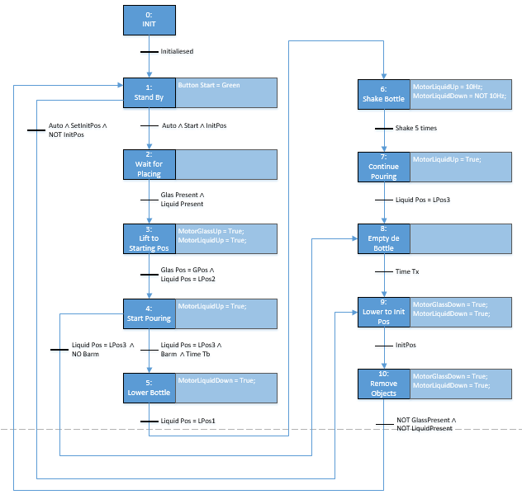
State Machine

Slide 15
Final statement

