Slide 2
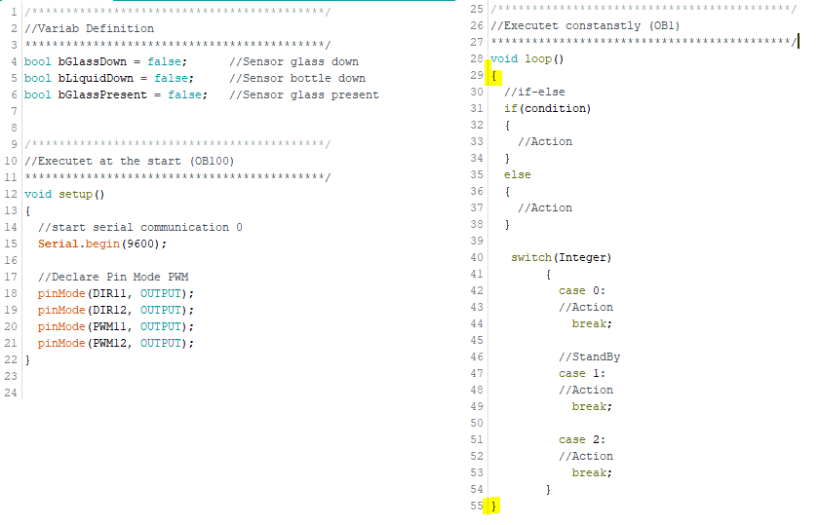
Development Environment
Arduino
Nextion Editor
Variabel Definition
Keywords
Void setup
Void loop
Statements
{}

Slide 3
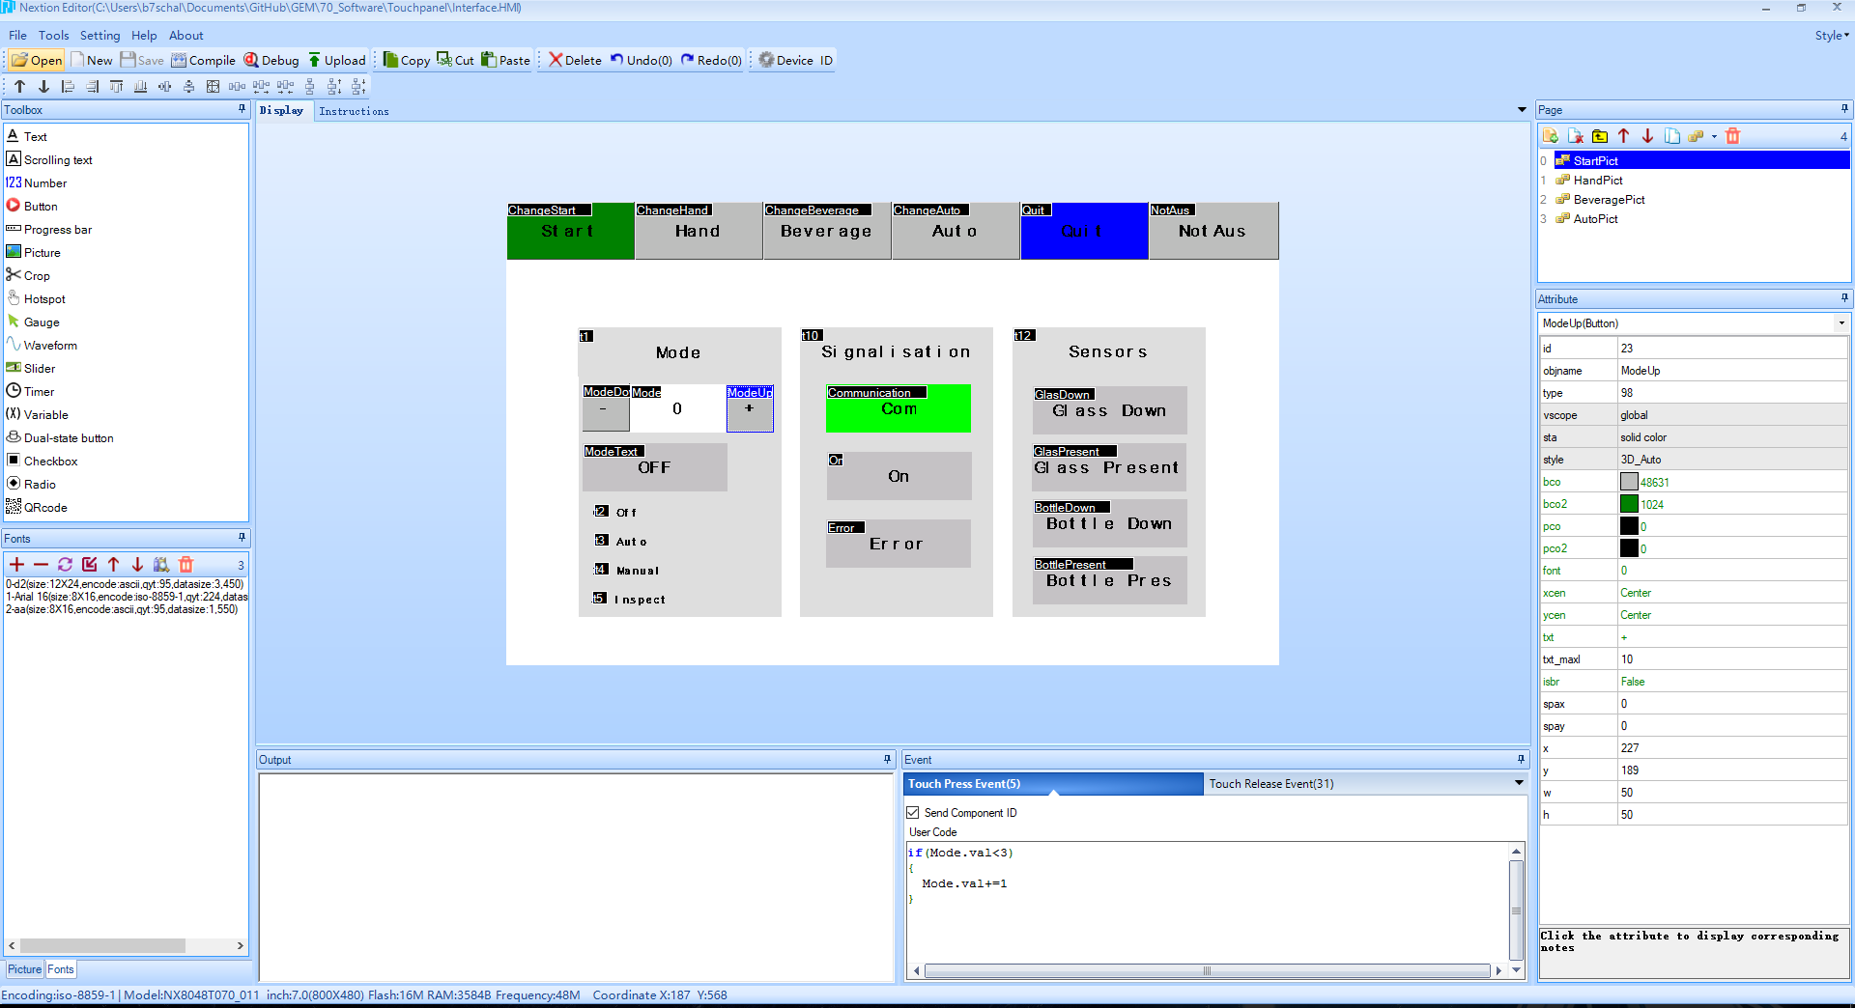
Development Environment
Nextion Editor

Slide 4
Operating Mode
Off
Auto
Hand
Insp

Slide 5
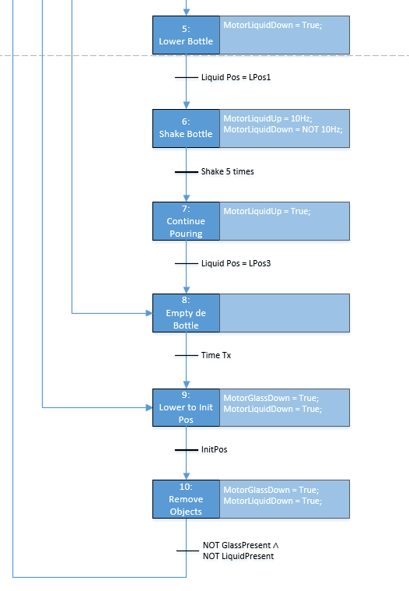
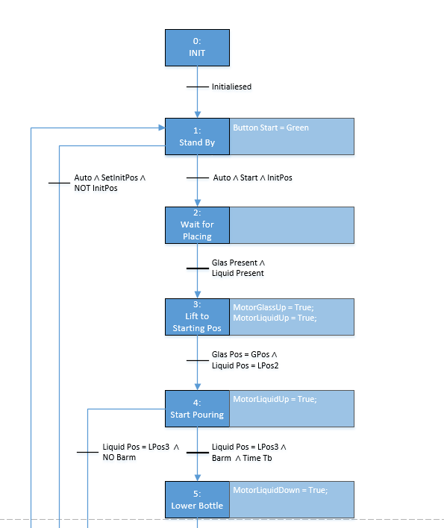
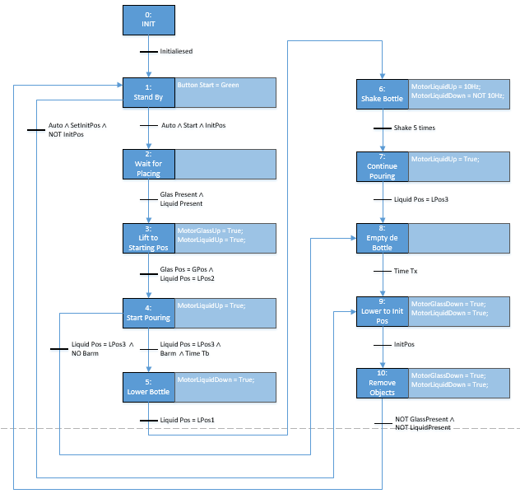
State Maschine

