Slide 1
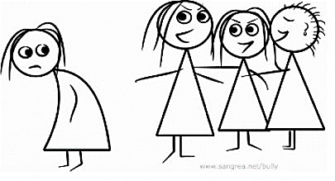
Bullying
By
Luca Schäfli & Nico Müller

Slide 2
Definition of bullying
Aggressive behaviour
Physically or psychically
Repeated over time

Slide 3
Different types of bullying
Verbal bullying
Social bullying
Physical bullying

Slide 4
Verbal bullying
Say/ write mean things
Includes:
Teasing
Name-calling
Taunting

Slide 5
Social bullying
Hurting reputation or realationship
Includes:
Leaving on purpose
Tell not to be friends
Rumours
Embarrassing

Slide 6
Physical bullying
Hurting a persons body or possessions
Includes:
Hitting, kicking,
Spitting
Tripping/pushing
Break someone's things
Rude hand gestures

Slide 7
Characteristics of bullies
Are often physically strong.
Have trouble following rules.
Show little concern for the feelings of others.
May or may not be popular with other children around their same age.

Slide 8
Characteristics of victims
Are often physically weak
They mostly have overprotective parents
Insecure Personality

Slide 9
Characteristics of bystanders
Encourage the bully
They don’t participate

Slide 10
Reasons why we must take action
No one has the right to bully
Cause depression and risk of suicide
Get bullied cause of race, religion, appearance
→no real reason victim is not resalable for the reason

Slide 11
Advices for victims
Tell someone teacher, parents or friend
Block the bullies
Build your confidence
with Write down some things you like about yourself
or Do something nice for someone

Slide 12
Ways of preventing bullying
You could walk away to the next Teacher and don’t fight back.
You also could talk to an adult you trust.
Simply stay away from places wher bullying happens
Stay near adults.

