Slide 1
>_
Student Record Manager
A C++ command-line app for keeping, searching and understanding student scores
Ahmed Mohammed · CIS 25 C++ Application Design
Notes:
Hi, I'm Ahmed. This is the Student Record Manager, the C++ application I built one module at a time in this class.

Slide 2
The problem and who it's for
1
The problem
2
Target user
Teachers keep scores in spreadsheets or on paper.
It's slow to find one student, easy to type a wrong score, and anyone with the file can change it.
Nothing points out which students need help.
A teacher or tutor with a small class.
Admin: the teacher, who can add, update and delete.
Regular User: a TA or student helper, who can only view and search.
Notes:
The problem is that student scores are usually in a spreadsheet anyone can edit, and it's hard to spot who is struggling. My users are teachers, who are Admins, and helpers, who are Regular Users.

Slide 3
Key features
1
Menu
2
Roles
3
Binary search
Loops until you choose Exit, with a switch for each option
Admin can edit. Regular User can only view and search
Finds a student by id in just a few steps
4
Sorted records
5
Input validation
6
AI Study Coach
Students are always kept in order by id
Bad names, ids and scores get an error and a retry
Gives a study tip based on the student's score (mock)
Notes:
These are the six main features. Each one came from a different module: the menu from Module 2, roles and binary search from Module 7, validation from Module 8, and the AI coach from Module 9.

Slide 4
How the data flows
students.csv
loadStudents()
Student objects
Menu + role check
Functions
Screen
8 records from a Kaggle dataset
reads each line with ifstream
kept sorted by id in an array
picks the function to run
search, add, update, delete, AI coach
results shown to the user
Every input on the way in goes through the validation functions, and every AI answer is checked before it's shown.
Notes:
The data starts in students.csv. loadStudents reads it and turns each line into a Student object in the right sorted spot. The menu checks your role, then calls the function you picked, and the result goes to the screen.

Slide 5
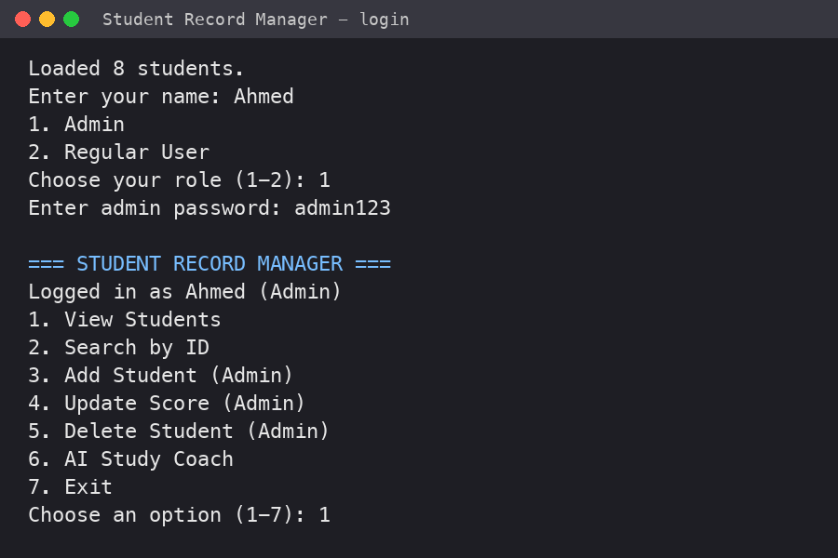
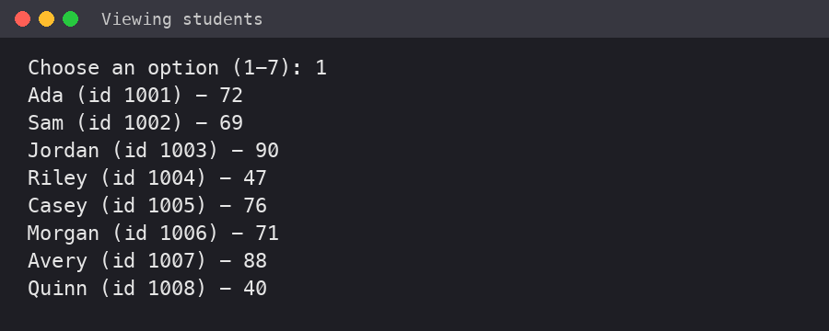
Screenshots
Viewing all students, sorted by id
Logging in as Admin and the main menu
Notes:
On the left is the login and main menu. On the right is option 1, viewing all the students, already sorted by id.

Slide 6
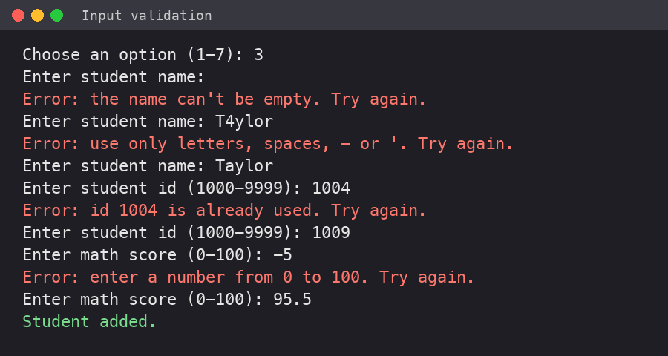
How to use it
1
Build
g++ -o records main.cpp Validation.cpp AICoach.cpp
2
Run
./records (keep students.csv in the same folder)
3
Log in
Type your name, then pick Admin or Regular User
4
Pick an option
Validation catching an empty name, a bad name, a used id and a negative score
Type 1-7 from the menu
5
Fix mistakes
If you type something wrong, the app tells you and lets you try again
Notes:
To use it, compile the three cpp files, run it, log in, and pick options from the menu. The screenshot shows what happens when you type bad input: you get a clear error and another try.

Slide 7
C++ features I used
Menus, loops, switch
Module 2
Classes, constructors, getters/setters
Module 6
Variables, cin, cout
Module 3
Inheritance and binary search
Module 7
Arrays, pointers, ifstream
Module 4
Input validation
Module 8
Functions and .h header files
Module 5
AI feature design
Module 9
Notes:
Here's every C++ topic in the app and the module it came from. The app grew one module at a time.

Slide 8
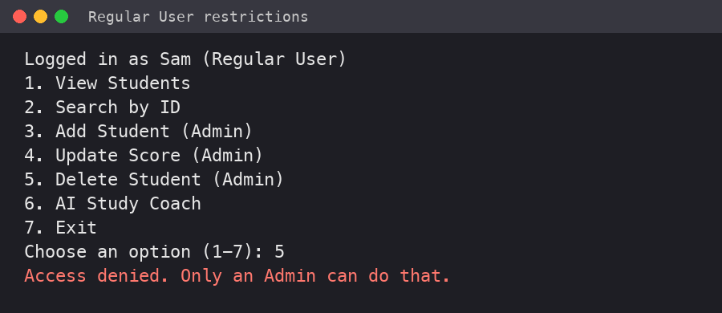
Challenges and lessons learned
Bad input broke cin
Typing letters for a number made the menu loop forever. cin.clear() and cin.ignore() fixed it.
Keeping records sorted
Binary search only works on sorted data, so every add has to go in the right spot.
Lesson: security is about rules. The app checks the user's role before every change.
Splitting code into files
Headers made main.cpp shorter, but I had to remember to compile every .cpp file.
Notes:
The hardest parts were handling bad input, keeping the list sorted for binary search, and organizing the code into files. The screenshot shows a Regular User being blocked from deleting.

Slide 9
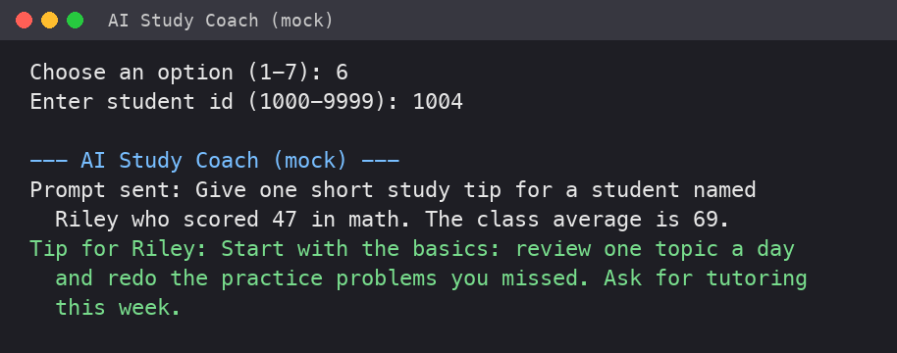
What's next
1
Connect the AI Study Coach to a real AI service
2
Save changes back to the file automatically
3
Move from a CSV file to a database
4
Track more subjects and scores over time
Thank you! Questions?
Notes:
Next I want to connect the AI coach to a real AI service, save changes to the file, and eventually use a database. Thank you, any questions?

