Slide 1
Invisible Women
Programmed America's First Electronic
Computer
v0.2.1

Slide 2
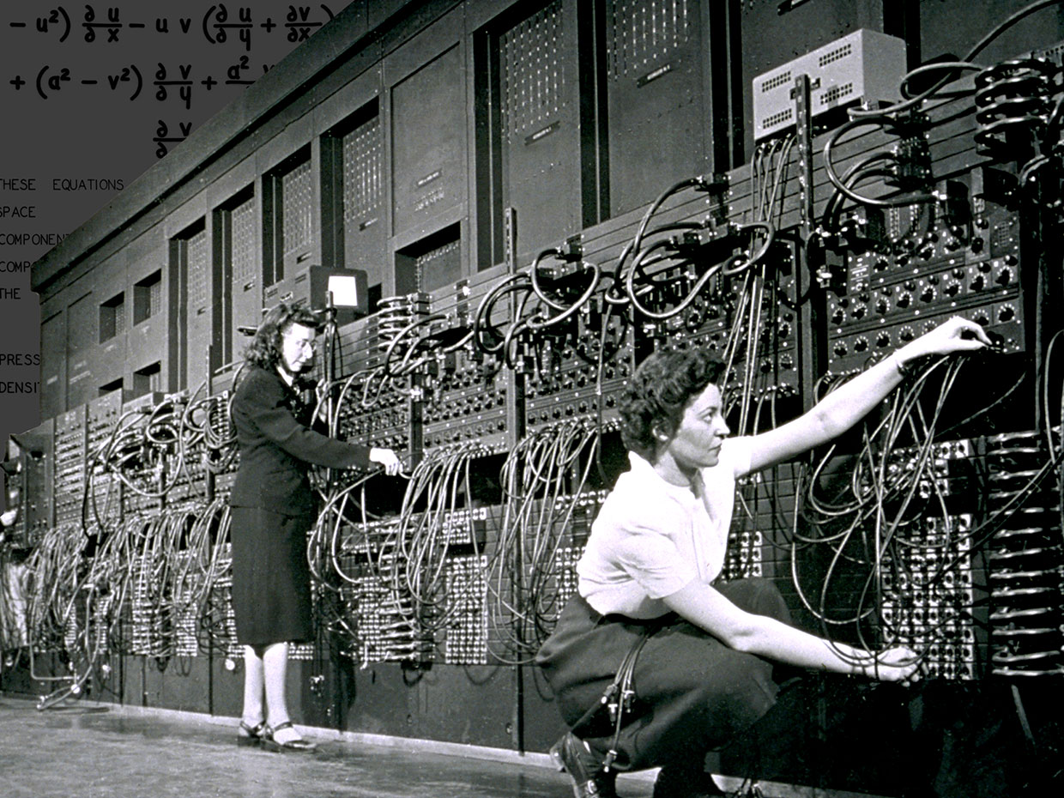
The “human computers” who operated ENIAC have received little credit
Marlyn Wescoff [left] and Ruth Lichterman were two of the female programmers of ENIAC.

Slide 3
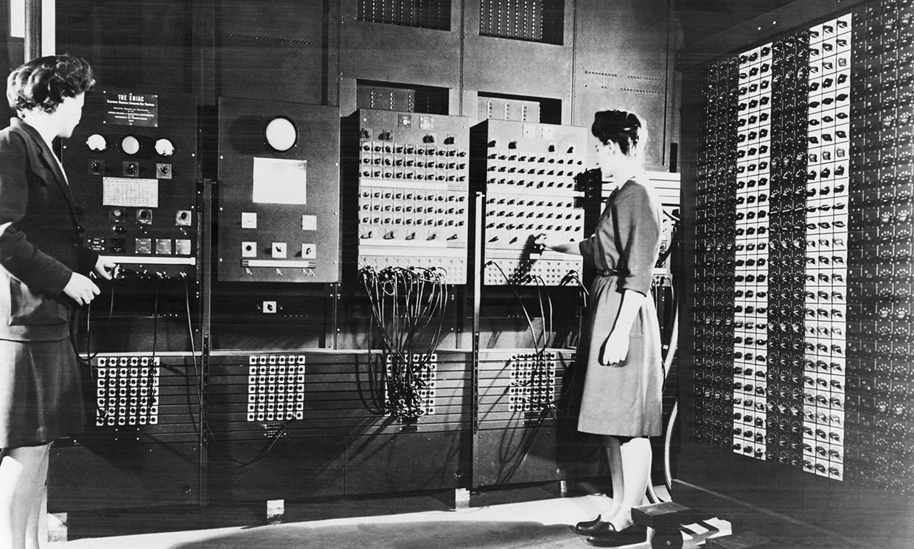
ENIAC Computer
Betty Jean Jennings [left] and Frances Bilas operating ENIAC's main control panel.

Slide 4
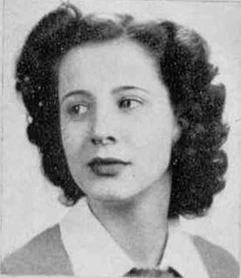
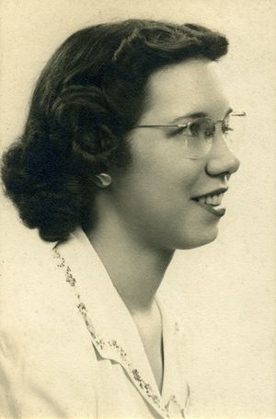
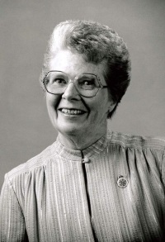
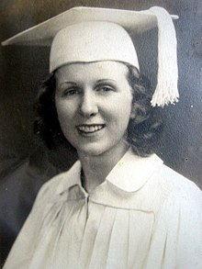
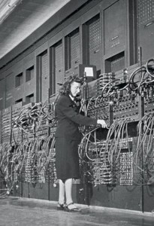
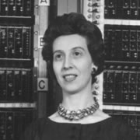
Operators of this 30 Ton behemoth
Betty Jean Jennings
Elizabeth Snyder
Frances Bilas
Kathleen McNulty
Marlyn Wescoff
Ruth Lichterman

Slide 5

Thank you equal rights equal responsibilities
Github.com/Akbar30bill/TE-presentation

