Slide 1
Content
Assumptions about LCC
Examples with results
Problems
Questions

Slide 2
Assumptions
The personal info of TCNs can be shared with each others
Even though the software entities (agents) of TCNs share their personal info, they do not share the names of TCNs.
The individual preferences of TCNs cannot be shared with each others
Once teacher requests for a result, agents proceed with the current average Course Progress Level (CPL) value of TCNs regardless of whether TCNs have Assessment Activities results for all of the previous lessons. In other words, if a TCN hasn’t done the Assessment Activities for lesson m (e.g. m=5) and teacher requests a grouping result for lesson (m+1), then the agent of TCN will proceed with the current CPL.
These assumptions are referenced in the next slides.

Slide 3
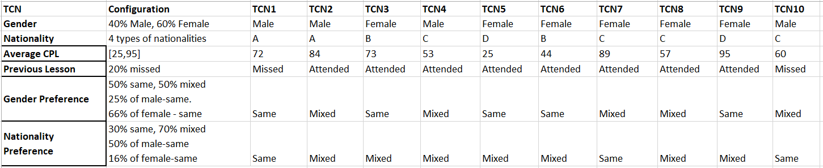
LCC scenario Examples Explanation 1
In the table below, 10 TCNs with different personal info and individual preferences are described. Instead of nationalities, the letters (A,B,C…) are used. CPL is the average Course Progress Level of TCNs.
A TCN can specify either same or mixed as his/her preference as already described in the Informal Description of LCC scenario.

Slide 4
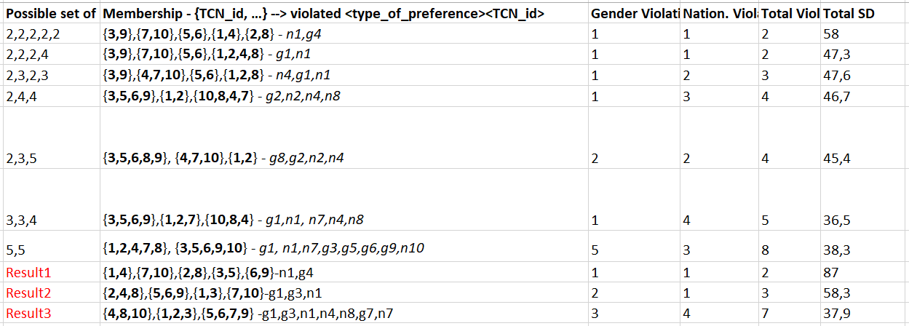
LCC scenario Examples Explanation 2
The table below illustrates different results. Each row in the first column (“Possible set of groups”) is a possible grouping result. For example, “2,4,4” means “10 TCNs can be grouped into 3 groups. One has 2, other two groups have 4 TCNs.”. “5,5” means “2 groups and each has 5 TCNs”. Result1 and Result2 are the solutions which Algorithm1 found for two different configurations. Result3 is found by Algorithm2.
In the second column (“Membership”), each row shows a grouping result. For example, “{3,9},{7,10},{5,6},{1,4},{2,8} –n1,g4” means that there are 5 groups in the class and group1 consists of TCN3 and TCN9, group2 consists of TCN7 and TCN10, group3 consists of TCN5 and TCN6, group4 consists of TCN1 and TCN4, group5 consists of TCN2 and TCN8. “n1,g4” means that in this grouping, the nationality preference of TCN1 and gender preference of TCN4 are violated.
Third, forth and fifth columns represent the amount of violations of Individual Preferences of TCNs for the specific grouping.
Sixth column represents the total Standard Deviation (SD) values. Higher SD means the similarity between TCNs in the groups in terms of CPL is low, while lower SD is the opposite.
Important to note that, the grouping results in the table, are designed intuitively without using any algorithm except Result1, Result2 and Result3 . Also, in all of the results for all examples, all of the Course Constraints are satisfied. Course constraints are “the size of each group” and “no more than 1 TCN in a group who missed previous lesson”.

Slide 5
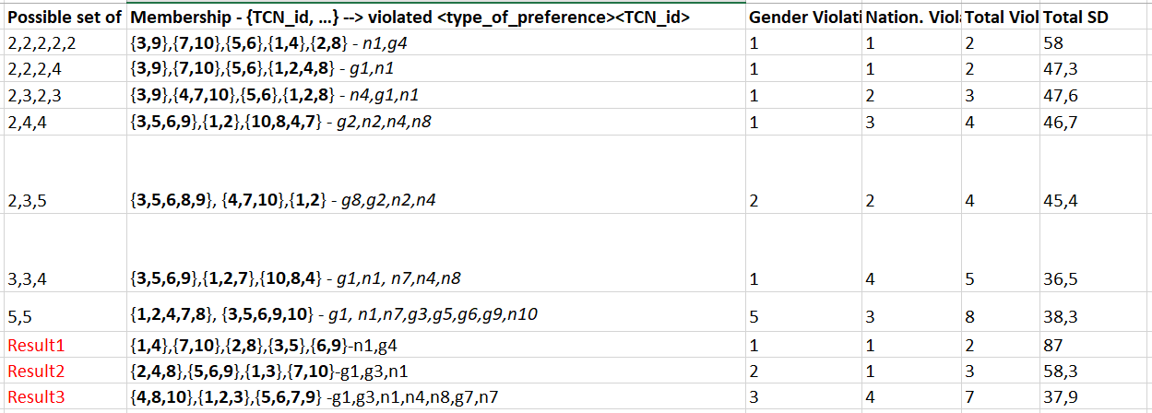
LCC scenario Example 1
In the following results for the configuration, most of the gender preferences of TCNs are satisfied but the total Standard Deviation (SD) of the groupings are high in general. In other words, satisfying the preferences, specifically gender preference, is preferred over having the most similar Course Progress Level (CPL) in the class.
* None of Course Constraints are violated.

Slide 6

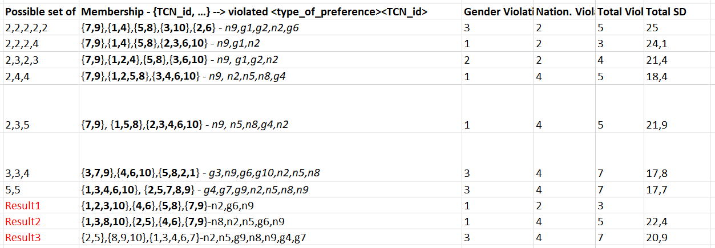
LCC scenario Example 2
In the following results for the given configuration, although the number of violations are higher compared to example 1, the SD values are lower which means TCNs have more similar CPL.
* None of Course Constraints are violated.

Slide 7
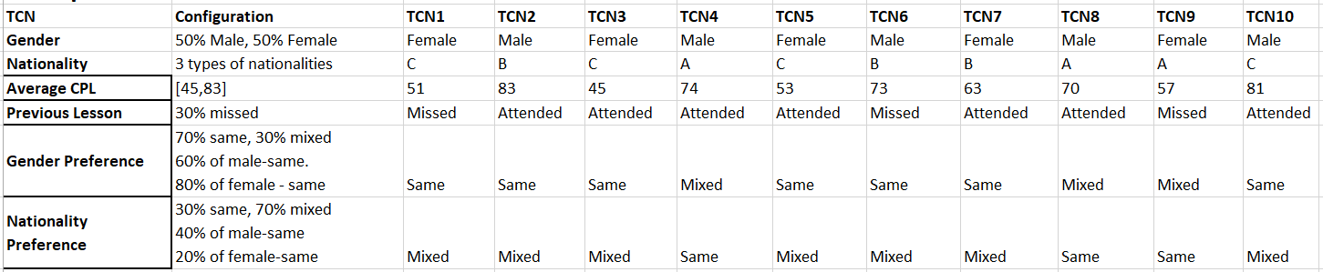
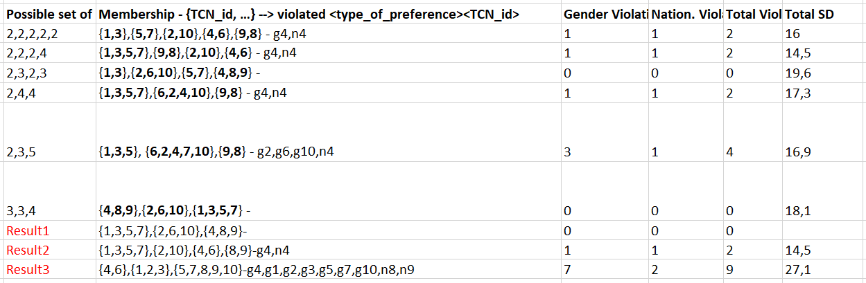
LCC scenario Example 3
In the following results for the given configuration, there are multiple solutions in which all preferences are satisfied.
* None of Course Constraints are violated.

Slide 8

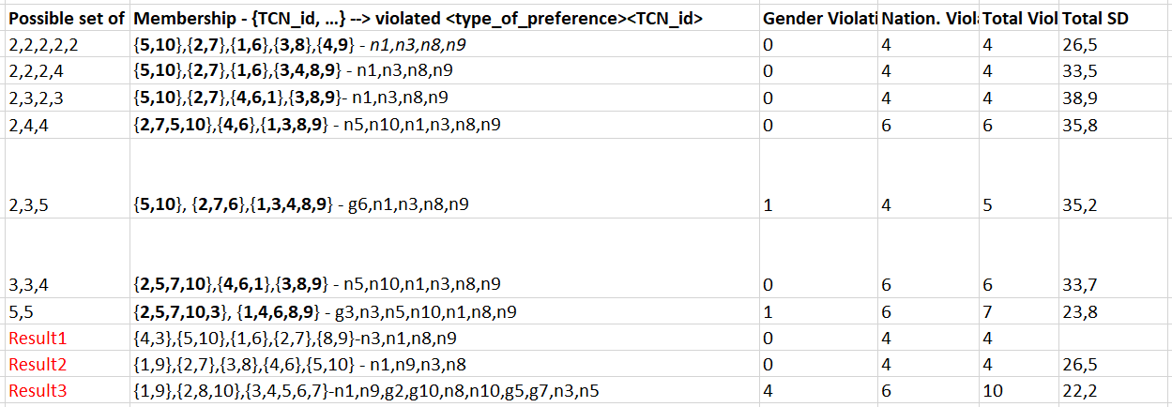
LCC scenario Example 4
In the following results for the given configuration, in multiple groupings, the gender preferences are satisfied completely with different number of nationality violations and SD.
* None of Course Constraints are violated.

Slide 9
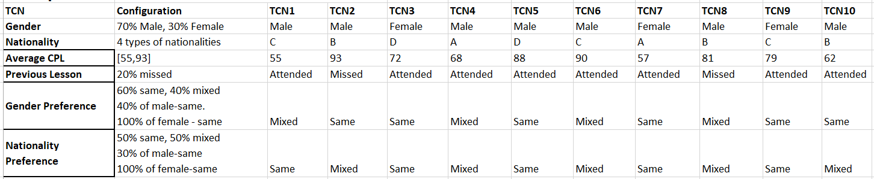
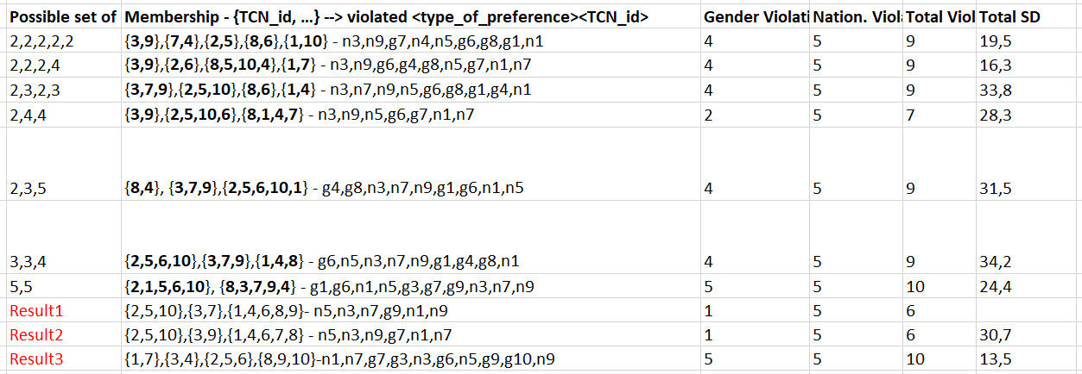
LCC scenario Example 5
In the following results for the given configuration, there is not a good result in terms of satisfaction of preferences because of the configuration that is built on purpose.
* None of Course Constraints are violated.

Slide 10
Preference problem with examples
Problem. In example 1, Result2 and Result3 assign TCN1 and TCN3 to the same group. However, this assignment violates the gender preferences of both TCNs. Because both of the prefer a same gender group while they are male and female.
So according to Assumption_2, preferences are not shared and therefore the algorithm cannot deduct if multiple preferences of multiple TCNs are violated by a certain assignment. So there are 2 options:
The preferences of TCNs can be shared just like the personal info: If preferences are shared, then the situations like the one mentioned above can be prevented.
Not sharing the preferences as it is assumed now and living with these kind of situations.
An alternative solution could be that a teacher agent can be created and it can collect the preferences of TCN agents. This way, no TCN agent knows the preferences of other TCNs. Only teacher agent knows all the information about TCN agents.
Which option is most suitable?

Slide 11
Questions
Q1. How to show/present the results to TCNs?
According to assumption 2, agents don’t know the name of other TCNs. Therefore, each TCN can be informed only with the group name (e.g. GroupA, GroupB, Group1, Group2, etc.). Is this satisfactory? If not, then how should TCNs need to be informed?
* If teacher agent solution is implemented, then TCN agents can be informed by teacher agent about their groups and the name of group mates. Since TCN agents wouldn’t know anything about other TCNs, all they know would be the name of the TCNs which are in the same group for a certain lesson.
Q2. Do TCNs need a functionality to view the results for all the previous lessons? Or displaying only the latest result is enough?
Q3. Information about missing a lesson. Where does this info come from? Does teacher assign this before asking for a grouping result? Or does “not doing the assessment activities for the previous lesson” mean that the TCN missed the lesson? The problem with second is that the TCN can be in the lesson but not submit the result of the assessment activities (maybe because of a technical issue). Therefore, wouldn’t it be safer if this information comes directly from teacher?
Q4. Which result would teacher select for each example? And why? Which one of these, “satisfying preferences” and “having most similar CPL”, is more important for teacher? For example, is “satisfying preferences” twice as important as “having most similar CPL”?

