Slide 1
Required Functions for LCC and Teacher

Slide 2
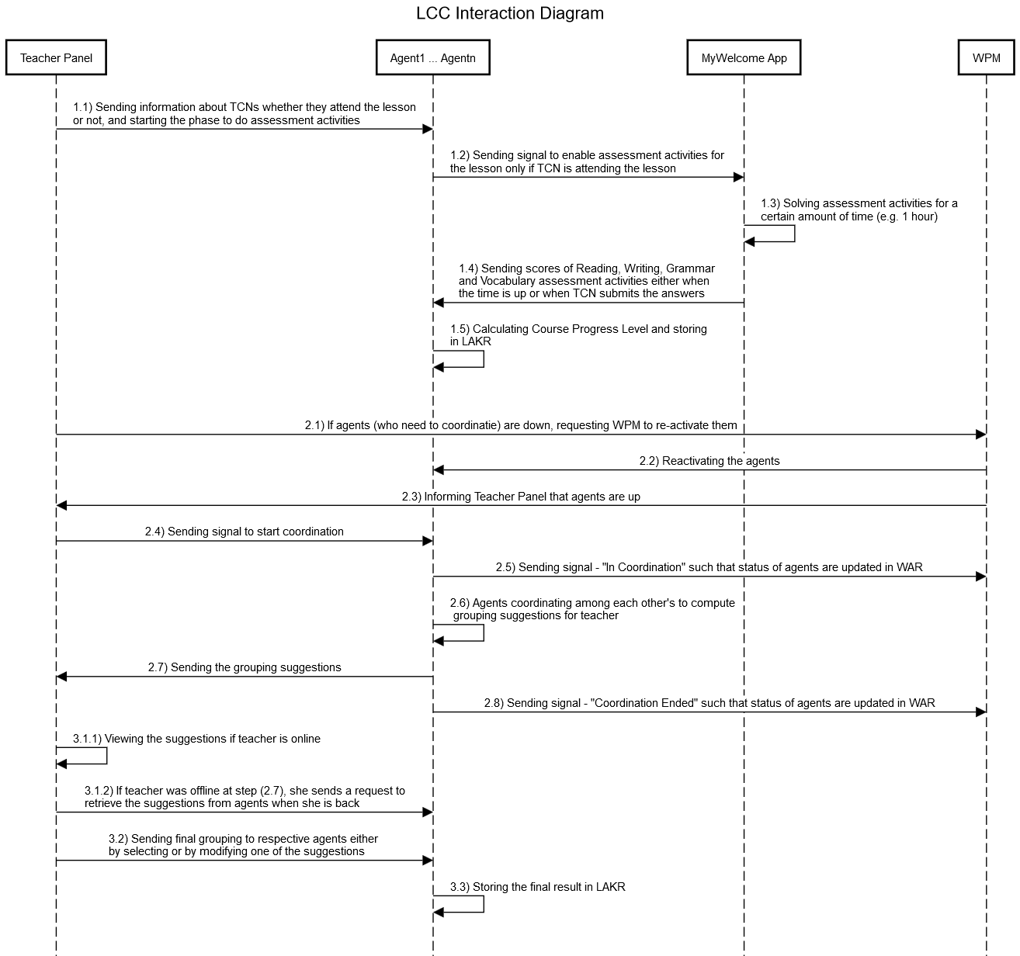
LCC Interaction Sequence
Additional functionalities which are required by teacher and not reflected in the diagram:
Teacher Panel
Functionality to modify the Course Progress Level of TCNs at anytime (even when the agents are down)
Agents don’t share the name of their TCNs among each other’s, therefore Teacher panel needs to map agent names into their TCN names to display the result to the teacher
MyWelcome App
Assessment activities should be disabled by default and should be enabled for a certain amount of time when agent sends a signal
Once TCN submits the answers of assessment activities, he/she cannot modify anymore
If TCN doesn’t submit the answers until there is a certain amount of time left (e.g. 10 minutes), app informs TCN that he/she should complete the activities

