Slide 1

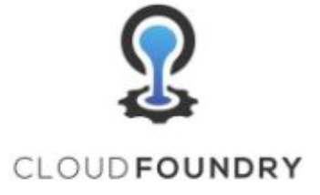
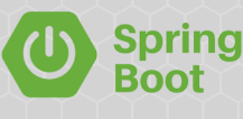
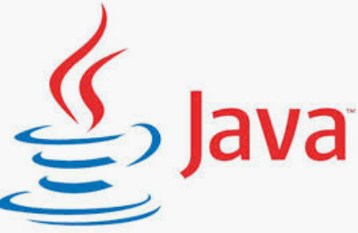

Microservices deployment with pivotal cloud foundry
ARVIND
#1
Monitoring
Deployment
Scaling
-- #greenlearner --

Slide 2
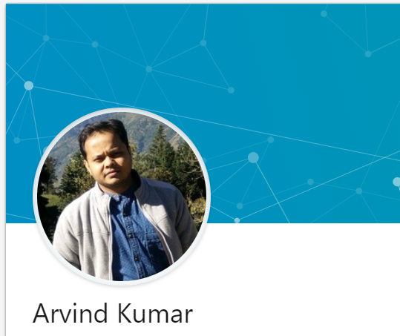
About me
Senior software developer
7 years
Working on
Passion
Facebook – https://www.facebook.com/greenlearner
LinkedIn - https://www.linkedin.com/in/arvind-kumar-108a4b2b/

Slide 3
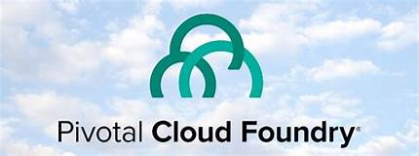
Introduction
ARVIND
#2
MICROSERVICES
AND
CLOUD FOUNDRY
-- #greenlearner --

Slide 4
What is cloud foundry??
Cloud Foundry is an open source, multi-cloud application platform as a service (PaaS) governed by the Cloud Foundry Foundation.
The software was originally developed by VMware and then transferred to Pivotal Software, a joint venture by EMC, VMware and General Electric.
Cloud Foundry is promoted for continuous delivery. It supports the
full application development lifecycle,
from initial development through all testing stages to deployment.
Cloud platforms let anyone deploy network apps or services and make them available to the world in a few minutes.

Slide 5
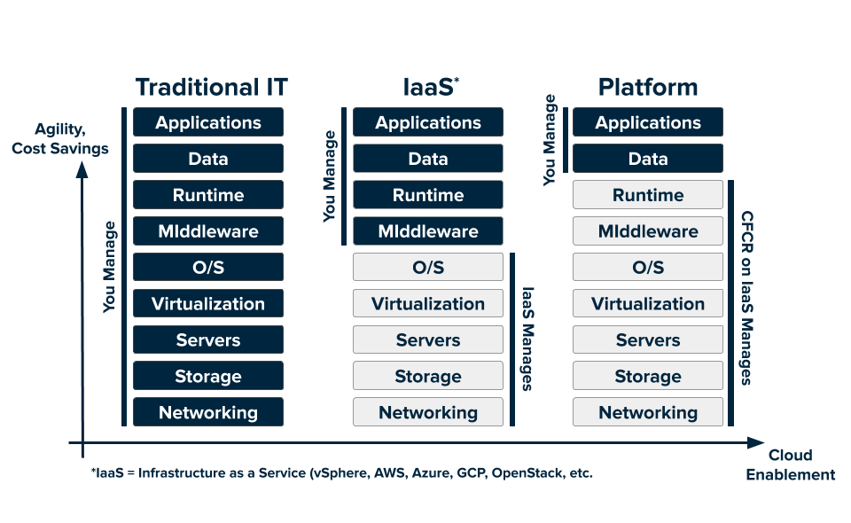
Cloud services

Slide 6
What is Pivotal Cloud Foundry??
Pivotal Inc. is the company behind development and support for cloud foundry

Slide 7
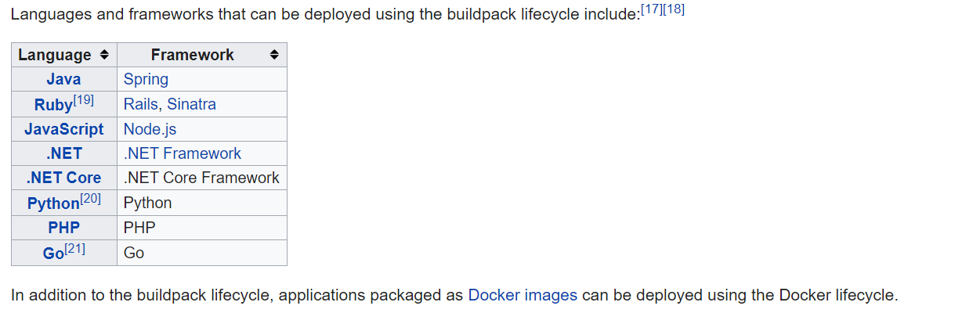
Supported languages/frameworks

Slide 8
Why PCF??
Easy and quick deployment
No worry about which cloud is in the backend
Migration among different cloud providers like aws, gcp, azure

Slide 9
Microservices deployment with pivotal cloud foundry
ARVIND
#2
pcf
ENVIRONMENT SETUP
GETTING READY
-- #greenlearner --

Slide 10
ENVIRONMENT SETUP PCF CLI installation
ARVIND
#3
MICROSERVICES
AND
CLOUD FOUNDRY
-- #greenlearner --

Slide 11
Steps to perform
CF cli installation
Registration
ORG/SPACE

Slide 12
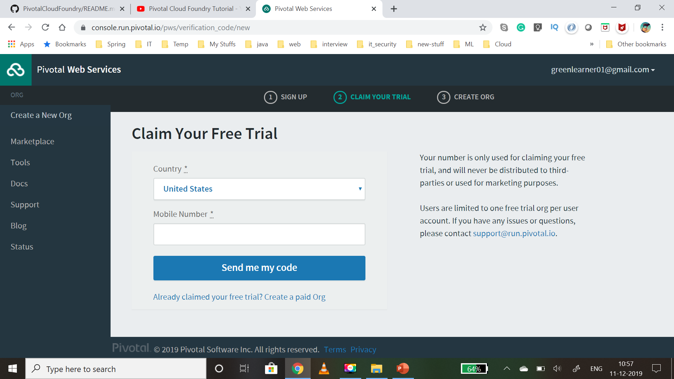

Slide 13
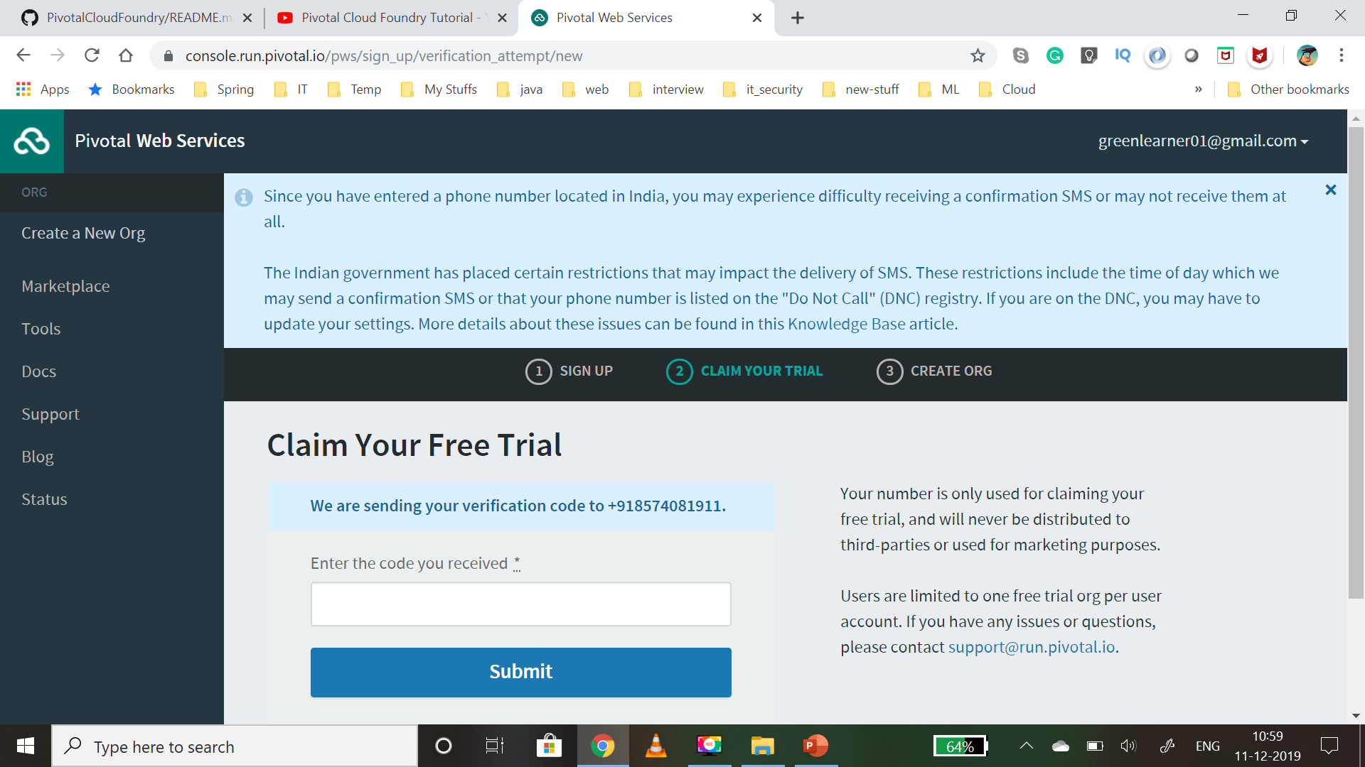

Slide 14
ORG
An org is a development account that an individual or multiple collaborators can own and use.
All collaborators access an org with user accounts, which have roles such as
Org Manager,
Org Auditor, and
Org Billing Manager.
Collaborators in an org share a resource quota plan, apps, services availability, and custom domains.
By default, an org has the status of active.
An admin can set the status of an org to suspended for various reasons such as failure to provide payment or misuse.
When an org is suspended, users cannot perform certain activities within the org, such as push apps, modify spaces, or bind services.

Slide 15
SPACE
A space provides users with access to a shared location for app development, deployment, and maintenance.
An org can contain multiple spaces
Every app, service, and route is scoped to a space
Org managers can set quotas on the following for a space:
Usage of paid services
Number of app instances
Number of service keys
Number of routes
Number of reserved route ports
Memory used across the space
Memory used by a single app instances

Slide 16
Deploying first application to PCF using CLI
ARVIND
#4
MICROSERVICES
AND
CLOUD FOUNDRY
-- #greenlearner --

Slide 17
Steps to perform
Open cf cli
Login
Get the .jar which is to be pushed
Push the app

Slide 18
Sample application to be pushed/deployed
DOCTOR’s PORTAL
/doctors [GET]
/patients [GET]
/diseases [GET]
/doctors [POST]
/patients [POST]
/diseases [POST]

Slide 19
What is Buildpack?
ARVIND
#5
MICROSERVICES
AND
CLOUD FOUNDRY
-- #greenlearner --

Slide 20
buildpack
Buildpacks provide framework and runtime support for apps.
Buildpacks typically examine your apps to determine what dependencies to download and how to configure the apps to communicate with bound services.
System Buildpacks
Sidecar Buildpacks
Community Buildpacks
https://docs.cloudfoundry.org/buildpacks/

Slide 21
Buildpack packager
Cloud Foundry deployments often have limited access to dependencies.
This limitation occurs when the deployment is behind a firewall.
In these circumstances, Cloud Foundry provides a Buildpack Packager app to provide the inhouse build pack setup.
https://github.com/cloudfoundry/buildpack-packager

Slide 22
Deploying application using manifest
ARVIND
#6
MICROSERVICES
AND
CLOUD FOUNDRY
-- #greenlearner --

Slide 23
Manifest.yml
Manifests provide consistency and reproducibility, and can help you automate deploying apps.
Both manifests and command line options allow you to override the default attribute values of cf push.
These attributes include things like number of instances, disk space limit, and memory limit.
Command line options override manifests.
https://docs.cloudfoundry.org/devguide/deploy-apps/manifest.html

Slide 24
What is Scaling??
ARVIND
#7
MICROSERVICES
AND
CLOUD FOUNDRY
-- #greenlearner --

Slide 25
Scaling
To handle the fluctuating(+ / -) request with time we have to increase or decrease the capacity of machines where application is running.

Slide 26
Vertical scaling (Scale up)
Increasing the capacity of existing machine by adding more resources or
Replacing it with new machine.

Slide 27
horizontal scaling (Scale out)
Adding more new machines with same capacity
So increase in number of machines and so the capacity to handle more load

Slide 28
AUTO Scaling up and down in PCF??
ARVIND
#8
MICROSERVICES
AND
CLOUD FOUNDRY
-- #greenlearner --

Slide 29
Cf scale
Horizontal scaling
Vertical scaling
https://docs.run.pivotal.io/devguide/deploy-apps/cf-scale.html

Slide 30
Auto scaling with PCF dashboard

Slide 31
Logging in PCF??
ARVIND
#9
MICROSERVICES
AND
CLOUD FOUNDRY
-- #greenlearner --

Slide 32
Cf logs
Loggregator
Timestamp
Log type
Channel: either OUT, for logs emitted on stdout, or ERR, for logs emitted on stderr
Message
Tailing Logs
cf logs hello-pcf
Dumping logs
Cf logs hello-pcf –recent
Filtering logs
cf logs spring-music --recent | grep -v Got

Slide 33
App Monitoring(PCF Metrics) in PCF??
ARVIND
#10
MICROSERVICES
AND
CLOUD FOUNDRY
-- #greenlearner --

Slide 34
How to learn the cf CLI commands
ARVIND
#11
MICROSERVICES
AND
CLOUD FOUNDRY
-- #greenlearner --

Slide 35
Routes in PCF
ARVIND
#12
MICROSERVICES
AND
CLOUD FOUNDRY
-- #greenlearner --

Slide 36
What is route??
The Cloud Foundry Gorouter routes requests to apps by associating an app with an address, known as a route.
We call this association a mapping.
Routes are globally unique.
Developers in one space cannot create a route with the same URL as developers in another space, regardless of which orgs control these spaces
By default, Cloud Foundry only supports routing of HTTP requests to apps.
Operations
Create
Map
Unmap
Delete

Slide 37
Blue green deployment??
ARVIND
#13
MICROSERVICES
AND
CLOUD FOUNDRY
-- #greenlearner --

Slide 38
What is deployment?
The application deployment is where a set of code (web, services, database etc…) is being installed onto a configured system(s) by some type of process.
Canary
A/B
Blue-Green

Slide 39
Blue-green deployment
V1
V2

Slide 40
Advantages

Slide 41
Blue green deployment with PCF cli
ARVIND
#14
MICROSERVICES
AND
CLOUD FOUNDRY
-- #greenlearner --

Slide 42
Checklist – steps to perform
Blue-version1 is in production – R1
Deploy green-version2 – it will get some route – R2
Now map R1 to green-version2, so now green-version2 has – R1 & R2
Un-map R2 from green-version2
Un-map R1 from blue-version1
Now R1 will send request to green-version2 only
blue-version1
green-version2

Slide 43
https://docs.cloudfoundry.org/devguide/deploy-apps/blue-green.html

Slide 44
Blue green deployment with PCF dashboard
ARVIND
#15
MICROSERVICES
AND
CLOUD FOUNDRY
-- #greenlearner --

Slide 45
Checklist – steps to perform
Blue-version1 is in production – R1
Deploy green-version2 – it will get some route – R2
Now map R1 to green-version2, so now green-version2 has – R1 & R2
Un-map R2 from green-version2
Un-map R1 from blue-version1
Now R1 will send request to green-version2 only
blue-version1
green-version2

Slide 46
https://docs.cloudfoundry.org/devguide/deploy-apps/blue-green.html

Slide 47
Services in PCF
ARVIND
#16
MICROSERVICES
AND
CLOUD FOUNDRY
-- #greenlearner --

Slide 48
Services
Marketplaces
User defined

Slide 49
references
https://www.cloudfoundry.org/the-foundry/pivotal-cloud-foundry/
https://pivotal.io/why-pivotal
https://docs.pivotal.io/pivotalcf/2-3/concepts/overview.html
https://en.wikipedia.org/wiki/Cloud_Foundry
https://docs.pivotal.io/
https://pivotal.io/platform/pcf-tutorials/getting-started-with-pivotal-cloud-foundry
https://pivotal.io/platform/pcf-tutorials/getting-started-with-pivotal-cloud-foundry/next-steps

