Slide 1
The OSI Model
and
TCP/IP Protocol Suite
Copyright © The McGraw-Hill Companies, Inc. Permission required for reproduction or display.

Slide 2
OBJECTIVES:
Idea of multiple layering in data communication &networking and the interrelationship between layers
The OSI Model
TCP/IP Protocol Suite
Addressing

Slide 3
PROTOCOL
Protocol is required when two entities need to communicate.
When communication is not simple, we may divide the complex task of communication into several layers. we may need several protocols, one for each layer.
A protocol is synonymous with rule.
It consists of a set of rules that govern data communications.
It determines what is communicated, how it is communicated and when it is communicated.
The key elements of a protocol are
syntax, semantics and timing

Slide 4
Elements of a Protocol
Syntax
Structure or format of the data
Indicates how to read the bits - field
*Semantics
Interprets the meaning of the bits
Knows which fields define what action
Timing
When data should be sent and what
Speed at which data should be sent or speed at which it is being received.

Slide 5
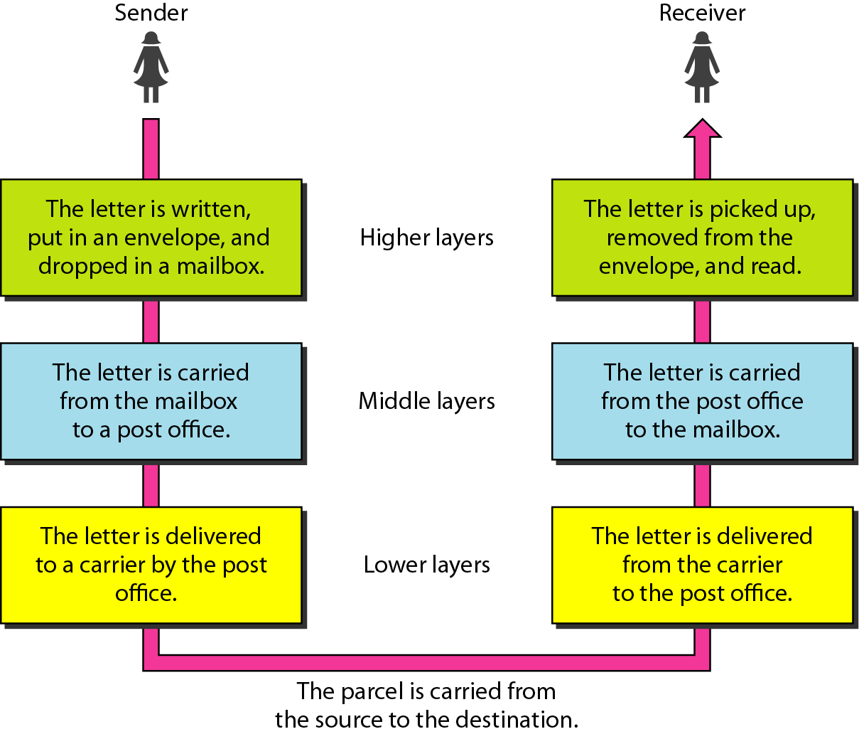
LAYERED TASKS
We use the concept of layers in our daily life.

Slide 6
Example 2
Maria and Ann are neighbors with a lot of common ideas.
Maria speaks only Spanish, and Ann speaks only English.
Since both have learned the sign language in their childhood, they enjoy meeting in a cafe a couple of days per week and exchange their ideas using signs.
Communication is face to face and Happens in one layer as shown in Figure

Slide 7
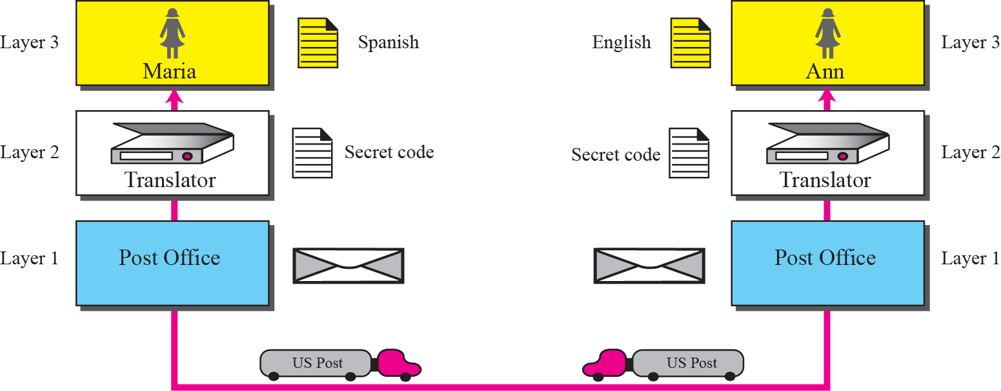
They have two machines
The first machine can scan and transform a letter in English to a secret code or vice versa.
The other machine can scan and translate a letter in Spanish to the same secret code or vice versa.
Two friends can still communicate using the secret code, as shown

Slide 8
THE OSI MODEL
International Standards Organization (ISO) established in 1947, is a multinational body dedicated to worldwide agreement on international standards.
Almost three-fourths of countries in the world are represented in the ISO. An ISO standard that covers all aspects of network communications is the Open Systems Interconnection (OSI) model. It was first introduced in the late 1970s.

Slide 9
ISO is the organization;
OSI is the model.

Slide 10
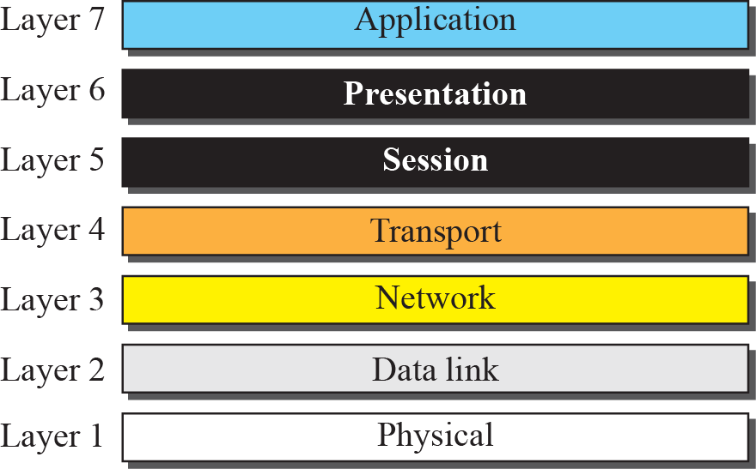
The OSI model

Slide 11

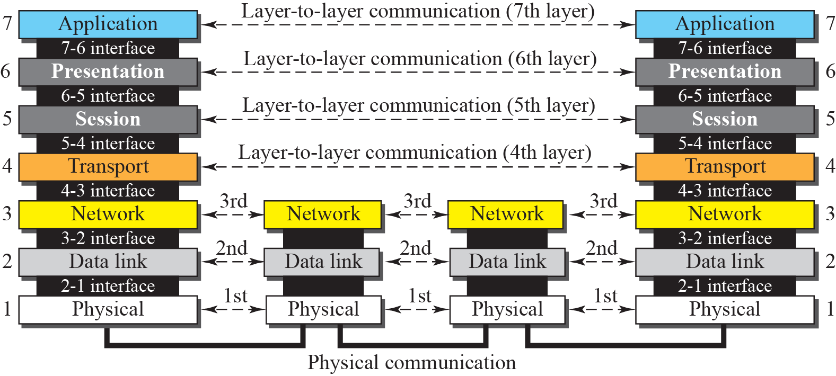
OSI layers
Layers 1,2 and 3 are the network support layers
Layers 5 ,6 and 7 can be considered as user support layers
Layer 4 is a sort of link between two sub groups

Slide 12
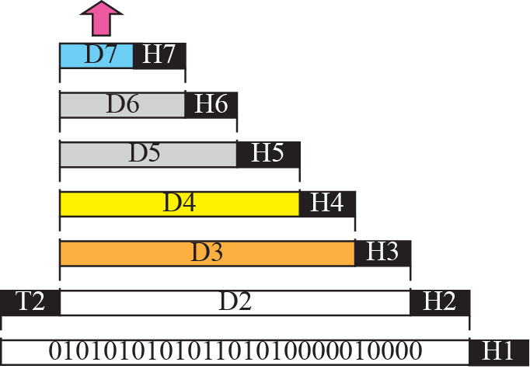


An exchange using the OSI model
Headers are added to the data at layers 6, 5, 4, 3, and 2. Trailers are usually added only at layer 2.

Slide 13
LAYERS
IN
THE
OSI
MODEL

Slide 14
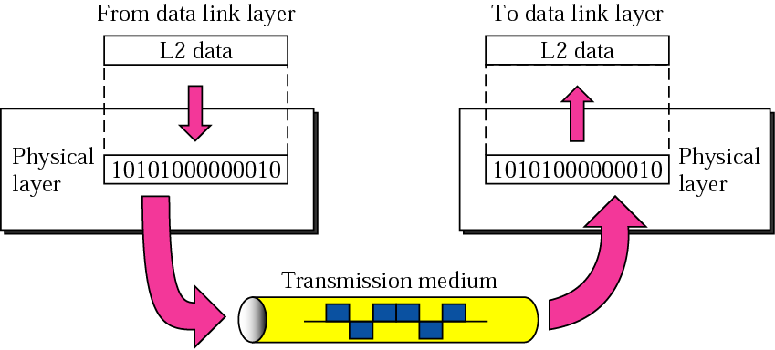
Figure 2-4
Physical Layer
Coordinates the function required to carry a bit stream over a physical medium

Slide 15

Note
The physical layer is responsible for moving individual bits from one
(node) to the next.
Concerns
Representation of bits
Data Rate
Line Configuration
Physical Topology
Transmission Mode

Slide 16
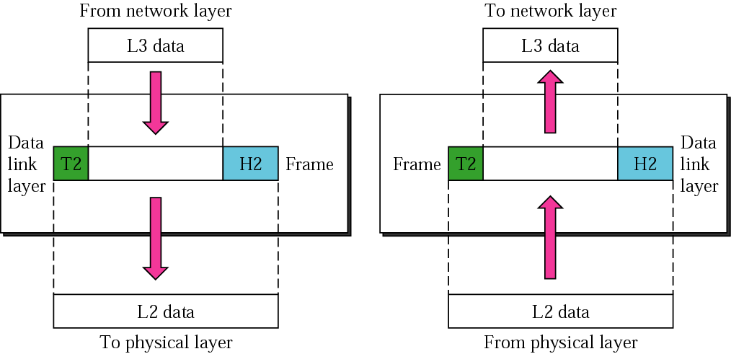
Figure 2-5
Data Link Layer
Transforms the physical layer, a raw transmission facility to reliable link

Slide 17
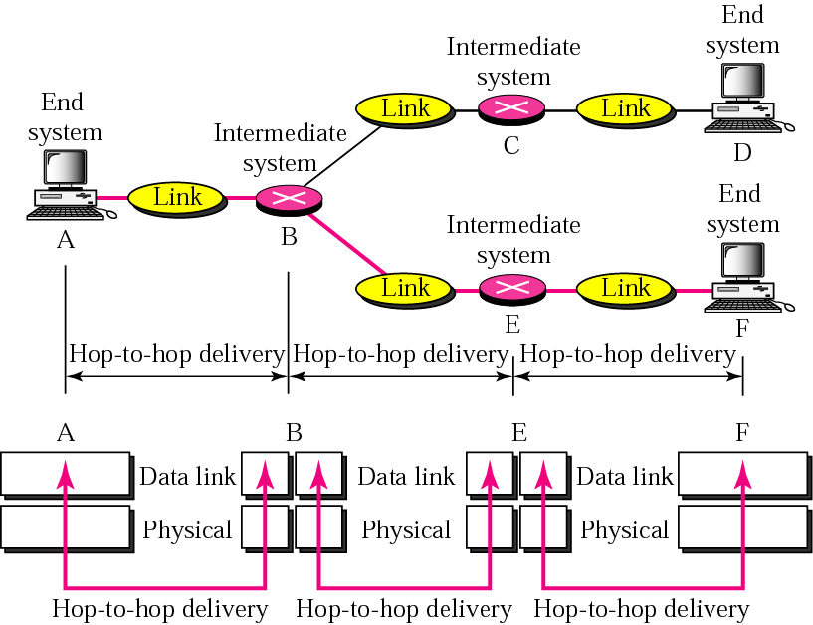
Figure 2-6
Concerns
Framing
Physical Addressing
Flow Control
Error Control
Access Control

Slide 18
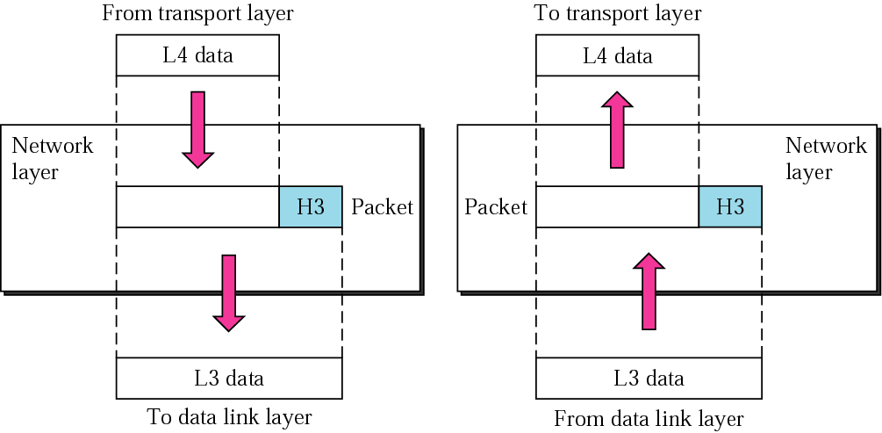
Figure 2-7
Network Layer
Responsible for source to destination delivery

Slide 19
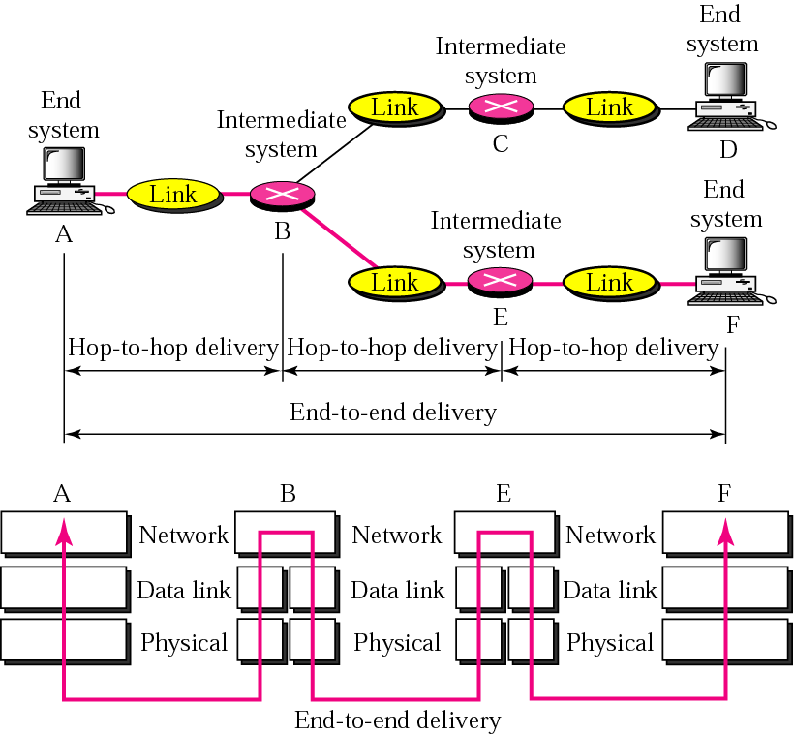
Figure 2-8
Concerns
Logical Addressing
Routing

Slide 20
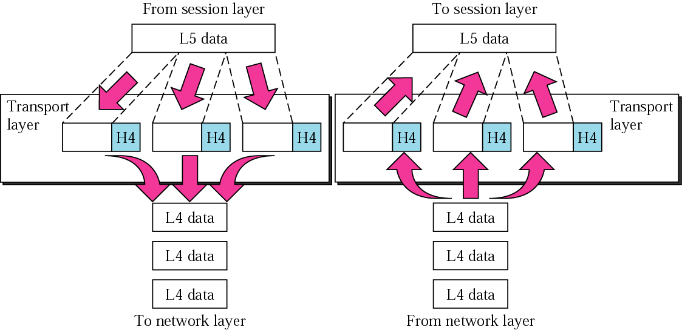
Figure 2-9
Transport Layer
Responsible for process to process delivery

Slide 21
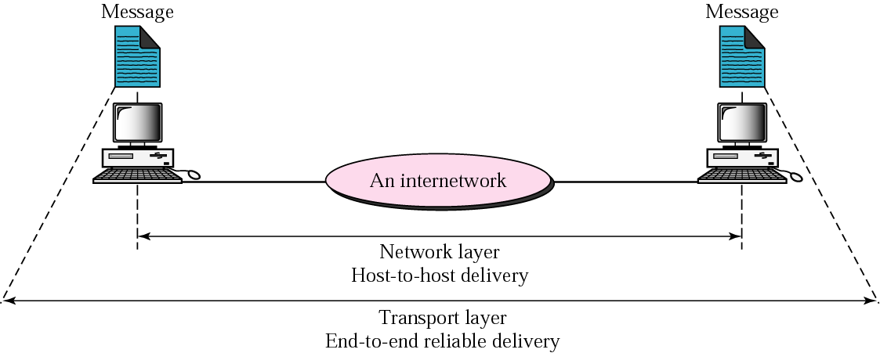
Figure 2-10
Reliable end-to-end delivery of a message
Concerns :
*Service point addressing
*Segmentation and reassembling
*Connection control
*Flow Control
*Error Control

Slide 22
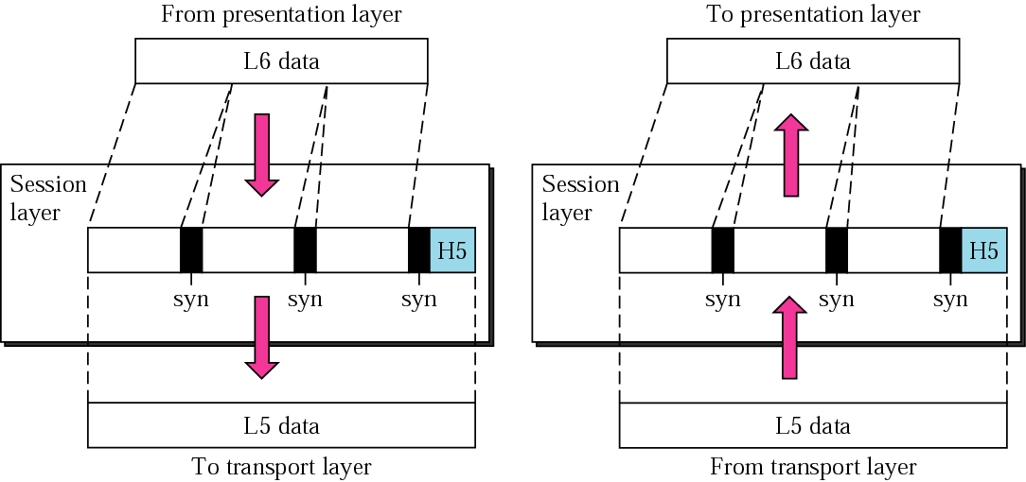
Figure 2-11
Session Layer
Establishes , maintains and synchronizes the interaction
Concerns:
*Dialog control
*Synchronization

Slide 23
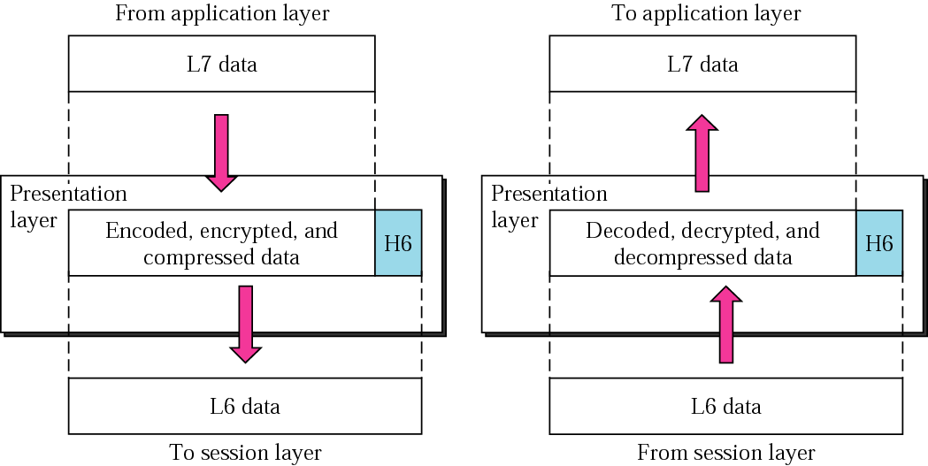
Figure 2-12
Presentation Layer
Checks syntax and semantics of information exchanged
Concerns:
Translation
Encryption
Compression

Slide 24
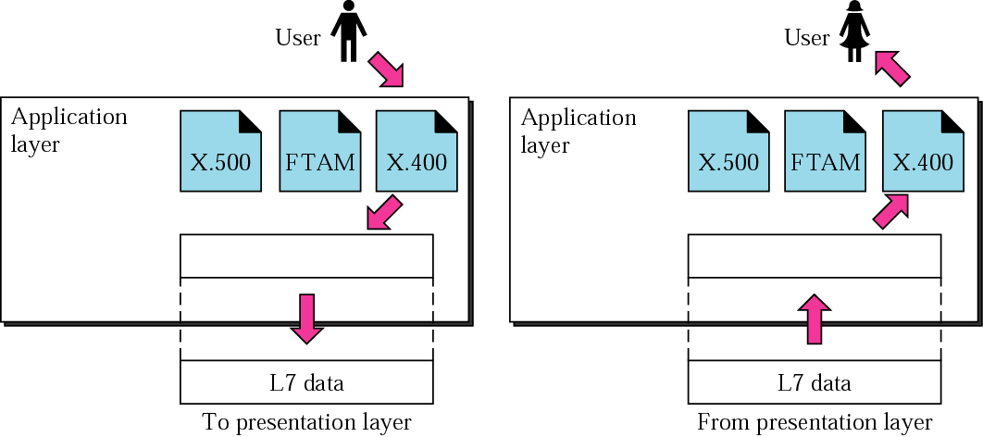
Figure 2-13
Application Layer
Access the network
Concerns:
*FTAM
*Email Services
*Directory Services

Slide 25
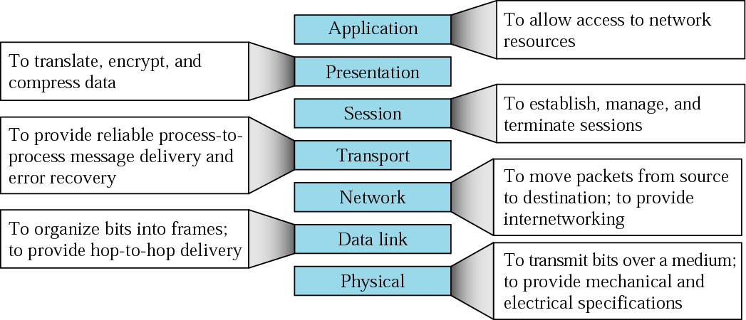
Figure 2-14
Summary of layers

Slide 26
TCP/IP
PROTOCOL
SUITE

Slide 27
TCP/IP PROTOCOL SUITE
The TCP/IP protocol suite was developed prior to the OSI model. Therefore, the layers in the TCP/IP protocol suite do not match exactly with those in the OSI model.
The original TCP/IP protocol suite was defined as four software layers built upon the hardware. Today, however, TCP/IP is thought of as a five-layer model with the layers named similarly to the ones in the OSI model.

Slide 28
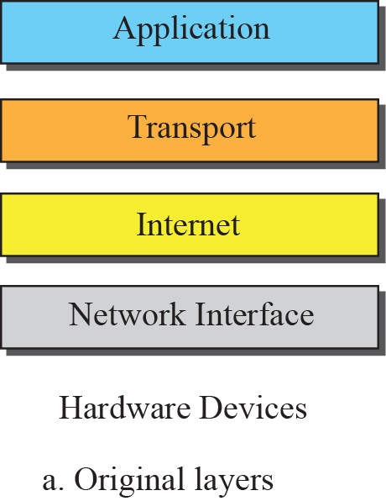
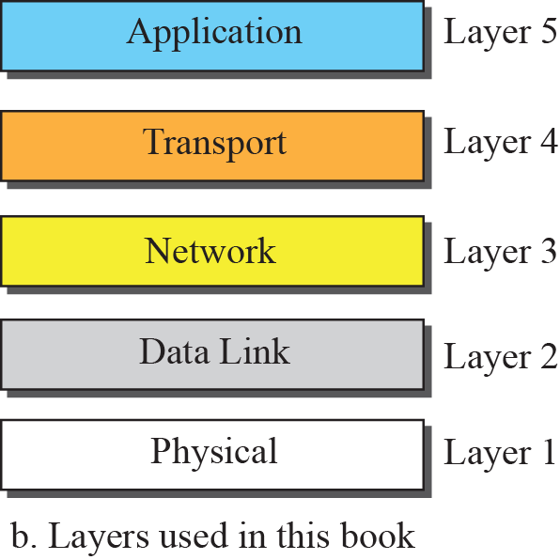
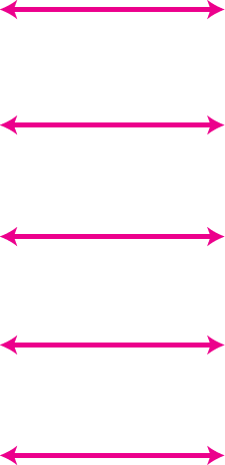
Figure 2.7 Layers in the TCP/IP Protocol Suite

Slide 29
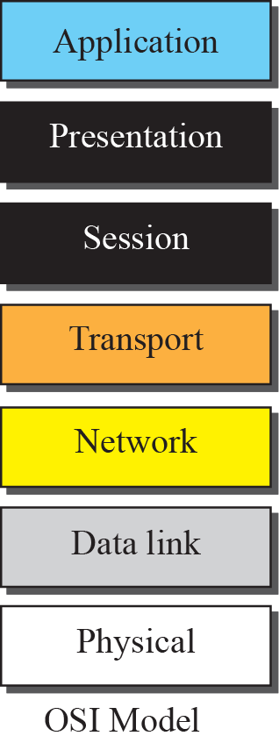
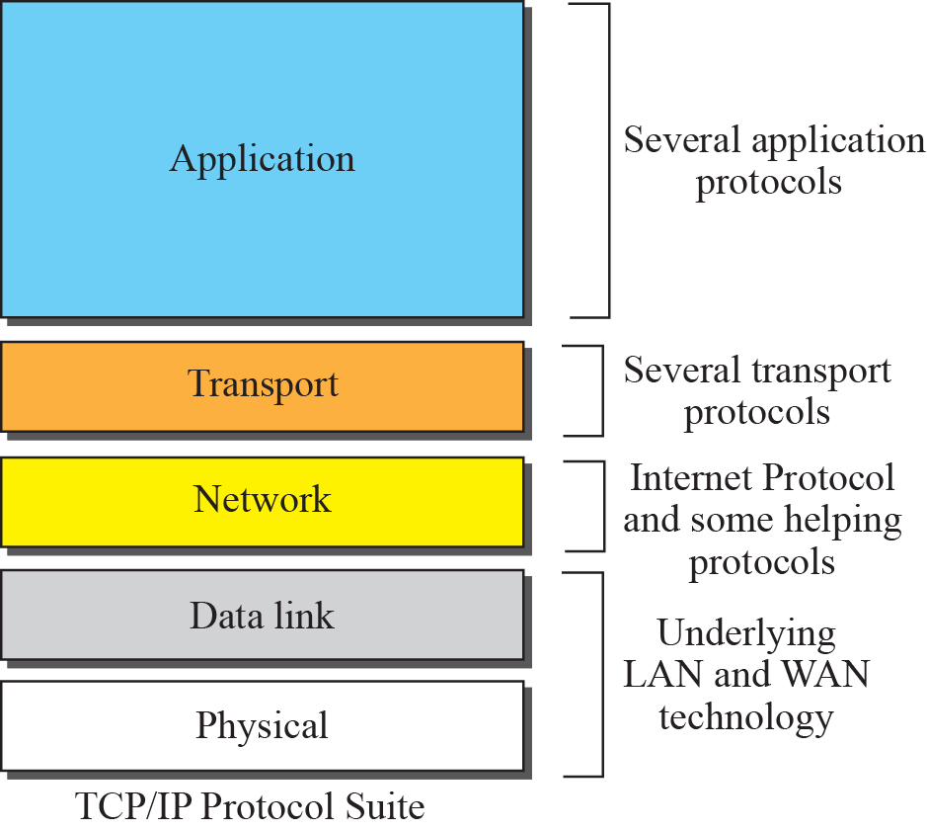
Figure 2.8 TCP/IP and OSI model

Slide 30
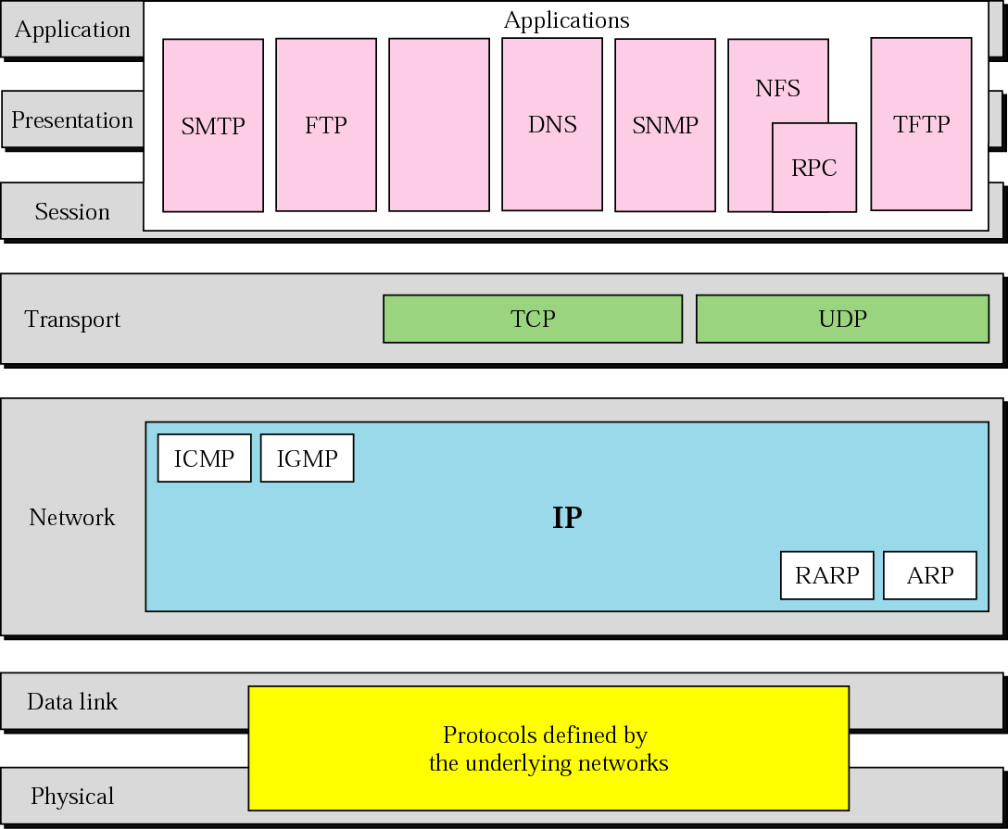
Figure 2-15
TCP/IP and OSI model

Slide 31
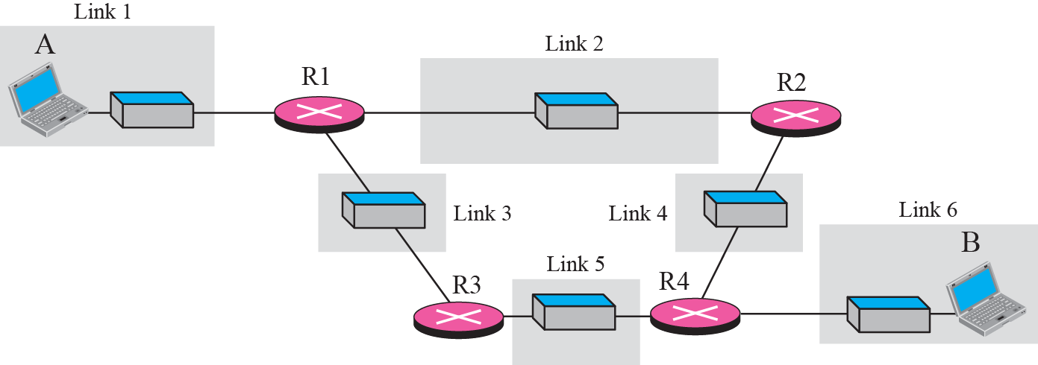
A private internet

Slide 32
Figure 2.10 Communication at the physical layer
The unit of communication at the physical layer is a bit.

Slide 33
Figure 2.11 Communication at the data link layer
The unit of communication at the data link layer is a frame.

Slide 34
Figure 2.12 Communication at the network layer
The unit of communication at the network layer is a datagram.

Slide 35
Figure 2.13 Communication at transport layer
The unit of communication at the transport layer is a segment, user datagram, or a packet, depending on the specific protocol used in this layer.

Slide 36
Figure 2.14 Communication at application layer
The unit of communication at the application layer is a message.

Slide 37
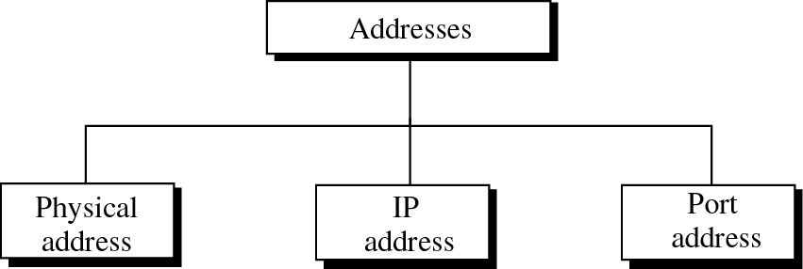
ADDRESSING
Four levels of addresses are used in an internet employing the TCP/IP protocols:
physical address,
logical address,
port address, and
application-specific address.
Each address is related to a one layer in the TCP/IP architecture,
Application Address

Slide 38
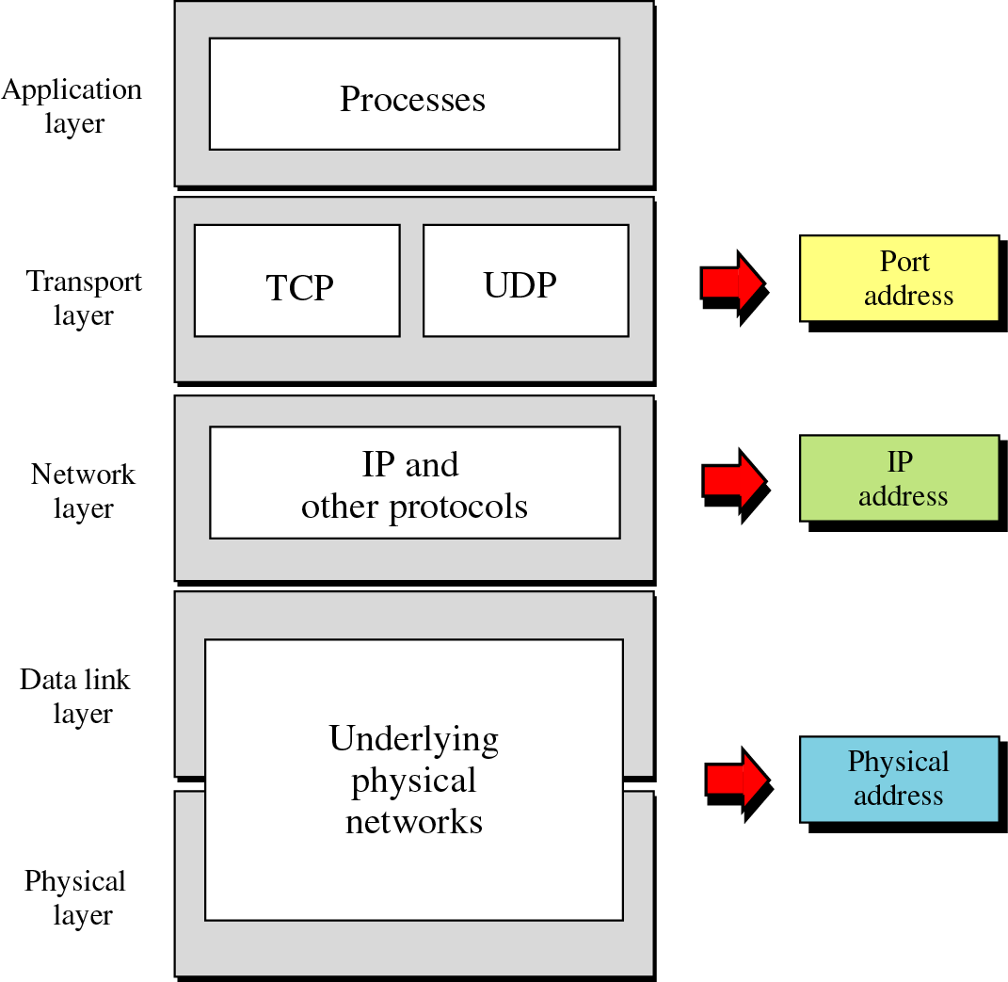
Relation-ship of layers and addresses in TCP/IP
Application Address

Slide 39
Physical Address
Most local area networks uses
48-bit (6-byte) physical address written as 12 hexadecimal digits
Every byte (2 hexadecimal digits) is separated by a colon
07:01:02:01:2C:4B
A 6-byte (12 hexadecimal digits) physical address

Slide 40
Example
The two nodes are connected by a link (a LAN).
A node with physical address 10 sends a frame
to a node with physical address 87.
At the data link layer, this frame contains physical (link) addresses in the header. These are the only addresses needed. The rest of the header contains other information needed at this level.
The data link layer at the sender receives data from an upper layer. It encapsulates the data in a frame. The frame is propagated through the LAN.
Each station with a physical address other than 87 drops the frame because the destination address in the frame does not match its own physical address.

Slide 41
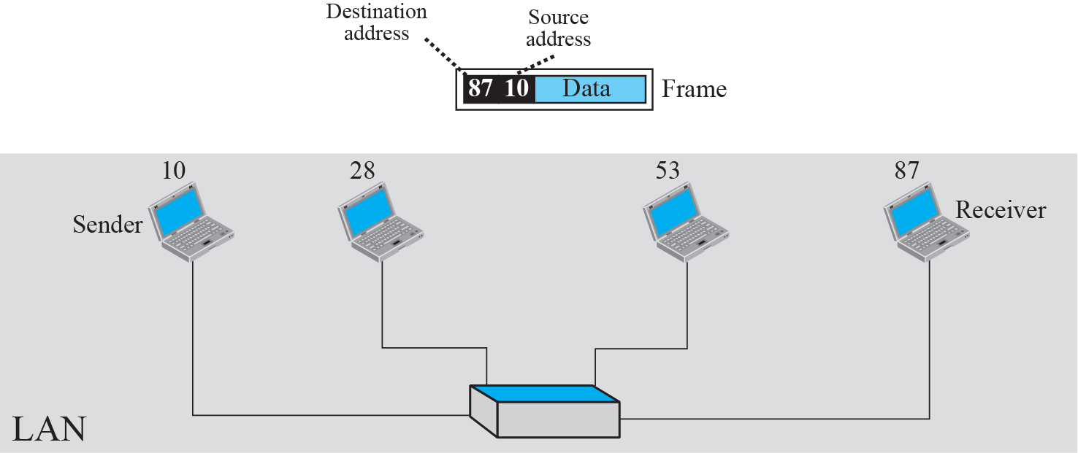
Figure 2.16 : physical addresses

Slide 42
Logical Addressing
Logical Addresses are independent of underlying physical networks and are necessary for universal communication
an Internet address is 32 bits in length, normally written as four decimal numbers, with each number representing 1 byte. The numbers are separated by a dot.
132.24.75.9

Slide 43
Example
Consider a part of an internet with two routers connecting three LANs.
Each device has a pair of addresses (logical and physical) for each connection.
In this case, each computer is connected to only one link and therefore has only one pair of addresses.
Each router, however, is connected to three networks. So each router has three pairs of addresses, one for each connection.
The computer with logical address A and physical address 10 needs to send a packet to the computer with logical address P and physical address 95.

Slide 44
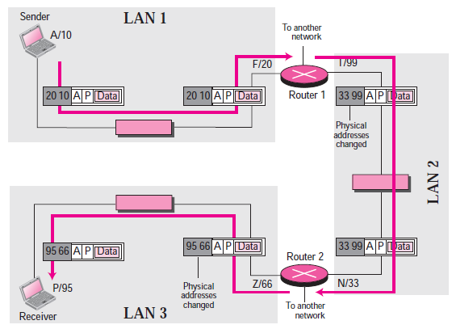
Figure : logical addresses

Slide 45
Note
The physical addresses will change from hop to hop, but the logical addresses remain the same.

Slide 46
Port Address
A port address is a 16-bit address
represented by one decimal number
753
A 16-bit port address represented as one single number
It is required since the computers can run multiple process at the same time, it is a method to label the different processes

Slide 47
Example 2.6
Consider two computers communicating via the Internet.
The sending computer is running three processes at this time with port addresses a, b, and c.
The receiving computer is running two processes at this time with port addresses j and k.
Process a in the sending computer needs to communicate with process j in the receiving computer.
Note that although both computers are using the same application, FTP, for example, the port addresses are different because one is a client program and the other is a server program..

Slide 48
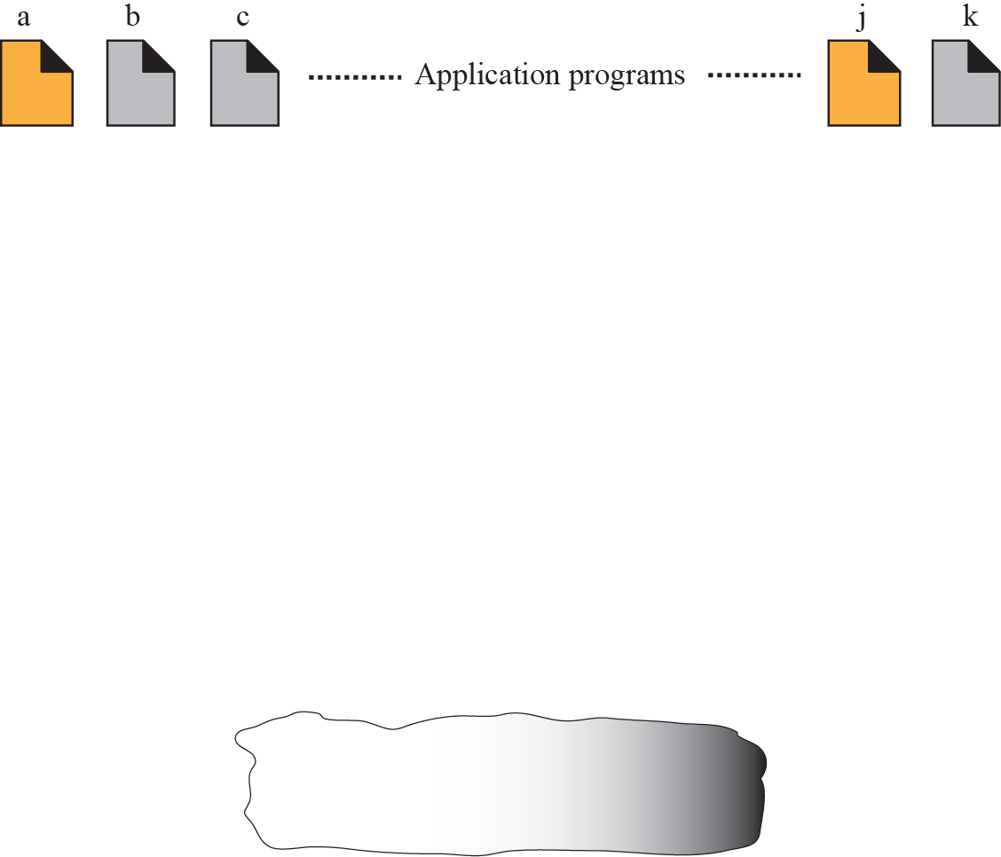
Figure 2.18 Example 2.6: port numbers

Slide 49
Application Specific Address
Some applications have addresses that are designed for specific applications
Ex.
Email addresses
Universal resource locator

Slide 50
Note
The physical addresses change from hop to hop, but the logical and port addresses usually remain the same.

Slide 51
TCP/IP
VERSIONS
Versions:
Version 4 (current)
Version 5
Version 6 (future)

