Slide 1

Scenic-sumo

Slide 2
Prerequisites
You will need the following:
Python version 3.8
Scenic
Sumo

Slide 3
Installing Python
Python version 3.8 is needed, version 3.9 is not currently supported
The python 3.8 install link can be found here
You will need to add python to your PATH variable
Guides are available for both Windows and Mac

Slide 4
Scenic and Sumo install
Scenic
Scenic can be installed with the command: pip install scenic
A more in depth install guide can be found here.
Sumo
A link to install sumo can be found here. Mac users may want to follow this link.
You may need to set the SUMO_HOME variable if it does not automatically do so. If you encounter a problem with the SUMO_HOME variable not being declared, more help can be found here.
If you need any help with interfacing TraCI from Python, it can be found here.

Slide 5
Setting up Simulator
To start incorporating this project with Scenic, first download the files from GitHub and put the project into the path scenic\simulators\sumo under the python version 3.8 install location.
The set-up will require you to change the *.sumocfg files to have the same path as they are stored in your computer. You can either do this by manually opening the *.sumocfg and potentially the *.net.xml files, or you can reconfigure using sumo-gui.
To reconfigure with sumo-gui, open the *.net.xml file that you want to modify. Open the file in sumo-gui and save the *.sumocfg file by clicking Save Configuration under File. This will change the path of the file to the correct one in your computer and will need to be done for every map file that is used.

Slide 6
Creating a Scenic Scenario
To create a scenario, you will want to refer to the interfacing TraCI from Python link on slide 4.
This link may also be helpful when creating your own scenarios.
For adding things like vehicles, you will need to set a route and assign a route ID. This will use the edges that are already present in the scene.

Slide 7
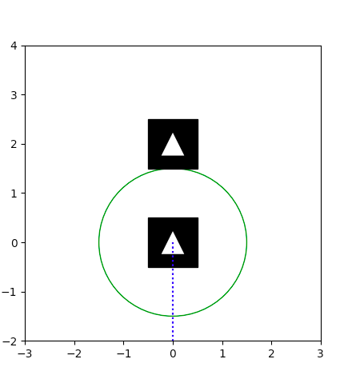
Running a Scenic Scenario
Scenic scenarios can be run in console with the command: scenic your\path\to\*.scenic
If you manage to run the scenario and encounter a problem with an "Invalid RGBA argument" then make sure that the color variable in the model.scenic file does not equal an empty string.
To give an example, here is how you would run the 1X.scenic file:
$ scenic simulators\sumo\Scenarios\1X.scenic
This will compile the scene and display it, and due to this being the 1X.scenic example, you should see something like this:

Slide 8
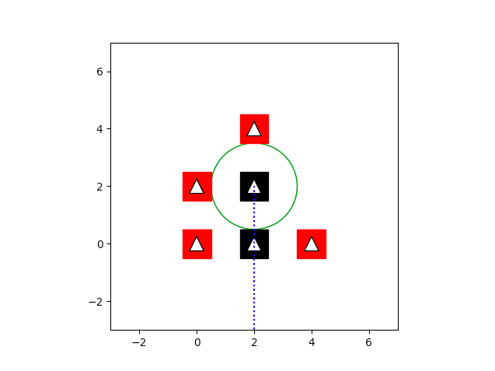
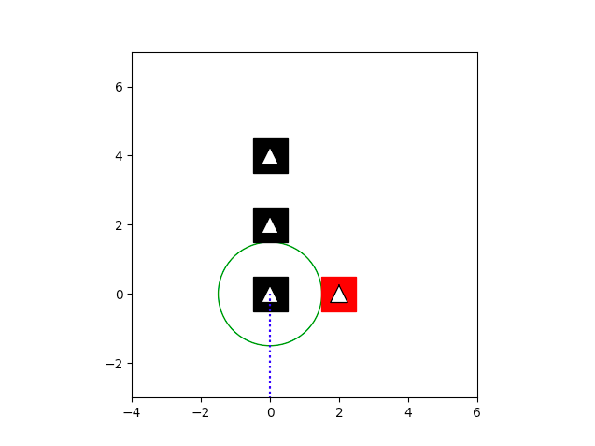
What should this look like?
Here are some examples of what some of the other scenarios should look like when generated:
H_Intersection.scenic
OnRamp.scenic

