Slide 1
Scenic-SUMO

Slide 2
Problem Statement
The goal of this project is to create an application that can cover an autonomous vehicle test space for cars and in the future cover other domains such as planes and boats.

Slide 3


Current Solutions
Tesla
Foretellix
Other Sims
Tesla does most testing in-house by gathering their data from consumer vehicles
Their product is AV testing, so their software is not open source
Currently all simulators used with Scenic are somewhat intensive on PC resources
Notes:
Current solutions are blocked by pay walls or are only used by companies on their own cars. Public versions are available but a lot of them are for high fidelity simulations and don’t offer fast simulation times. They also require higher end computers that can run the software which is not always available.

Slide 4
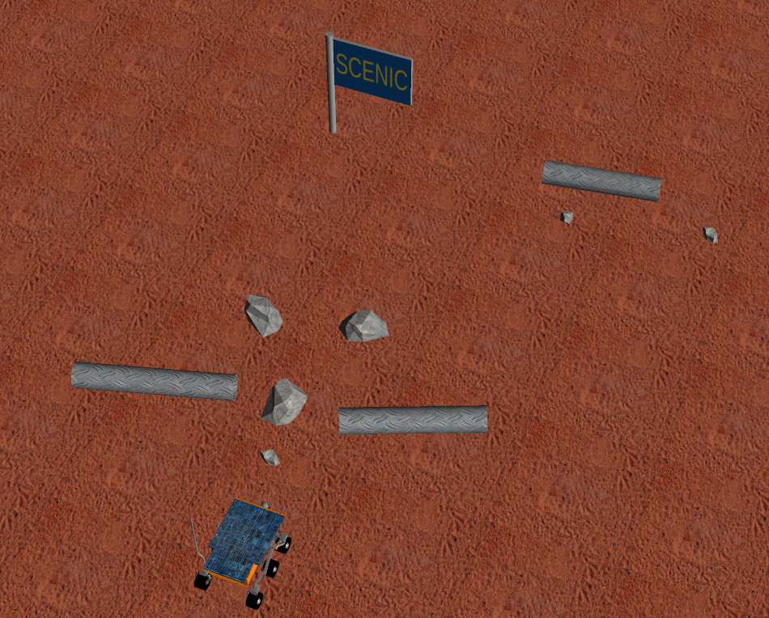
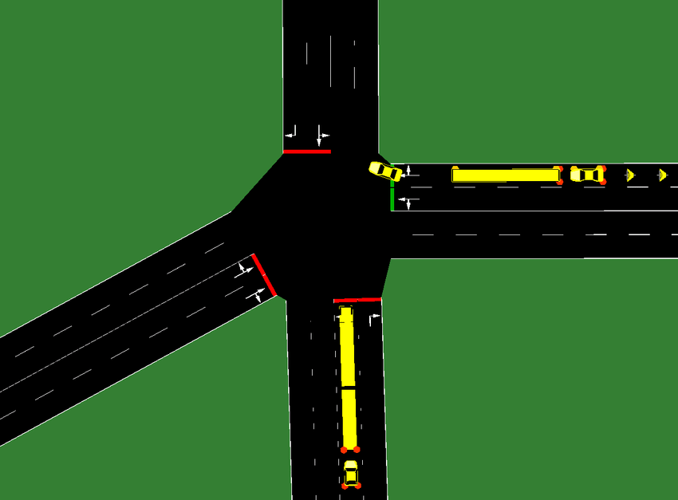
Our Solution
Scenic and Sumo integration allows for a faster compilation time while still maintaining the ability to explore a test space.
Notes:
Our team’s solution to this problem is to integrate Scenic which is a scenario-based coding language and SUMO which is a low fidelity simulation environment. Scenic provides an easy coding language to use that is like python, it also provides an easy way to cover a test space using their distribution functions. SUMO provides a simulation environment that allows for quick compilation times.
The higher fidelity simulations such as Scenic with LGSVL will be used when a user wants to see a specific scene when some threshold is hit.

Slide 5
Scenic
Scenic provides distribution functions and provides a tuple of objects to SUMO.

Slide 6
Simulation of Urban Mobility (SUMO)
Sumo is a resource light simulator that can add and get values of cars in the simulation at run time.
Notes:
SUMO is short for Simulation of Urban Mobility. SUMO is typically used to simulate road networks to find where congestion occurs.
In our case SUMO is used to find occurrences of accidents. We do this by allowing the cars to ignore laws such as stopping at a red light. SUMO also supports basic GUI functions and reports errors that happen during the simulation.
Errors that could occur are car crashes, cars who are stuck at a section of road network and pedestrians not being able to complete their path.

Slide 7
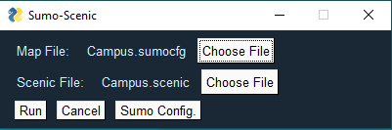
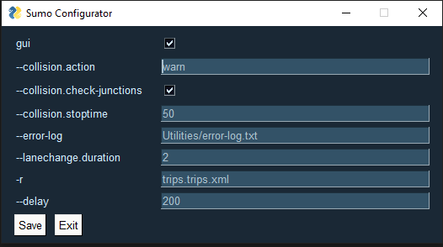
Interface
Simple code base
Simple user interface
Notes:
Scenic provides a simple code base for users to interact with. Complex scenes can be run without loops or functions which can confuse new programmers. The user interface is simple to use as well. The Sumo Config commands can be changed or toggled in the Sumo Config menu and files can be chosen for compilation.

Slide 8
Atomic Blocks
Atomic actions taken by driver under test
A collection of atomic blocks create a scene.
Notes:
Atomic blocks are atomic actions that can be taken by the AV to create a scene. An example is a driver under test(DUT) overtaking another car in the slow lane. The atomic steps would be merging into the left lane, accelerating until you’re in front of the other vehicle, then merging back into the right lane. These three atomic blocks create a single scene which can be tested using scenic.

Slide 9
Scenic-Sumo Translator
The translator takes in the tuple from Scenic then places actors into SUMO
Notes:
The translator is the most important part of the project. This is what translates the scenes taken from scenic into functioning simulations in SUMO. Scenic produces a tuple of the information from the scene. From here the simulator class iterates through this tuple to create all the actors in the scene and sets up the configuration file pulled from the utilities folder.

Slide 10
Creating a Scenario
Notes:
To create a scenario like this you can make a road map or download one from Open Street maps.
Then the user would create a short scenario script to control the actors in the scene. Each actor in the scene has a unique name, start edge and end edge.
When running the scene, the user has many options to change how the GUI is displayed and how cars interact with each other. In this scene the randomCar() function is active so cars are randomly placed into the scene. There is still a car controlled by Scenic which is the only red car. This allows for some randomness in the simulations.

Slide 11
Evaluate
Notes:
Here is a more complex scenario that implores more of the functions offered by our testing environment.
Here the traffic light is controlled by the user and same with all the vehicles in the scene.
In the middle of the scene there is a collision which causes an error to be sent to be printed to the console.
The car encounters this collision because as a user I told it to ignore red lights and to have a delayed reaction time. This scenario can run without the GUI, so it increases run time.

Slide 12
Future Goals
Add automation in covering test space
Learn more about distributions in Scenic
Notes:
For the short-term future, our team is looking to add the random distribution functions. The random distribution is the focus since it will allow automation in covering the test space.

