Slide 1
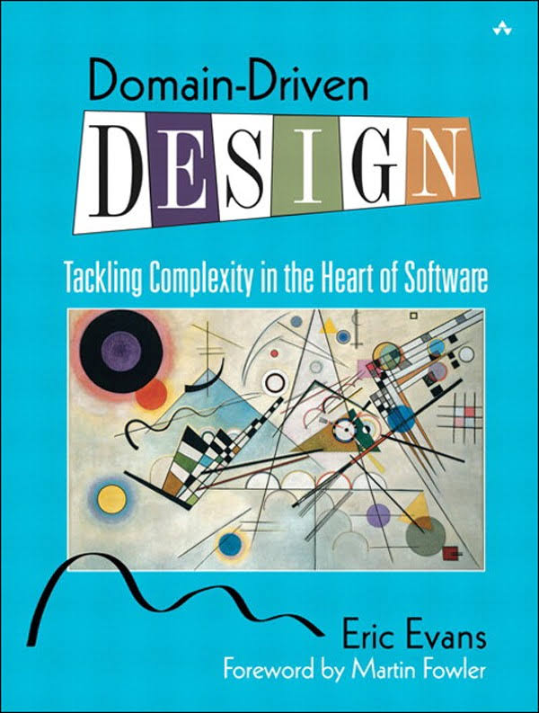
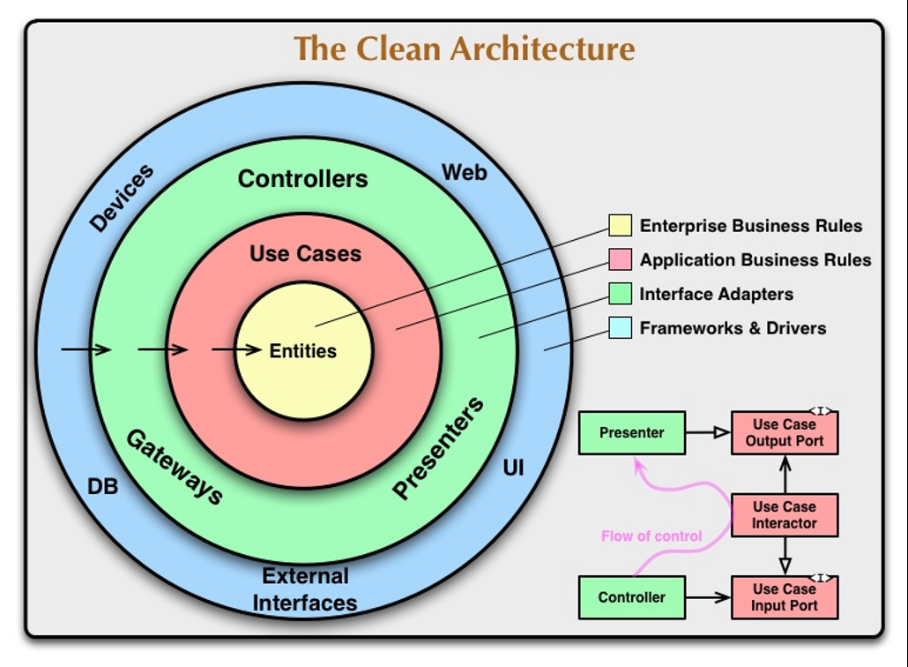
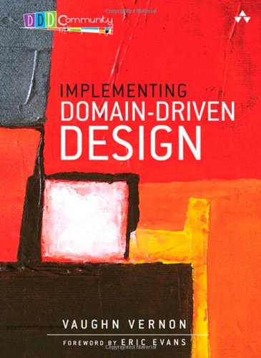
DomainDrivenDesign();
TackLıng COMPLEXITY IN THE HEART OF SOFTWARE

Slide 2
Problems of Enterprise Software
Maintenance, as software grows.
Mixing presentation, application and domain logics.
Monolithic code base.
Mixing infrastructure and business code, makes hard to switch technology.
Testability
«Any fool can write code that a computer understand. Good programmers write code that humans can understand.»
Martin Fowler

Slide 3
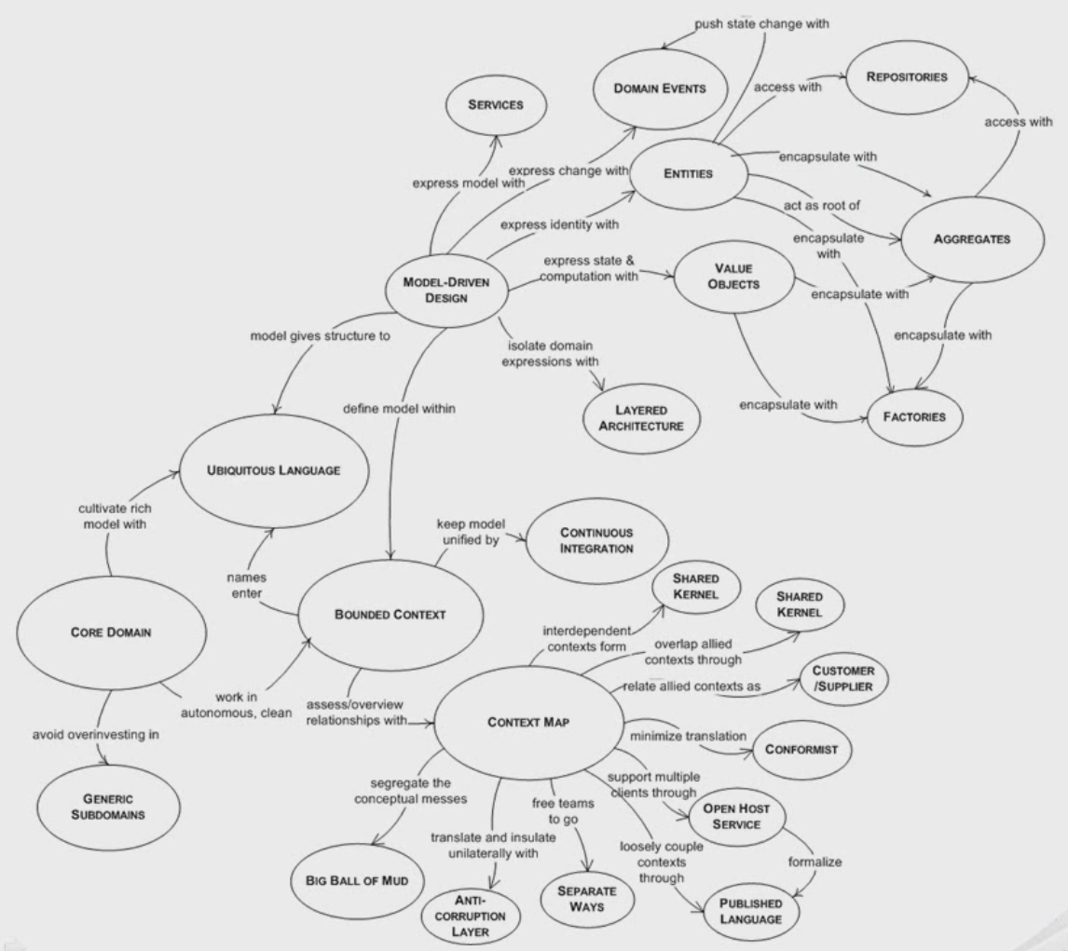
Solution Approaches
Principles
SOLID
Seperation of Concerns (SoC)
Don’t Repeat Yourself (DRY)
Patterns & Practices
Layering
Dependency Injection (DI)
Domain Driven Design (DDD)
Test Driven Development (TDD)

Slide 4
Domain Driven Design / Overall
Ubiquitous Language
Knowledge Crunching, Continuous Learning, Knowledge-Rich Design, Deep Models.
One team, one language
Code base should be based on that language
Bounded Context (Microservices?)
Layered Architecture
Domain, Application, Presentation, Infrastructure, Distributes Services

Slide 5
Domain Driven Design / Layers
Domain Layer
Entities, Aggregates, Aggregate Roots, Value Objects, Repositories, Domain Services, Domain Events, Policies
Application Layer
Application Services, Data Transfer Objects (and their Validation), Unit Of Work, Authorization, Auditing…
Infrastructure Layer
Persistence, Sending Emails, Dependency Injection, Logging, Caching implementations…
Presentation Layer
Web, Mobile… specific technologies and tools

Slide 6
Domain Driven Design / An Antipattern
The Smart UI «Anti-Pattern»
Put all the business logic into the user interface. Chop the application into small functions and implement them as separate user interfaces, embedding the business rules into them. Use a relational database as a shared repository of the data. Use the most automated UI building and visual programming tools available.

Slide 7
Discussions
Persistence Ignorance
Not Database/ORM Driven Design, but Domain Driven Design!
Bounded Contextes
Entities should not be re-used between contextes even they represent same database table.
Aggregate Roots
Responsible for it’s own validity and integrity.
Can refer other Aggregates by only reference (by their id).
Should go over aggregate root to access an aggregate member.
Should be retrieved as a whole object (including collections) from repository (or support lazy load).
Applications
Create application layer per application (UI).

Slide 8
Discussions
How to managing exceptions?
Infrastructure Exceptions (database connection… etc.)
Application Exceptions (like a null value sent to a method)
Authorization & Validation Exceptions
Domain Exceptions (business rules and validations)
Presentation logic vs application logic vs domain logic.
Validation
UI validation
DTO validation
Business validation
Application Service vs Domain Service
Write Model - Read Model / Reporting
DDD is mostly for changing the state, not reporting!

